Slide 1

Rwanda Experience in Implementation of National Human Papillomavirus (HPV) Vaccination Program
Francois UWINKINDI, MD, Msc
Manager of NCDs Division/RBC

Slide 2
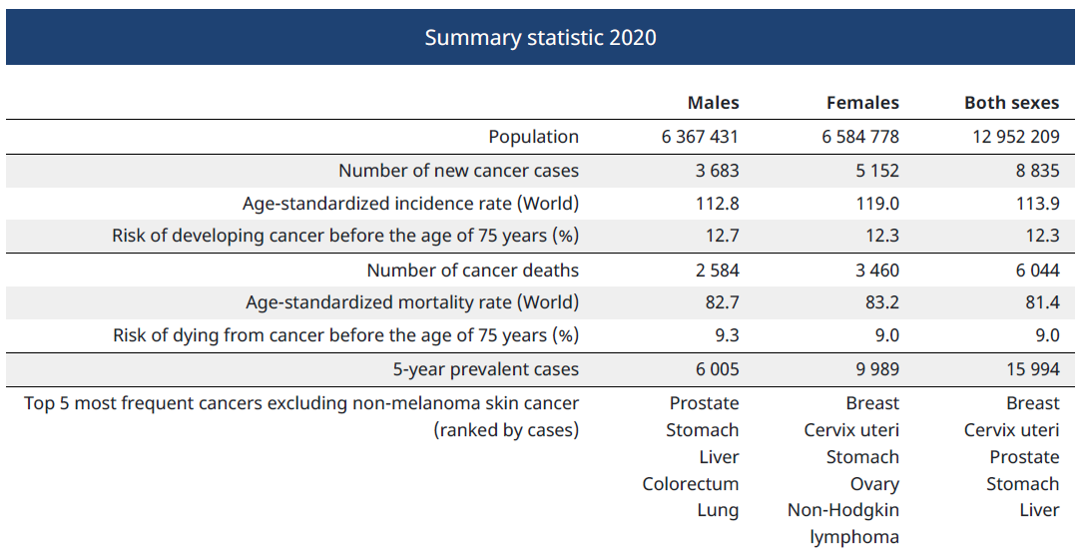
Cancer epidemiological profile
Source: Globocan 2022: https://gco.iarc.fr/today/data/factsheets/populations/646-rwanda-fact-sheets.pdf

Slide 3
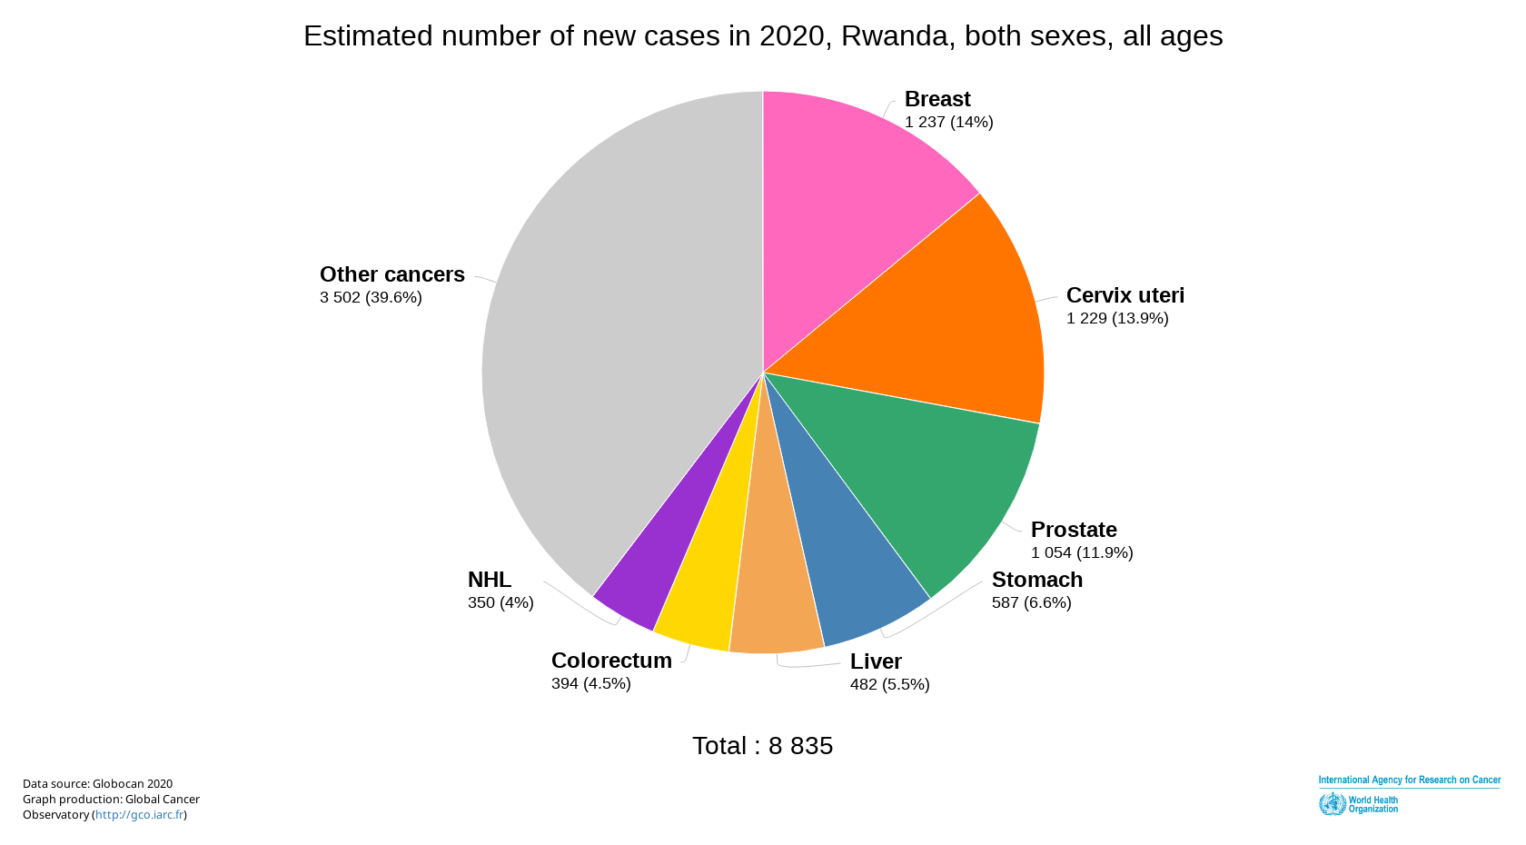
Globocan estimated incidence

Slide 4
National Cancer Registry Data
Improved awareness and diagnostic capacity: From 1 lab with 1 pathologist in 2007 to 5 labs with 22 pathologists
Cancer registration initiative created awareness in health care workers for good documentation and reporting of cancer cases

Slide 5
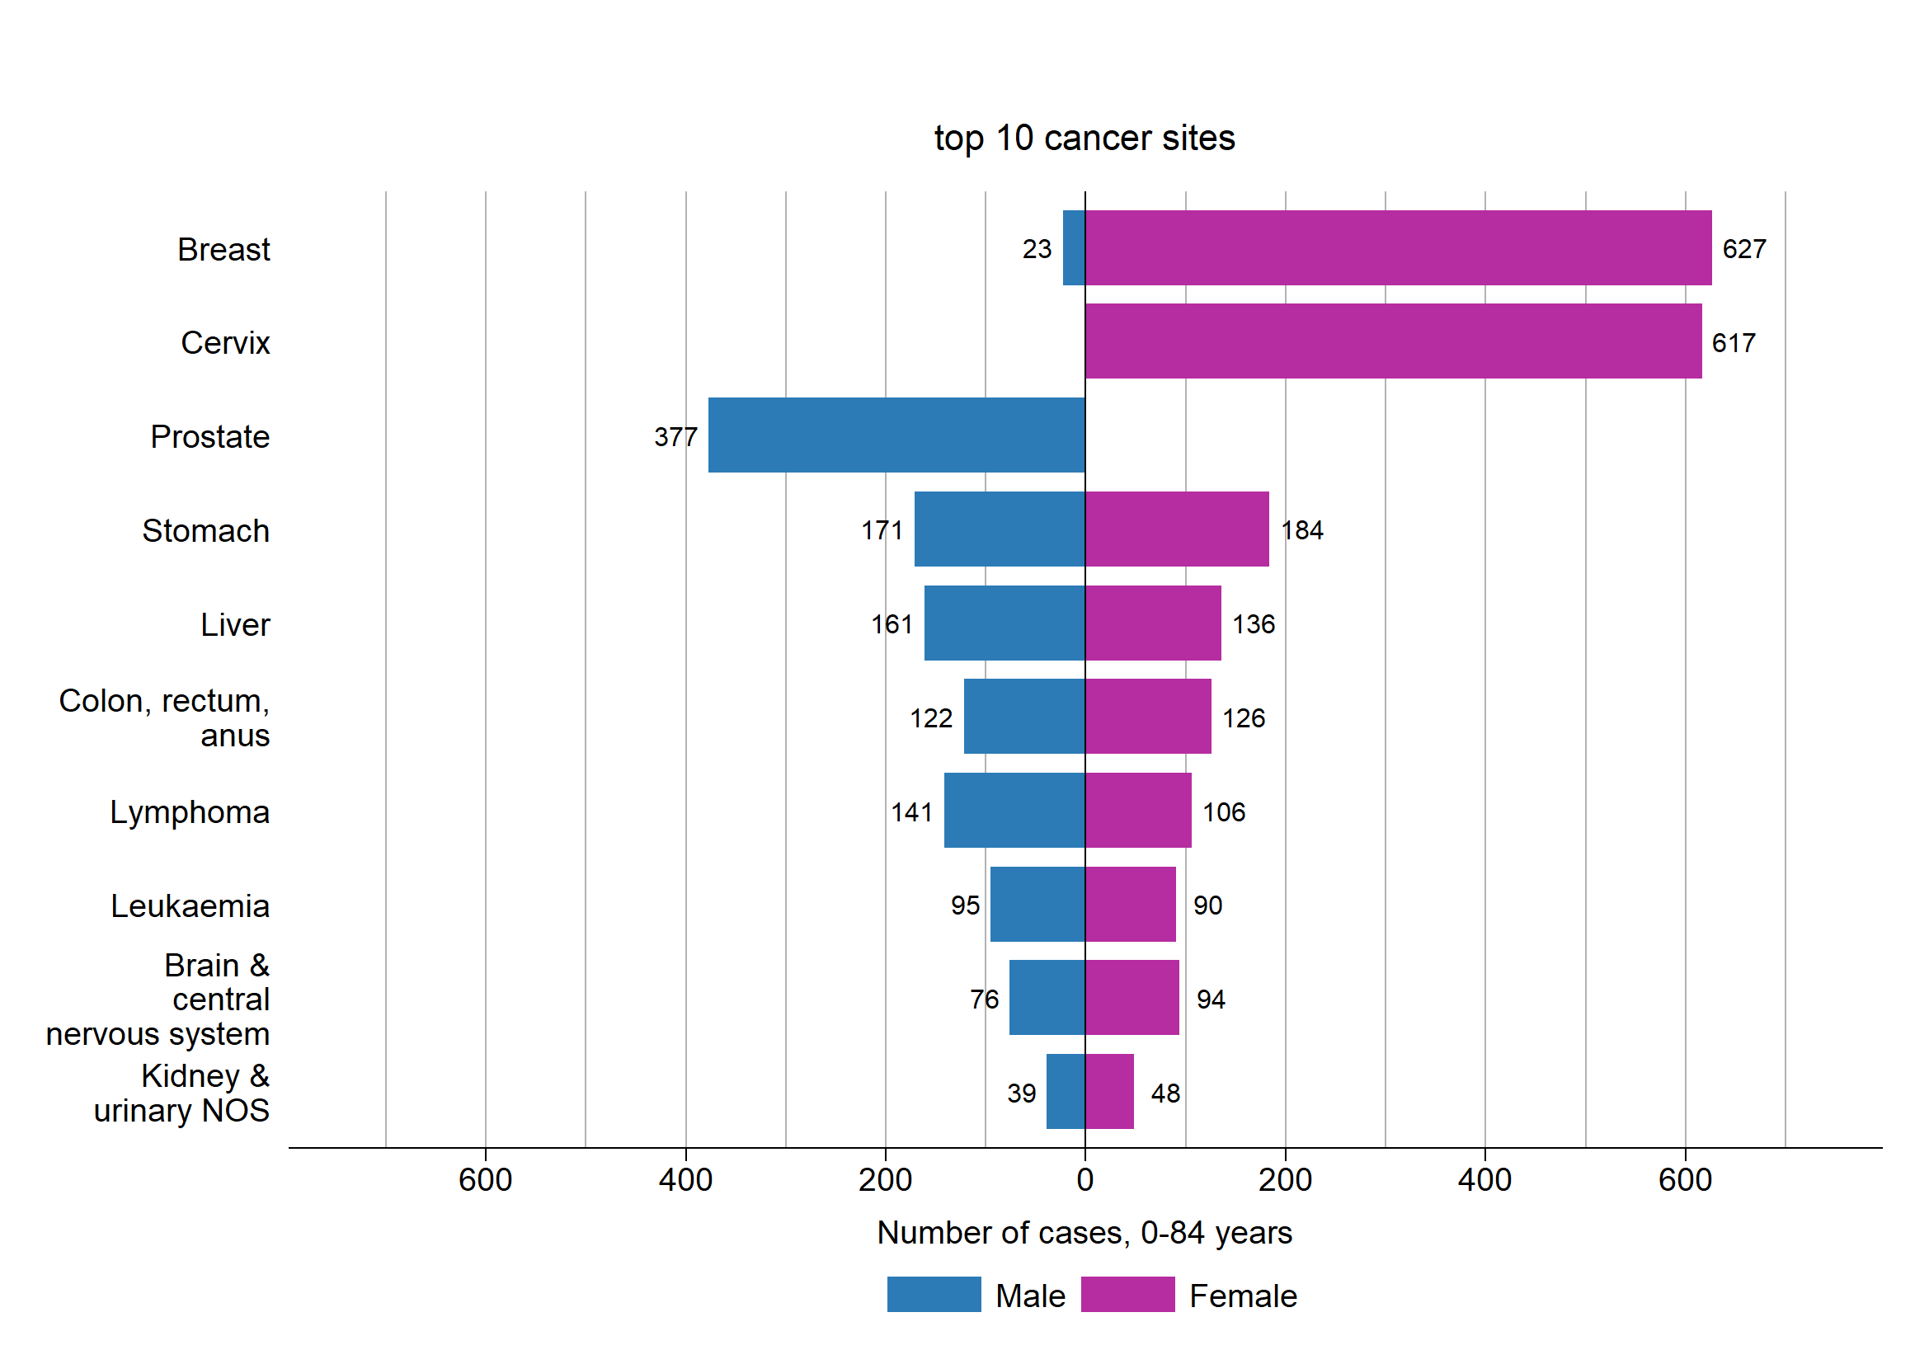
Top 10 new cancers in 2020, n= 4,894
Source: National Rwanda Cancer Registry
Cervical cancer represents 12.6% of all cancers and 13.7% of total cancer mortality
50% detection rate: 617 new cases vs 1,229 cases estimated by WHO

Slide 6



Global cervical cancer elimination strategy targets by 2030
90%
70%
90%
Of all girls fully vaccinated with HPV vaccine by 15 years of age
Of all women screened using a high-performance test by 35 years of age and again by 45 years of age
Of all women identified with pre-cancer and cervical disease are treated
Primary prevention
Vaccination & communication
Secondary prevention
Screening &
treatment
Tertiary prevention
Cancer
treatment & care
HPV vaccination coverage is at 93% in Rwanda
Sexuality education
Condom promotion/provision
Male circumcision
Screening with HPV and VIA
On-site treatment for eligible lesions
Referral for LEEP for extended lesions
Referral for diagnosis of suspected cancer
Surgery
Radiotherapy
Chemotherapy
Palliative care
WHO’s elimination strategy calls for mobilization towards achieving and maintaining 90-70-90 targets by 2030 that would result in >62 million cervical cancer deaths averted in the next 100 years

Slide 7
HPV Immunization in young girls (12 yrs old)
Drop due CIVID-19, doing catch up vaccination campaigns
MERCK Donation; Campaign mode:
2011 – Coverage: 93%; 2012 – Coverage: 97%
2020– Coverage: 74%
Routine immunization mode: 2015 – Coverage: 90%
2017 – Coverage: 93%
2019– Coverage: 97%
2011-12
2015
2017
2019
2021
Continue campaign mode: 2013 – Coverage: 97% ; Gavi; 2014 – Vaccine coverage: 99%; VIA screening started
2016 – Coverage: 93%
2018
2013 - 14
2016
2018– Coverage: 93%
2020
2020– Coverage: 75%
Introduction of HPV DNA based cervical cancer screening strategy at PHC
From 2011-2021: 1,3 million girls fully vaccinated

Slide 8
Effectiveness and Impact of HPV vaccination
SUMMARY OF FINDINGS
High prevalence of HPV in Rwanda at baseline (HPV16 & 18 ++),
High prevalence of HPV and cervical lesions in HIV positive women
Significant decrease of prevalence of vaccine targeted HPV types
Marked Vaccine Effectiveness 78% (51-90%)
Ngabo et al. BMC Infectious Diseases (2016) 16:225 Int. J. Cancer: 139, 518–526 (2016) -
Franceschi et al.Int. J. Cancer: 139, 518–526 (2016) VC 2016 UICCBossano et al. Emerging Infectious Diseases • www.cdc.gov/eid • Vol. 27, No. 1, January 2021

Slide 9
Lessons Learnt
Political will
Multi-sectoral collaboration
Organized health system
First Lady leadership
Ministry of Health
Guided by science and evidences
Government institutions: Education, Local government,,…
Civil Society Organizations
Faith based organizations
Strong community health worker system
Decentralized health system
Ownership by health facilities
Meaningful partnerships
Development partners ( GAVI,…)
Private sector ( Merck,..)
International NGOs
Local NGOs
Strong communication and community engagement
Vaccine delivery strategy
Mass media communication
Community opinion leaders
Community health workers
Address myths and rumors
School-based vaccination
Catch up campaigns
Integration into routine immunization
Encouraging early good results

Slide 10
Rwanda’s commitment to eliminate cervical cancer
Country has already achieved the vaccination target and will keep it high
Screening and treatment of pre-cancerous lesions prioritized
    HPV DNA based screening strategy at primary health care level
    Treatment of precancerous lesions at health centers
    Follow up and referral enabled by a digital tool
    Inclusion of cervical cancer screening in health insurance schemes
    Screening coverage: 23%
Management of invasive cervical cancer is being strengthened
    Local gyne-oncology fellowship training program
    Radiation therapy capacity
    Diagnosis and treatment covered by health insurances
Building strong and interoperable digital systems to enable tracking of implementation progress and achievements

Slide 11
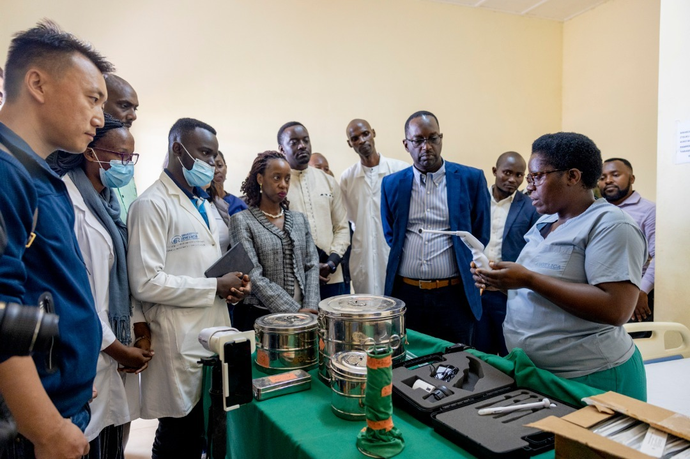
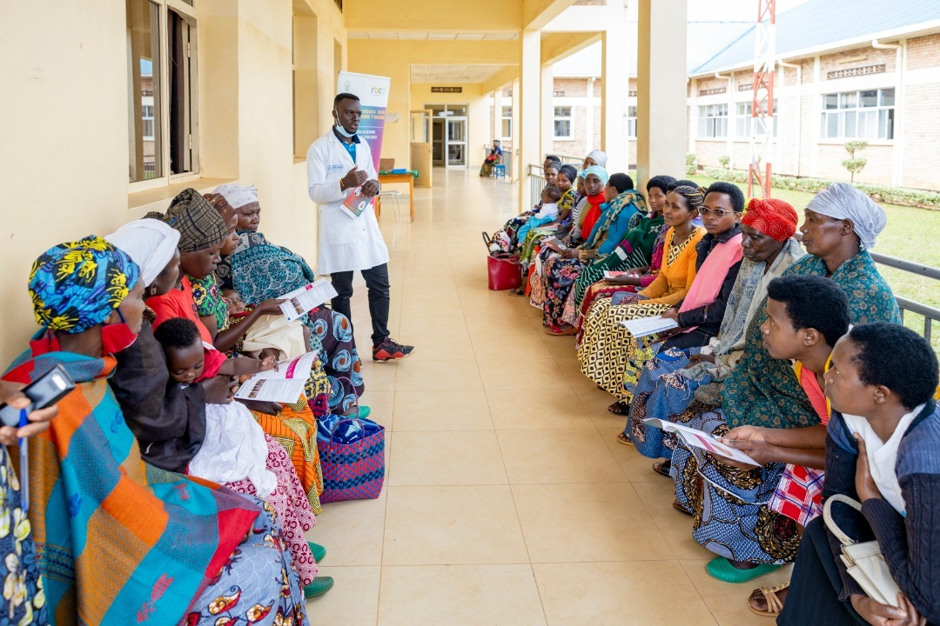
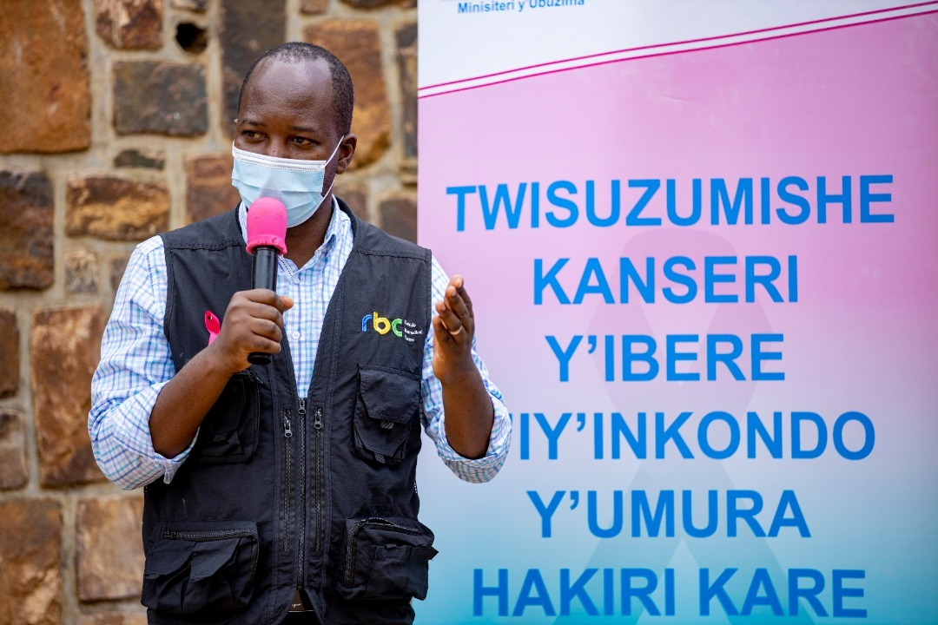
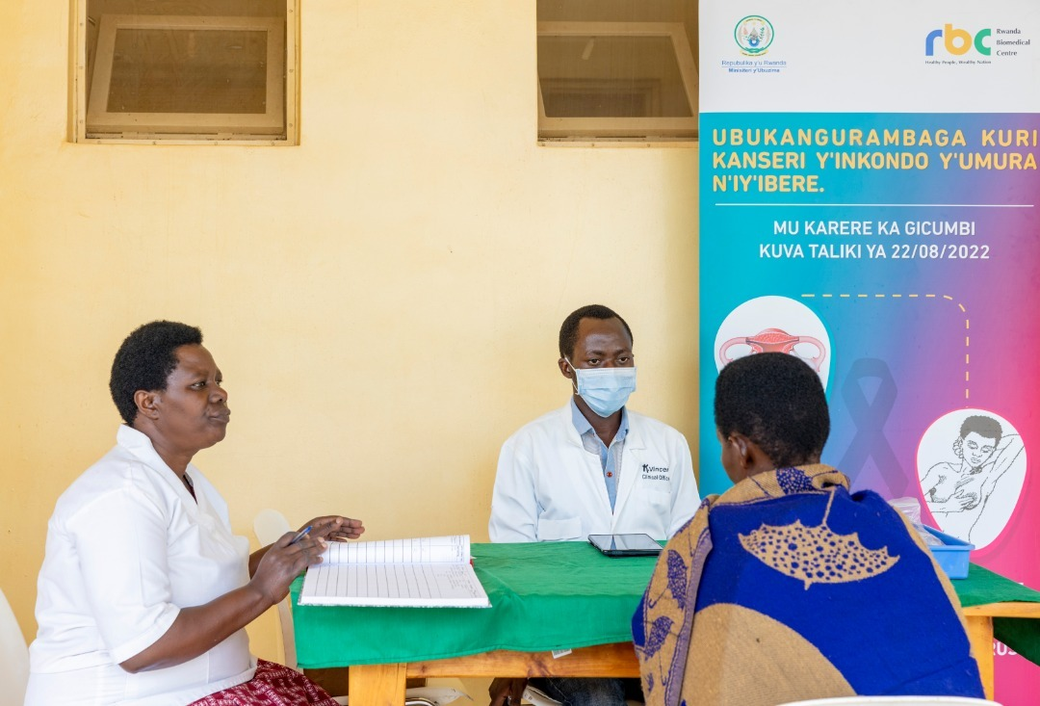
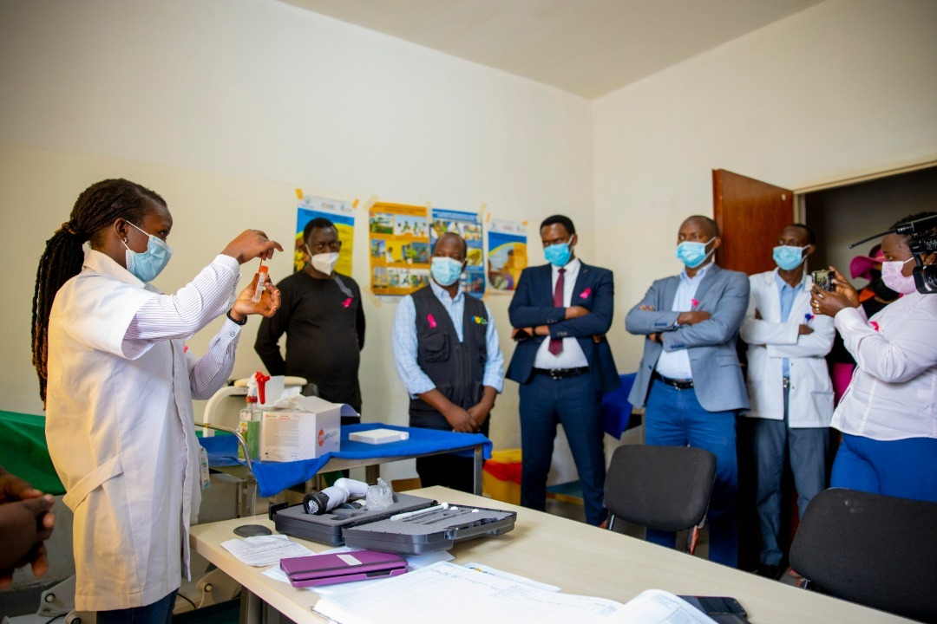
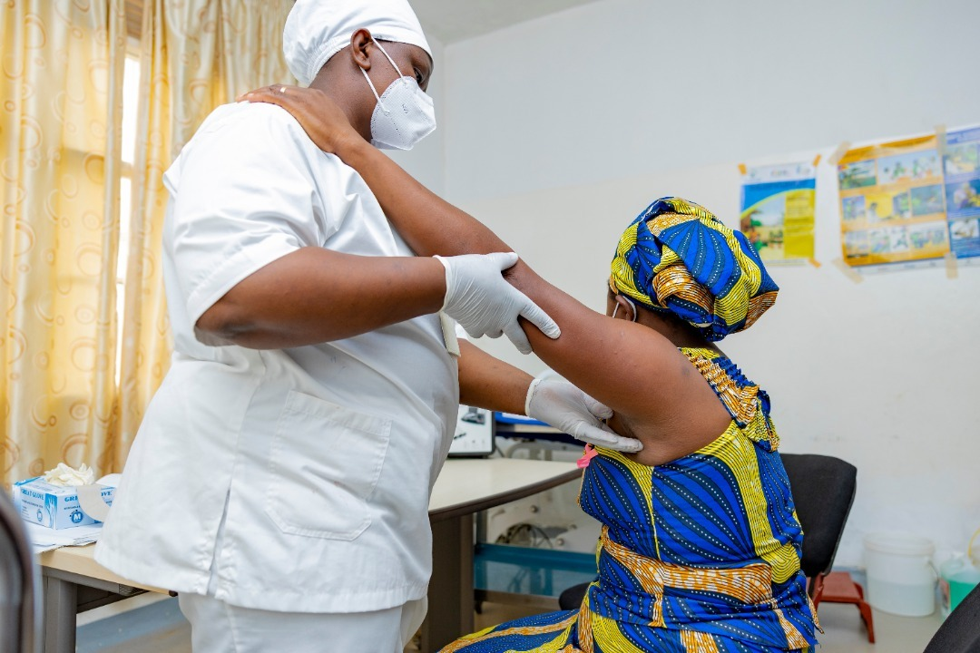
Cervical cancer screening and breast cancer early detection at health centres

Slide 12
THANK YOU
TOGETHER WE CAN ELIMINATE CERVICAL CANCER

