Slide 1
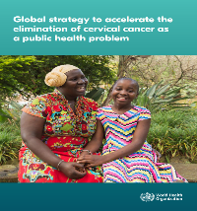
WHO Global Cervical Cancer Initiative:
Key Issues and Priorities for the
Africa Region
Dr Sharon Kapambwe
Technical Officer Cancer
East and Southern Africa
WHO AFRO

Slide 2
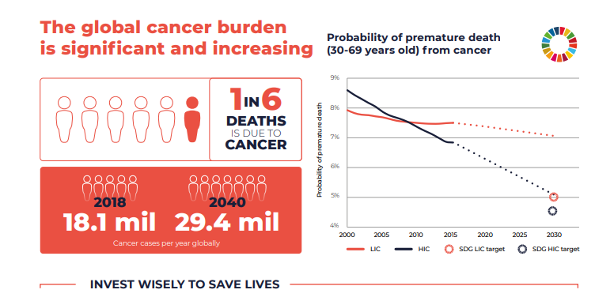
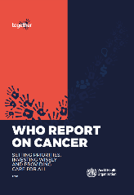
WHO setting global agenda
WHO guidance on strategic investments / interventions needed to achieve on SDGs
>60
Member States receive direct support by WHO to national cancer control programme

Slide 3
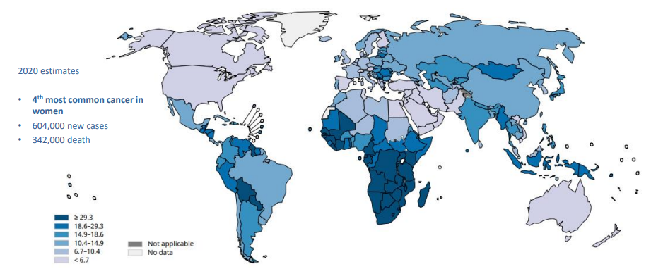
2020 Cervical Cancer Estimates
The highest incidence rates of cervical cancer are in Africa.. yet just 50% of countries have introduced HPV vaccination for adolescent girls
Ref: Global Cancer Observatory

Slide 4
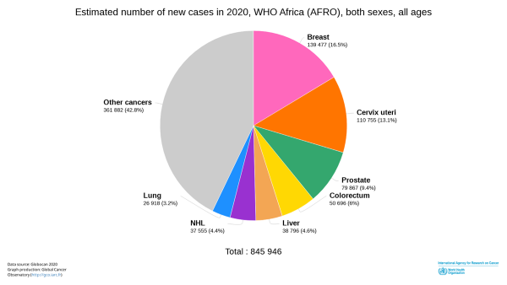
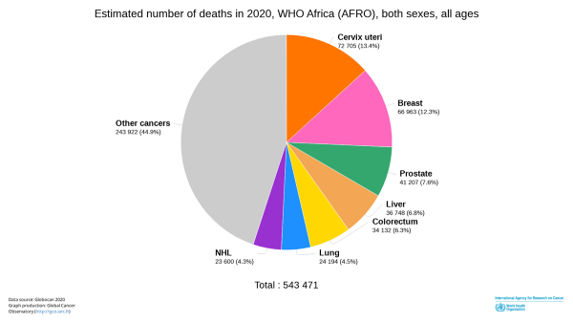
Breast cancer is the most common cancer in Africa,
cervical cancer is the most common cause of cancer-related deaths
Large disparities in cervical cancer incidence and deaths rates between LMICs and HICs: incidence rates are 2x as high; death rates are 3x higher

Slide 5
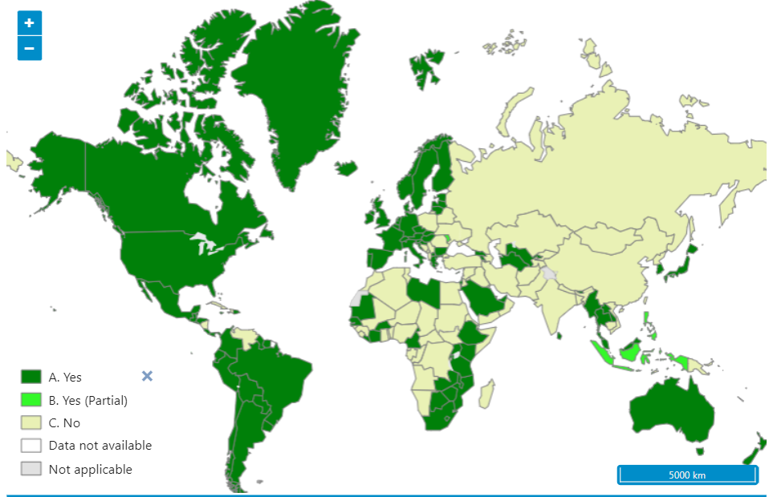

Countries with HPV vaccine in the national immunization programme
Date of slide: 2022-4-8
Map production: Immunization Vaccines Biologicals (IVB), World Health Organization
Data Source: IVB database as at 4 Aug 2022
2030 Target: 194 countries
120 (62%)
74 (38%)
Notes:
So who and where are the countries that have introduced:?
Today some 117 countries or 60% of the worlds countries have introduced. Still 77 short of the 2030 target
Mostly in the high income countries as you can see, but encouragingly more in Africa and Asia
The demand for HPV vaccines increased strongly by 2018 but then led to a global shortage as manufactures could not follow demand. Form the graph you can see that the introduction pace has reduced – mainly due to supply, though now COVID is also creating some delays.
2022 - BF, Lesotho, Saudi Arabia, Slovakia

Slide 6
Trends in population adjusted coverage rates
HPV vaccination coverage remains modest in Africa
Meaning of this indicator: “% of all girls (15 yr) in all countries in Africa that had access to and actually received the HPV vaccine”

Slide 7
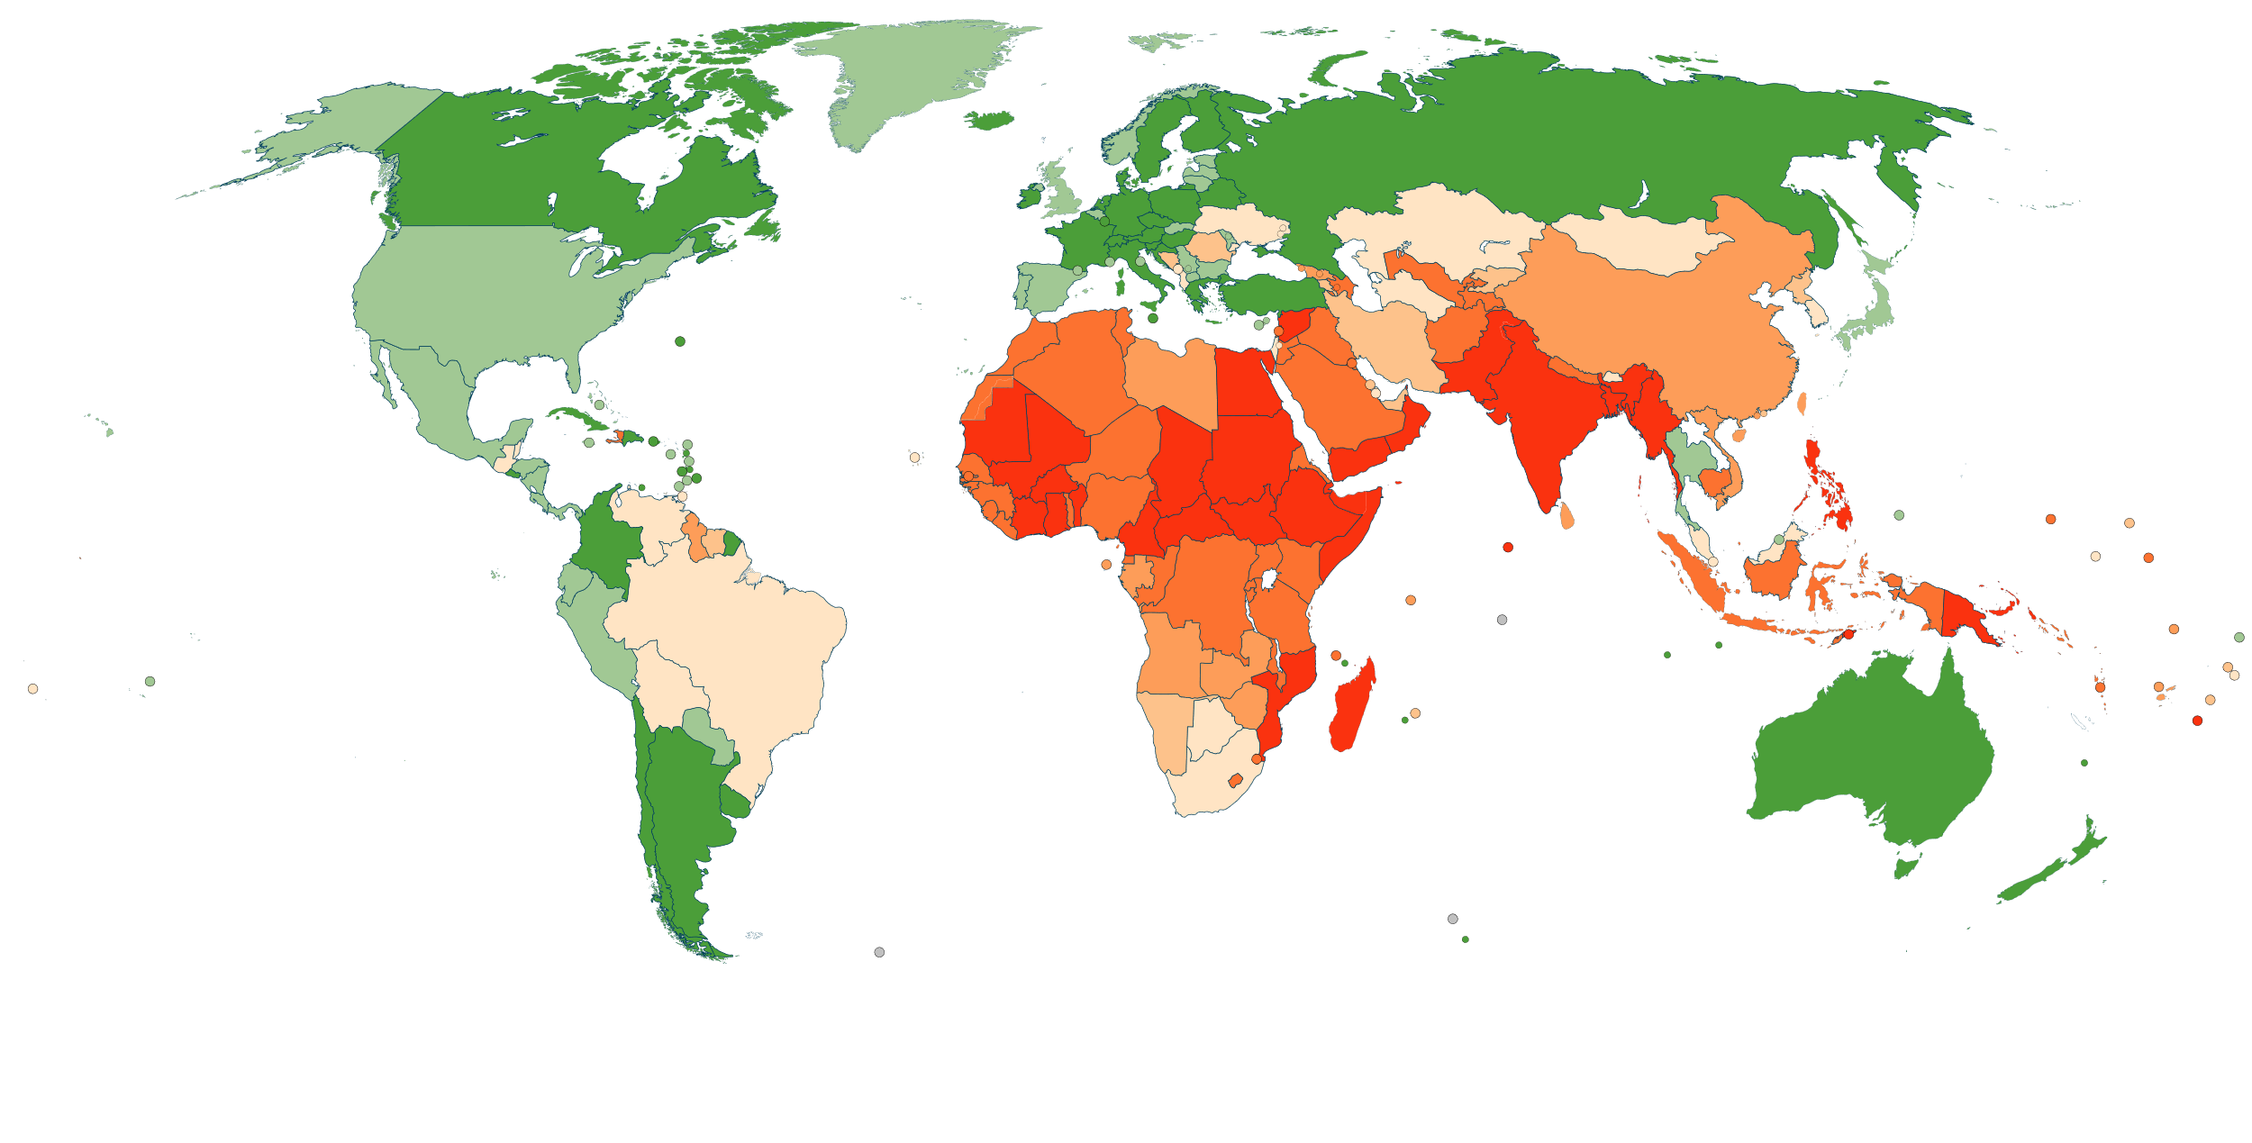










Only a small fraction of women on the continent have ever been screened for cervical cancer
Ever in lifetime screening coverage (2019), women aged 30-49, by country
0-9%
10-19%
20-34%
35-49%
50-69%
70-89%
90-100%

Slide 8
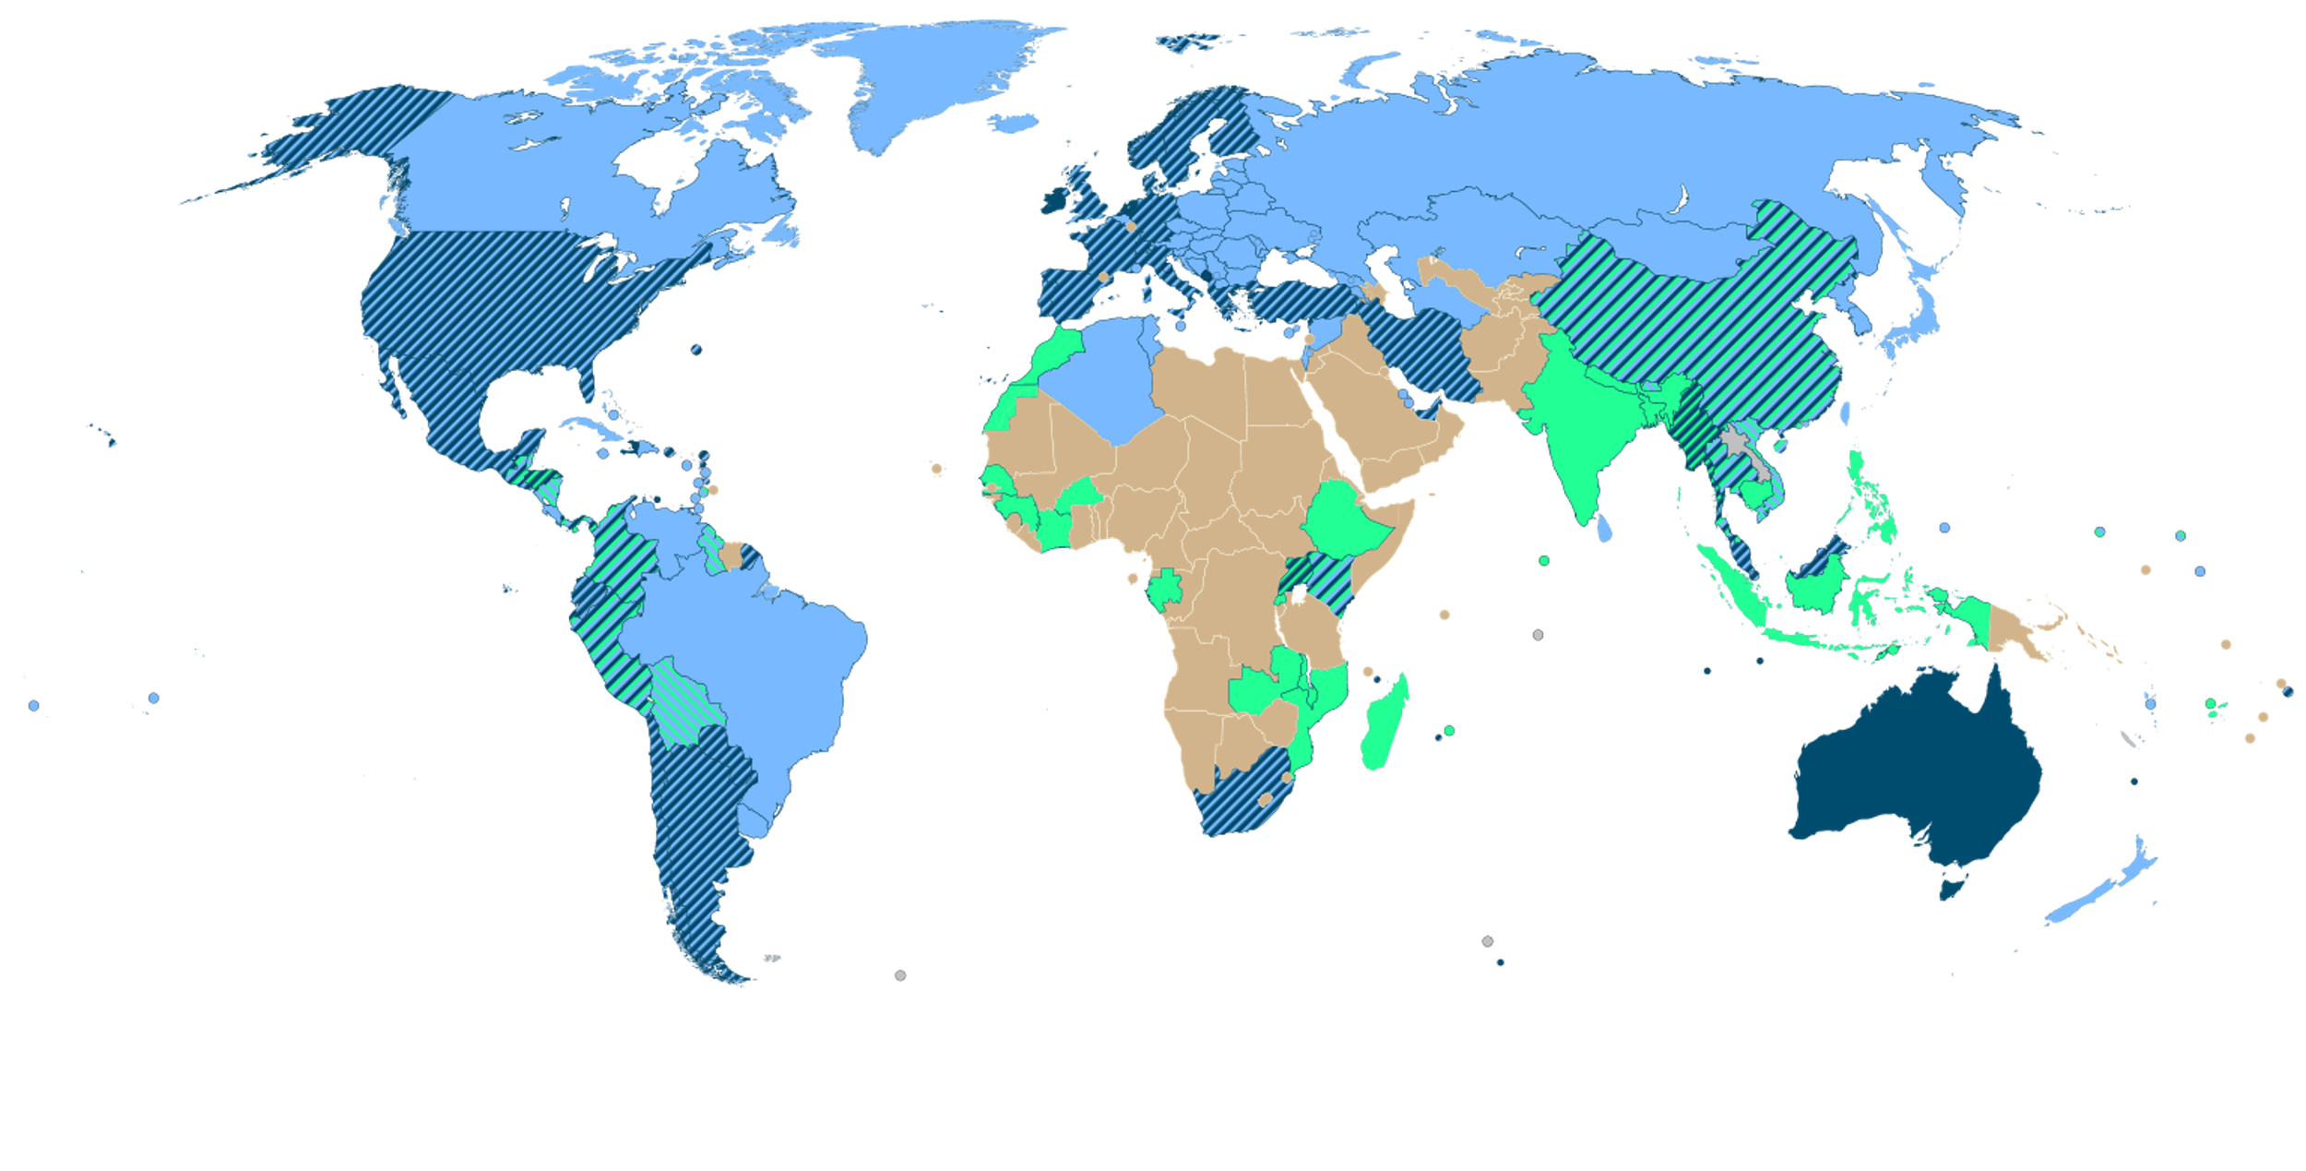




WHO recommended screening tests for cervical cancer screening
HPV
PAP
VIA
Solid fill
Striped pattern
One main primary test
More than one primary test (either as
co-test or for same/different indications)
No official recommendation

Slide 9
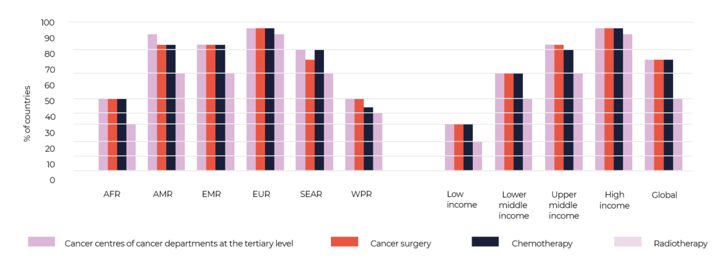
Status of cancer treatment
Cancer care and treatment capacity in Africa is lagging
Radiation therapy (public and private sectors) is only available in 22 member states,
80% of countries have no access to palliative care

Slide 10
Key Issues
FINANCING: Insufficient domestic funding and donor funding; limited financial protection; high out of pocket spending, with a high risk of catastrophic spending and impoverishment
LATE PRESENTATION: Limited awareness and knowledge combined with fear and stigma leads to delayed treatment and poor outcomes
WEAK MONITORING AND EVALUATION CAPACITY: Limited availability of population-based cancer registries
SERVICE DELIVERY: Health systems are inadequately prepared to address the growing burden of cervical cancer with limited availability of population-based screening programs, and inadequate access to treatment, reflecting:
  Shortages and uneven distribution of skilled and specialized human resources
  Inadequate infrastructure, including pathology services
  Use of low performance screening tests (VIA, pap smear)

Slide 11
Regional Strategic actions to accelerate progress
90%
of women identified with cervical disease receive treatment and care
90%
of girls fully vaccinated with HPV vaccine by 15 years of age
70%
of women screened with a high precision test by 35 and 45 years of age
Secure sufficient, affordable HPV vaccines
Quality & coverage of vaccination
Improve communication & social mobilization
Innovate to improve efficiency of vaccine delivery
Understand barriers to accessing services & create enabling environment
Integrate screen & treatment services into primary care
Promote screen & treat approach
Ensure an affordable supply of quality assured, high performance screening tests and treatment devices
Strengthen laboratory capacity and quality assurance
Implement management guidelines
Strengthen pathology services
Expand surgical capacity
Improve access to radiotherapy & chemo
Optimize workforce competencies
Survivor care & ↓cancer stigmatization
Palliative care as human right
Source: WHO Regional Framework for implementation of cervical cancer

Slide 12
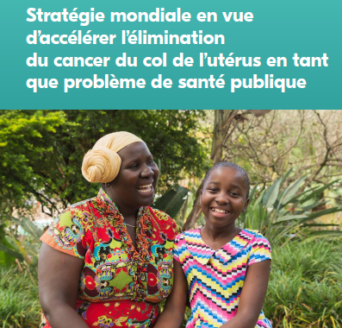

WHO Support
Development Costed National Cancer Control Plans/ Cervical Cancer Strategic Plan:
  Tchad, Senegal, Zimbabwe, Zambia, Kenya, Benin, Burundi, Mauritania, Uganda, Malawi, Rwanda, Namibia, Botswana, Tanzania, eSwatini, etc.
Development of Guidance Documents
  HPV Testing Guidelines: Kenya, Zambia, Botswana
  Treatment Guidelines ( Surgical and non-surgical)-Zambia
  Investment cases- Mozambique
Capacity building:
  Screening and treatment of precancerous lesions Malawi, Liberia, Guinea, Nigeria
  Community workers ( self-sampling, awareness)- Kenya, Uganda
Management of invasive cervical cancer
  Training of gynaecologists
  Establishing of Multidisplinary Teams (MDTs)
Procurement of equipment and supplies (start up)
  Nigeria, Senegal, Botswana, Lesotho, Liberia, Zambia
Cancer Surveillance and Cancer Registries/ Data Management-
  Malawi, Rwanda, Kenya, Uganda,

Slide 13
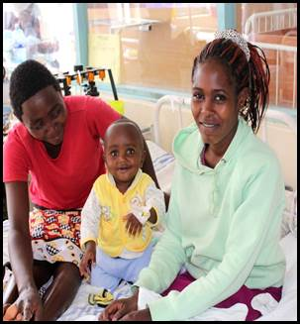

Building a future free of cervical cancer in Africa

Slide 14
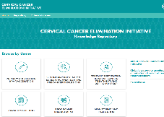
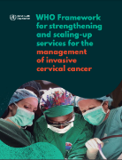
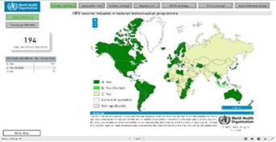
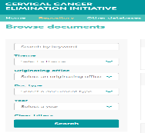
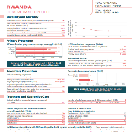
Resources
HPV Vaccine Dashboard
Microsoft Power BI
CCEI Knowledge repository
https://cceirepository.who.int/
Cervical cancer country profiles
https://www.who.int/teams/noncommunicable-diseases/surveillance/data/cervical-cancer-profiles

