Slide 1
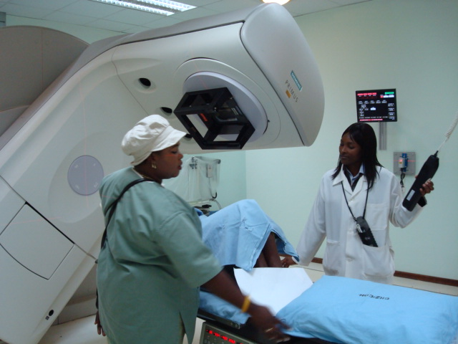
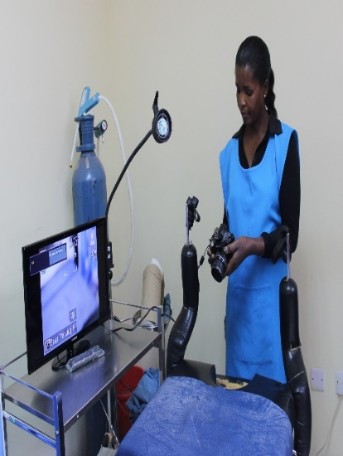
Zambia’s Cervical Cancer Prevention Program: Key Achievements and Main Challenges
Dr. Angel Mwiche
Assistant Director, Reproductive Health
Ministry of Health
Zambia

Slide 2
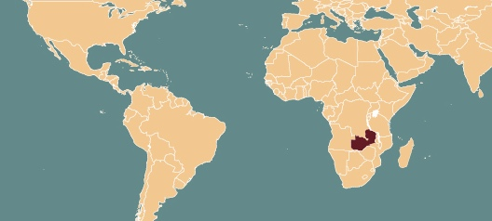
Overview, 2020
Population: 19 million
Rural population: 56%
High HIV prevalence rate 11%
Third highest incidence rate of cervical cancer in the world
Cervical cancer makes up 23% of new cancer cases annually
Number of new cases: 3,161
Number of deaths: 1,904
Incidence rate: 66.4/100,000 Mortality rate: 44.5/100,000

Slide 3
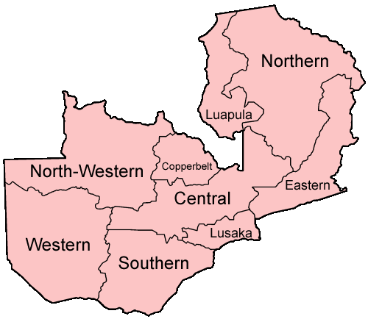
Cervical cancer program in Zambia
Cervical cancer screening program in Zambia started in 2006
Since inception more than 1.1 million women have been screened
Program uses three types of tests (VIA, Cytology and now HPV)
Northern circuit has fewer implementing partners thus the provinces have been lagging in access and standard of practice
Excellent coordination between government and implementing partners

Slide 4
Historical Background
Zambia suffered from one of the world’s most devastating HIV/AIDS epidemic with a HIV prevalence rate of 16.5%
Cervical cancer was the leading cause of cancer and cancer deaths among women (mortality rate: 35/100,000, Globocan 2002)
Conducted study among WLHIV
Screening with Thin Prep
Accessing HIV services with average CD+4 count 165/μL (range 7–942)
Health sector capacity to conduct cervical cancer prevention and treatment was very limited
No HPV vaccination program
Limited cytology-based screening
25 gynecologists nationwide
Only 6 pathologists in the public sector
No cytologists
No chemo-radiation treatment centre
No formally trained oncologists
No screening program

Slide 5
Gynecol Oncol 2006; 103: 1017-22.
Notes:
HIV-infected women living in resource-constrained nations like Zambia are now accessing antiretroviral therapy and thus may live long enough for HPV-induced cervical cancer to manifest and progress. We evaluated the prevalence and predictors of cervical squamous intraepithelial lesions (SIL) among HIV-infected women in Zambia. intraepithelial lesions (SIL) among HIV-infected women in Zambia. The median age of study participants was 36 years (range 23–49 years) and their median CD4+ count was 165/μL (range 7–942). The
prevalence of SIL on cytology was 76% (114/150), of which 23.3% (35/150) women had low-grade SIL, 32.6% (49/150) had high-grade SIL, and
20% (30/150) had lesions suspicious for squamous cell carcinoma (SCC). High-risk HPV types were present in 85.3% (128/150) women.

Slide 6
Mobilized political support and mounted a strong national response
Rolled out VIA strategy, a single-visit ‘point-of-care’ clinical screening test for early detection of cervical cancer; VIA with enhanced digital imaging
Adopted a “Screen-and-treat” approach for precancerous lesions to maximize opportunities for immediate cryotherapy treatment for eligible women without need for diagnostic pathology confirmation and risk of loss to follow up
Used fixed and village-based screening strategy to increase uptake
Deployed a nurse-led program, targeting HIV+ women but not limited to this group
Rolled out HPV DNA testing to improve efficacy

Slide 7
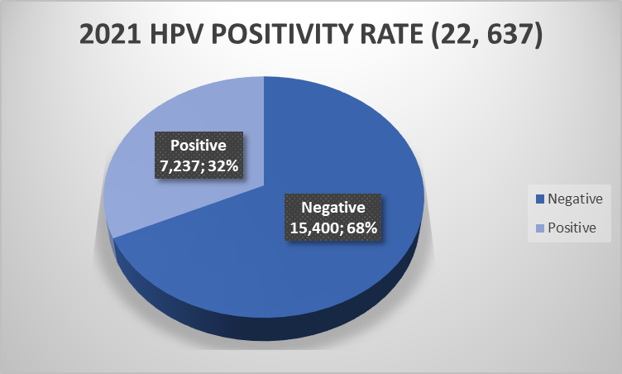
HPV DNA Testing Introduction
2021 target was 300,000
10 % of the target was to be screened with HPV and increasing by 10% every year to be at 70% in 2030
22,637 women were screened with HPV DNA Test
278 VIA centres in 10 provinces
Courier system of samples-integrated system for Multi-Disease Testing platform (ie EID,VL)

Slide 8
Targeting underserved areas through the World Bank-funded Zambia Health Systems Improvement Program (ZHSIP)
Cervical cancer not initially in program,
included subsequently
Following the resource mapping meeting with stakeholders, it was apparent that the provinces with the least cervical cancer services were: Northern, Muchinga, Luapula, North-Western. Least partner support
34 new sites established
162 health workers trained
Over 70,000 women screened,3600 precancer treat
Over1,000 suspected CaCx

Slide 9
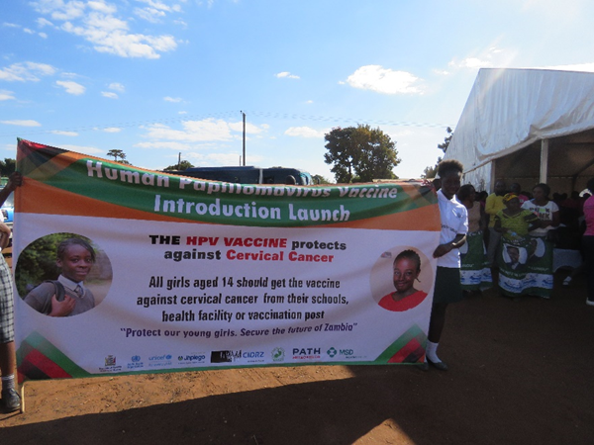
Health System Overview
Primary
Nat. HPV Vaccination June 2018/ 2019
Secondary
100 % districts have screen and treat with VIA
Tertiary
Tx of pre cancer: 68%
Target: vaccinate 90% of girls by 15 years
HPV DNA Testing piloted November 2019
Over 20,000 patients seen at CDH since 2006
General Surgery & Gyn available in all provinces
Radiotherapy, Brachytherapy, Chemotherapy, Surgical & Gyn Oncology- CDH
Vaccination Coverage <50%
Multi age cohort planned in 2022
Fully integrated with HIV services

Slide 10
Overarching factors for success of the program
Political will from the government and strong ownership of the program at the Ministry of Health
Establishment of cervical cancer management structure at the Ministry of Health; functional National Cancer Control Technical Working Group
Coordinated action between government and implementing partners
Availability of funding from government and donors
Dedicated, trained, and motivated workforce

Slide 11
Lessons Learned
Prepare investment case and costed plans for cervical cancer elimination, prevention, and treatment
Leverage existing platforms (maternal, RH/FP, adolescent, HIV/AIDS)
Ensure a continuum of care (vaccination, screening, treatment)
Adopt a targeted approach (high-risk groups, high prevalence areas)
Consider creation of regional Centres of Excellence
Develop robust data systems (e.g., cancer registries)
Establish resilient and robust partnerships

Slide 12
Kalya Uzumanana
He who keeps on trying, get's the reward

