Slide 1
ACCESS TO CANCER DIAGNOSIS AND TREATMENT IN KENYA
Dr Mary Nyangasi
Head, National Cancer Control Program
MINISTRY OF HEALTH
KENYA
14th December 2022
@Cancer Program

Slide 2
Background
Globally, cancer is a significant cause of morbidity/ mortality; 70% of all cancer mortality occurs in LMICs
A disease of health inequities and disparities: 80% of childhood cancers are curable in developed countries in contrast to 20-30% in Kenya)
Low awareness levels, late-stage presentation, limited access to cancer diagnostics and treatment are key challenges
Division of National Cancer Control Program

Slide 3
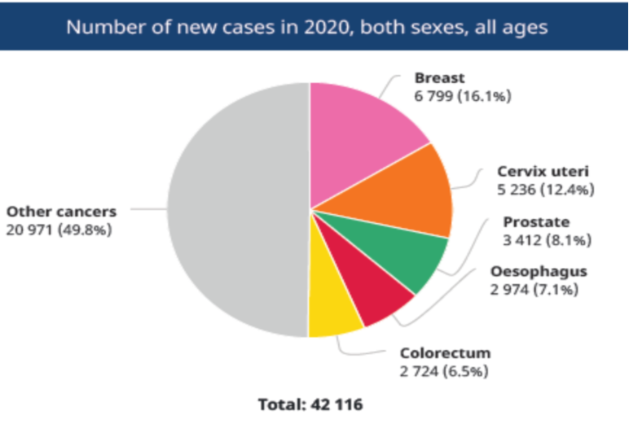
Kenyan Context
Pop: 48 Million
Cancer burden: 47,887 cases annually,overall cancer incidence peaks at ages 40-74 years in adults and 0-4yrs in children
Leading cancer types: breast, cervical, prostate, esophageal
Equity of access: 31, 587 require RT annually (60%=25,269 +25% of 25,269 require retreatment); in 2020, only 26% of those who required RT received it
Division of National Cancer Control Program

Slide 4
Status of Cancer Management Services
Cancer Diagnostics:
In Kenya, 10 county referral hospitals and 2 National Referral Hospitals provide histopathology services; imaging and IMIC have been established at KUTRRH and nuclear medicine services are available; X-rays, U/S, CT scan services
Cancer Surgery:
Generalist services are available in all county referral hospitals, specialized surgeries are available at the 3 national referral hospitals
Division of National Cancer Control Program

Slide 5
Status of Cancer Management Services
Chemotherapy:
11 county hospitals provide these services; 3 national referral hospitals
Radiotherapy: 43 machines are required to treat the estimated number of annual curable cancers (21,549) against 19 teletherapy machines available
Teletherapy: 12 well established facilities (6 private, 6 public)
Brachytherapy: services available in 6 public facilities, and 3 private; 4,117 pts (40% of prostate & cervix, 20% of esophageal) require brachytherapy annually hence 20 machines required against 10 available
Division of National Cancer Control Program

Slide 6
How Kenya has benefited from IAEA support
Use of IAEA documents to develop policy documents; advisory services to design bunkers for 3 new regional centers
Kenya has benefited from various IAEA technical cooperation projects, including:
Capacity building: Scientific visits, expert missions, fellowships and training support, seminars and conferences, training courses and workshops
Equipment support: LINAC to MTRH, CT simulator, TPS and various equipment ot KNH, ongoing procurement of two LINACs through Rays of Hope project
Support for radiation safety and security
Division of National Cancer Control Program

Slide 7
Key Challenges and how they were addressed
Stakeholder engagement: NCCS and policy advice
Funding: social insurance scheme, advocacy at high political level, demonstration of return on investments, use of data
Human resource gaps for radiotherapy( gap of160ROs,133MP, 224RTTs): train and recruit early during the project implementation phase, local programs for training in place
Specifications for procurement of radiotherapy, nuclear medicine and QA equipment and commodities: incorporate in essential equipment lists, TWGs
COVID-19: coordination including with other ministries for relevant import waivers, movement passes

Slide 8
Fig 1: Number of patients served by the cancer centers in the financial year 2021/22 (KHIS).
In FY 2021/22, 17,690 new patients and 105,760 follow-up visits were recorded at the public cancer centers up from 75,928 in 2020/2021.

Slide 9
Figure 2: Cancer stage by age group at the regional cancer centers, 2021 (p<0.001)

Slide 10
Future Plans: Phased Expansion
Rays of Hope: 2 LINACS for 2 empty bunkers (Nakuru and Msa)
Expand infrastructure: MOH equipping with 4 additional LINACs: KUTRRH, KNH, Kisumu and Garissa planned, construct & equip Nyeri and Kisi
Develop radiotherapy bankable documents in Jan/Feb 2022
Develop appropriate purchase modalities: MES, PPP, B?
Expand diagnostic imaging infrastructure utilization and QA
Strengthen local training programs
Sustain community awareness and sensitization: cancer as a treatable disease

Slide 11
The End

