Slide 1
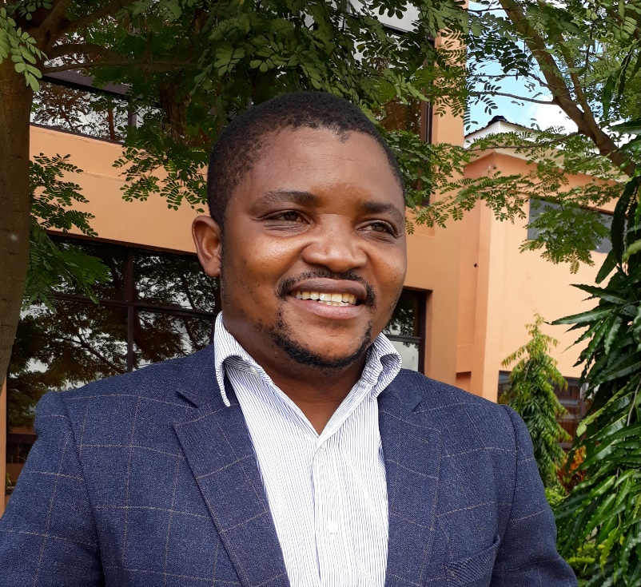
Country Examples of PEN-Plus Scale-up: Malawi
Dr. Jones Kaponda Masiye
Deputy Director of NCD and Mental Health Clinical Services,
Ministry of Health, Malawi

Slide 2
Origins of PEN-Plus in Malawi
Neno District PEN-Plus Cohort
Number of Patients | >500
% less than 40 years | 39%
% less than 20 years | 18%
% female | 50%
Neno District PEN-Plus clinics opened in Nov 2018
Dedicated clinical officers, nurses, clerks
NCD medications and supplies supported
Linkage to care and active case finding programs developed
Social support includes transport, food packages and cash transfers

Slide 3
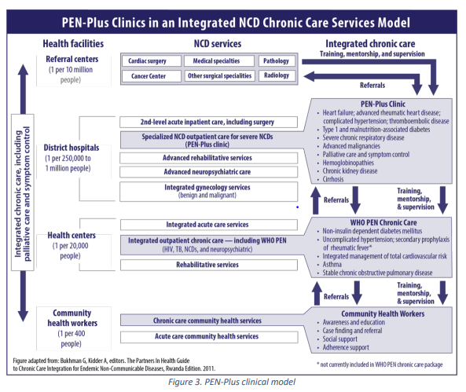
PEN-Plus bridges the gap for severe conditions
PEN-Plus in Malawi serves a vital role at primary hospitals for severe chronic conditions
PEN-Plus improves access to care for severe conditions at facilities more accessible to the population
PEN-Plus decongests referral centers and may provide more appropriate referral and follow-up

Slide 4
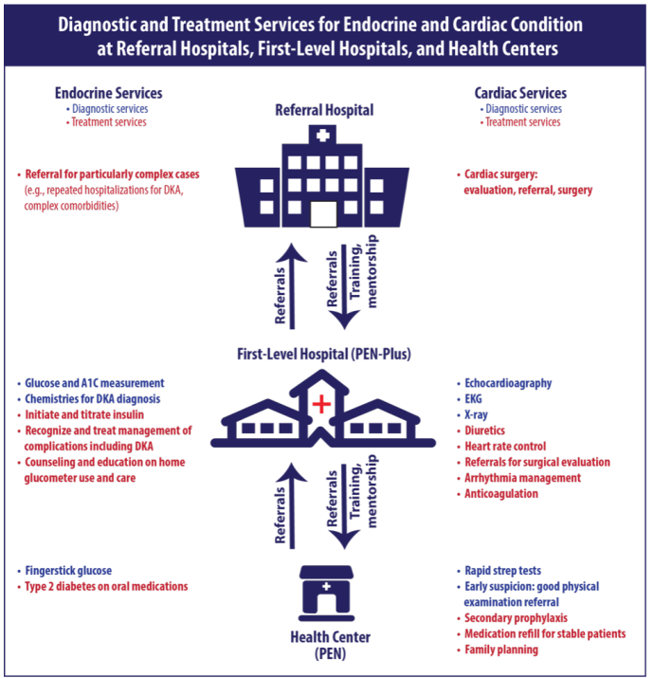
PEN-Plus strengthens WHO Package of Essential NCD CAre
Cases of simple hypertension and type II diabetes may be managed at the primary care level (health centers) through the WHO “PEN” package
More “advanced” diagnostics and treatments can be feasibly delivered at first level hospitals
PEN-Plus providers can provide training, mentorship, and supervision to lower levels
PEN-Plus provides a clear referral pathway for these patients

Slide 5
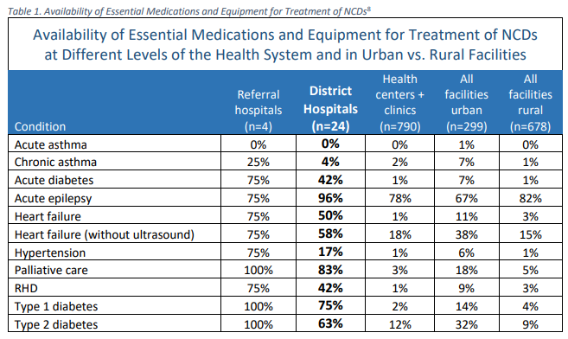
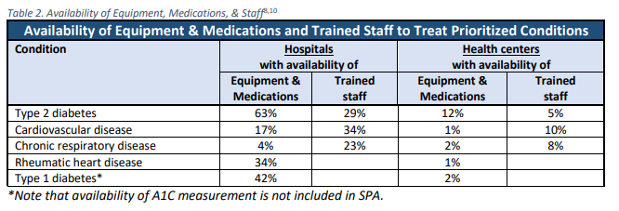
Facilities require strengthening for PEN-Plus
At baseline, availability of essential medications and equipment needed for severe conditions is highly variable at district hospitals
Rural hospitals are typically less prepared than urban hospitals
There is a shortage of trained staff
Source: Malawi PEN-Plus National Operational Plan, 2021

Slide 6
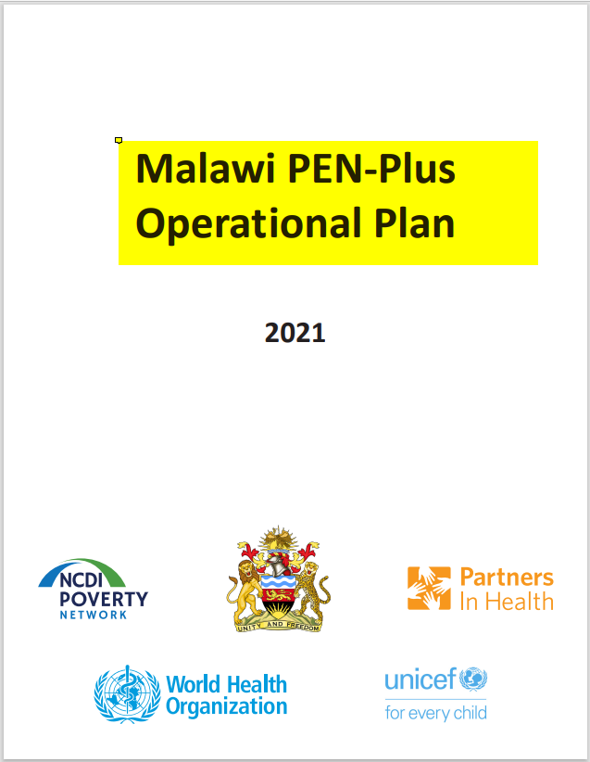
Malawi PEN-Plus National Operational Plan
Malawi PEN-Plus National Operational Plan developed in 2021 to elaborate objectives, inputs, and expected outcomes
Broad coalition of stakeholders mobilized to align on this plan, including:
Ministry of Health
Partners In Health
Helmsley Charitable Trust
World Diabetes Foundation
UNICEF
WHO
Source: Malawi PEN-Plus National Operational Plan, 2021

Slide 7
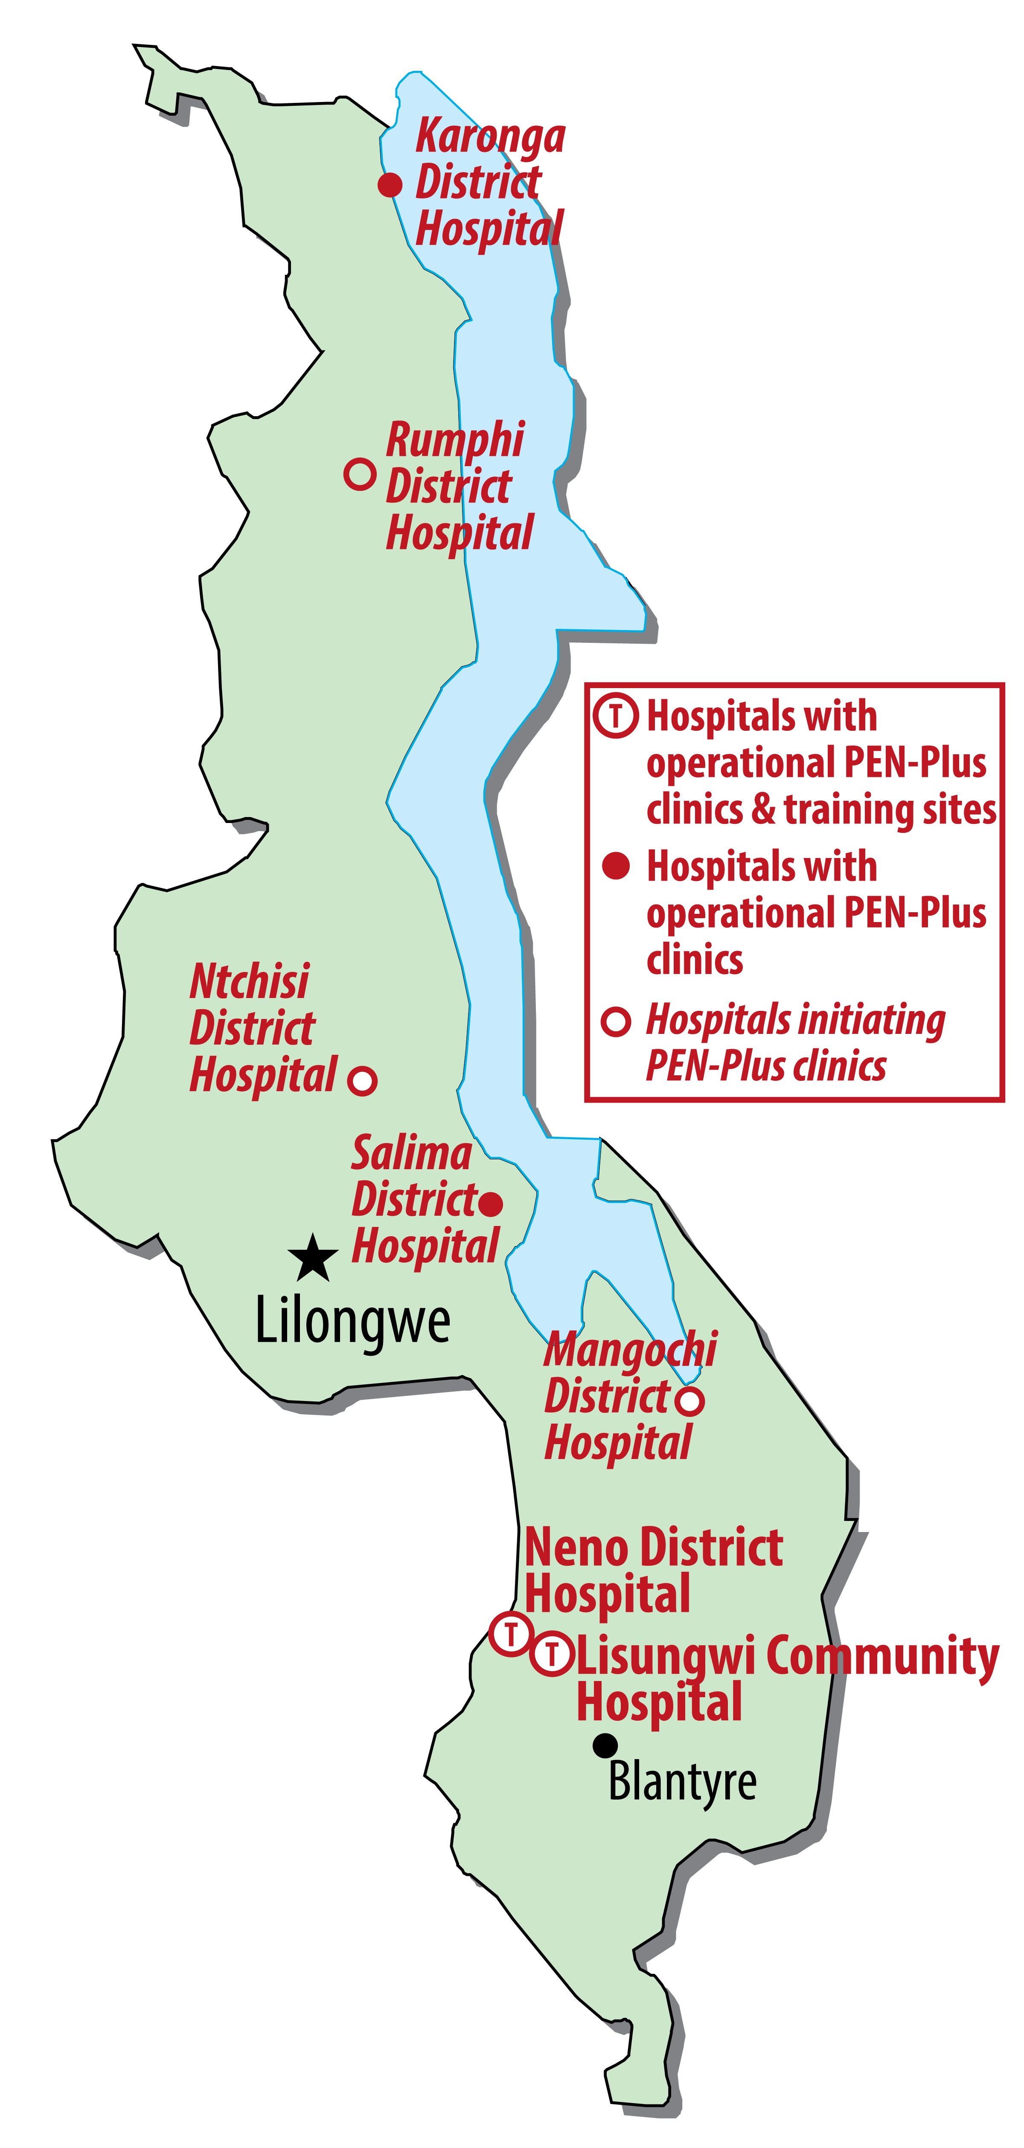
Malawi PEN-Plus scale up
Source: Malawi PEN-Plus National Operational Plan, 2021

Slide 8
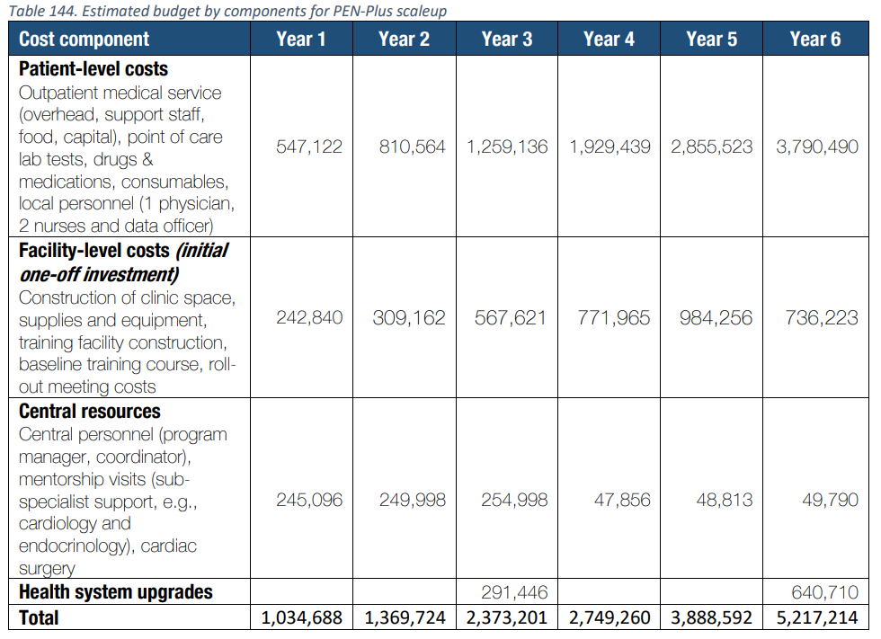
Resource Estimation for PEN-Plus Scale-up
Estimated need for PEN-Plus scale-up: $16.6 million over 6 years
Two PEN-Plus clinics and training sites established in the Southern Region in 2018 by the Malawi MOH and Partners In Health
Two new clinics initiated in 2022 with funding support from World Diabetes Foundation ~$2.1 million*
Three additional clinics preparing to open in 2022 with funding support from UNICEF ~$1.8 million*
* Total grant budget
Source: Malawi PEN-Plus National Operational Plan, 2021

Slide 9
Summary Points
Successful initial experience for PEN-Plus in Malawi for providing access to care for severe NCD conditions at primary hospital level
Ministry of Health led National Operational Plan provides strategy and plan for PEN-Plus scale-up
Donor and implementing partner alignment for Malawi PEN-Plus strategy

