Slide 1
Country Examples of PEN-Plus Scale-up: Nepal
Professor Dr. Bhagawan Koirala
President, Nepal Medical Council
Head of Department of Cardiothoracic and Vascular Surgery at the Institute of Medicine, Tribhuvan University, Kathmandu
Founding Chairman of Kathmandu Institute of Child Health
National Co-chair of Nepal NCDI Poverty commission

Slide 2
WHO-PEN for simple NCDs at PHC level in Nepal
Package for Essential NCDs (WHO-PEN) introduced and scaled to all 77 districts in the country (2016-current)
Focused on primary health care centers and health posts
Scope:
Management of diabetes and hypertension
Management of asthma and COPD
Assessment and referral for breast and cervical cancer
Health education and counseling on healthy behaviors
Gaps:
Implementation
Medications
Case finding
Referral pathways-continuum of care
HUMLA
DARCHULA
BAJHANG
MUGU
BAITADI
BAJURA
DADEL-
JUMLA
DHURA
DOTI
ACHHAM
KALIKOT
DOLPA
KANCHAN-
DAILEKH
MUSTANG
PUR
JAJARKOT
KAILALI
RUKUM
MANANG
SURKHET
MYAGDI
BARDIYA
SALYAN
ROLPA
B
KASKI
GORKHA
A
G
L
U
N
G
LAMJUNG
BANKE
PYUT-
PARBAT
RASUWA
DANG
HAN
GULMI
ARGHAK
SYANGJA
TANAHU
SINDHU-
HACHI
PALPA
NUWAKOT
PALCHOK
DOLAKHA
SOLUKHUMBU
KAPIL-
NAWAL
DHADING
KATHM
BHAK
BASTU
RUPAN-
PARASI
SANKHUWA-
DEHI
CHITWAN
MAKAWAN-
LALIT
KAVRE
C
H
H
A
P
SABA
TAPLEJUNG
PUR
R
A
M
E
OKHAL-
PARSA
SINDHULI
DHUNGA
KHOTANG
BHOJ-
TERHA-
T
H
A
R
BARA
RAUT-
PUR
THUM
H
E
AHAT
SARLAHI
MAHO-
UDAYAPUR
DHAN-
P
A
C
TARI
DHANUSA
KUTA
SIRAHA
ILAM
SAPTARI
SUNSARI
MORANG
JHAPA
Source: Nepal PEN-Plus Evaluation, 2022

Slide 3
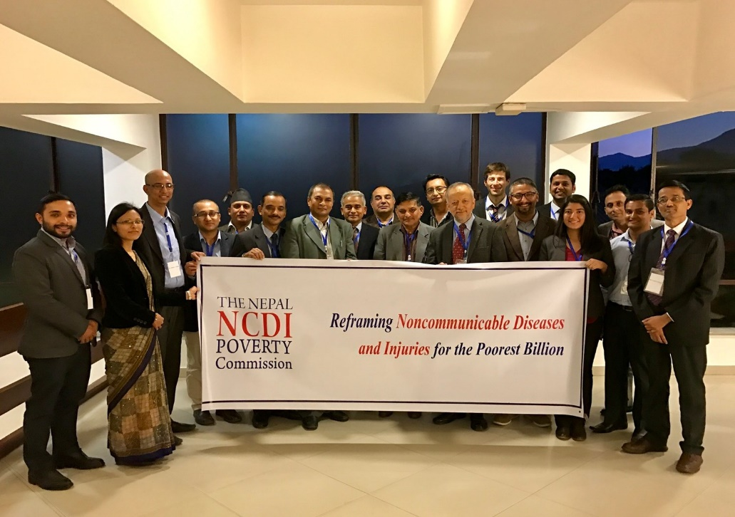
Nepal NCDI Poverty Commission (2016-present)
Host institutions:
Kathmandu Institute of Child Health
Ministry of Health
Objectives:
Understand burden of severe chronic diseases, particularly among children and young adults
Set priorities in NCDIs using established criteria
Propose integrated care solutions
Align stakeholders
Source: Nepal NCDI Poverty Commission Report, 2018

Slide 4
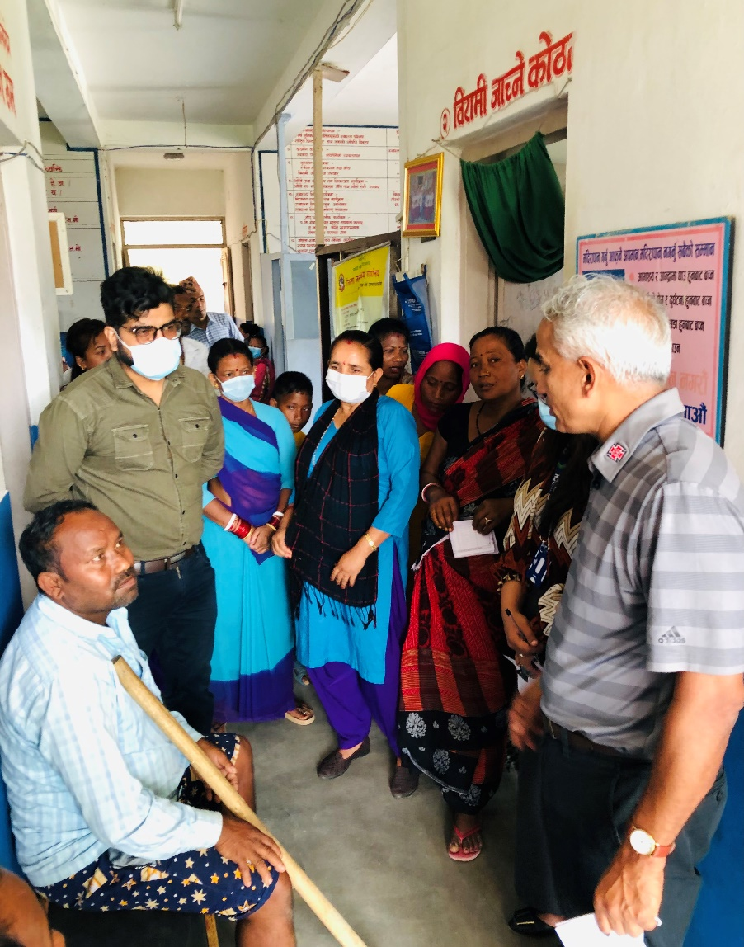
Major findings and recommendations
Assessed interventions based on local burden estimates, financial risk protection, and equity characteristics
Recommended 23 priority conditions
Recommended 23 priority interventions
Estimated cost of $8.76 per capita for introduction and scale up in Nepal’s Health System
Source: Nepal NCDI Poverty Commission Report, 2018

Slide 5
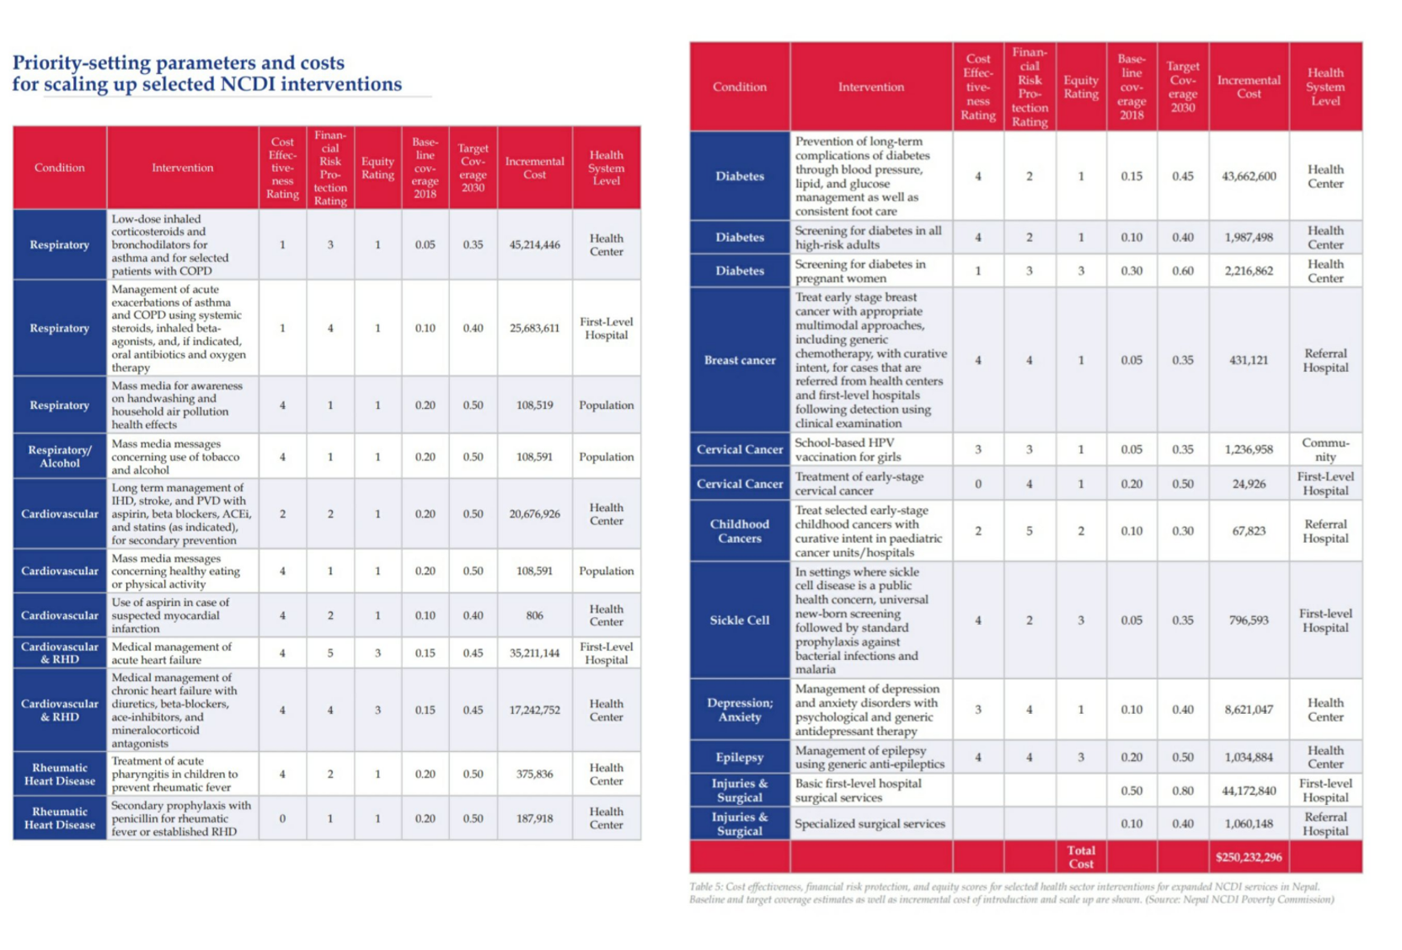
Priority Setting for NCDIs in Nepal

Slide 6
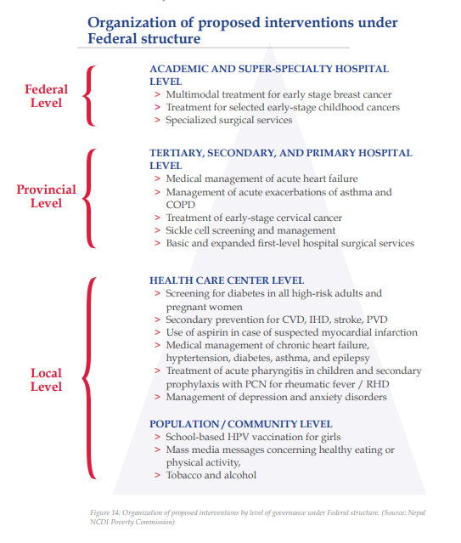
Availability of prioritized interventions
Assessed availability and feasibility of the interventions in the Nepal health system
Advocated for uptake into National Essential Medications Formulary, National Health Insurance benefits package, and MOH NCD Strategic Planning
Currently exploring how to optimally integrate these interventions and train non-specialist providers

Slide 7
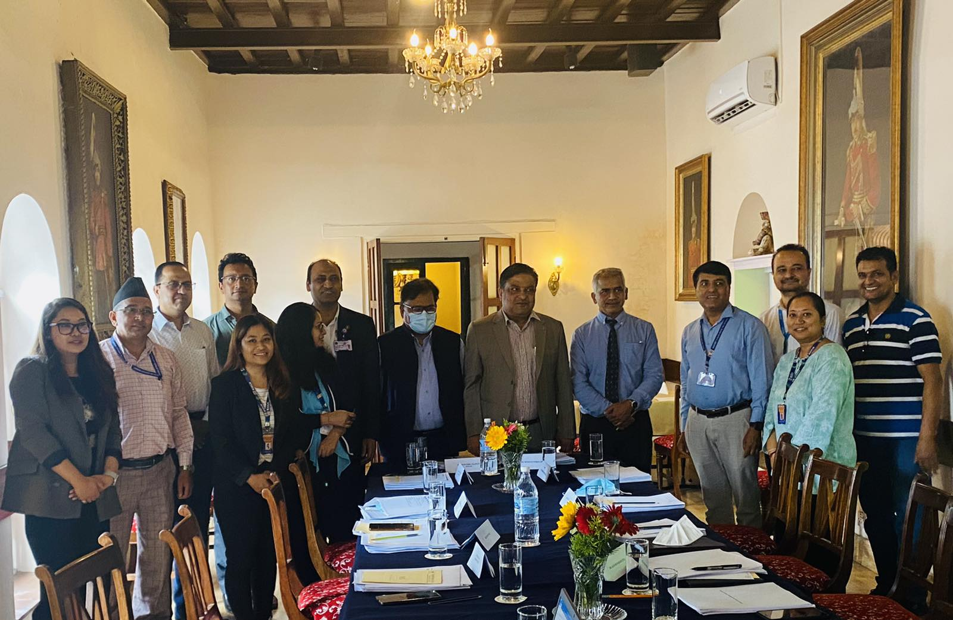
PEN-Plus in Nepal Steering Committee
MOH-Chaired Steering Committee:
Professional societies
Civil society
NCDI-PC/KIOCH
Objectives:
Central governance for PEN-Plus roll-out
Coordinate efforts of stakeholders and funders
Align PEN-Plus with existing national health sector strategies
Notes:
Decisions:
-Approval of the clinical protocols after recommended amendments
-Work in coordination with the NHTC for Manual development
-Implementation of UNICEF funded child and adolescent PEN-Plus with the support and coordination of MoHP in the same modality as PEN-Plus
-Incorporation of UNICEF in PEN-Plus TWC

Slide 8
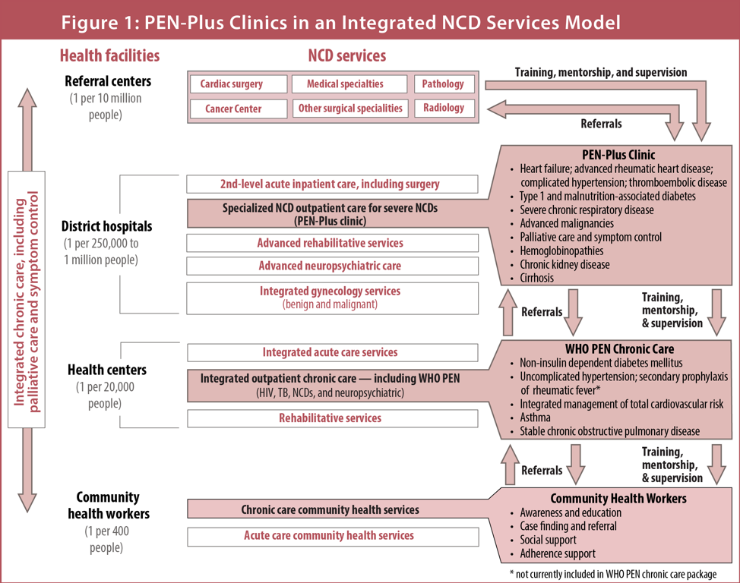
PEN-Plus in Nepal
Focus on following conditions:
Endocrinology: Type I and Type II Diabetes Mellitus (DM)
Cardiovascular:
Rheumatic Heart Diseases (RHDs)
Congenital Heart Diseases (CHDs)
Hypertension
Ischemic Heart diseases
Respiratory: Chronic Respiratory Diseases (CRDs)- asthma, COPD
Hematology: Sickle Cell Disease (SCD)
Oncology: Cervical and Breast Cancers
Train non-specialist clinicians
Secure supply chain and inclusion in national health insurance system
Build M&E platforms and EMR
Strengthen PEN referral pathways
Reach all provinces

Slide 9
PEN-Plus Implementation 2021-2024
Goals:
Implement PEN-Plus at one district hospital in six of seven provinces
Develop two training centers of excellence for PEN-Plus
Construct PEN-Plus National Operational Plan
Timeline: 2021-2024
Funding:
NCDI Poverty Network, Center for Integration Science, Brigham & Women’s Hospital
UNICEF Nepal

Slide 10
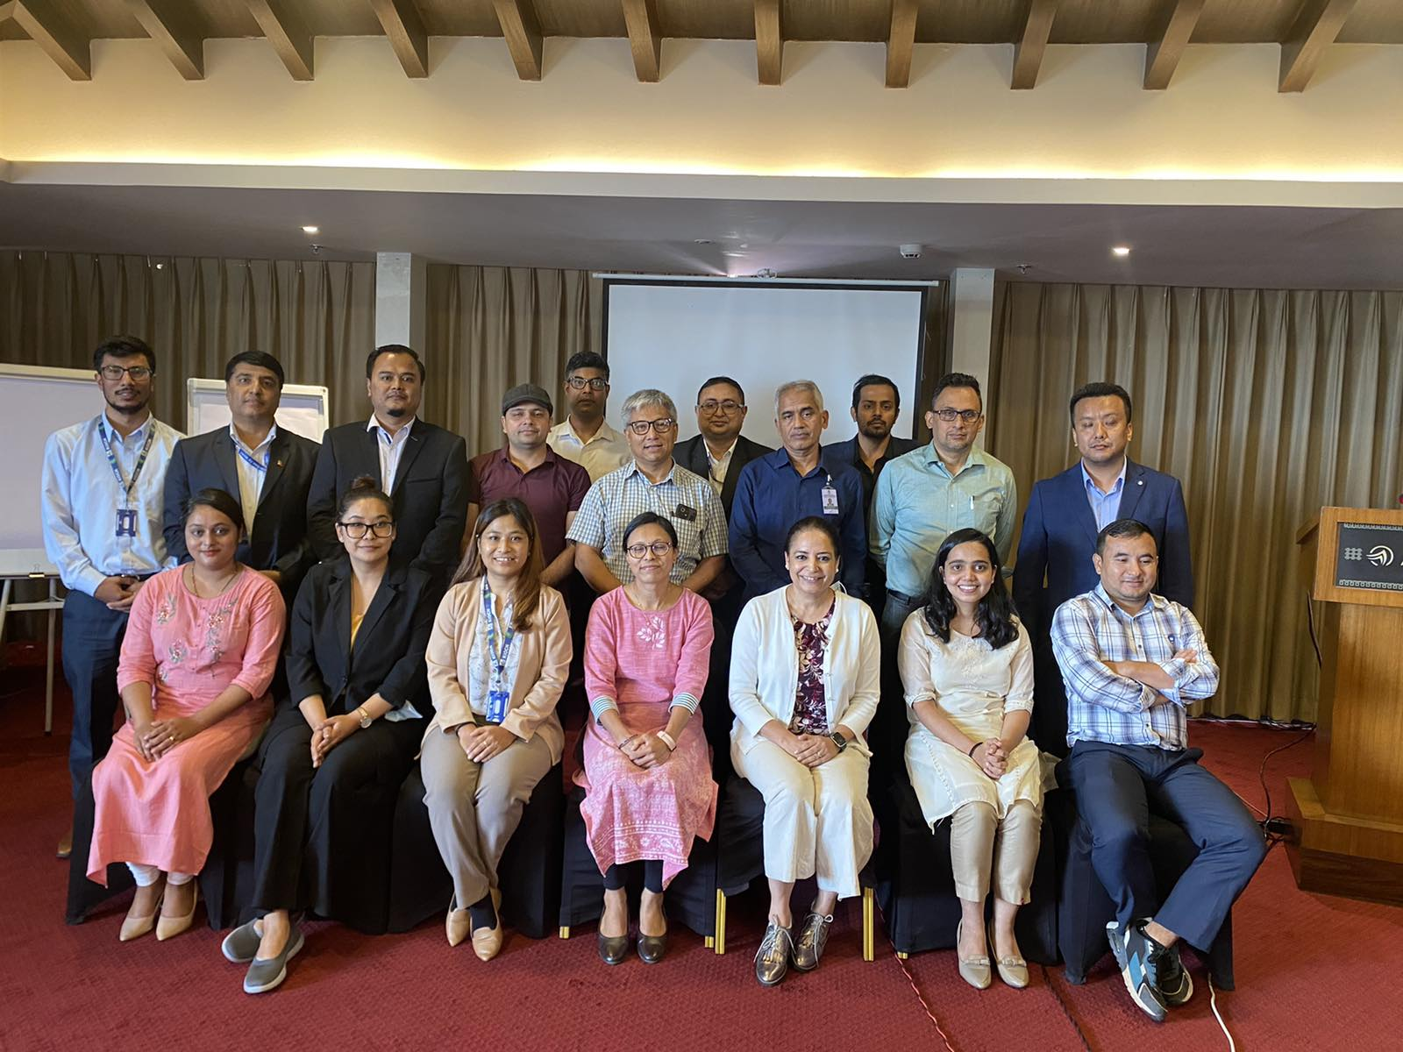
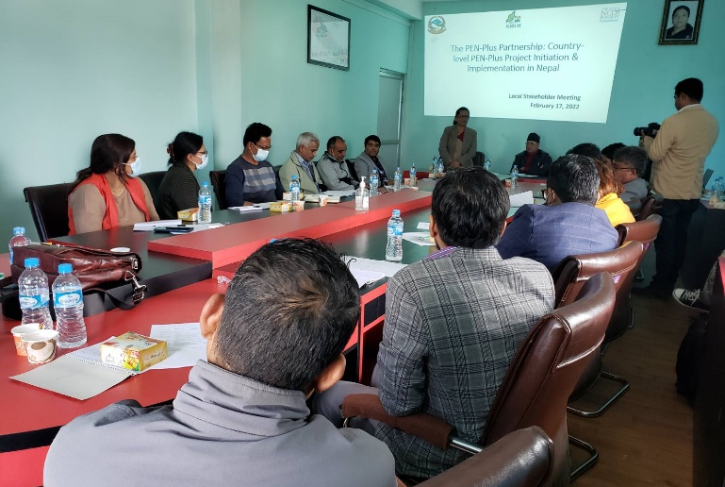
Looking Ahead: Next Steps for Scale-up and Financing
Detail costing and outcomes from the six initial sites
Develop Nepal National Operational Plan for PEN-Plus
Human resource strategy
Medications and equipment forecasting
Monitoring & evaluation plan
More focused fight against NCDI among children and adolescents leveraged by KIOCH satellites centers in each province
Build sustainable financing plan
Engage whole of government
Align donor financing

Slide 11
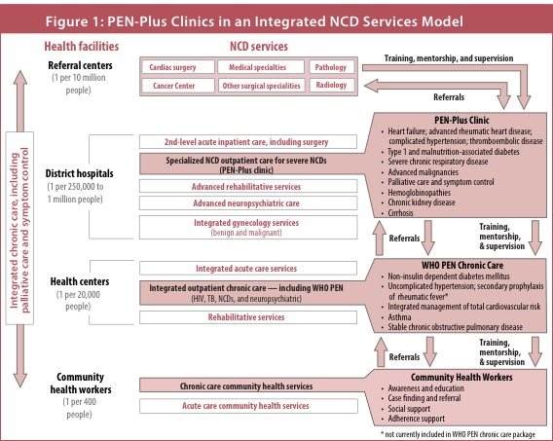
PEN-Plus in Nepal
1. Facility Assessment for Prioritized NCDI Interventions: Availability and Feasibility
2. Time-driven Activity-based Costing Study for Service Integration
Source: www.ncdipoverty.org

Slide 12
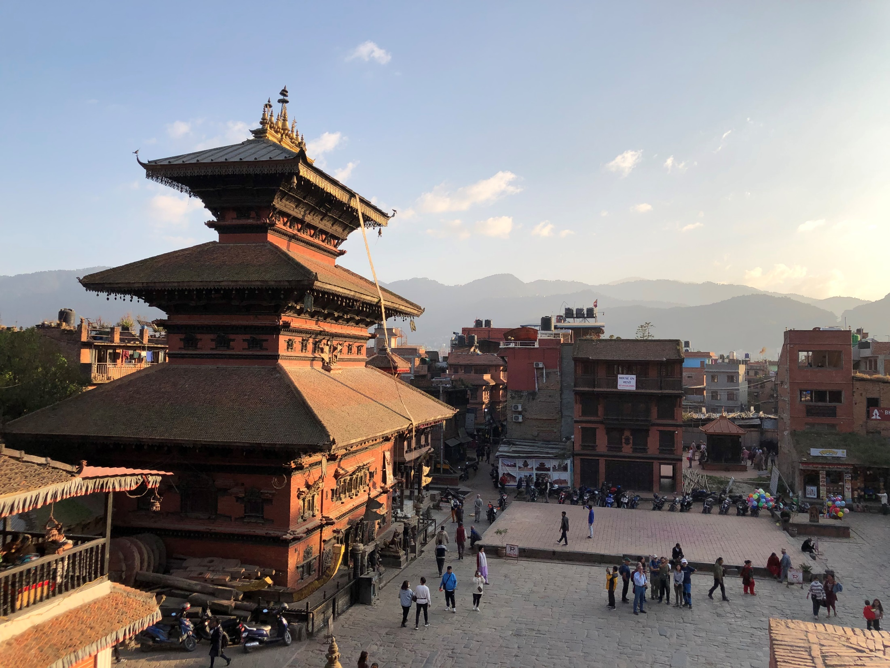
THANK YOU

