Slide 1
Questions about the transition?
Contact your Community Manager

Slide 2
The technology that powers C4D will change to SharePoint

Slide 3
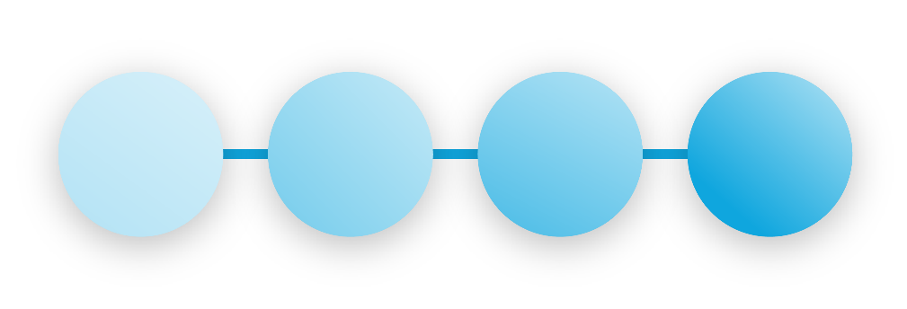
Agenda
Where we are
Preparing for the transition
Post transition
During the transition

Slide 4
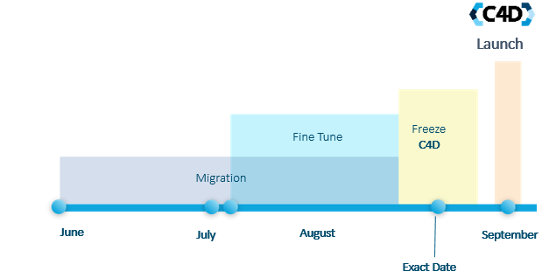
Key Dates to Remember!

Slide 5
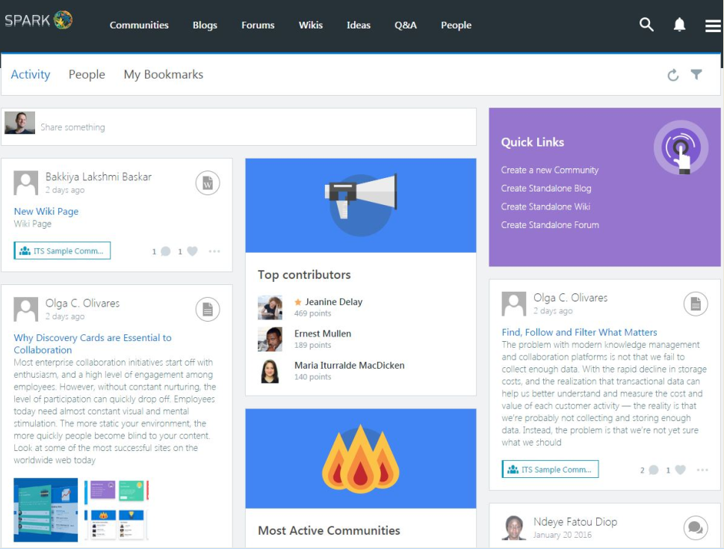
Sleeker Look, Better Mobile

Slide 6
Collaboration Features will Transition
Jive Content
Beezy Content
Documents
Blogs
Discussions
Polls
Projects/Spaces/Groups
Videos
Events
Ideas
Photo album
Categories
Files
Blogs
Discussions / Questions
Polls
Communities
Files/Links
Calendar
Ideas
Tags to categorize photos
Tags

Slide 7
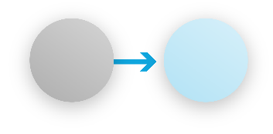
Existing Access Restrictions Will Not Change
Current
New
Open
Public
Members Only
Moderated
Private
Restricted/ Discoverable
Secret
Restricted/ Hidden

Slide 8
What You Need to Know
Some features won’t be available in the updated platform
The new C4D will have an updated, more mobile-responsive layout and look
Some content won’t be migrated to the new platform, and has to be archived prior to migration. If not archived prior to the migration, this content will be lost and cannot be recovered

Slide 9
Dealing With Drafts
The new platform technology does not support drafts. Draft C4D documents will not be migrated and cannot be retrieved after migration.
Action: Please go through your drafts and publish or download what you need.
What if I don’t? Your drafts will be lost.

Slide 10
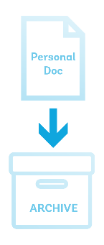
Archive Personal Documents
In the new platform, all content must reside in communities. Personal C4D user documents will not migrate to the new platform.
Action: Please move your personal documents to a community of your choice, or save them to your computer.
What if I don’t? Public/personal documents will be moved to a single community that will house everyone’s personal documents. Private/personal documents will be saved as PDFs and emailed to their owners. Current historical space and groups’ statistics (#views, #content items) won’t migrate over.
What if I don’t? Your historical data will be lost.

Slide 11
All Users Must Register
The new technology requires all users to register before viewing a site. C4D communities will show up in Google results but won’t be accessible to users until they go through registration.
Action (Current “Members Only” groups only): Please notify your users that they must register to view their site after the updated platform goes live.
What if they don’t? They won’t be able to navigate C4D sites.

Slide 12
Features That Will Go Away
Projects, Spaces and Groups Will Become Communities. The new technology does not support projects as a separate collaboration vehicle. All projects will become communities where members have assigned tasks.
No Direct Messaging. Just use your e-mail.
No Creating Content by E-mail. This feature may be available with the next release.
Selective Editing and Document Sharing. In the new platform, users will no longer be able to share or co-author discussions or documents with user-selected group of people.
Space-Subspace Relationship. In the new architecture, all communities will exist in a flat hierarchy where communities can be related but not subordinated to each other.

Slide 13
Key Reminders
Every transition comes with challenges. Things won’t be perfect during the initial stage. Together, we can make the new C4D work for us to collaborate and connect across the World Bank Group.
The project team is committed to supporting you throughout this transition. Please contact your community manager if you have questions, concerns, or would like more information.
Second phase of the platforms enhancements is scheduled for FY17.
We are developing resources to make it easier for you to handle the changes. Stay tuned.

