Slide 1
Municipal Solid Waste | Service Provider Behavior Change | Leveraging Private Sector Finance
Reaching Informal Settlements | Introduction to OBA | Overcoming Common Challenges
OBA in Social Sectors | Support to Local Governments | OBA/RBF Community of Practice
OBA BINGO

Slide 2
INTRODUCTION TO OUTPUT-BASED AID (OBA)
GPSURR Forum 2015
April 2015

Slide 3
OBA Solution Model Snapshot Principles and Funding Rationale
Targeting of Subsidies
Accountability
Innovation and Efficiency
Using Incentives to Serve the Poor
Output Verification and Monitoring
Sustainability
Output-Based Aid is a results-based financing (RBF) mechanism designed to facilitate access to basic services for the poor. Subsidies are payable upon the achievement of agreed upon, measurable results.
OBA Principles
3

Slide 4
Global Partnership on Output-Based Aid (GPOBA) 10+ years of experience in supporting RBF approaches around the world
Total subsidy projects: 42 ($208m)
Total pipeline projects: 3 ($24.6m)
Technical Assistance/
Dissemination activities: 175 ($21 m)
Beneficiaries: Over 8 million
Subsidy portfolio
(active/closed)
Pipeline Technical PforR
Assistance support
4
Notes:
Story line → Provide a bird’s eye view of GPOBA’s reach, including closed and active subsidy projects, pipeline under preparation, TA, and PforR support
*Striped countries signify where GPOBA has multiple activities, i.e., subsidy project + PforR support

Slide 5
Portfolio of Activities: Sectors & Regions
Subsidy Grants Portfolio ~ $208 Million
5

Slide 6
Typical Project Structure
GPOBA/World Bank
Options for pre-financing:
Community/user contribution
Working capital
Loan finance
Supplier credit
Other donor financing
The IVA can be:
Audit firm
NGO or civil society representative
Qualified individual consultant
Independent government agency
Grant Agreement
Government
Examples of outputs:
Household connection to network
Infrastructure improvements related to access to basic municipal services
Implementing agency
Reimbur-sement
IVA reports to implementing agency
Service Provider 1
Service Provider 2
Pre-finance
Independent Verification Agent (IVA)
Verifies outputs
Outputs (Services for consumers)
Back to Bingo!
6

Slide 7
Output-Based AID (OBA) in Solid waste management
GPSURR Forum 2015
April 2015

Slide 8
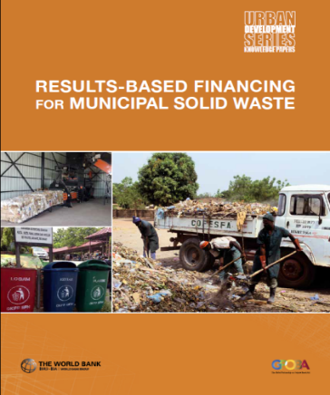
OBA Schemes can address challenges across the SWM Value Chain
Disposal
Energy Recovery
Generation
Growing urban population
Collection/ Transport
Low SWM collection rate
Poor organic waste diversion
Unsanitary dumping & open burning
Untapped opportunity for energy gen from landfill gas
Recycling/
Organic diversion
Severe environmental impact
Low capacity to operate sanitary landfills
Low WTP for collection
Poor SWM planning
Opportunities for informal sector
Experiences of RBF in SWM Areas of Intervention
Improving Service Delivery and User Fee Collection
Nepal (GPOBA)
West Bank and Gaza (GPOBA)
Source Separation and Recycling
Indonesia
Waste Collection and Transport in Underserved Communities
Tanzania
8

Slide 9
Nepal SWM Case Study Improving Service Delivery and User Fee Collection
Challenge
Outputs
< 50% waste collected & most informally dumped
Low revenue collection by municipalities
Subsidy disburses against:
1: Improved service provision (cleanliness, recycling, collection practices)
2: Increased revenue collection
OBA solution
OBA subsidy for low-income municipalities to improve SWM service
Reducing subsidy is replaced by user fees over time
Assumes WTP increases with visible improvement to service coverage & delivery
Back to Bingo!
9

Slide 10
ENCOURAGING BEHAVIOR CHANGE TO IMPROVE SERVICES FOR POOR COMMUNITIES
GPSURR Forum 2015
April 2015

Slide 11
Overview
OBA/RBF – An instrument to achieve Behavior Change
Desired behavior
Local Context
Behavioral
Change intervention
Results
Lessons
OBA/RBF
Theory of change:
information & incentives can change organizational behavior
Waterfall effect:
when organizations change behavior, individuals may change as well
11
Notes:
This behavior change example is based on the Kenya Community Water Schemes
See the OBApproaches and Lessons Learned Notes

Slide 12
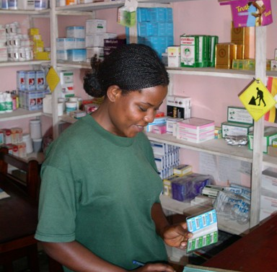
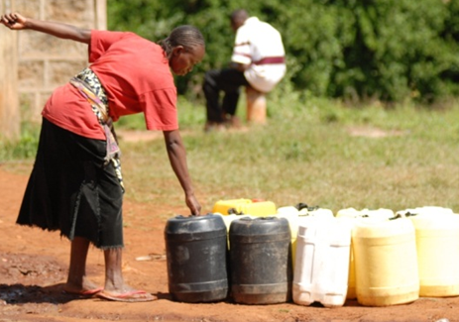
Increase available funding for basic services
Desired Behavior
Commercial lenders
To provide financing on reasonable terms for improvements to community utility schemes
12

Slide 13
Local Context: What Banks Were Thinking
Local Context
Utilities serving poor communities
Therefore not creditworthy
Mental Model
Based on intuition and superficial
observations
13

Slide 14
Behavioral change intervention
Behavioral change intervention
Change
Action
Behavior
Incentives to Communities
Information to Lenders
Social thinking
Partial Subsidy
Community Investment
Theory of change
OBA/RBF – uses incentives & information to change behavior in Lenders and Communities
Better understanding & analysis
Funding for projects
Capacity building & shared
incentives create trust
e.g. use of safe water sources
14

Slide 15
Results
Results
1. Kenya : Community Water Trust Projects
$3m = $7m
$1 = $2 to $10
$3m subsidy leveraged an additional $3.4 m in debt & $1.2m in community equity, making $7.2m available for projects
Each $1 invested yielded $2 - $10 in economic benefits to the local communities (>supplementary income)
Behavior Changed
Banks started lending
Communities invested in themselves
Organizational change led to individual change
2. Waterfall effect
System improvements meant increased reliability, therefore more households participated & turned away from unsafe water sources.
15
Notes:
See Lessons Learned” Lesson #1
See also OBA Approaches Box 1: Karaweti Water Project

Slide 16
Lessons
Lessons
Subsidies can leverage additional financial resources from banks to make pro-poor investments viable & attract equity from local communities
Significant technical support is needed to educate lenders, communities and small utilities. Instead of one-off support, could be institutionalized to benefit future projects.
Adjust to local context, even more important with national scale ups
Back to Bingo!
16
Notes:
See Lessons Learned – Lessons #4 & 5

Slide 17
LEVERAGING PRIVATE SECTOR FINANCE
GPSURR Forum 2015
April 2015

Slide 18
OBA can leverage commercial finance to make pro-poor investments viable
Creditworthy service providers borrow to implement viable infrastructure projects
OBA reduces lender credit risk by providing cash on implementation of project
Example model:
Service provider pre-finances investment and provides service to poor beneficiaries
Upon achievement of pre-agreed outputs, GPOBA provides OBA subsidy to service provider
Commercial bank provides loan to service provider after due diligence
OBA subsidy is swept into loan account
→ reduces loan repayments
→ Keeps tariffs affordable
Sustainable operation: SP generates revenue to cover O&M costs and repay loans
18

Slide 19
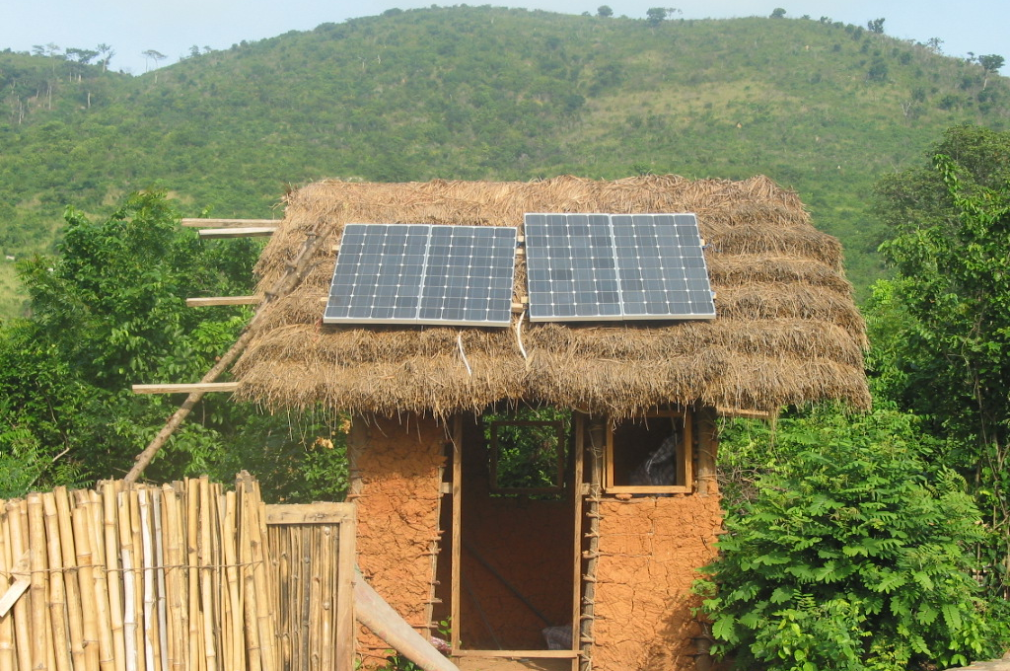
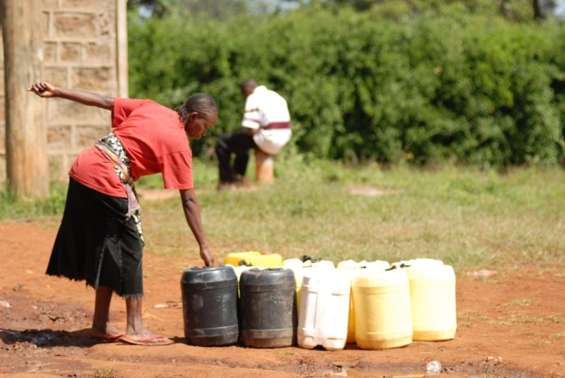
Examples
KENYA
COMMUNITY
WATER
GHANA
SOLAR HOME
SYSTEMS
$2.5m subsidy for community water systems helped access $3.5m in medium-term loans & raised $1.2m in community equity
Provided access to 190,000 people
National scale-up $16m OBA to leverage $25m in commercial bank loans for water + sanitation
$4m in subsidies finance up to 50% of solar products in rural areas
Remainder financed through loans from rural banks, subsidiaries of ARB-APEX bank
15,000 solar lanterns and solar home systems
85,000 beneficiaries
Back to Bingo!
19

Slide 20
REACHING INFORMAL SETTLEMENTS
GPSURR Forum 2015
April 2015

Slide 21
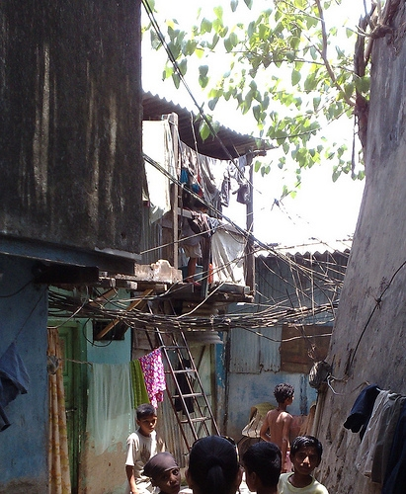
Informal Settlements
Challenges to service provision
Challenges to informal/slum service provision:
Precarious tenure status of slum dwellers
Lack of incentive to serve these areas
21
Notes:
Tenure status of slum dwellers: many ineligible for formal HH connections by law
No guarantee that dwellings will be safe from demolition
Service providers may lack legal or regulatory authority to serve informal areas
Lack of incentive to serve such areas for fear of low uptake or high risk investment

Slide 22
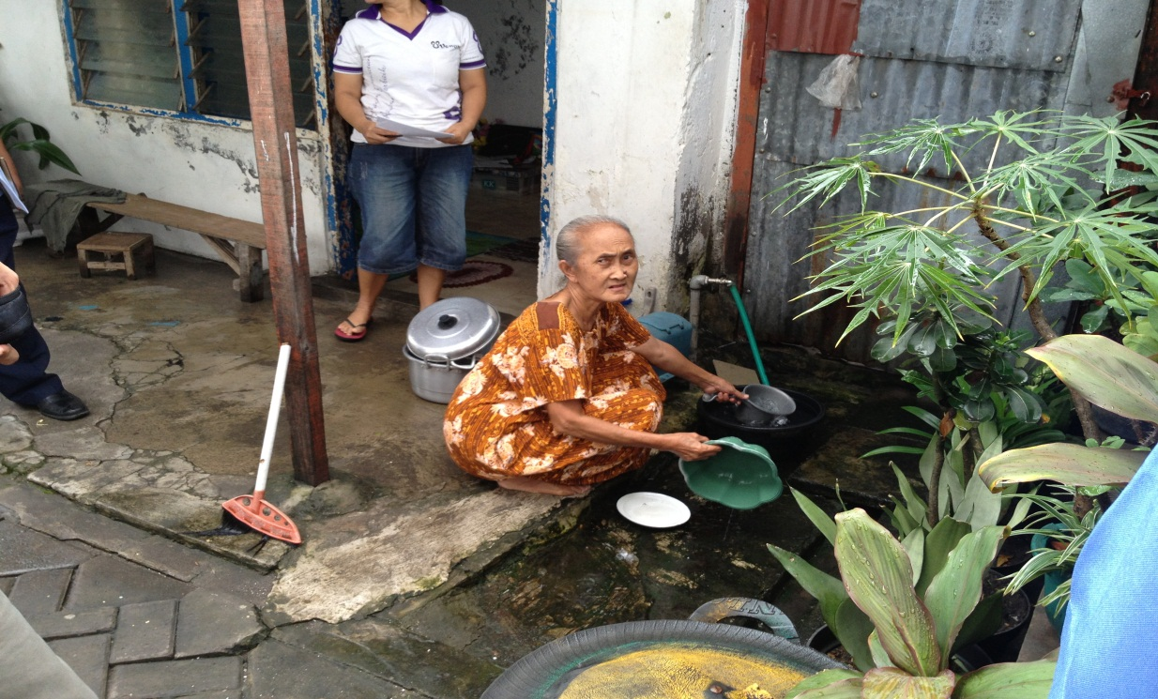
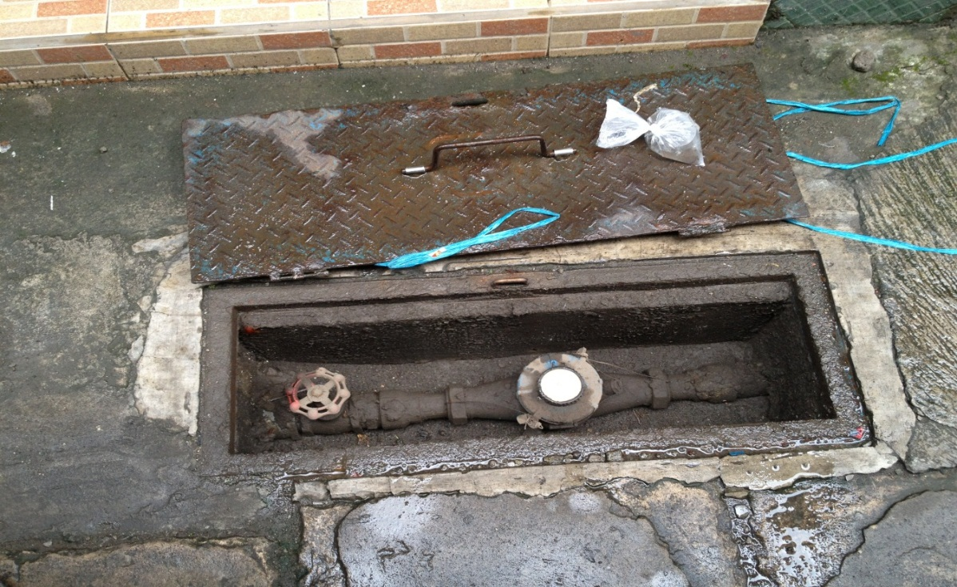
Intervention close-up
Surabaya water: micro-meters for informal settlements (OBA $2.41 million)
“Master meter” approach applied in informal communities to alleviate legal constraints
Service provided through bulk supply, whereby utility asset ownership stops at the community entrance
Scale-up by the Gov’t of Indonesia, DFAT and USAID: “Hibah” National Water Program
22
Notes:
In Surabaya, an OBA scheme introduced an innovative “master meter” approach to account for informal communities and alleviate the legal constraints in expanding services to areas were residents lack a legal land title
Service is provided through bulk supply, whereby utility asset ownership stops at the entrance to the community. This enables communities to manage their own distribution networks, metering, billing, and collection
Based on the project’s success and demonstration of the merits of OBA in expanding services to the urban poor, the approach has been scaled up by the Gov’t of Indonesia, DFAT and USAID through the National Water Program “Hibah”

Slide 23
Intervention close-up
Kenya electricity: illegal connections (OBA $5.15 million)
Illegal connections → utility losses, public safety risks, extortion and gang behavior
Back to Bingo!
23
Notes:
In Kenya, Illegal connections were causing losses for the Kenya Power & Lighting Company (KPLC), posing public safety risks, and encouraging extortion and gang behavior
The OBA slum electrification scheme introduced design innovations to improve sustainability and decrease the threat of theft and tampering, including:
Switching to concrete poles, which cannot be climbed as easily
Using a medium voltage line that is difficult to access illegally as the main feeder line across the communities
Using small transformers on each pole to step down the voltage to distribution levels for a small number of HHs
Using split pre-paid meters so most of the equipment is on the pole instead of in the HH
Limiting the need for house wiring through the use of ready-boards

Slide 24
Overcoming Challenges in oba projects
GPSURR Forum 2015
April 2015

Slide 25
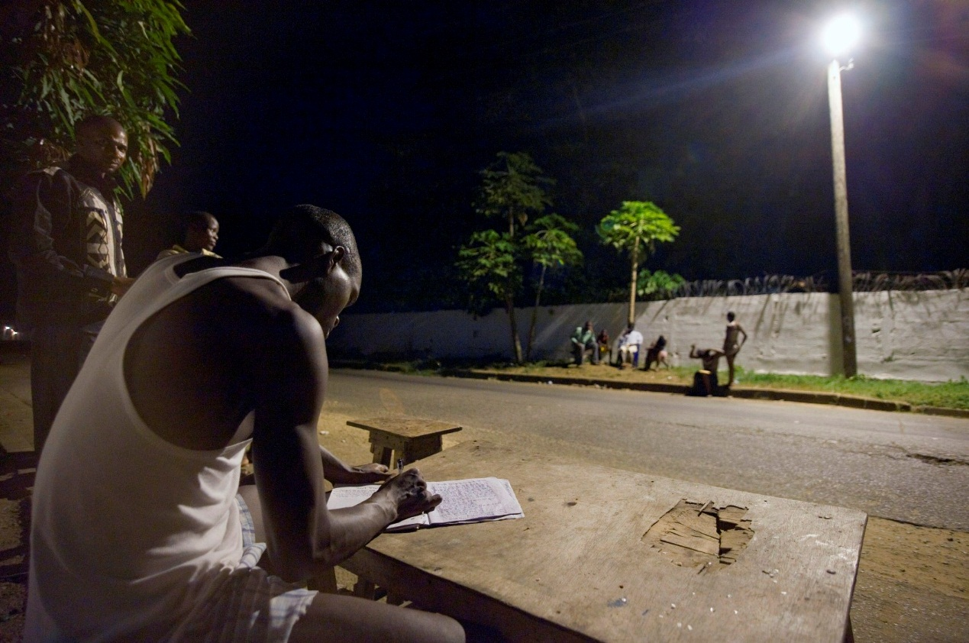
Risks: Overcoming Challenges in OBA Projects
Access to finance
Where service providers cannot access capital to pre-finance investments, OBA is not an ideal financing mechanism.
Possible solutions:
Supplier credit
Credit guarantee
Donor funded revolving fund in FCS
Photo: United Nations
25
Notes:
In Liberia, the Norwegian government provided capital for a revolving fund to pre-finance works under the OBA project, as the environment was not conducive for Manitoba Hydro to raise pre-finance capital.

Slide 26
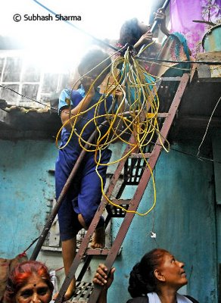
Risks: Overcoming Challenges in OBA Projects
Financial incentive
Insufficient financial incentive for service providers to adopt OBA as a tool to expand access can considerably slow project implementation.
Build in financial incentives for firms to implement projects & ensure positive IRR and ERR
26
Notes:
Ethiopia electricity – weak incentives to connect the poor under GPOBA program after 2 year of moratorium on connections caused by the generation crisis. Significant backlog of normal connections (0.5 mil)
Actions:
-intensive dialogue with the Government to connect under GPOBA for grant extension closing date
-change in the subsidy disbursement schedule from connections/3 billing cycles 50/50 to 80/20
Kenya water lessons learned
Strategic grant can leverage commercial capital
Economic returns for $2-$10 for every $1 invested
Repayment performance is good because of strong customer WTP and project ownership
Commercial lender preference for urban/peri-urban model, especially with WSPs
Quickly implementable projects with large # of customers performed best
Simplify the output targets (Revenue target was not fully achieved)

Slide 27
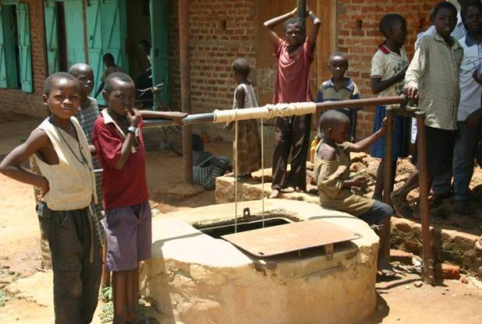
Consumer ability to pay
Consumers must have sufficient willingness and ability to pay for services that can cover provider costs over the long-run
Check:
WTP user contribution towards CAPEX
WTP & ATP for on-going services
Back to Bingo!
27
Notes:
Bolivia – hh WTP underestimated at project preparation. Municipalities and departmental governments shared the hh contribution during project implementation

Slide 28
SUPPORT TO LOCAL GOVERNMENTS
GPSURR Forum 2015
April 2015

Slide 29
OBA for urban services
Challenge: Can OBA improve access to urban services e.g. slum upgrading
Context: LG provides various services to low-income areas
Problem: Lack of funds or incentive to extend services to low-income HHs
Criteria: LGs collect user fees, may receive CG transfers & covers its operating costs
Additionality to Bank projects: Additional funds for excluded low-income groups e.g. IDPs, strengthens accountability by paying against results, covers last mile costs up to and inside the HH
OBA subsidy disbursed upon outputs:
Desired outcomes:
Services provided to targeted new users
Sustained service (3-6 mos)
LGs reimbursed for partial capex
Improved access/quality of services for the poor
New customers & greater revenue for the LG
29
Notes:
Context: LG provides a host of services to low-income areas e.g. water, electricity, sanitation, street lighting, SWM, roads, etc

Slide 30
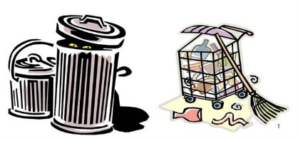
Sample mechanism
OBA subsidies
New users
Increased revenue collection
Improvement in O&M cost coverage
Local Government
Services x users x fees
New services
Output 1 → + users of basic services → as a measure of improved access
Output 2 → + revenue collected by LGs → as a measure of financial sustainability

Slide 31
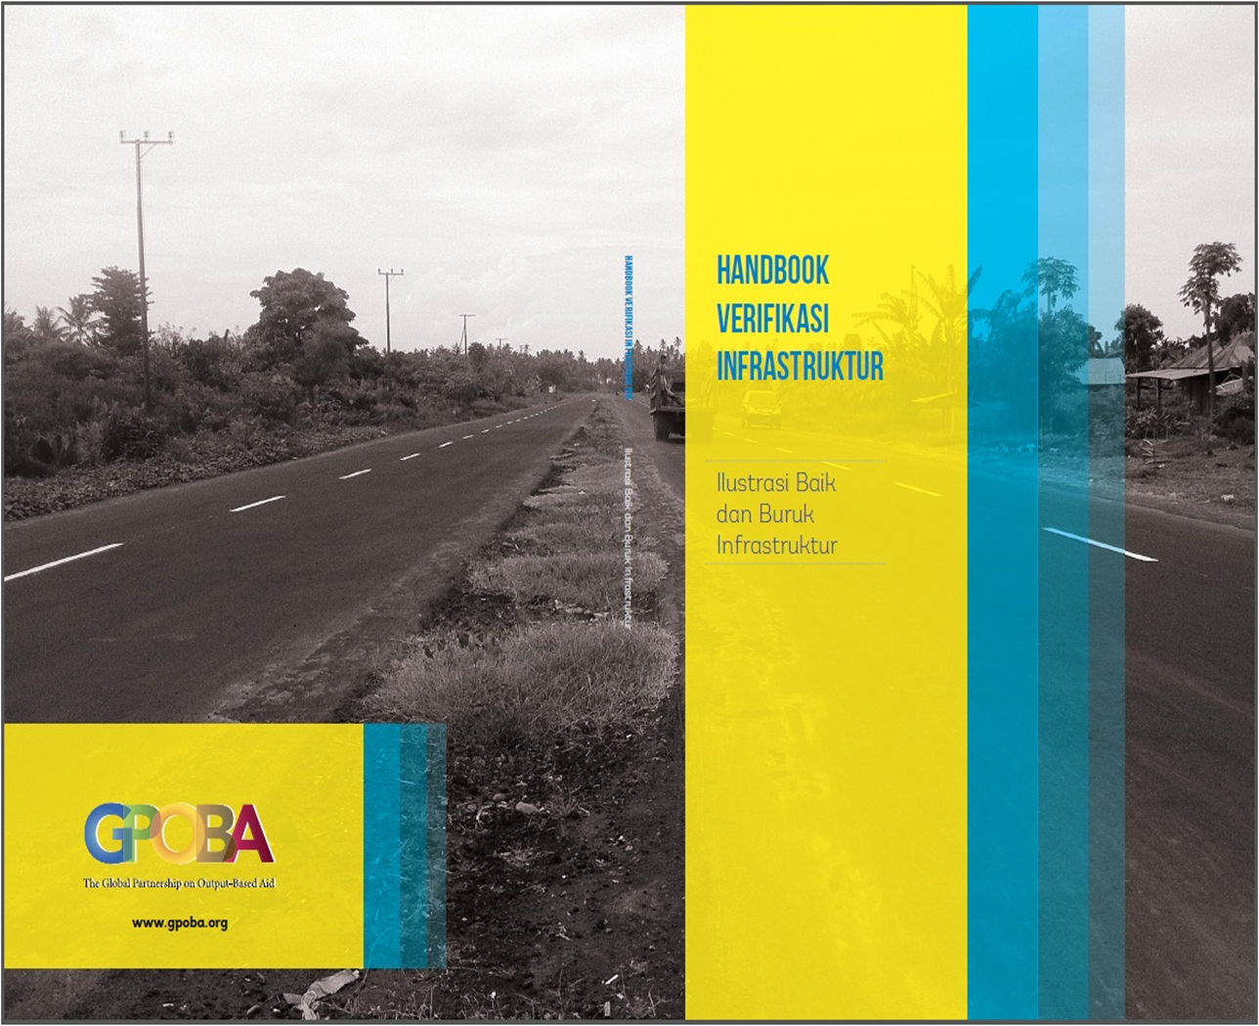
Technical Assistance Indonesia: Supporting Government Independent Verification
IBRD loan for output-based disbursements from central government to local authorities for basic infrastructure
Audit Board (independent public institution) verifies physical deliverables against which disbursements are made
GPOBA TA ($780K) supports public auditors’ build capacity for technical verification of outputs, and helps civil society monitor deliverables by the local governments
213 verifiers from 15 provinces received training on technical protocols and RBF in general
Back to Bingo!
31
Notes:
basic infrastructure includes roads, irrigation, water and sanitation

Slide 32
OBA IN SOCIAL SECTORS
GPSURR Forum 2015
April 2015

Slide 33
OBA in Education
Scoping study of OBA in education & fit with RBF universe
Evidence from 24 OBA projects
Outputs: enrollment rates, teacher or student attendance rates, test scores, promotion rates, training completion, exam participation
Subsidy: for delivery of education services; incentive payments
Innovation and efficiency: when providers were given autonomy, they invested more effort into improving student performance
33

Slide 34
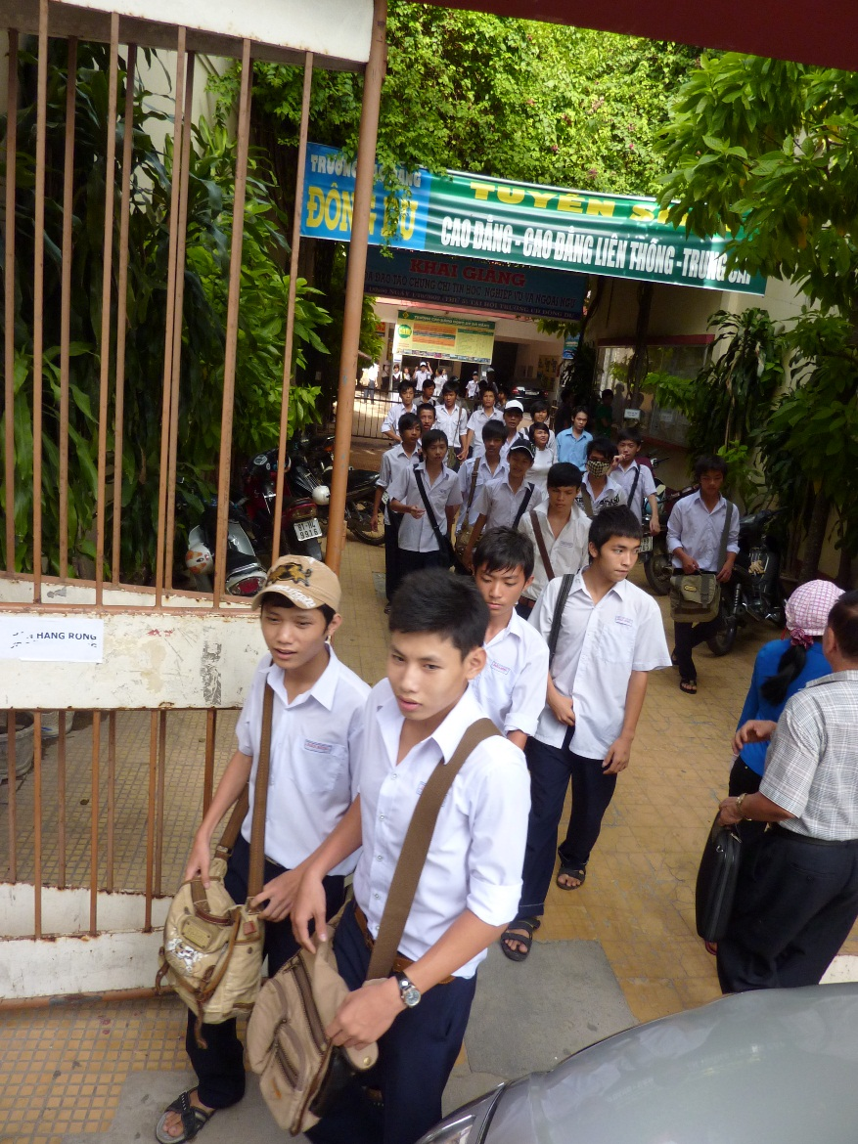
OBA in Education: Vietnam secondary-school project
Improves access to quality upper secondary and professional education for poor students, strengthens student performance
School fully pre-finances tuition for targeted students
Outputs for subsidy reimbursement → Continued enrollment, attendance and exam scores at end of each term
34
Notes:
Over the last 20 years, Vietnam has achieved nearly universal primary and lower secondary education. However, approximately 20 percent of lower secondary students do not make it to high school, and 45 percent drop out from lower secondary school. There are still major disparities between advantaged and disadvantaged children, linked closely with factors such as gender, ethnicity, and household income. Drop-out rates among disadvantaged groups are high, generally because of economic hardship or low student performance.
In 2010, GPOBA signed its first grant in education to improve access to quality education for low-income students and strengthen student performance in upper secondary and professional secondary schools. GPOBA’s subsidy funds tuition for targeted students admitted to the participating schools, covering 55 to 84 percent of the total cost of school. The user contribution from families entails all school-related expenses aside from tuition, including insurance, materials, travel, and lodging.
The project identifies beneficiaries by targeting poor provinces and relying on the “certificate of the poor” (an existing state proxy means-testing mechanism). Priority is given to students certified by the state as poor, disabled students, Agent Orange victims, orphans, and economically disadvantaged students from ethnic minority groups.
Under this scheme, the East Meets West Foundation (EMWF) serves as the implementing agency and grant recipient. The schools, which bear the performance risk by fully pre-financing tuition for these students, are later reimbursed upon verification that students maintain enrollment with an adequate attendance record, and achieve a passing grade at the end of each term. Standard exams are given to assess student performance and the quality of education provided.
EMWF also bears pre-financing risks and has the incentive to minimize implementation costs, as built into the scheme. The Foundation must pre-finance half the variable operational cost, and is reimbursed only agreed outputs have been verified. In this way, EMWF is also incentivized to help participating schools perform.
The project had considerable impact on the enrollment of disadvantaged students at targeted schools, increasing enrollment by nearly 20%. The GPA of beneficiary students increased on average from 5.95 in 2010/11 to 6.06 in 2011/12 to 6.33 in 2012/13. The pilot demonstrates that applying the OBA approach to education not only addresses the issue of access, but can also improve learning outcomes.

Slide 35
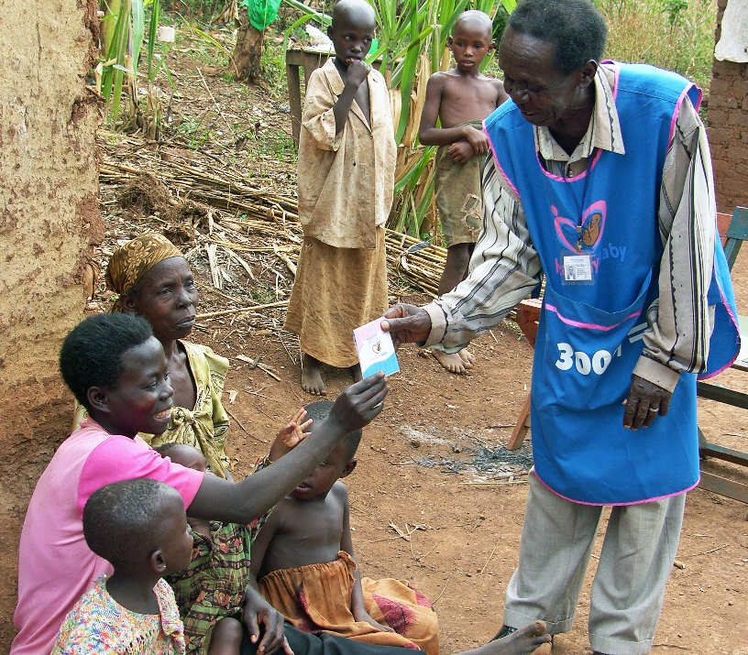
OBA in Health: Uganda Reproductive Health Voucher Program
Voucher → pre-natal visits, safe delivery, post-natal visit, couple STD screening
Targeted users pay small fee to obtain voucher
Health care providers reimbursed remaining service cost through OBA subsidies after service delivery
Project scale-up signed 2014 to expand program and establish OBA voucher scheme under MoH
Back to Bingo!
35
Notes:
About 435 women die per 100,000 live births in Uganda due to lack of access to health service facilities and professional health care, a 2006 study found. The majority of women still rely on traditional birth attendants with little or no formal training. Uganda’s decentralized health system has left rural areas poorly resourced; some expectant mothers must walk more than nine miles to the nearest health facility.
In 2008, GPOBA launched an OBA voucher scheme, in partnership with KfW, to bring maternal and other reproductive health services to rural communities in western Uganda. The voucher system was used as a means to stimulate demand for facility-level health care services among those who were less likely to seek care without a subsidy, by giving them purchasing power to seek care from a wide range of available providers.
The outputs in this project consisted of a safe delivery package of four prenatal visits, a delivery attended by a trained medical professional and one postnatal visit, or a screening and treatment of sexually transmitted diseases (STDs) for couples. Users paid the equivalent of $1.30 per voucher for a safe delivery package of services costing from $70 to around $100 for a complicated delivery, and $0.65 per couple for STD- related treatment services costing $11. Marie Stopes International (MSI) Uganda was contracted as the voucher management agency (VMA) to supervise overall operational management. Service delivery was contracted out to accredited, private, local clinics to offer services in exchange for prepaid vouchers. Once approved services had been delivered, service providers submitted claims for reimbursement to MSI-Uganda.
Important innovations in this project included the use of mobile phones to increase efficiency and communicate with voucher service providers, as well as the locally created and maintained referral system. Providers initially faced challenges in providing effective referrals. Together with the service providers, the VMA addressed this by establishing a network of emergency care providers in two sub-regions. In one sub-region, a community group organized motorcyclists to transport mothers to the hospital for delivery.
After four years, the project succeeded in safely delivering around 66,000 babies and providing STD treatments to 32,000 couples. The project received recognition and awards from both the World Bank’s Vice President for Africa and the IFC. Having provided evidence of successful results, the scheme is being scaled up by the Ministry of Health to expand the voucher program to rural communities and other districts of Uganda, as well as to build national capacity to mainstream voucher management functions.

Slide 36
GPSURR Forum 2015
April 2015

