Slide 1
Indonesia Experience in Improving Transparency and Reporting
Bambang Utoyo
Director for Monitoring of Regional Finance
Arief Tri Hardiyanto
Head of BPKP Representative of Banten
BPKP
Government of Indonesia

Slide 2





Indonesia Supervisory Structure
  PRESIDENT
  VICE PRESIDENT
  Parliament
  Supreme Audit Board
  GOVERNMENT
  LOCAL BUDGET
  Central & Regional Office
  STATE BUDGET
  Province / City / Municipal
  Ministries and National Agencies
  Perform the internal supervisory
  Function on state financial
  accountability under
  the Presidential Instruction
  Local Secretary
  Inspectorate
  Inspectorate
  General
  Deputy
  Minister
  Local Program & Priorities
  National Program & Priorities

Slide 3

Role of BPKP and Arrangements for DAK output verification
Role
As the GOI’s internal auditor, the use of BPKP in LGDP promotes sustainability
Create baseline for output verification of the GOI’s transfer funds for infrastructure sectors and possibility for replication to other sectors and other types of transfers
Scope of Assignment
Task 1. Conduct output verification and the report.
Task 2. Recommend the reimbursement amount based on eligible outputs.
Task 3. Provide information to Project Indicators (Results and Outcome).
Instruments
Commitment Letter
Sent by the participating LGs to Ministry of Finance.
Verification checklist
List the 4 (four) aspects of verification.
Reference Unit Costs (RUC)
List the eligible work items and its unit price.

Slide 4
Involvement of substantial resources
# of representative offices:
22 of 34 representative offices
# of auditors:
783 of 3,704 auditors
Auditor qualification:
Accountant (in general) with technical support from MPWH
# of trained verifiers:
350 verifiers

Slide 5

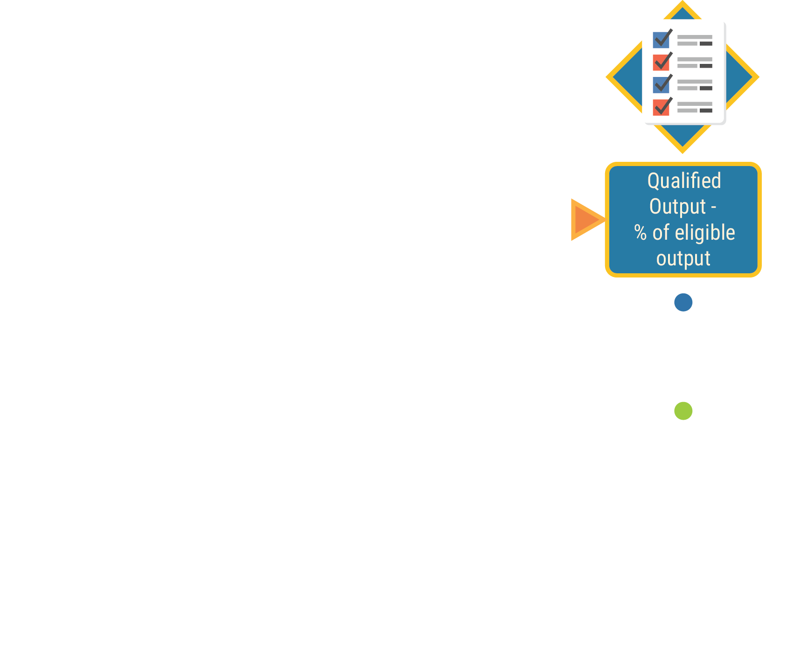






Steps of Output Verification

Slide 6
Retaining Output Verification Quality
Capacity Building
Institutionalization of the verification mechanism within BPKP and capacity building for all BPKP representatives at the Provincial level.
Possible replication of BPKP verification of outputs to other institutions within the GOI, e.g. the Supreme Audit, and Local Treasury Unit
Involve line ministry (MPWH), Inspectorate General (IG) of MPWH, and/or consultants for technical and safeguards specialists for quality assurance.

Slide 7
Retaining Output Verification Quality
Organization and Resources
BPKP developed a Verification Manual as a guidance for auditors of BPKP Province Representative Offices (LG level) in verifying the project outputs.
The Verification Manual is disseminated to the audit team at the beginning of the year
Establish a national level task force to oversee and validate the Verification Output functions

Slide 8



Benefits of Having BPKP
Output Verification Report
BPKP Central Office
Analyze internal control status of Local Governments
BPKP Regional Offices
Provide Management Report and recommendations for Local Govts
Ministry of Finance
Policy decision on the allocation of DAK infrastructure and implementation analysis
Ministry of Public Works and Housing
Review performance of local governments on the implementation of DAK infrastructure
Ministry of Home Affairs
Evaluation on online reporting effectiveness (using WBRS information) in Specific Purpose Grant

Slide 9
BPKP Competitive Advantage
Capacity building program for BPKP verifiers have internalized in the BPKP Training Curricula
Including e-learning and face to face training methodology
BPKP role has transformed from project auditor to support project implementation
Adaptation of output verification mechanism in other projects, both financed by the World Bank and other donors

Slide 10
Remaining Challenges
The output verification is a component of LGDP project, not a formal government processes
How to scale up the Output Verification become continuous audit and monitoring?
Limited IT support and the facilities to record, process, and analyze the Output Verification information
Expansion strategy for output verification to other sector/ministries

Slide 11
Thanks!
Any questions?

