Slide 1
SOUTH-SOUTH KNOWLEDGE EXCHANGE
LEVERAGING PERFORMANCE BASED FINANCING AND IMPROVING ACCOUNTABILITY
FOR LOCAL GOVERNMENTS
09 – 11, MAY 2017

Slide 2
CONTENTS
Introduction
Macro and Sector Context
Project – Objectives and Expected Outcomes
Strengths and Limitations
The Next Steps

Slide 3
IMPROVING LOCAL GOVERNANCE SERVICE DELIVERY IN SRI LANKA
Sri Lankan Independence and Constitution in 1948
Constitution changed in 1972, 1979 and then 17 amendments
13th amendment brought Local Government under Provincial Councils
Commission of Inquiry on Local Government in 1999 on Local Government reforms
There are 335 Local Authorities
Notes:
50 year period after independence can be considered an eventful era in the history of LG in SL. The Constitution introduced to SL at independence was replaced in 1972 and again in 1978, followed by 17 amendments passed from time to time. The 13th amendment made very drastic changes, introducing a sub-national level administration with legislative powers and LG itself became a subject under Provincial Councils. With LG becoming a function of the PCs, less attention was paid and less assistance given to LAs. With the establishment of PCs, all staff of LAs was absorbed into the Provincial Public Service. As a result, officers of LAs with sound knowledge of LG matters moved to other Departments. Several committees were appointed to examine the performance of Local Authorities. The Commission of Inquiry on LG Reforms in 1999 recommended (i) incorporation of LG into the constitution as a level of Government; (ii) constitution of LG institutions; (iii) re-introduction of ward system; (iv) expansion of powers and functions of LAs; and (v) creation of Code of Conduct for LG. At present, there are 330 LAs and they are mandated for (i) human & physical resources management; (ii) revenue and financial management; (iii) development and physical planning; (iv) road development; (v) public health; (vi) public utility services; (vii) community services; (viii) public participation and social development; (ix) economic activities; and (x)statutory and legal affairs. This shows that the LG system in SL has a good foundation to build upon compared to other countries.

Slide 4
Local Authority Typology
Province | MC | UC | PS | Total
Western | 7 | 14 | 27 | 48
Central | 4 | 6 | 33 | 43
Southern | 3 | 4 | 42 | 49
Northern | 1 | 5 | 28 | 34
North Western | 1 | 3 | 29 | 33
North Central | 1 | 0 | 25 | 26
Uva | 2 | 1 | 25 | 28
Sabaragamuwa | 1 | 3 | 25 | 29
Eastern | 3 | 5 | 37 | 45
TOTAL | 23 | 41 | 271 | 335

Slide 5
Constraints for Local Empowerment
Support System
Weaker support systems at PCs and National level
Lack of exclusive non-government LG support systems
Institutional
Knowledge and capacity issues
Financial management is based on predecessors acts
Untapped potential of LAs
Political Leadership Vs Administrative Superiority
Legal and Policy
Lack of visionary policies
Out dated legal mechanisms

Slide 7
Fundamentals of Sri Lankan LG
LAs are unique entities than other Government institutions
Governed by set of Acts and Ordinances
Different administrative and financial procedures
LG Finance is governed by totally different set of legislations
Inadequate fiscal transfers to Local Authorities for their development
Low service delivery and accountability in linking communities to the State
Three decades of armed conflict stunted local area development in Northern and Eastern Provinces

Slide 8
Project: North East Local Services Improvement
Components
Infrastructure Service Delivery (Fiscal transfers)
Institutionalizing Accountabilities
Building Capacities
Assessment & Evaluation
Project Management
Expected Outcomes
Rehabilitation of destroyed infrastructure
Citizen satisfaction
LAs meeting agreed norms

Slide 9
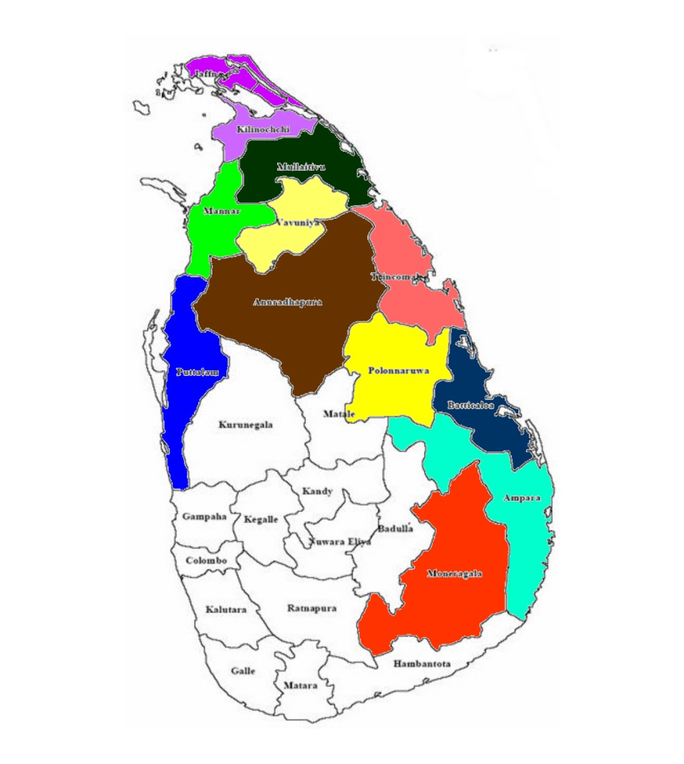
NORTH EAST LOCAL SERVICES IMPROVEMENT PROJECT (NELSIP)
Kilinochchi
3 PS
Jaffna
1 MC, 3 UC, 13 PS
Mannar
1 UC, 4 PS
Mullaitivu
4 PS
Vavuniya
1 UC, 4 PS
Trincomalee
2 UC, 11 PS
Anuradhapura
1 MC, 8 PS
Batticaloa
1 MC, 2 UC, 9 PS
Polonnaruwa
3 PS
Ampara
2 MC, 1 UC,17 PS
Puttalam
2UC, 5 PS
Monaragala
3 PS
Total No. of LAs - 5 MC, 12 UC, 84 PS
PDO: To Support Local Authorities to deliver services and local infrastructure in a responsive and accountable manner

Slide 10
BASIC PROJECT DATA
Bank Approval Date | May 13, 2010
Credit Effectiveness Date | December 15, 2010
Credit Closing Date | August 31, 2017
 | Planned | Disbursed to-date
IDA Credit Amount (Original) | US$ 50 Million | US$ 50 Million
IDA Credit Amount (Additional Financing) | US$ 20 Million | US$ 20 Million
DFAT Grant | US$ 20.3 Million | US$ 20.3 Million
GOSL Contribution | US$ 14 Million | US$ 14 Million
Community Contribution | US$ 2 Million | US$ 3 Million
TOTAL | US$ 106.3 Million | US$ 107.3 Million

Slide 11
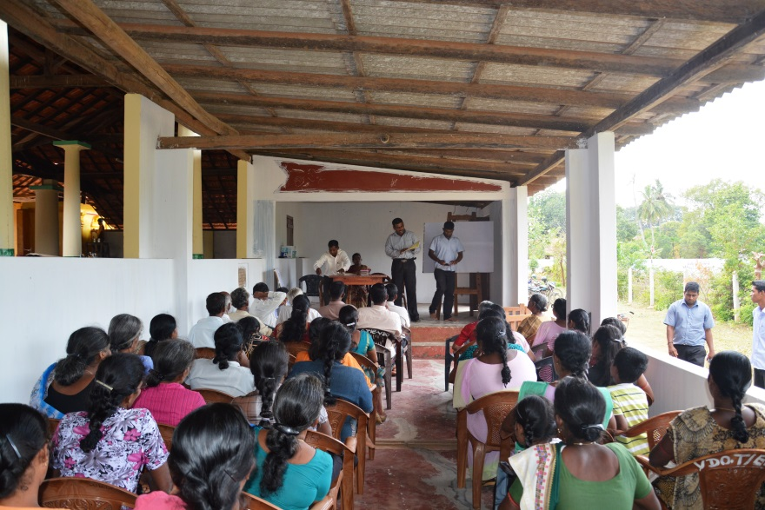
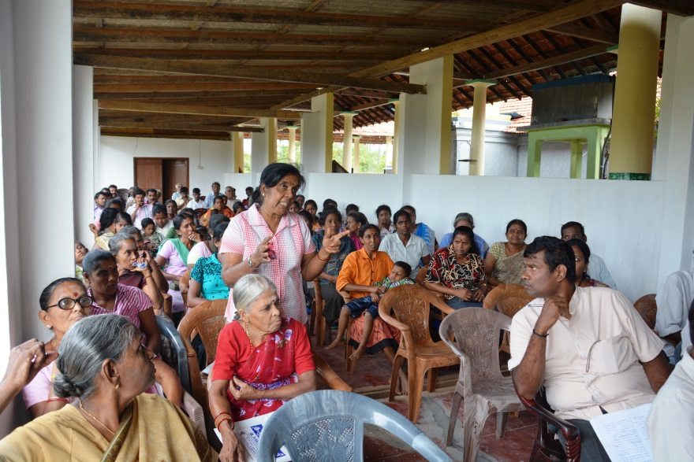
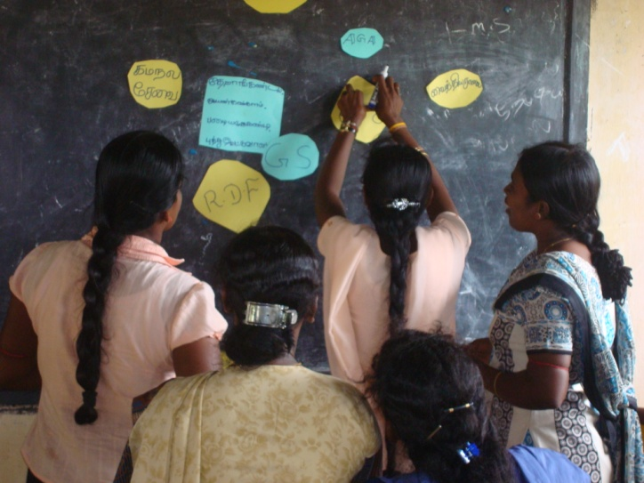
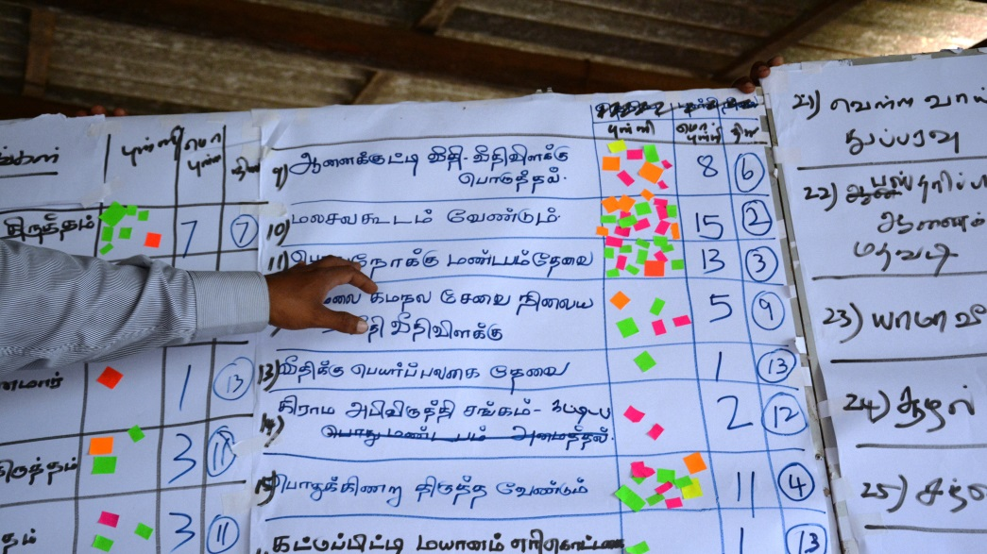
Participatory Planning

Slide 12
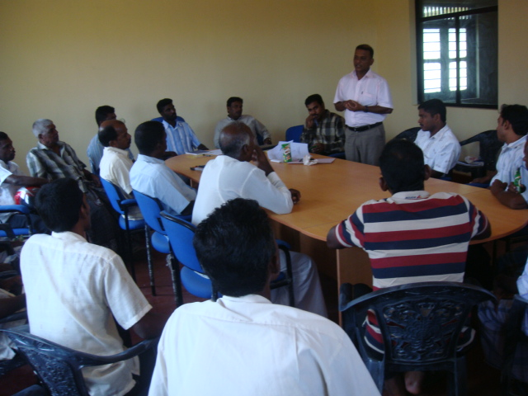
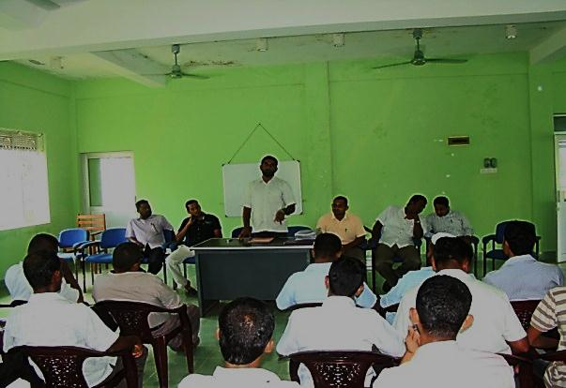
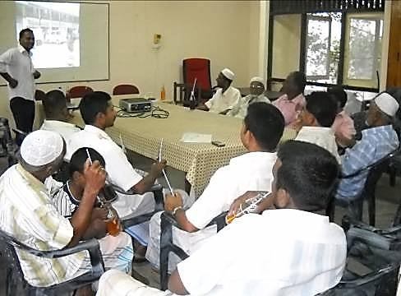
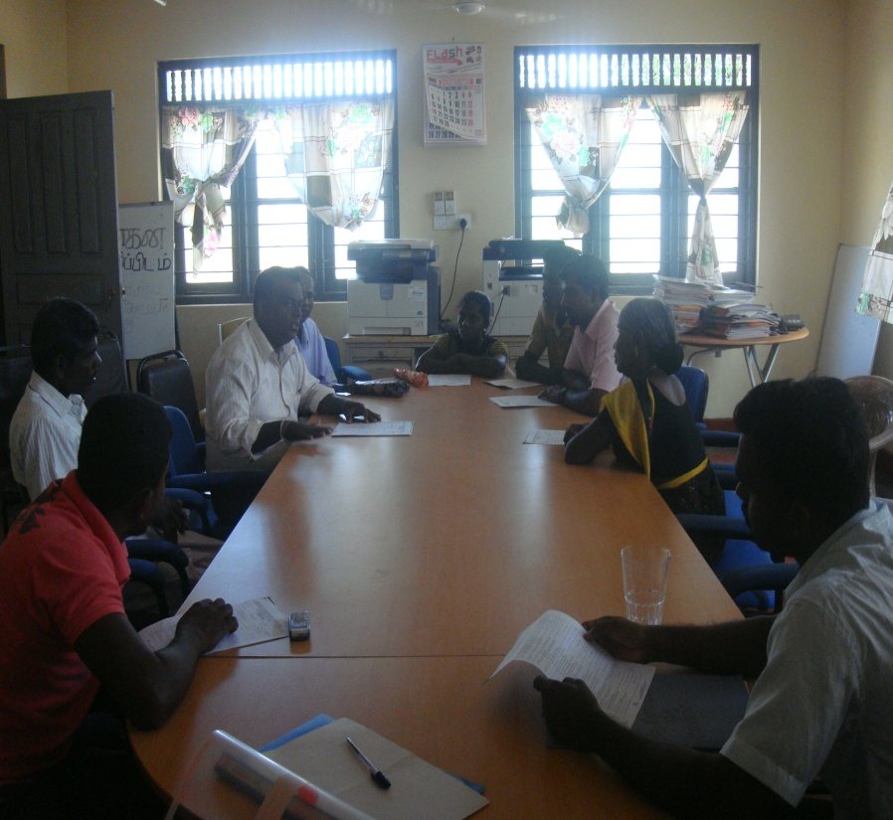
Social Audit Committee (SAC) – Progress Reviews

Slide 13
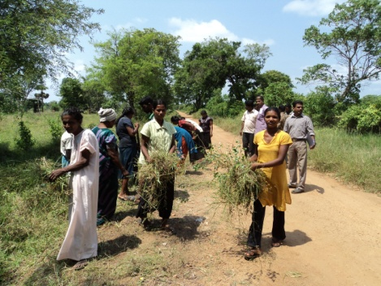
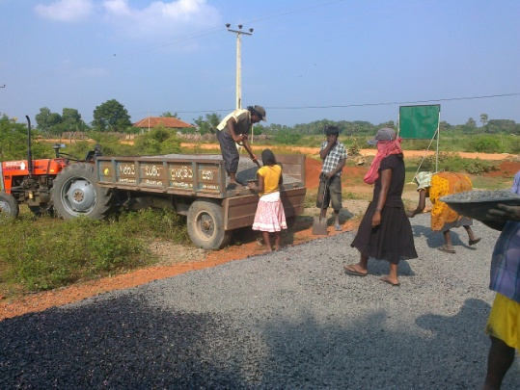
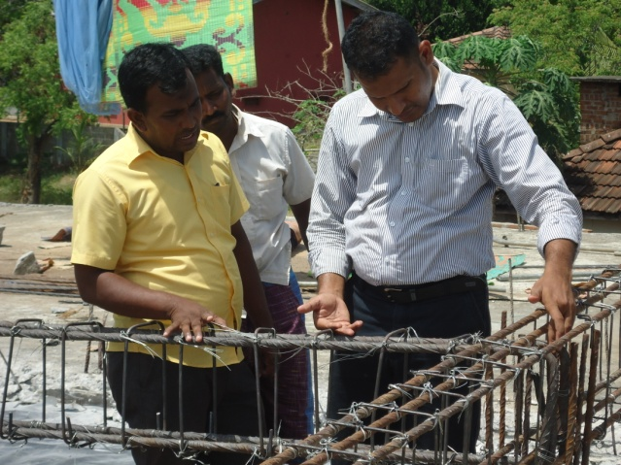
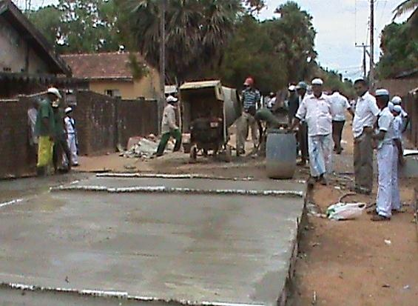
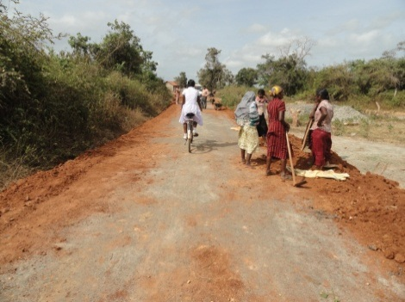
CITIZENS IN ACTION

Slide 14
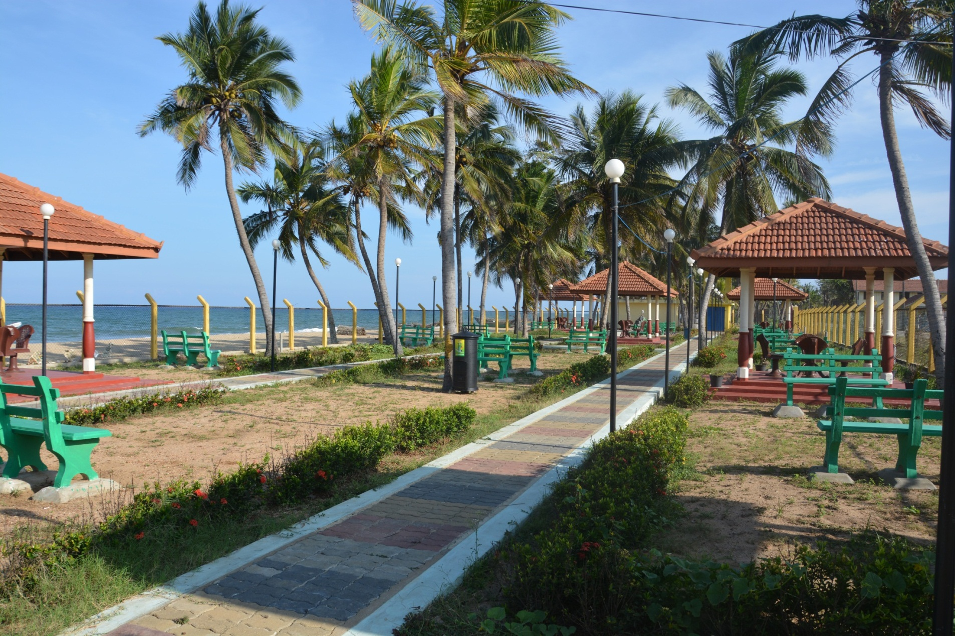
A CHILDREN PARK

Slide 15
STRENGTHS AND WEAKNESSES
Strengths of the project – predictable fiscal transfer has worked; the capacity of LAs built to manage their mandated activities; project design, implementation arrangements, and oversight contributed to achieve project objectives.
Innovative features of the project - in next slides.
Limitation of the project - change in the executing agency mid way; capacity constraints of regional small contractors contributed to slow progress for which actions were taken; weak local government institutions (LLDF and SLILG).
Role of the government - political commitment, policy environment, and strategic oversight had been excellent.

Slide 16
Innovations in the Project (as designed)
Preparation of Local Authority Participatory Development Plans (LAPDP)
Establishment of Project Appraisal Team (PAT)
Establishment and Strengthening of Community Organization (Praja Mandala)
Establishment of Social Audit Committees
Establishment of Grievance Redressing Mechanism (GRM)
Establishment of Good Governance Resource Centers (GGRC) at District level
Establishment of Fiscal Local Government Division (LGD) at Provincial Level
Establishment of Fiscal Analysis Cells (FAC) at Provincial Level
Introduction of Citizen Score Cards (eCSC)

Slide 17
Innovations in the Project (as designed)
Preparation of Sub Project Completion Reports
Preparation of Maintenance and Sustainability Reports
Preparation of Business Plans for Commercial Projects
Enhance the Procurement and Financial Capacity of Local Government Sector
Adoption of Citizen Charter initiated by the Government

Slide 18
(Additional) Innovation Activities Introduced
Establishment of Front Offices at Local Authorities
Establishment of Automated Libraries
Reviewing and designing the existing Local Authority Accounting System with accounting software package
Strengthening of Local Loan and Development Fund
Enhance the Technical Capacity of Local Government Sector
Strengthening of Sri Lanka Institute of Local Governance
Training Local Authorities on RTI Act

Slide 19
Lessons Learned
Local governments are better positioned to deliver local development, but political economy hampers bolder reform initiatives
Local services are sub-optimally delivered and rather costly due to ineffective coordination between institutions
Participatory planning & budgeting and performance-based grants worked in addressing capacity issues
Predictability and timely transfers facilitate local governments deliver services as planned
Performance-based grants promote resource mobilization in local governments
Social audits and citizen report cards supplement public and local government accountability

Slide 20
FUTURE ASSISTANCE NEEDED
BASED ON THE NELSIP EXPEREINCE GAINED:
=> PREPARE A FOLLOW ON PROJECT TO STRENGTHEN THE FISCAL AND INSTITUTIONAL SYSTEM OF THE LOCAL GOVERNMENT SERVICE DELIVERY IN THE COUNTRY, THAT WILL HELP TO DEVELOP POTENTIAL ECONOMIC GROWTH CENTRES!
MINISTRY OF PROVINCIAL COUNCILS AND LOCAL GOVERNMENT

Slide 22
THANK YOU

