Slide 1
Integrated Urban Water Management – An Overview
IUWM Workshop in Indonesia
Jakarta & Bogor, January 28 – February 1, 2019
Integrated Urban Water Management Workshop in Indonesia
Dr Carlos E M Tucci
WB Consultant

Slide 2
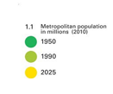
Rapid Urbanization and Competition for Water Resources
Projected metropolitan population by 2025
1950
1990
2025
Urban world population in 2050 will be 70%
Fertility decrease with urbanization
Main issues in cities
Projected Metropolitan
Population by 2025
Notes:
An estimated 150 million people currently live in cities with perennial water shortage; population growth and climate variability may increase this number to 1 billion by 2050 (McDonald 2011)

Slide 3
Increasing Vulnerability due to Disaster and Climate Change Risks
r
a
c
c
i
S
t
r
y
e
,
t
D
Drought
a
r
W
o
u
g
h
t
,
A
g
r
i
c
u
l
See level rise
t
u
r
a
l
l
o
s
s
a
L
e
e
S
v
e
,
e
s
l
s
d
R
o
i
s
e
o
e
t
l
,
c
F
H
.
u
r
r
i
c
a
n
e
s
,
E
x
p
o
s
Climate change challenge
e
d
p
r
o
p
.
e
c
r
t
t
e
y
s
a
t
n
s
d
e
s
a
s
Notes:
Climate change is adding more uncertainty and vulnerability to these challenges as water management has to take into account the additional stresses stemming from rising temperatures, changes in precipitation patterns and weather variability. In many areas we have experienced shorted and more intense periods of precipitation as well as unforeseen and longer lasting drought periods.

Slide 4
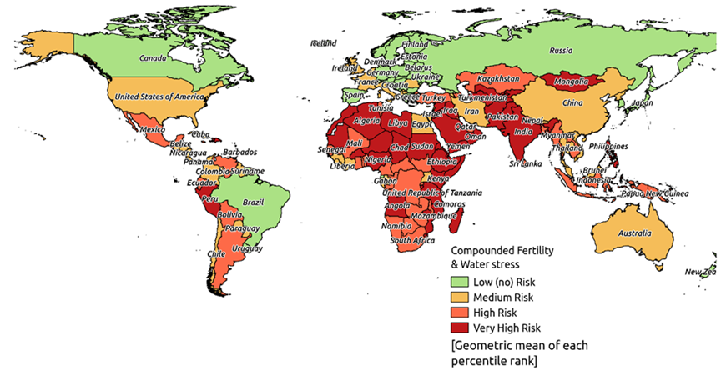
The Water Crisis - Unchartered Waters
HIGH WATER DEMAND IN SMALL AREA AND INTEGRATED IMPACTS DUE TO URBANIZATION AND LACK OF INFRASTRUCTURE.
Growing demands driven by demography, urbanization, rising incomes & warmer climate
Reduced availability & quality: Less precipitation & runoff, more variability, contamination of sources
Transboundary rivers as a major issue: 90% of major rivers are shared
WB 2017 “Uncharted Waters, the Economics of Water Scarcity and Variability”

Slide 5
Environmental Degradation
Urban development without control and infrastructure with environment impacts
Higher risk of water contamination through changes in land use patterns, poor solid waste management, inadequate sanitation including wastewater collection & treatment, inadequate stormwater management, and ageing infrastructure.
Lack of integrated urban water management, where they exist, are often fragmented and not well coordinated with urban planning and with the provision of other urban services.
Notes:
Business as usual is no longer working …

Slide 6
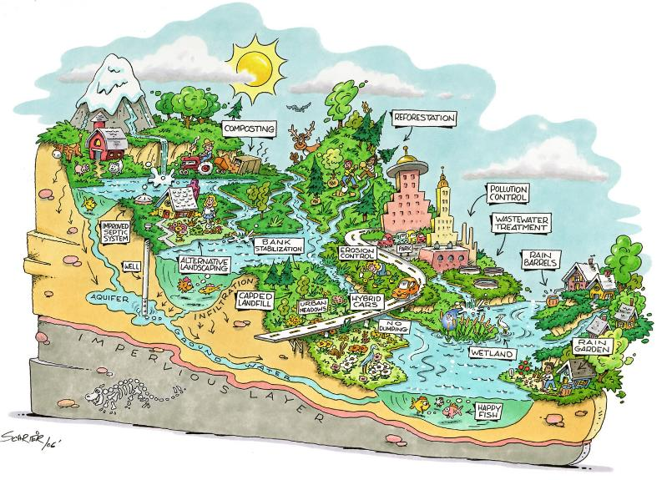
Integrated Urban Water Management – IUWM
Holistic strategic urban planning that takes a landscape approach and preserve water sources, control the contaminations, recognizing the needs of the city, as well as those of upstream and downstream users.
Graphic Source: http://www.neorsd.org/images/RestoredUrbanWatershed_large.jpg
Notes:
Integrated Urban Water Management is a holistic way of strategic planning by taking a landscape approach and managing competing water users at the level of the watershed, recognizing the needs of the city as well as those of upstream and downstream users
It brings diverse actors and services/sectors together around common goals. The idea is to make the whole of the interventions be bigger than the sum of each of its parts.

Slide 7
Key Principles of Integrated Urban Water Management
Integration across the water cycle
Wastewater and stormwater: a resource
Water cycle as one system
Matching water quality with intended use
Integration of urban and water systems
Pursuing economic efficiency, social equity and environmental sustainability
Integrating water resources, land-use planning and key urban services (e.g., solid waste, housing, transport)
Integrated planning and implementation
Stakeholder involvement instead of top-down
Multidisciplinary planning teams
Source-http://www.ewater.org.au/uploads/images/source-composite-web.jpg

Slide 8
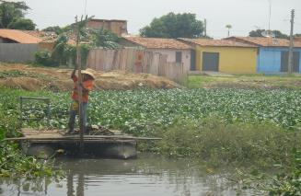
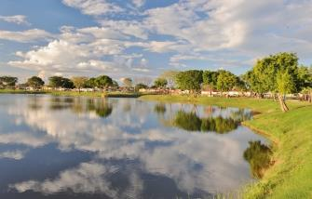
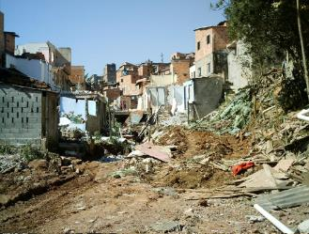
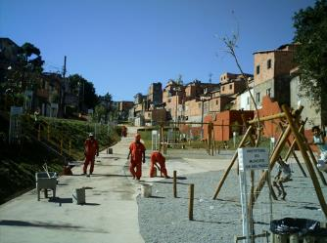
Benefits of Integrated Urban Water Management
Before
After
Costs savings through coordination & synergies, promoting alternative technologies & approaches
Leveraging complementary financing different sectors; different levels of government, bringing in alternative financing (private sector, payment for environmental services)
Improved living conditions, quality of life, economic stimulation, etc., through urban transformation, including green & cultural aspects
Notes:
Before and after pictures top from Teresina – Phase 1; bottom from Mananciais Program in São Paulo

Slide 9
Fast Growing Cities can ‘leap-frog’ to Water Sensitive Cities …
Cumulative Socio-Political Drivers
Water supply access & security
Public health
protection
Flood Protection
Social amenity, environmental protection
Limits on natural
resources
Intergenerational equity, resilience to climate change
… and avoid mistakes of most developed cities
Water Supplied City
Sewered City
Drained City
Waterways City
Water Cycle City
Water Sensitive
City
Diverse, fit-for- purpose sources & end-use efficiency, waterway health restoration
Adaptive, multi- functional infrastructure & urban design reinforcing water sensitive values & behaviors
Supply hydraulics
Separate sewerage schemes
Sustainable drainage
Point & diffuse source pollution management
Service Delivery Functions
Source: Brown et al (2009), and Wong and Brown (2009)
Notes:
Cities in developed countries have transitioned their service delivery functions through these phases, spurred by socio-political drivers:
1: Water Supply
Socio-political driver: access and security
Service delivery function: water supply hydraulics
2: Sewerage
Socio-political driver: public health protection
Service delivery function: separate sewerage schemes
3. Drainage
Socio-political driver: flood protection
Service delivery function: drainage, channelization
4. Waterways
Socio-political driver: social amenity, environmental protection
Service delivery function: point and diffuse source pollution management
5. Water cycle
Socio-political driver: limits on natural resources
Service delivery function: diverse, fit-for-purpose sources and end-use
efficiency, waterway health restoration
6. Water wise
Socio-political driver: intergenerational equity, resilience to climate change
Service delivery function: adaptive, multi-functional infrastructure & urban
design reinforcing water sensitive values & behaviors
Fast-growing cities in the developing world could ‘leap-frog’ to water-sensitive cities in order to avoid the mistakes of developed-country cities.

Slide 10
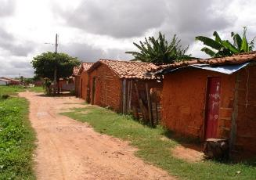
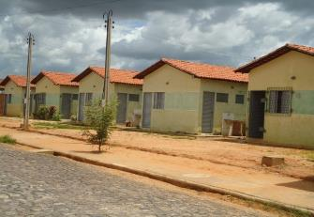
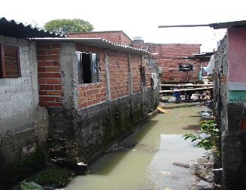
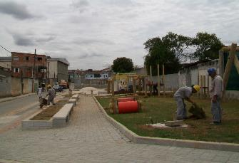
Implementing Integrated Urban Water Management
Sustainable Solutions
Before
After
Water Resources Management
Water Supply & Sanitation
Sustainable Stormwater
… and beyond water …
Urban Planning, Land use
Solid waste
Environment, recreational
Housing
Regulations, policies, non-structural measures (e.g., flood zoning, permits, etc.)
Notes:
FYI - Before and after pictures top from Teresina – Phase 1; bottom from Mananciais Program in São Paulo
What does it take to implement integrated sustainable solutions?
Land use: reduction of irregular occupations; avoid occupation of areas of risk; regulations and incentives for sustainable occupation
Water Supply & Sanitation: protection of river basin to preserve the quality of water supplies; efficiency in WSS services; high coverage of sanitation and water quality goals
Stormwater: incentives and regulations for source measures to increase on- site infiltration; detention facilities; integrated amenities
Solid waste: collection and treatment (sanitary landfills); avoid proliferation of degraded areas; preserve functionality of hydraulic infrastructure; reduce-reuse-recycle
Housing development is important, particularly if you are working in areas that are risk-prone.
Other sectors: such as transport can/should be integrated in the solutions, the planning could also take into consideration education and health services offered for the particular area in question always aiming for improvement in quality of life

Slide 11
Key Elements
Integrated Participatory Planning
Coordinated Execution
Cross-Sector Tailored Solutions
Main Drivers:
Urban Planning and Land Use as well as…
For the improvement of quality of life and the environment
…stakeholder and community engagement
Notes:
Pictures are before and after of Seoul

Slide 12
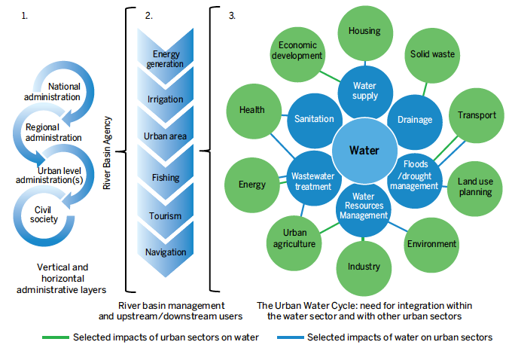
Multiple Layers of Integration
National/local government level
Watershed/basin level
City level
Source: World Bank (2016) IUWM Guidance Note, based on ICLEI (2011)
Notes:
An IUWM approach takes into account the needs of all users within the basin/watershed (2) while working across vertical and horizontal administrative boundaries (1) to overcome the traditional fragmentation of the Urban Water Cycle (3) and integrate interdependent sectors (urban (in green) and water (in blue)).

Slide 13
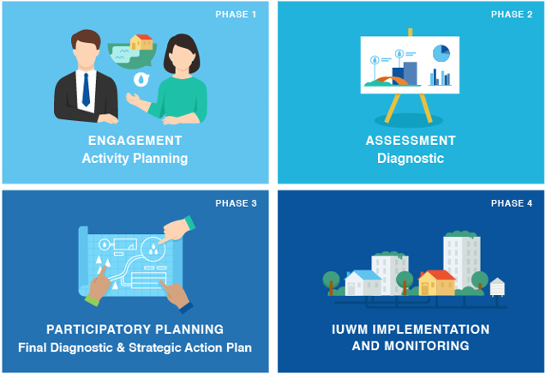
Process
Range of players and sectors involved for…
…an integrated solution tailored to local context and dynamics
Notes:
This is an example of how a team can engage on IUWM, based on the methodology developed during the Blue Water Green Cities Initiative in Latin America.
This methodology can and has been changed and adapted to specific local circumstances.
In Phase 1 – you identify a champion, assemble a small local planning team and identify stakeholders to be involved. On the stakeholders the net should be cast as broad as possible to include civil society, universities, water utilities, municipal departments in charge of urban planning, storm and solid waste management, any institution that can contribute with information and that is important to be ‘integrated’.
In Phase 2 – You bring these stakeholders together for some capacity building and brainstorming on water and urban issues, their main causes and consequences. As part of the brainstorming process a catalog is built with the sources of information available, sector plans, reports, data that the team can use to build and substantiate a quick assessment/diagnostic of the current situation. The idea is not to re-invent the wheel but start working in a pragmatic way based on information available.
In Phase 3 – You continue discussions around the diagnostic and engage in a participatory and integrated planning process that evaluates potential strategies, identifies priority areas of intervention and works towards preparing an action plan for the short- and medium-terms that will help move the process forward – the actions can range from studies/integrated master plans as well as investments, implementation of mechanisms for better cooperation. This can build and enhance already existing investment plans.
Phase 4 represents a move towards a coordinated implementation of the action plan, and systematic brainstorming and review of the action plan as the different initiatives are implemented and more information becomes available and also to take into account changes in the political economy.

Slide 14
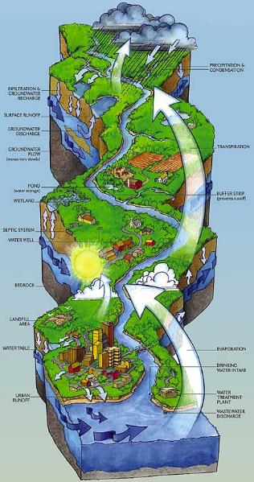
Example: Brazil – Espírito Santo Integrated Sustainable Water Management Project
Watershed Management
(Scaling up Payment for Environmental Services)
Basin Planning and Management
Wastewater collection and treatment Small towns upstream of Metro Vitória and Caparaó - CESAN
Strengthening institutions for integrated planning and management, including monitoring of risks, contingency planning and response to disasters, and continued work on utility efficiency improvements
Wastewater collection and treatment Metropolitan Vitória - CESAN
Urban Drainage in Metro Vitória
Coastline management
Notes:
Loss of forests has:
Contributed to desertification in the northern part of the State
Reduced groundwater recharge,
Increased velocity of surface runoff, resulting in erosion and higher levels of sedimentation in the water
Rapid unplanned urban growth in the Greater Vitória Metropolitan Region has:
Put pressure on the quality and availability of water
Led to increased recurrent flooding in key areas due to the nature of the unplanned growth and inadequate drainage infrastructure
Pollution of water resources (sanitation and agricultural runoff)
Increase in intensity and frequency of extreme events in recent years (i.e., floods, landslides, drought) accentuating conflicts between various water uses

Slide 15
COMMENTS
The need of Integration in time, space, institutions, management and services;
Requirements: monitoring and data base; Capacity building and public participation; assessment and measures;
Long process based on sound Strategy, no fragmented projects;
The management requires Champions and visibility for political support;
Permanent assessment of results and goals

Slide 16
THANK YOU
Notes:
These are two of the publications we have on Integrated Urban Water Management: A guidance note and lessons from regional experiences in Latin America, Central Asia and Africa.
Tomorrow at 9:30 there is a Showcase Session in which the Guidance Note will be presented/discussed in more detail.
Thank you!

