Slide 1
NATIONAL POLICY AND STRATEGY FOR INTEGRATED URBAN WATER INFRASTRUCTURE
DIRECTORATE OF WATER RESOURCE AND IRIGATION
Integrated Urban Water Management Workshop in Indonesia

Slide 2
URBANIZATION IN INDONESIA
2010
2045 (SUPAS, 2015)
Population
238.5 Mil.
318.9 Mil.
Urban Population
Source: Visi Indonesia, 2045
49.9%
72.8%
Population growth drives urbanization and the growth of small and medium cities throughout Indonesia. Big cities and peri-urban area will form mega urban areas
Source: Visi Indonesia, 2045
The government has a responsibility to provide people with basic need
Challenge
Urban Sprawl
Increase Pollution
Water and
Sanitation Issue
Susceptible to the impact of climate change and disaster
Increase Urban Slums

Slide 3
URBANIZATION IN INDONESIA
...Impact of Urbanisation on Water Cycle...
NATURAL WATER CYCLE
WATER CYCLE IN URBAN AREA
Precipitation
Evapotranspiration
Imported portable water and virtual water
Precipitation
Reduced
Evapotranspiration
Runoff
Poor Quality Runoff
Wastewater Discharge
Reduced Infiltration
Infiltration
Source: SSWM, 2018
Source: SSWM, 2018

Slide 4
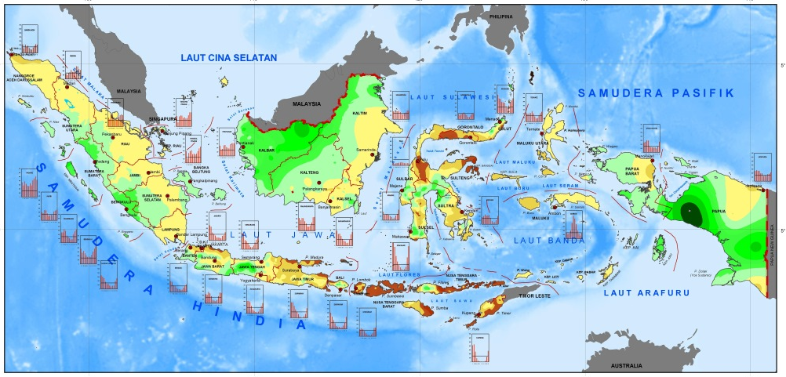
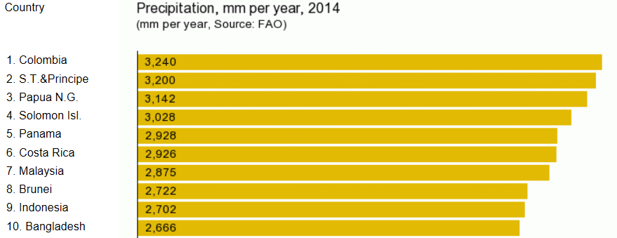
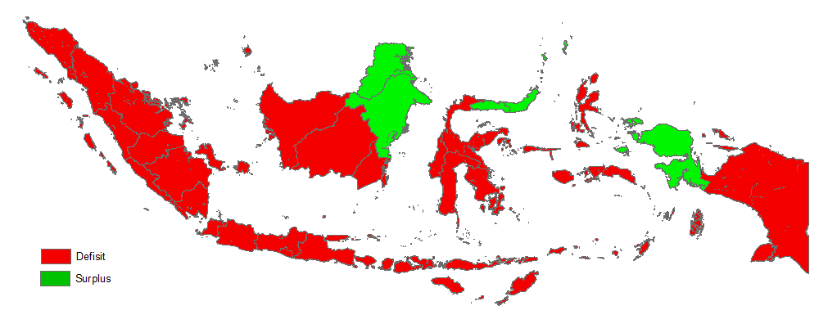
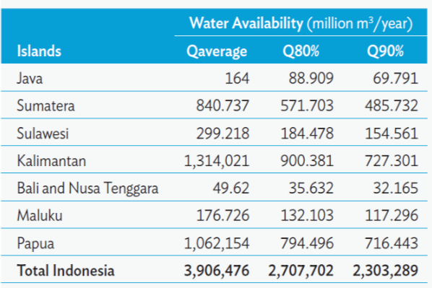
CHALLENGE IN WATER RESOURCE MANAGEMENT ...Uneven Water Resource Distribution ...
Monsoon type
Indonesia has abundant of water resources; Yearly precipitation 2700 mm make Indonesia rank-9 for country with the highest precipitation in the world.
Source: BMKG in Background Study RPJMN 2020-2024, 2017
Meanwhile
Source: FAO, 2014
Uneven distribution creates shortage in some areas, while surplus in others
Huge differences between dry and rainy season exist
Prediction of domestic water demand (2024) versus current the built-in raw water supply infrastructure (2018)
Source: Country Water Assessment, ADB, 2016
Source: Country Water Assessment, ADB, 2016

Slide 5
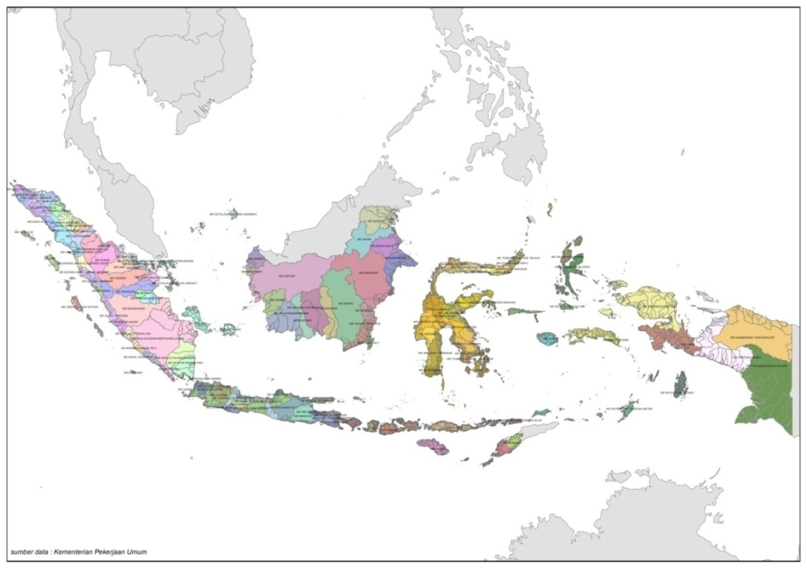
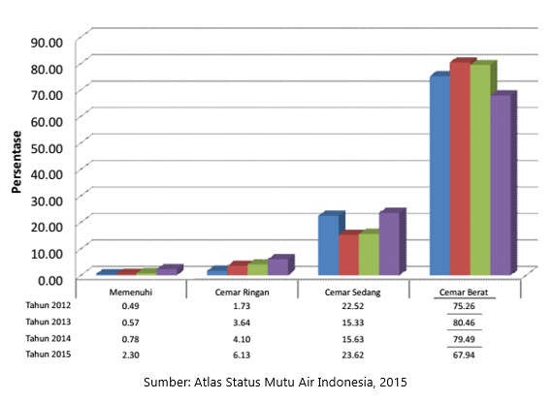
CHALLENGE IN WATER RESOURCE MANAGEMENT ...Population Growth and Water Quality...
DISTRIBUTION of POPULATION by REGION 2015
(million persons)
Increasing population (1.3% per year) → Need more water for live
Java is inhabited by nearly 60% of total population.
140 millions people live in Java in 2015 with average population density of more than 500 people/km² (MPWPH, 2016)
POPULATION INCREASING → WATER COMPETITION
15.34
18.72
Sumatera
Sulawesi
Kalimantan
Maluku - Papua
55.27
256
279,3
7.72
Mil People
Mil People
Java
Bali – Nusa Tenggara
145.14
14.11
2015
2024
Source: BAPPENAS, processed from Statistics Indonesia 2015
*Population Projection in Indonesia (million persons)
More than 65% rivers are heavily polluted (670 samples)
Demand for freshwater is rising with population growth
Population density as a major factor that should be well controlled to overcome the rapid deterioration and degradation of the water ecosystem.
Heavily Polluted
Source: Atlas, Indonesia Water Quality Status, 2015

Slide 6
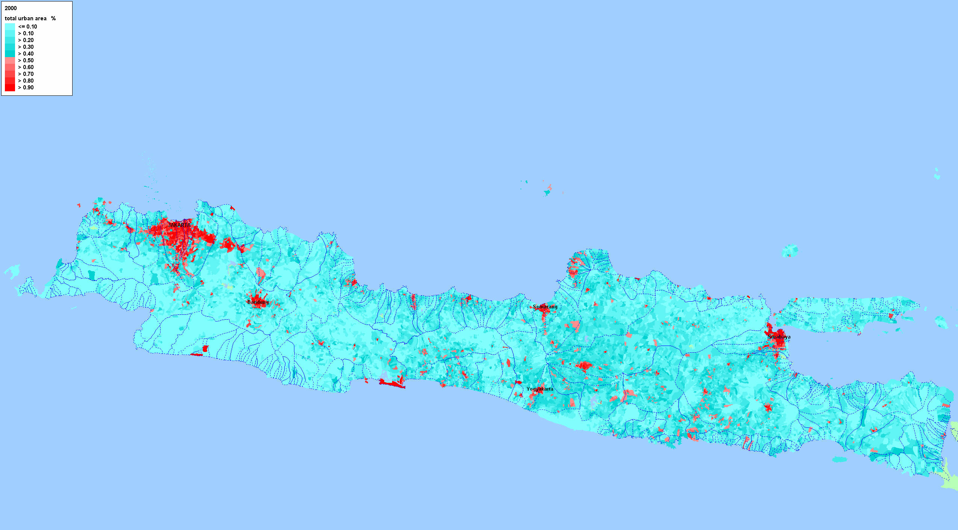
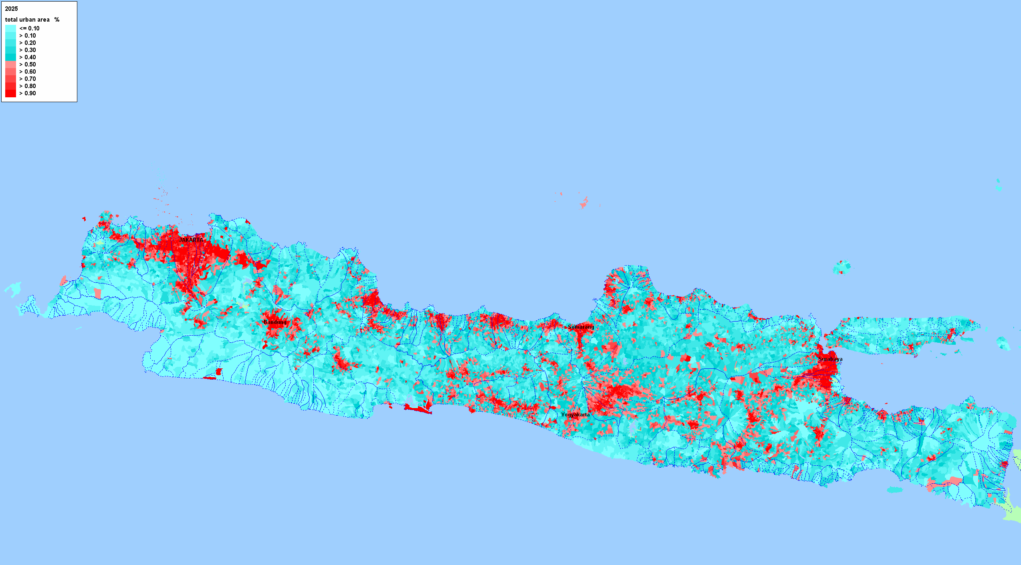
CHALLENGE IN WATER RESOURCE MANAGEMENT ...Land Use Change...
Urbanization
Deforestation
Middle-High Residential development in coastal area → Reclamation Area
Urban Area in year 2000
Deforestation plays many roles in flooding because trees prevent sediment runoffs and forests hold more water.
Forest
Low residential development in river basin area and mostly near river estuary / catchment area
Non- Forest
Urban Area in year 2030
Source: Indonesia Urban Flood, Disaster Risk Management and Drainage Program, 2018
Source: Bappenas, 2018
10 cities in Indonesia have increased the number of flood events significantly
Land-cover change (urbanization, deforestation, and cultivation) results in increased flood frequency and severity.
Souurce: Indonesia Urban Flood, Disaster Risk Management and Drainage Program, 2018

Slide 7
CHALLENGE IN WATER RESOURCE MANAGEMENT ...Water Usage...
More than 40-55% of people in Indonesia use Ground Water to fulfill domestic and drinking water needs
Source: Analysis from data PODES 2014
Smart water management and modernization of irrigation have important role toward efficiency and effective of water utilization.
Source: Bappenas from various data, 2017

Slide 8
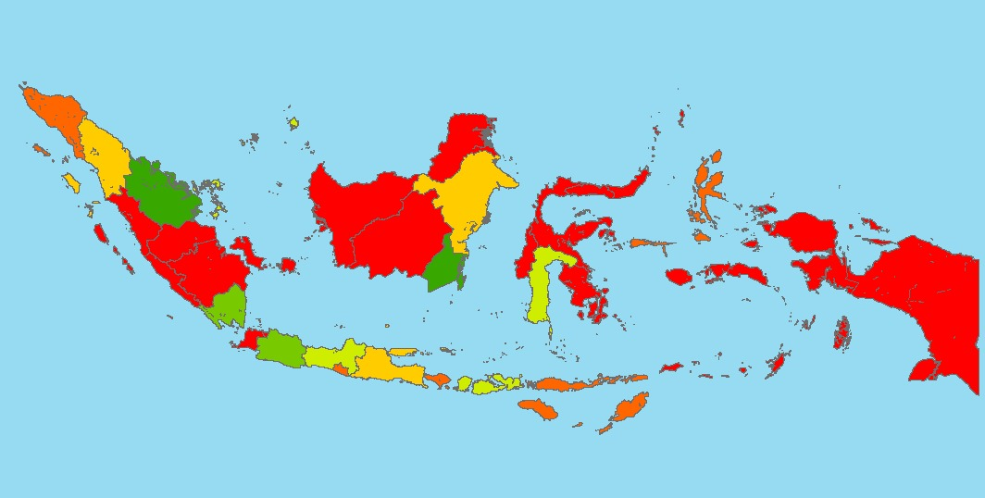
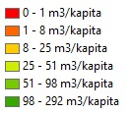
CHALLENGE IN WATER RESOURCE MANAGEMENT ...Storage per Capita and Irrigation Infrastructure...
The existing dam is not spread evenly; there are large gap storage per capita rate between provinces
Irrigation:
913.423 ha
Total Volume:
14,1 billion m³
Water Supply:
40,9 m³/s
22
4
Number of Existing Dam
Storage per Capita:
54 m³/person
Hydropower:
4059,3 MW
TARGET OF AGRICULTURE DEVELOPMENT 2015-2045
In 2030, urban areas in Java are predicted to increase to 40%
As a result: It is estimated that 2.1 million ha of productive irrigated land in Java will decrease
40% of paddy fields and 52% of national rice production are on P. Java.
2015-2019
2020-2024
2025-2045
Rice Surplus > 10 million ton for food security
Rice Ekspor > 5 million Ton
Rice Stok : 20 mil ton
Rice Export : 15 mil ton
Source: Ministry of Agriculture, 2018

Slide 9
CHALLENGE IN WATER RESOURCE MANAGEMENT ...Climate Change...
Climate change accelerates sea level rise and changes precipitation patterns.
The figure shows the growth of the alluvial (river) flood hazard zone area for RCP 8.5
The figure shows the growth of the coastal flood hazard zone area for RCP 8.5, Under this climate change scenario, climate change will increase coastal flooded areas by more than 100% in Sulawesi, Nusa Tenggara, Kalimantan, and Maluku.
Big cities in the coastal areas are threatened by sea level rise due to global warming.
Water management (water storage, agriculture, flood control, raw water supply) need to be adapted
Location of cities threatened by sea level rise in North Coastal of Java
Source: Analysis from MPWPH, 2016

Slide 10
INTEGRATED WATER RESOURCE MANAGEMENT
IWRM
Smart Water Management
Water for Food Security and Nutrition
Water Safety Plan
Green Infrastructure
Multipurpose storage for WFFE
Disaster Resilience Infrastructure
North Java Integrated Coastal Development
Solving water resource challenge with Integrated Water Resource Management (IWRM)

Slide 11
INTEGRATED WATER RESOURCE MANAGEMENT
...Water Safety Plan...
1
2
WATER DEMAND AND SUPPLY
3
DRINKING WATER TREATMENT, DISTRIBUTION, AND SERVICES
Challenges
WATER AVAILABILITY
4
Needs 90 m³/s pipe water supply (2024) to achieve universal access.
33% national Non Revenue Water (2015)
38 m³/s idle capacity in Production Unit and 6 m³/s in Distribution Unit (2017)
GROUND WATER USAGE
Concept
5
WATER SUPPLY INSTITUTIONAL, REGULATION, AND FINANCE
Optimization of water resource from dam
Rehabilitation and building the new water supply infrastructure, Water Treatment Plant (WTP), also distribution system, especially in agglomeration, industry, and high poverty area.
Idle capacity usage of water supply infrastructure and optimalization of WTP for urban drinking water
The new distribution network development of urban drinking water
Construction of small scale storage and practical drinking water technology for outermost island, including the SWRO (Sea Water Reverse Osmosis) and Rain Water Harvesting technology usage.
Development of Regional SPAM and investing scheme with business entity involve
The regulation solving and institutional strengthening of bulk/drinking water management
Increased community awareness of water-saving behavior
Acceleration of Supplying Bulk/Drinking Water that is safety from Source to the Consumer with Quality and Quantity Needed
Policy Direction

Slide 12
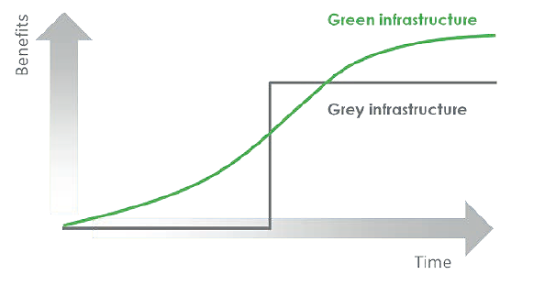
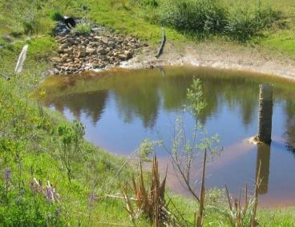
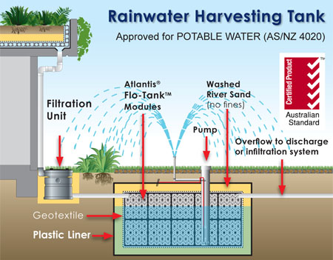
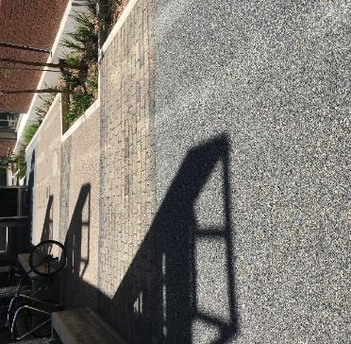
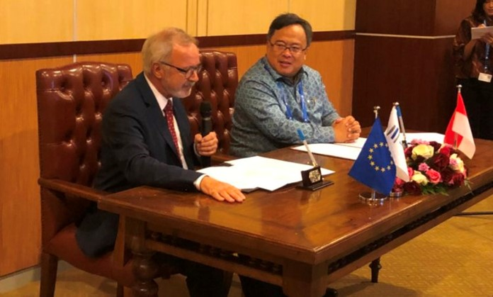
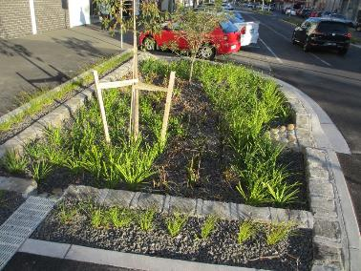
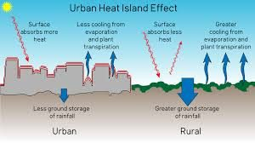
INTEGRATED WATER RESOURCE MANAGEMENT
...Green Infrastructure...
Challenge
Policy Direction
Lowland restoration
Reforestation through social forestry, public open space, and rehabilitation
Piloting green infrastructure approach for urban and coastal flooding management, drainage system, water quality management, and water conservation (groundwater recharge).
Water for renewable energy
Land use changes into impermeable surface leads to increased run-off
High cost grey infrastructure
Deteriorating eco-life
Unintegrated green approach into existing plans and managements
Phasing of Green Infrastructure and Grey Infrastructure Benefits
Source: New York City Green Infrastructure Plan
Porous Pavement
Sediment Pools
Rain Harvesting Tank
MoU Indonesia-European Investment Bank (EIB) on Green Infrastructure Development.
October, 13th 2018
Constructed Wetland
Rain Garden
Urban Heat Island Effect
Source: Water Sensitive Urban Design, Public Health Notes, and Atlantis Rainwater Harvesting Tank

Slide 13
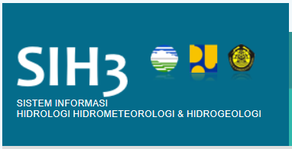
INTEGRATED WATER RESOURCE MANAGEMENT
...Smart Water Management...
Vision
Challenge
Components Related to SWM
Meters and Sensors
Communication Infrastructure
Information System
Hydraulic Models
ICT Policies
Decision Support System
Unaccountable water usage
Unreliable and unavailable data
Partial data management
Inconsistency in application of new technology
Policy Direction
Efficiency improvement system on water supply and integrated water management through the technology utilization.
Advanced decision support system for water distribution and quality
Conservation, prevention, and law enforcement on water quality
Optimization of current information system for hydrology, hydrometeorology, and hydrogeology (SIH3)
Integrated early warning system for water related hazard

Slide 14
INTEGRATED WATER RESOURCE MANAGEMENT
...Water for Food, Security, and Nutrition...
Challenge
Vision
DIRECTION ON DEVELOPMENT 2005-2025
In year 2030, urban areas in Java are predicted will become 40%
Impact: 2.1 million hectare of productive irrigated area will decrease
MASTERPLAN STRATEGY FOR FARMING DEVELOPMENT 2015-2045
Demand management to overcome water deficit in Java by:
Developing irrigation outside Java
Increasing water productivity
2015-2019
2020-2024
2025-2045
Rice Surplus > 10 Million Ton for Food Stock
Rice Export > 5 Million Ton
Rice Stock 20 Million Ton
Rice Export 15 Mil. Ton
Irrigation Infrastructure Change (Million Ha)
(Source: Country Water Assessment - ADB, 2016)
Source: Ministry of Agriculture
Policy Direction
Sustainable water management and conservation, from central government to local government to ensure water quality and water quantity for food security and nutrition in the future.;
Comprehensive policy to determine the right priority FSN;
Placing the most needed (susceptible and marginalized) in policy and action;
Improving irrigation management and farming management to overcome water deficit by increasing efficiency and resilience of farming system;
Knowledge and technology;
Inclusive and effective governance; and
Promoting a right-based to water for FSN.

Slide 15
INTEGRATED WATER RESOURCE MANAGEMENT
...Multipurpose Storage for Water, Food, Flood, Enerrgy...
Challenge
Policy Direction
Existing Dam are Mostly Single Purpose
Around 50% dams are built only for single purpose
More than 50% of dam > 20 years old
Sedimentation problem
Existing Dams
Dam upgrading for new purposes and maintaining level of service
Innovative management scheme for O&M improvement
Community based catchment management
New Dams
Innovative financing scheme
International protocol utilization for better preparation
Multipurpose based
Forest
Non- Forest
Source: MPWH 2018
Source: BIG 2018

Slide 16
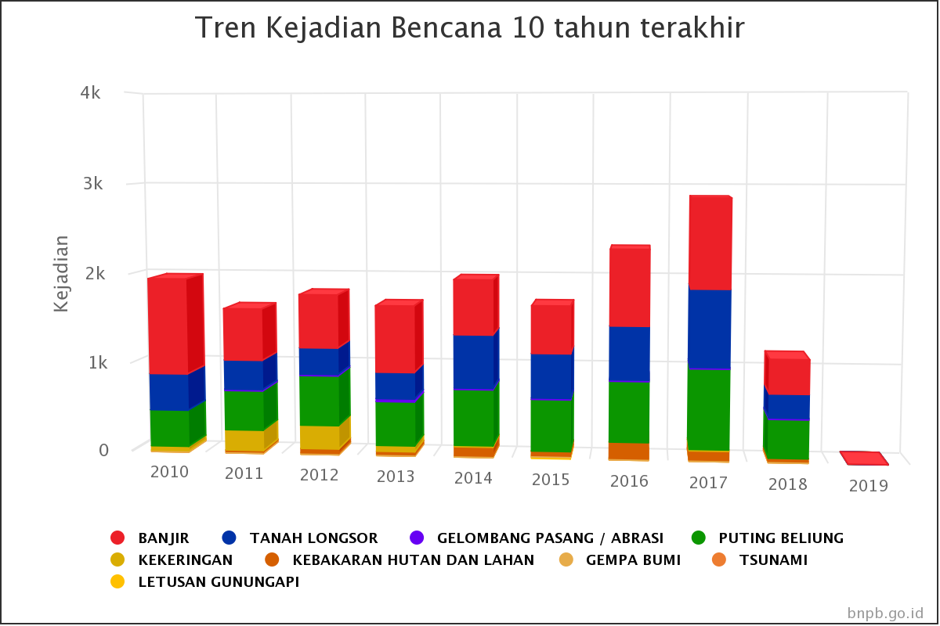
INTEGRATED WATER RESOURCE MANAGEMENT
...Disaster Resilience Infrastructure...
Challenge
Number of disaster in the last ten years
Indonesia has a high potency of natural disaster, and can results in economic loss
High potency of natural disasters
Deterioritation of water resource infrastructure caused by natural disaster
Higher scale and impact of loss from year to year
More burden on national financial to reconstruct damaged water resource infrastructure
62% disaster economic loss caused by flood
Policy Direction
Funding & Regulatory Framework
Zoning system
Building code
Infrastructure insurance
Natural disaster bond
Resilience of Urban Areas and the Economic Center for Flood Disasters
Infrastructure reliability and resilience to disasters
Strengthen mitigation capacity for flood, volcanic eruption, earthquake, and landslide to reduce the disaster risk
Disaster resilience based development and spatial planning enforcement
Development early warning systems, especially in disaster-risk areas

Slide 17
INTEGRATED WATER RESOURCE MANAGEMENT
...North Java Integrated Coastal Development...
Challenge
Urban Agglomeration in North Java
Mangrove area decrease causes abrasion
Coastal flooding
Land Subsidence worsen flood
Drought and lack of water storage results to water scarcity
Climate change causes tidal flood
Waste disposal decrease fisherman revenue
Population growth increases land needs
Jabodetabekpunjur
Provinsi DKI Jakarta
Bogor
Bekasi
Depok
Tangerang
Tangerang Selatan
Kabupaten Cianjur
Policy Direction
Kedungsepur
Kendal
Demak
Semarang
Salatiga
Grobogan
Integrated coastal development zone in North Java Cities:
Solution for flood and tidal flood through polder system
Development of land, sea, and air infrastructure
Solution of raw water limitation and water quality improvement
Renewable energy potency (water and sun)
Conservation and extention of vegetation ecosystem
Development of fishery and maritime industry
Gerbangkartasusila
Gresik
Bangkalan
Mojokerto
Surabaya
Sidoarjo
Lamongan
Source: Dechatlon 2017

Slide 18
INTEGRATED URBAN WATER RESOURCE MANAGEMENT
...Case Study: The Urban Watershed Program...
The Urban Watershed Strategy Program (2018)
Key Findings
10 selected urban agglomeration focused on potential and critical issues related to water quantity, water quality and water flow.
Water Quantity
Overall attitude change to use the natural resources sustainably/responsibly.
Sustainable water use by reduction of shallow groundwater
Private sector participation in water distribution improvement
Water Quality
awareness and behaviour improvement and treatment capacity for sanitation
Many sanitation and solid waste management projects are implemented at pilot scale only.
Private sector participation in domestic wastewater water treatment has very little potential
Selected 10 agglomeration
Water Continuity
High Urban Population Size
Potency of hydropower and irrigation
Improved control on land conversion
Restrictions made on agricultural activities still allowed in hilly/erosive upperwatersheds and water infiltration areas.
The community resilient for natural disasters,
No potential for direct private sector participation flood control improvement projects.
Critical issues related to water shortage, water pollution and flooding
Souurce: Studi Decathlon, 2018

Slide 19
INTEGRATED URBAN WATER RESOURCE MANAGEMENT
...Case Study: Indonesia Urban Flood, Disaster Risk Management, And Drainage Program...
Increase in people in river flood hazard zone
40.0
35.0
30.0
25.0
20.0
15.0
10.0
5.0
0.0
Aqueduct 2010 Flood Hazard
BPS 2016 Population
Urban population growth is the dominant factor (risk increases by 47%) of flood hazard
Number of people affected
The combined effect results in an estimated 75% increase of Indonesians at risk of flooding by 2055
Aqueduct 2050 Flood Hazard
BPS 2055 Population
Souurce: Indonesia Urban Flood, Disaster Risk Management and Drainage Program, 2018

Slide 20
THANK YOU

