Slide 1
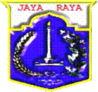
DKI JAKARTA
JAKARTA CAPITAL CITY
PROVINCE
URBAN WATER CHALLENGE
Presented on Integrated Urban Water Management Workshop
Jakarta & Bogor, January 28th – February 1st, 2019

Slide 2
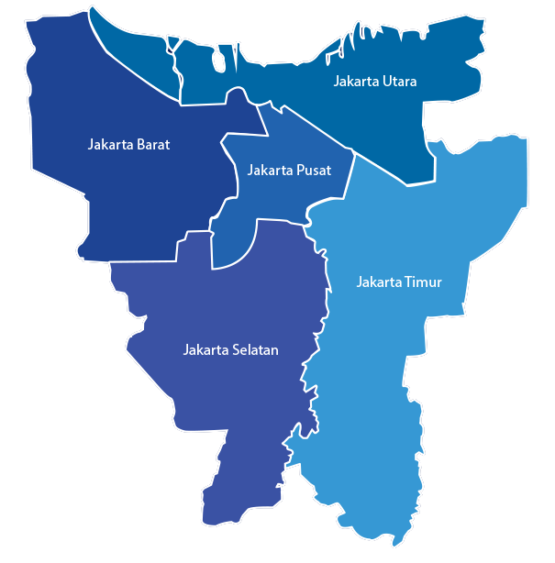
FACTS AND PROFILE
GENERAL DESCRIPTION OF JAKARTA CONDITIONS
6
40
5 Municipalities
and 1 regency
percent
662
13
Rivers
Square km
10.4
70
million
percent
Notes:
Jakarta is the capital city to the Republic of Indonesia. (National Law Number 29 of 2007)
It consist of 5 municipalities and 1 regency, with 44 districts, and 267 sub districts.
With land area is about 662 square km and 6,998 square km for the ocean area, the total area of Jakarta is about 7,660 square km. (Decree of the Governor of DKI Jakarta Province Number 171 of 2007)
Jakarta is home for 10.4 million people
Jakarta and its surrounding cities form a metropolitan area Jabodetabek with a total population of more than 28 million people.
The topography of DKI Jakarta Province was analyzed from the aspect of land height and slope of the land. DKI Jakarta Province is located in a lowland, Situated as delta city with 40 percent of the land lies below Mean Sea Level, Jakarta is vulnerable to urban floods and other environmental issues.
The north boundary of Jakarta stretches 32 km of coastline and Jakarta is traversed by 13 rivers and the biggest river is Ciliwung River with upstream catchment originated in Bogor Region, West Java.
Jakarta has many roles. It is a capital city, and also a national activity centre for economic, business, tourism and also higher education.More than 70% of the country's money circulates in Jakarta.

Slide 3

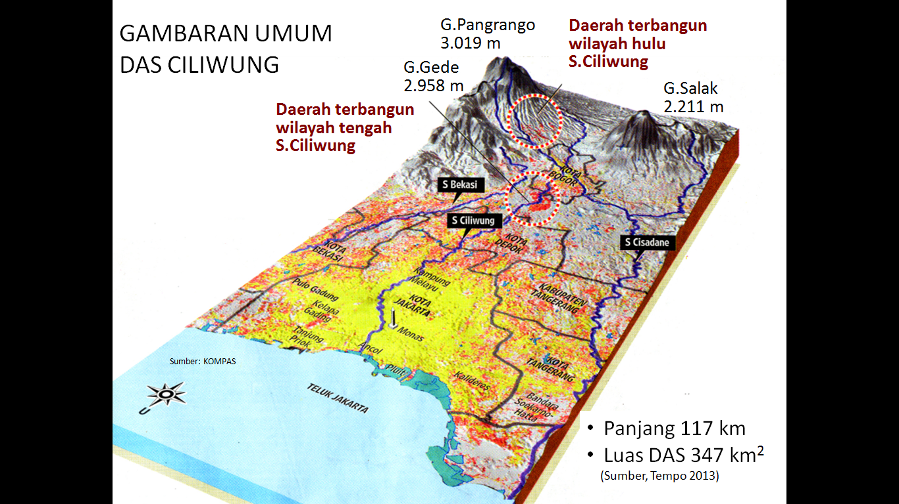

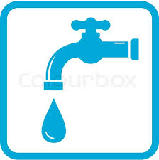
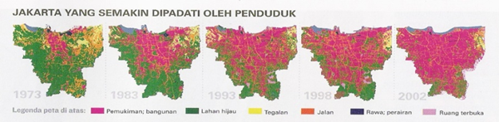
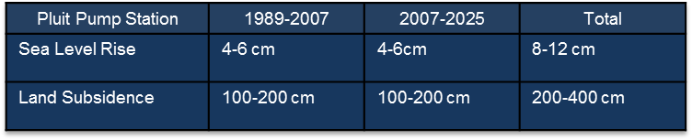
Jakarta
Banjir
  Pemanfaatan ruang yang tidak terkendali
  Maraknya hunian illegal dibantaran sungai
  Peningkatan ketinggian air laut pasang dampak dari climate change
ISSUE
  Penurunan muka tanah
  Tingginya intensitas hujan
  Keterbatasan infrastruktur pengendali banjir dan drainase
  Perilaku masyarakat membuang sampah di sungai
pencemaran air,
10% BAB langsung ke sungai
65% septick tank yang tidak terkontrol
21% masyarakat menggunakan IPAL
4% masyarakat telah mendapatkan pelayanan sewerage system
  Keterbatasan air baku dan jaringan distribusi
  cakupan layanan baru 60%
  NRW 40%
  Ekstraksi air tanah dalam yang berlebihan
Notes:
we got 18 strategic issues are grouped into five main issues namely Human Development Issues, Economic and Infrastructure Issues, Apparatus Integrity Issues, Sustainable City Issues and Jakarta as the Node of Progress on national development Issues
For the climate change issues are included in Economic and Infrastructure Issues and Sustainable City Issues

Slide 4
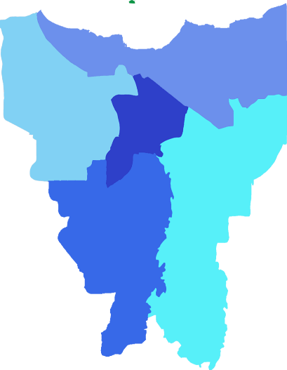

Sea
Sea Dykes
Reclamation Area
Jakarta
Urban Water Management Concept
Water Dykes
Sea
01
02
Low Land
Cengkareng Drain
West Canal
East Canal
Higher Land
Legend
Higher Land
Polder System
Lakes/Reservoir
2000 m + MSL
03
Pumps
Evapotranspirasi
Evapotranspirasi
Water Gate
Waduk/situ
Water Dyke
.
Banjir kanal
Sistim
polder
Evaporasi
.
.
.
.
Port
t₀
t₁
t₂
t₃
t₄
Resapan air
Gravitasi
Retention Lakes
Outside Jakarta
Polder
Pesisir
01
Plan for Cengkareng Drain II
UPSTREAM
(Puncak-Bogor)
MIDDLESTREAM
DOWNSTREAM
COAST AND SEA
Flows by Gravity
Polder System, discharged by pumps
Sea Dikes
02
Coastal Dikes
03
Planned Development for Port of Tanjung Priok & Marunda
Notes:
This slide shows schematic concept of Jakarta urban water management.
At the upstream and middlestream (higher land) will flow by gravity to river and retention lakes. Measures to minimise runoff is by reforestation, construction of infiltration well and development of new lakes also maintain green open space.
Infiltration wells and biopores
Reduce runoff, maintain green open space upstream
development of lakes/reservoir
At Downstream (low-lying areas), water is collected in polders and pumped to river or major drainage system. Several river shortcuts and diversion are also planned such as interconnection of East Flood Canal and West Flood Canal, also Cengkareng Drain dan Cakung Drain . Dredging and river normalization are also planned to improve river and major drainage systems capacity.
Polder system extension to the West
Interconnection of WFC – EFC
Capacity improvement of existing canals, rivers, lakes and polders
Construction of Cengkareng Drain II
At the coastal area, the existing break water must be improved to develop a higher sea defense as an anticipation to higher sea level and climate change.
Stage I: Existing coastline /construction of coast embankments
Stage 2 and 3: depth – 8m or deeper/construction of sea embankments
The concept have been stipulated in the Jakarta Spatial Plan 2030 and Regional Mid Term Development Plan 2017- 2022
The overall strategic direction is to increase the water body ratio to 5 percent

Slide 5
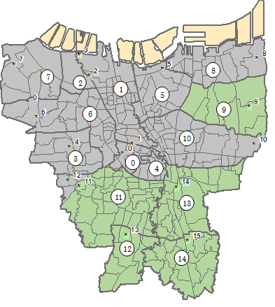
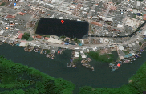
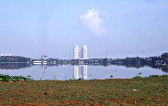
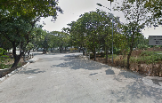
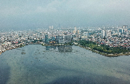
JAKARTA SEWERAGE SYSTEM
ZONE 1,2,5,6 AND 8
Zona 2
MUARA ANGKE
Zona 8
MARUNDA
8
2
5
6
1
Zona 6
DURI KOSAMBI
Zona 5
SUNTER
Zona 1
PLUIT
Notes:
total cost ……

Slide 6
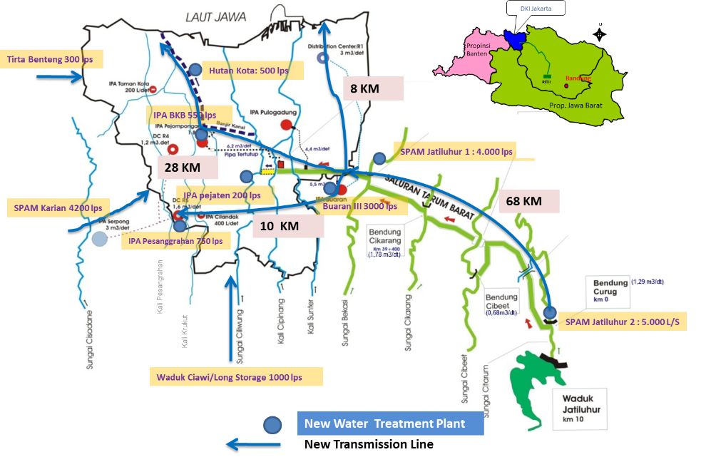
CLEAN WATER
SPAM JATILUHUR 1

Slide 7
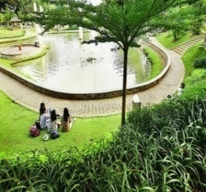
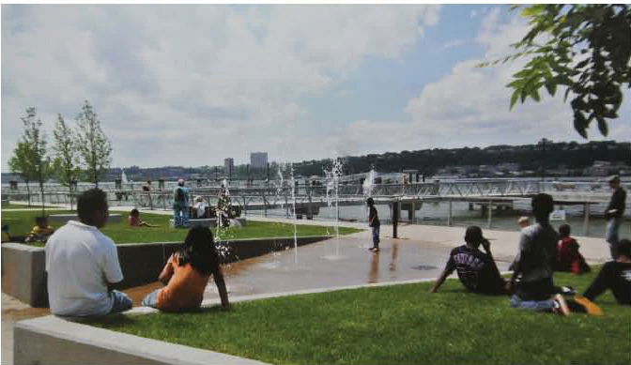
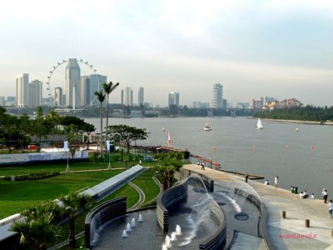
CHALLENGE
GENERAL DESCRIPTION OF JAKARTA CONDITIONS
Integrated Flood Management and Urban Spatial Planning
  Waterfront Urban Development
  Multi-function Development
Integrated Planning of Green and Blue Open Space
  River Normalisation + Green Belt (Naturalisation; third space)
  Integrated Green and Blue Infrastructure
Notes:
There are two challenge with regard to urban flood mitigation.
The first being integrating flood management with urban spatial planning. The idea is to promote waterfront urban development thus increasing sense of belonging of people to the waterways, and multi-function development of urban water body, such as development of flood control infrastructure that is integrated with recreational facilities.
The second approach involves integrated planning of green and blue infrastructure, such as river normalisation and development of green belt along riverbank.

Slide 8
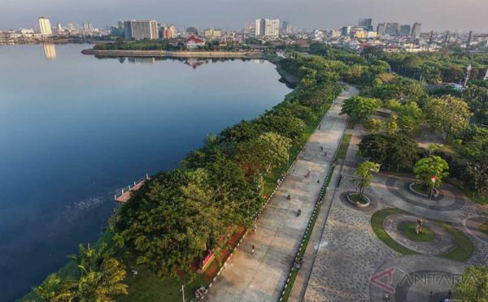
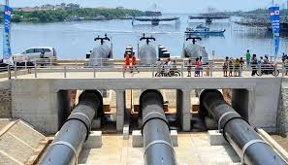
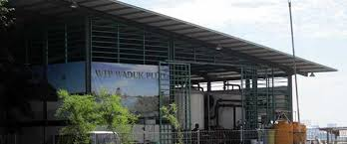
Waduk Pluit
Multi Purpose Structure
Notes:
we got 18 strategic issues are grouped into five main issues namely Human Development Issues, Economic and Infrastructure Issues, Apparatus Integrity Issues, Sustainable City Issues and Jakarta as the Node of Progress on national development Issues
For the climate change issues are included in Economic and Infrastructure Issues and Sustainable City Issues

Slide 9
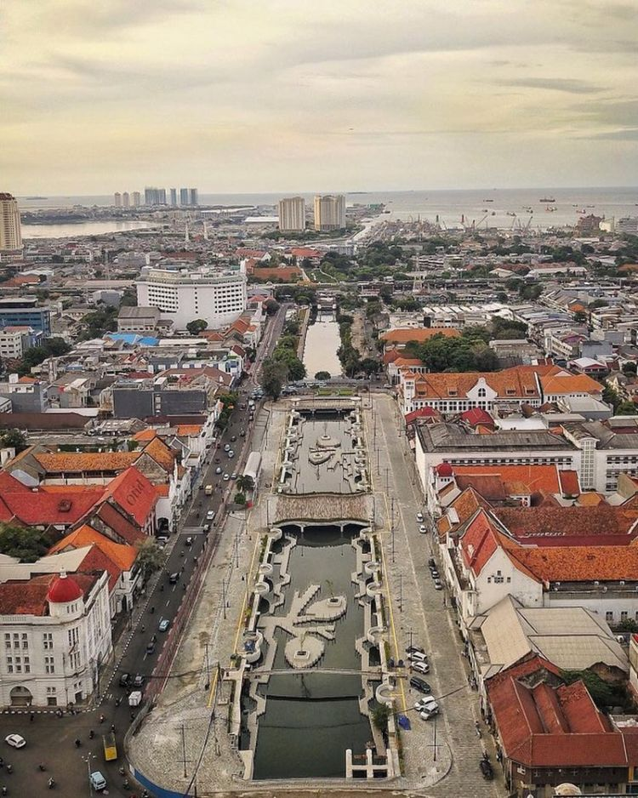
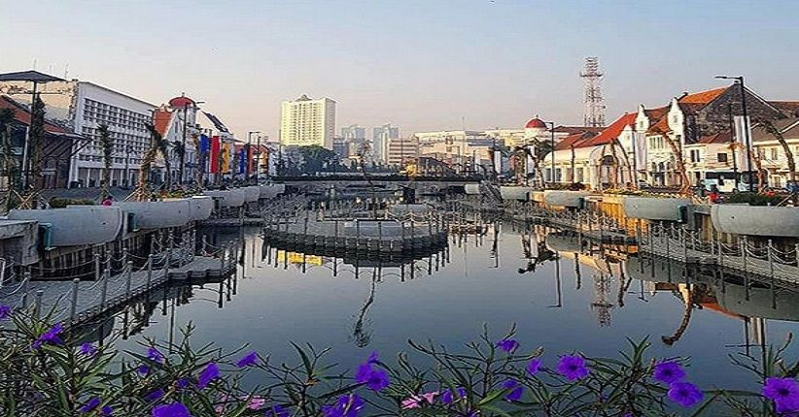
Kali Besar
JAKARTA OLD CITY
Notes:
we got 18 strategic issues are grouped into five main issues namely Human Development Issues, Economic and Infrastructure Issues, Apparatus Integrity Issues, Sustainable City Issues and Jakarta as the Node of Progress on national development Issues
For the climate change issues are included in Economic and Infrastructure Issues and Sustainable City Issues

Slide 10
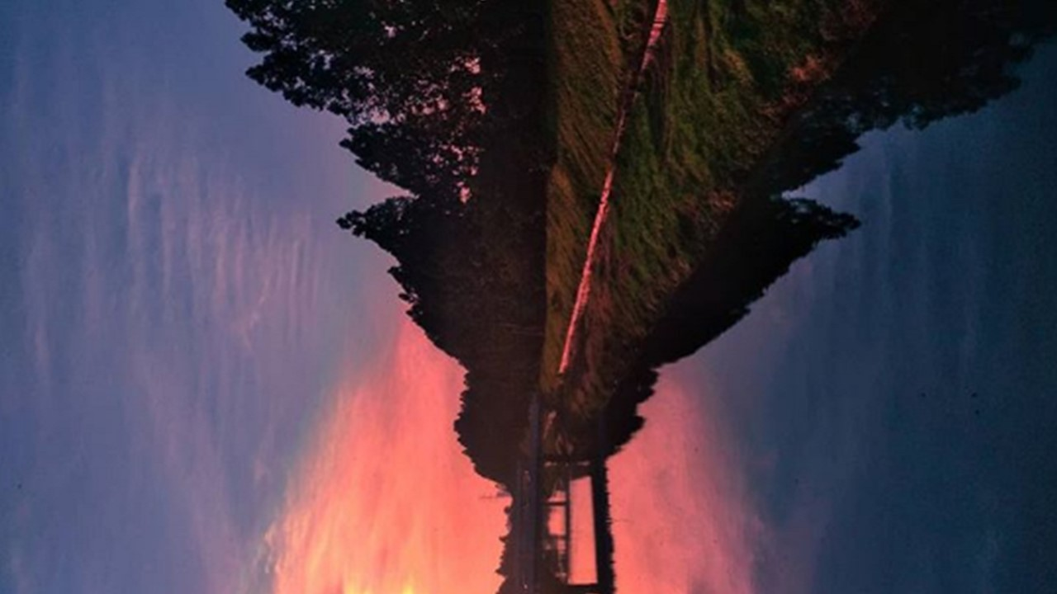
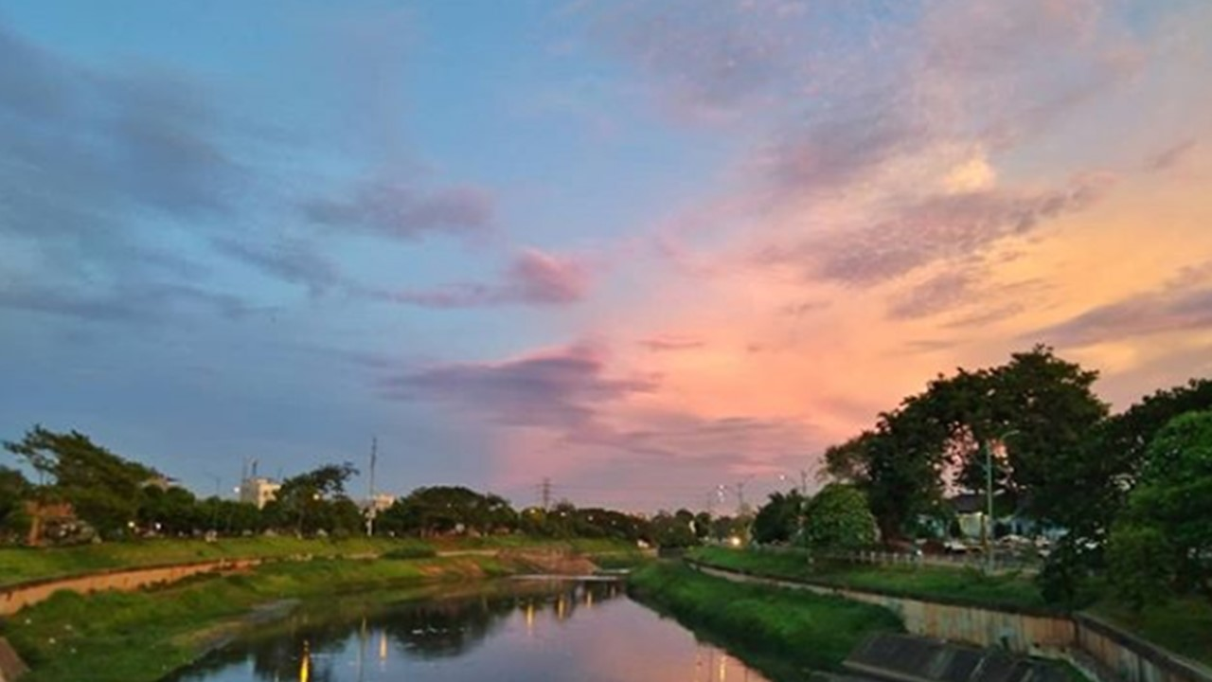
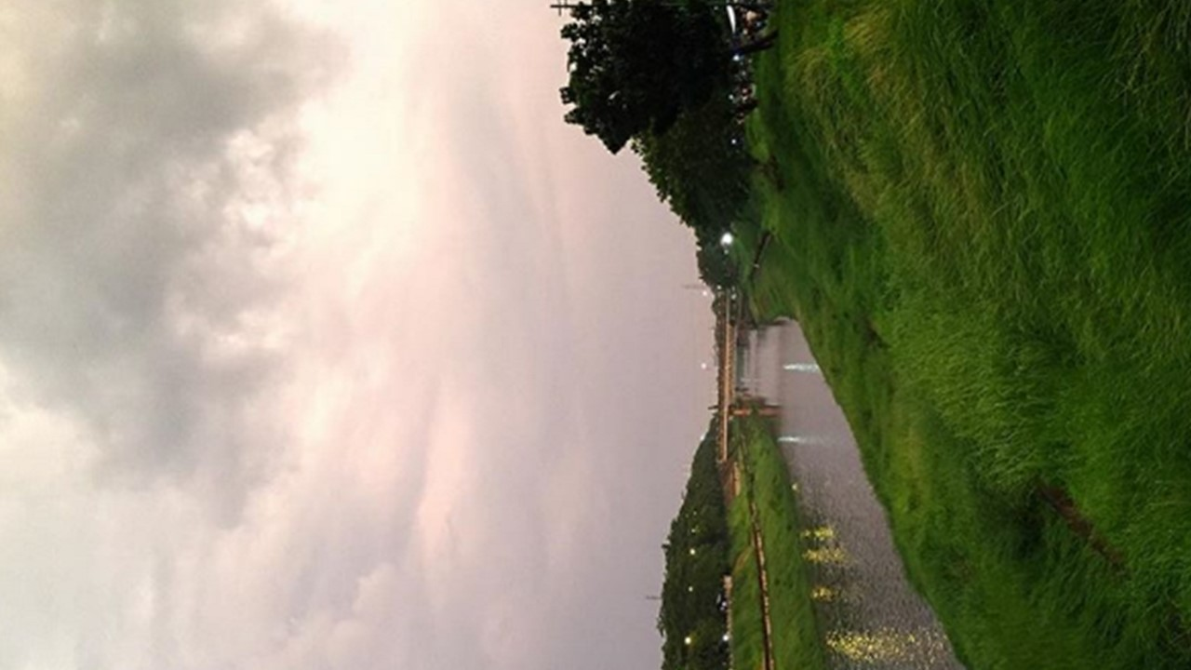
Kanal Banjir Timur
GREEN INFRASTRUCTURE
Notes:
we got 18 strategic issues are grouped into five main issues namely Human Development Issues, Economic and Infrastructure Issues, Apparatus Integrity Issues, Sustainable City Issues and Jakarta as the Node of Progress on national development Issues
For the climate change issues are included in Economic and Infrastructure Issues and Sustainable City Issues

Slide 11
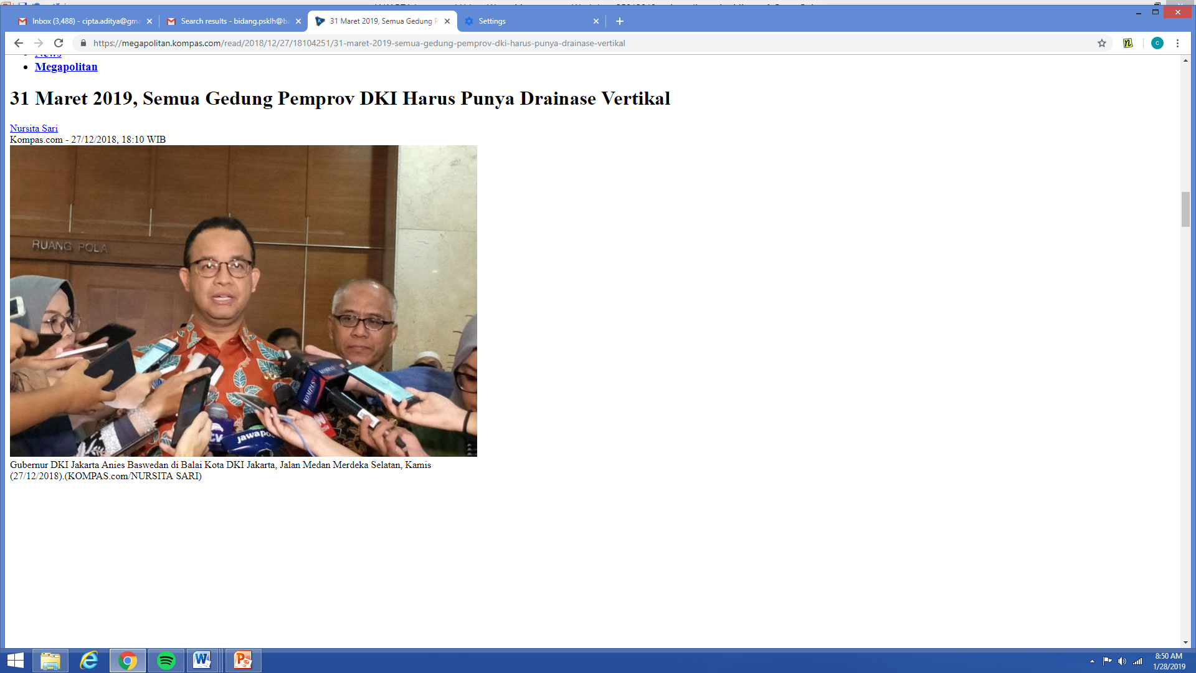
Vertical Drainage
Notes:
we got 18 strategic issues are grouped into five main issues namely Human Development Issues, Economic and Infrastructure Issues, Apparatus Integrity Issues, Sustainable City Issues and Jakarta as the Node of Progress on national development Issues
For the climate change issues are included in Economic and Infrastructure Issues and Sustainable City Issues

Slide 12
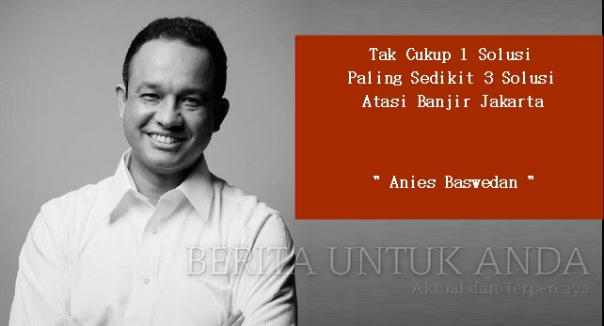



Tantangan
Integrated Urban Water Resource Management
Notes:
we got 18 strategic issues are grouped into five main issues namely Human Development Issues, Economic and Infrastructure Issues, Apparatus Integrity Issues, Sustainable City Issues and Jakarta as the Node of Progress on national development Issues
For the climate change issues are included in Economic and Infrastructure Issues and Sustainable City Issues

Slide 13
Thank You
from
Jakarta, Indonesia

