Slide 1
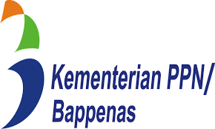


Integrated Urban Water Management
Wet cities
IUWM Workshop in Indonesia
Jakarta & Bogor, January 28 – February 1, 2019
Dr. Carlos E. M. Tucci
World Bank Consultant
tucci@rhama.com.br and www.rhama.com.br

Slide 2
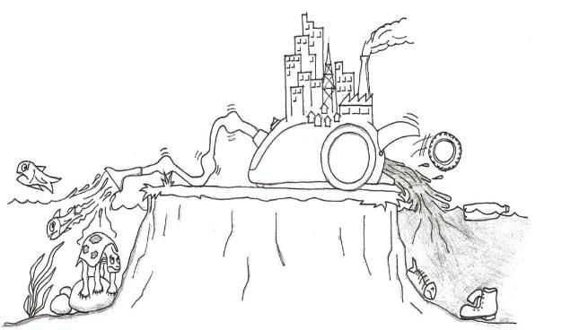
Main challenges
Supply sources
Water Sources
Rain
Contamination of water sources – agriculture and urban areas
Inappropriate land use: unregular land occupation and flood risk areas
Lack of basic urban services – lack of sanitation, solids and stormwater services
Increasing floods – stormwater increasing floods due to urbanization
Negative environmental impacts -solid waste, degraded areas, water contamination
Water related diseases and poor quality of live
URBAN AREAS
Floods
Sewage
Solids
Stormwater Pollution
Floods and Contamination sources
Notes:
Water has an urban cycle of impacts. The water sources: surface and groundwater are used to supply the cities: human, industrial and services, after it resulted in sewage which should be treated, but in developing countries the coverage is small and sewage polluted the rivers and the waters sources. In addition, rainfall precipitation washes the urban surfaces and polluted the rivers, increase velocity of the flow and floods due to the increase in impervious areas, conduits and channels together with solids from sediments and garbage. These impacts are mainly due to lack of appropriate service and education from population. The consequences are polluted urban environment which increases disease’s and poor quality of live. The picture shows the cycle and the drawing the transformation of natural resources in garbage and polluted water.

Slide 3
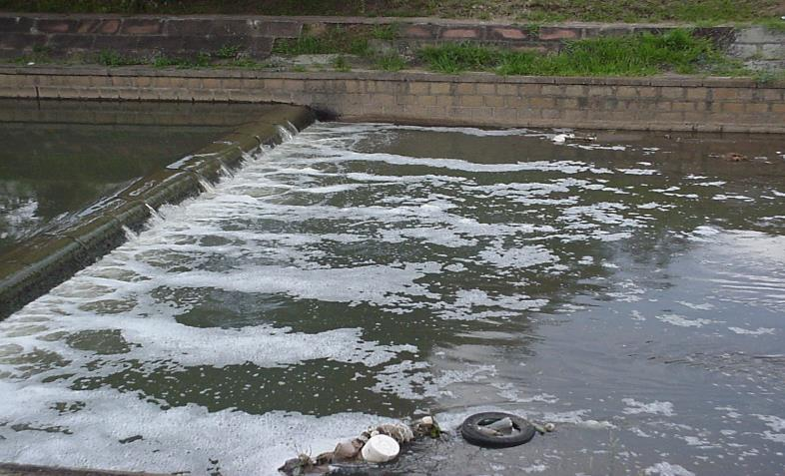
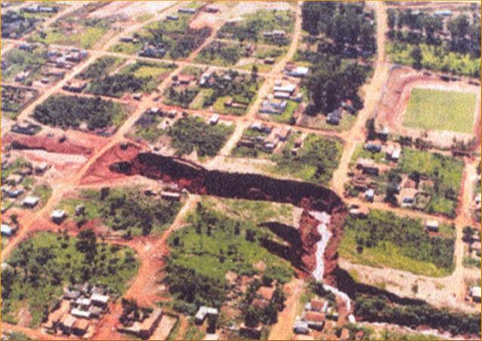
Contamination of water sources with unregular occupation
River and channels Water quality contamination
Flood increase due to urbanization
Degraded area by increase on flow velocity
Flow obstruction from solids
Notes:
The above left pictures shows the contamination of water source by urbanization in São Paulo (Guarapiranga). In the right The drainage of a channel in Porto Alegre where it can be seen sewage contamination and garbage. In the bottom left is shown the hydrograph of a rural basin and the same hydrograph when the basin get urbanized, which increases the peak flow and anticipated the peak. This is increase usually is about 6 to 7 times. Bottom middle picture shows the erosion of a stream as result of an upstream urbanization. The last picture shows in the dramatic way of an obstruction in drainage by a Volkswagen car. Obstruction is often due to many large or small detritus.

Slide 4
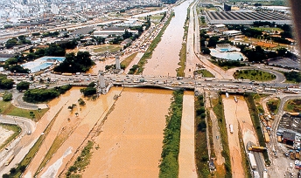
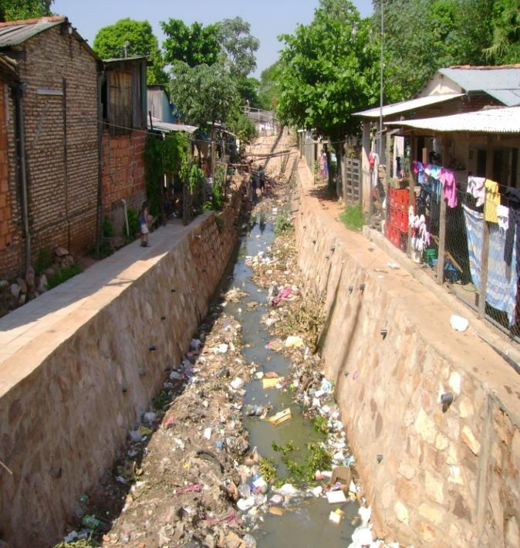
Floods due urbanization increase, river reduction capacity (solids and sediments), and occupation of the valley
Integrated impacts: lack of water supply, sewage, drainage, solids and illegal occupation
Bad practice of closing channels
Notes:
The left above picture shows a flood on Tiete River São Paulo due a urban drainage event. In right side shows a channel with all types of issues: Sewage without treatment, Garbage, illegal occupation, lack of capacity for storm water and water supply. This in an integrated problem. In the bottom left the picture shows the amount of garbage inside of a channel under construction. This is unsustainable scenario since in a few years the channel will be filled with garbage .There is a need of maintenance, which is more complex for a closed channel. This picture tell us that we should deal with garbage and try to do not close a channel.

Slide 5
IUWM Framework
Urban Planning -Land Use
Driver
The main driver of IUWM is land use and its Planning
The society needs basic Institutional construction
Urban water services should be integrated in the space solution
Urban water services should take account of land use aspects and institutional constraints…
…in order to improve quality of life and the urban environment
Solids
Institutional
Legislation & Management
Quality of Life and Environmental Conservation
Water supply
Sanitation
Stormwater
Constraints and conditions
Goals
Urban Water Services
For the same area
Integration means: provide all service to the same planned space
Notes:
The main driver in urban areas in the land use or the urbanization. Based on the urbanization and its distribution the services are provided. The four service in Urban waters are: water supply, sanitation (sewage collection and treatment), Storm water, and Solids management. These services are integrated in each area, but usually they are provided by different institutions which do not talk to each other. Institution construction to deliver services is key in the integration. The main goals should be quality of live and conservation. Development of indicators of these goals is a task for each urban area. The Institutional aspects are a necessary condition for a successful management.

Slide 6
Sustainable Solutions for IUWM
Land use: reduction of irregular occupations; avoid occupation of areas of risk; regulations and incentives for sustainable occupation, efficient transport;
Water Supply & Sanitation: protection of river basin to preserve the quality of water sources; efficiency in WSS services; high coverage of sanitation and water quality goals for the river and Treatment plants;
Flood management and Stormwater: regulation of flood spaces, incentives and regulations for source measures to increase on-site infiltration; detention facilities; integrated amenities
Solid waste: collection and treatment (sanitary landfills); avoid proliferation of degraded areas; preserve functionality of hydraulic infrastructure; reduce-reuse-recycle
Integrated solutions Develop all the services for the same area. Usually the best division are the creek basin inside of the city in order to comply with the impacts from upstream to downstream.
Notes:
The main sustainable solution aspects of IUWM are to improve urbanization with reduction of irregular occupation, avoiding risk areas and decrease the incentive for invasion. Improve urbanization taking into account all services, but in first stage transport, energy and water are the important one. In water supply and sanitation the protection of water supply basins is key. Increase the coverage of sustainable sewage with elimination of contamination and recover the rivers. Storm water is extremely depend of urbanization. Regulation to hold peak flood increase an incentives to source measures and green infrastructure, use infiltration and storage instead of channel and integrated it with amenities. In flood plains the development alternative for risk area such as parks and recreation or preservation are needed in order to decrease the population on these areas. In solid waste management is important to increase value of the garbage with incentives to recycling and improve management with educational processes and pricing the services per volume. Integrated solution is mainly an institutional approach. The services has to be integrated in the space and each city requires an institutional process after assessing its conditions.

Slide 7
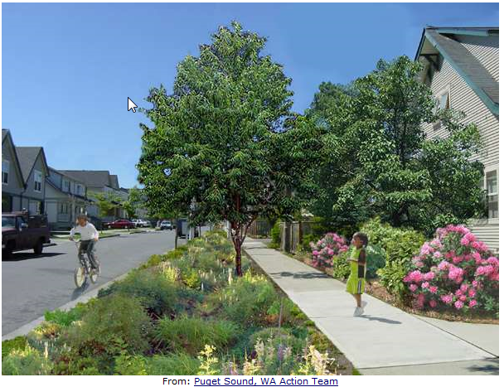
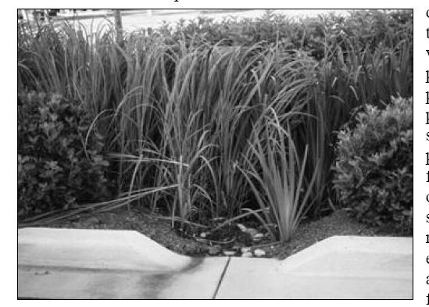
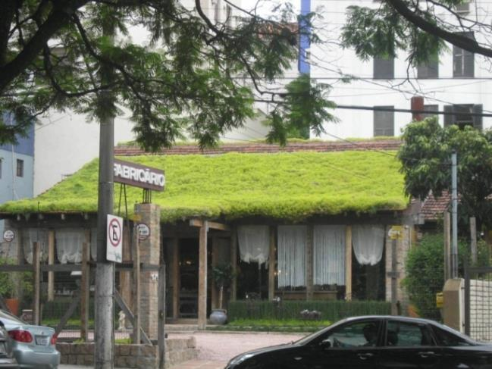
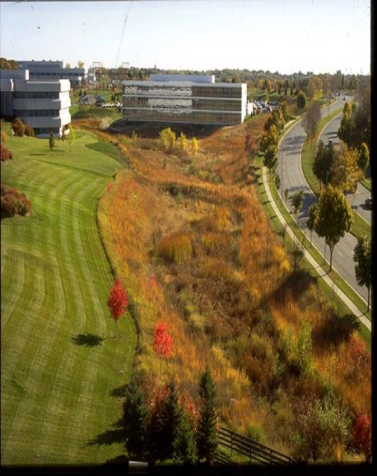
IMPROVING ON SITE MEASURES AND LAND SCAPE
Improve the urban landscape, infiltration and heat
Allow infiltration in the vegetation and side walk
Infiltration decreases the overland flow and recharge the groundwater, recovering the natural hydrologic cycle
Storm water detention, environment landscape and amenities
Improve the local environment and decrease the heat
Notes:
This pictures shows how it is possible to improve urban environment and dealing with the services. The above left picture shows the public area with a lot of areas for infiltration and to receive water from impervious areas. This kind of environment give value to the properties, but requires more maintenance. In the above right side the picture show it is possible to open the curb in order increase infiltration in the vegetation. In the picture below left is presented a green roof which helps on temperature and in the right shows a urban reservoir (detention) integrated to green areas.

Slide 8
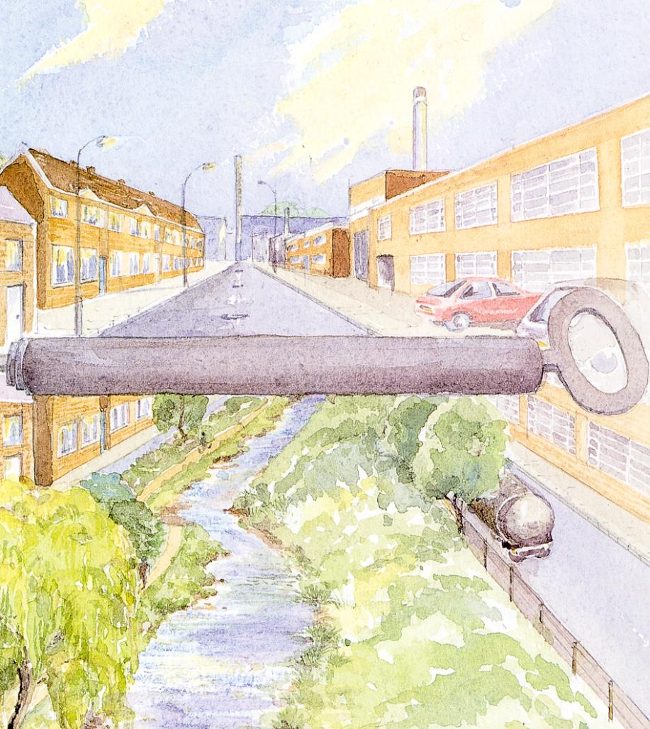
Level of actions
At the private level – at source
  …encouraging environmental certification such as Green Building, LEED, among others, bringing value to the investment. This area actions at source: building, plot development
At the public level – urban area
  …undertaking new developments with sustainable standards for urban recovery which represents an opportunity to change the city. It represents an area of the city
8
Notes:
Nowadays, there are two major ways to develop sustainable measures: At private levels it has been by certification and regulation. Certification is a way to shows that a construction is developing sustainable solutions and there a few private institutions which certificate the projects based on indicators. The regulation is the public requirement to comply with the impacts such as increase floods in storm water by limiting the flow from properties, together with reduce sediments and improve water quality. At public level the solution is by am urban recovery integrated to the interventions in part of the cities. It can be developed in three stages: infrastructure (water, sanitation drainage and solids, transport, resettlement, etc) amenities and education: parks, school, museum, etc; and urban operation which brings investment to the area and cost recovery by taxes and construction permits trading.

Slide 9
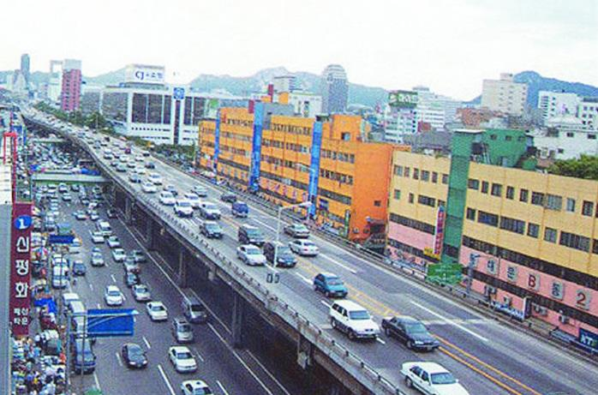
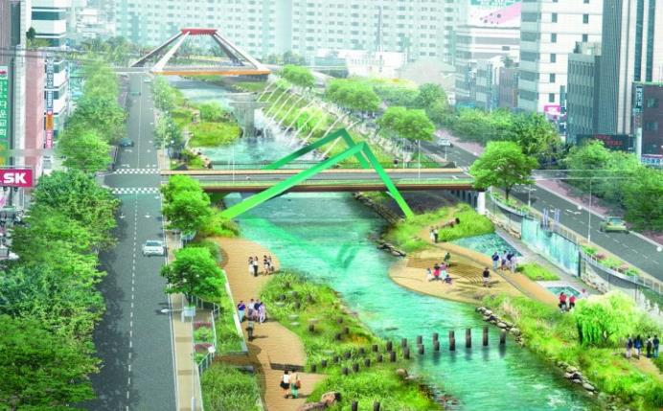
Integrated solutions in Seul
Develop all services for the same area and improve the urban development
Transport
Sewage system
Solid Waste
Stormwater
Housing
Amenities
Improving Landscape
New private Investments
Sewage treatment, storm water, urban recovery, solids, transport, etc
Notes:
Remarkable intervention is show in pictures of the urban recovery from Seul. A River which was covered by concretes and speedway was recovery with a transformation which integrated sanitation, solids management, storm water, transport, among others, improve the area amenities and bring more investments. In the three steps of urban recovery, The cost was about US$ 360 millions in a basin of 62 km2 and 35 months of for projects and implementation.

Slide 10
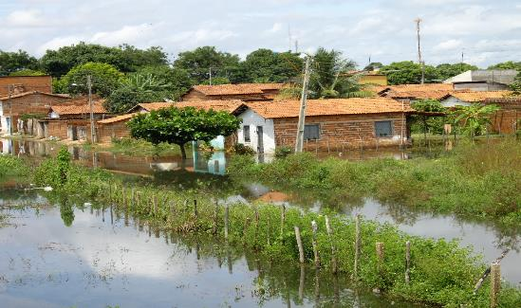
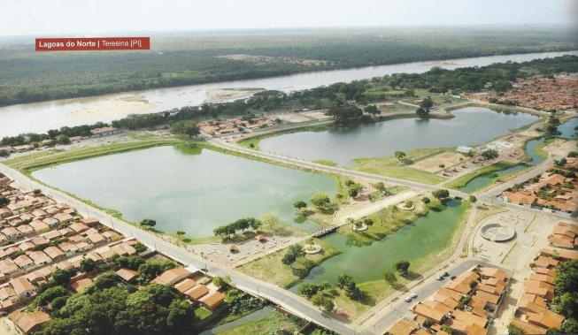
IUWM In Teresina, Brazil
13 km2 (100.000 inhabitants) -Teresina, Brazil;
Poor population without overall infra-structure;
Interventions developed was on:
Sanitation: collection and sewage treatment;
Solid Management: improve the services;
Storm water and flood control;
Integrated lagoon to park with recreational facilities, school, museum, among other
Resettlement of population in risk area;
Urbanization of the area in parks, streets for transport ways
Alternative job opportunities
2008 flood
Notes:
Teresina is a World Bank project in Northeast of Brazil in a part of the city with 100,000 inhabitants and 13 km2. There was floods, solids, poor population with lack of all infrastructure. The integrated intervention was developed for part of the city in the first phase and now is underdevelopment the second phase. It integrated sanitation of the neighborhoods around the lakes, improve de storm water and flood control, parks recovery with recreation, museum, school, resettlements, job opportunities, transport .This process has transformed the area of the city and improve quality of live, water quality and environment.

Slide 11
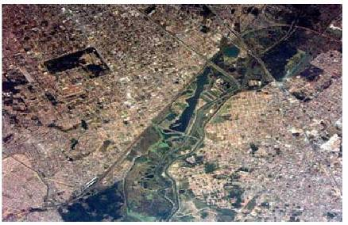
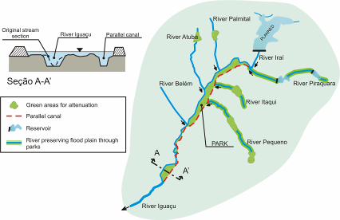
Flood Management in Metropolitan área of Curitiba
About 3 millions inhabitants and stormwater and flood plains impacts;
Strategy:
Step 1: Emergency works
Step 2: Flood Plains of Iguaçu River
Step 3: Stormwater Master Plan for Metropolitan Area
The flood plains after 20 years is still protected

Slide 12
Conclusions
IUWM is a process with a long term vision
IUWM should be developed in stages and requires continuous actions
Institutional strengthening and capacity building are conditions to move from planning to actions
A holistic approach that integrates actions and measures in the urban space is more efficient to achieve economic, social and environmental goals
Notes:
IUWM requires long term investments and change in the way to develop the city. It requires the development in stages with continuity. This a difficulty since in the political arena, the administration changes every 4 years. However, if there a strong public participation the new administration needs to go ahead on this type of investments. The Institutional development requires steady institutions and utilities with strong capacity building with State type of employee which keep the memory and development of strategic projects. Integration is a word to be used for space areas in all aspects of services and outputs for society goals in economic, social and environment.

