Slide 1
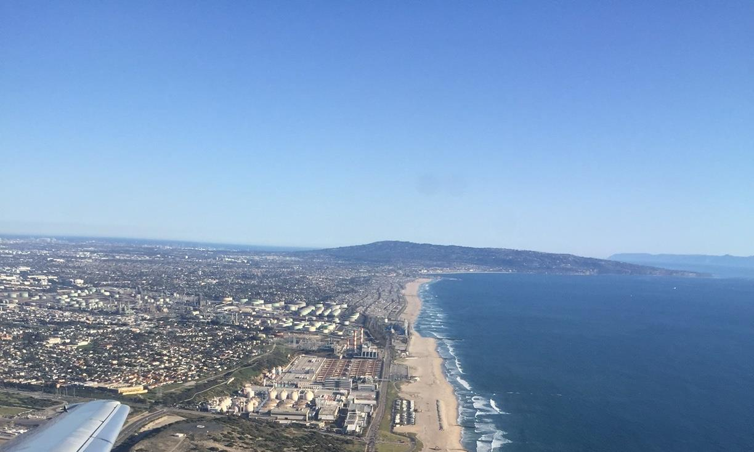


Urban Water Security Under Scarcity
Lizmara Kirchner
World Bank
January 2019
Courtesy of the World Bank Water Scarce Cities Team
Notes:
Based on inputs from Stephane Dahan, Richard Abdulnour, Amal Talbi and Clémentine Stip
Reference to the report “Water Scarce Cities: Thriving in a Finite World – Full Report

Slide 2
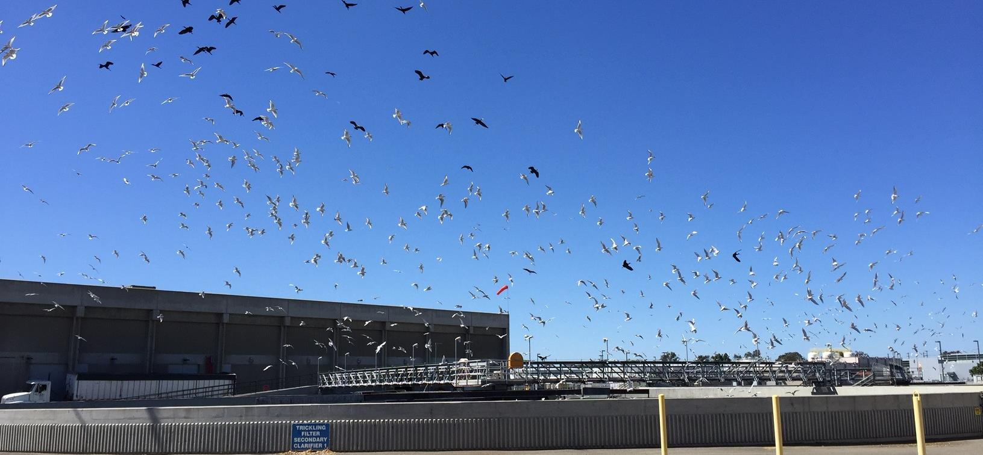
Urban Water Security under Scarcity
A new pathway to urban water security
Unprecedented Challenges
Unsustainable Resource Management
Unconcerned Utilities
Population growth, urbanization, economic and climate change are looming over urban water security in the region
Putting the region on a dangerous path towards major water crises in many countries
Cities worldwide continue to rely on traditional solutions based on abundant resources and engineering approaches to increasing water supplies
Shifting the mindset towards resilience through diversification
The mindset must shift away from linear solutions, to embrace more integrated approaches. To support this, there is tremendous scope to demystify some of the existing, practical solutions to get there, and unleash the potential to tackle physical scarcity
Notes:
Today, cities are facing unprecedented challenges, while the water resources they depend on are not always well managed at the basin level.
At the same time, the thinking has not evolved towards new approaches and solutions that could help meet these challenges head on – utilities continue to seek traditional, supply driven solutions.
We need a paradigm shift:
1) to embrace more integrated approaches
2) to seek diversification and seek solutions that break away from traditional linear approaches and consider diverse water portfolios that respond to diverse risk profiles.
This shift will enable cities to unleash their potential to tackle scarcity.

Slide 3
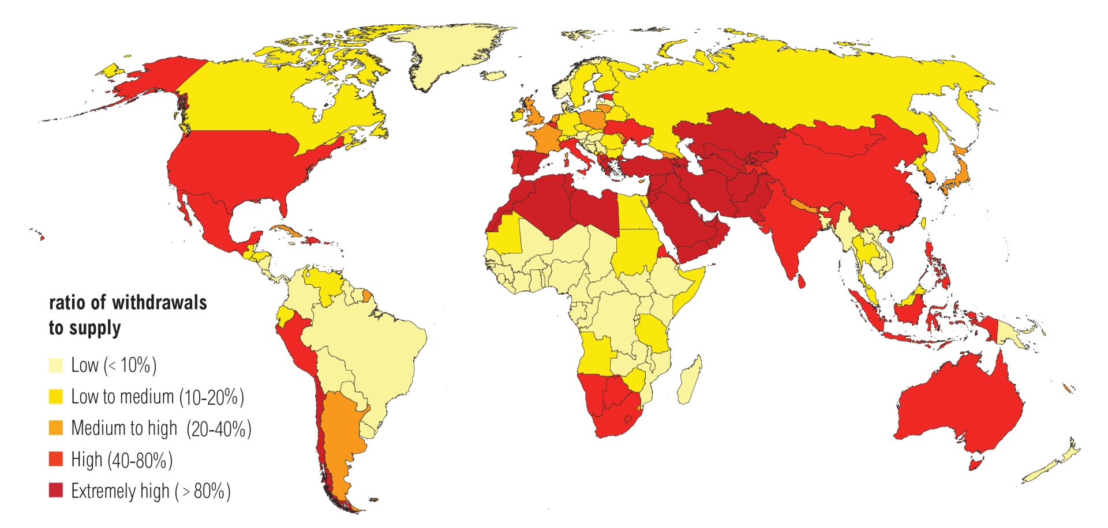


Unprecedented challenges are looming over urban water security…
By 2030, half of the world’s population will be living in water-stressed areas (UNDESA 2014).
By 2050, 66 percent of the world’s population is expected to reside in urban areas (up from 54 percent today), with nearly 90 percent of the increase concentrated in Asia and Africa (UN 2014).
All climate models point to more severe and intense droughts in the future.
Water stress by country in 2040 (Source: WRI)
In 2050, urban water demand could increase by as much as 250%, and 1 in 4 cities could have water shortages even if they had first priority for water.
…and the current management of water resources is putting us on a dangerous path
Notes:
Source for the last stat: https://blog.nature.org/science/2018/01/12/global-change-and-urban-agriculture-competition-for-water/

Slide 4

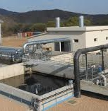
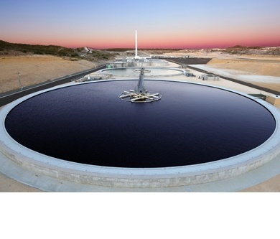
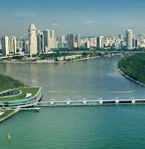
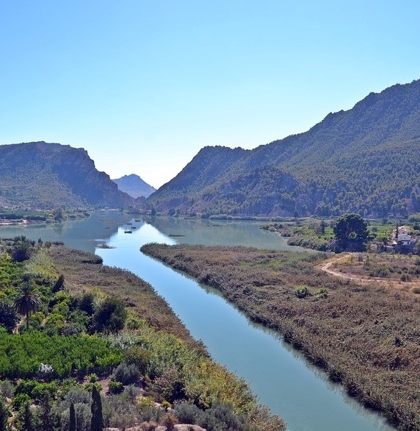
Shifting the paradigm
Reducing city’s dependence on abundant water.
Hedging against risks through diversification.
Relying on solutions that are not vulnerable to climate change.
Ring fencing water systems from external competition.
Coping with uncertainty and variability through adaptive design and operations.
Areas of focus for ‘traditional’ service providers
How much water is allocated to the city and in which quality?
How to produce and distribute safe drinking water, and how to collect, treat and discharge wastewater at the lowest cost?
With traditional operating cultures, utilities may not be in a strong position to
address many of these new threats to water security, as faced by:
Amman
Windhoek
Perth
Singapore
Murcia
Sharp, unplanned inclines
in water demand
Slow deterioration of
water resources
availability / quality
Drastic changes in
hydrology due to
climate change
Shifting priorities
of the main, historic
water source provider
Power play with
competitive water
basin users
Notes:
We need to shift from the linear approach where service providers focus on quantity of water allocation and lowest-cost service provision.
The cities of today face: (go through the list of cities and challenges on slide)
- sharp, unplanned increase in water demand
- deterioration of water resources availability and quality
- drastic changes in hydrology due to climate change
- shifting priorities
- competition with other users in the basin

Slide 5
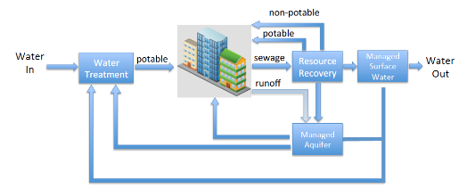
This redefines the challenge of delivering urban water services
Managing urban water service delivery is no longer sufficient, the key is understanding and managing the urban water cycle in all its components, and its links to the watershed (and aquifer)
Water 4.0
New questions become critical for service providers…
Are the water resources we rely on managed in a sustainable manner?
Which other users rely on these water resources?
Will their (and our) water demand increase? What will that mean for our supplies?
How will water resources be affected by climate change?
Are there other, untapped water resources available?
… some of which have already embraced a new mindset
Closing the urban water cycle
Promoting recycling and recharge, and increase unlimited resources such as desalination
Resilience through diversification
It’s not either/or anymore, it’s both/and, where increased uncertainty and variability call for a better risk balance
Cooperating for increased allocations
Working with non-municipal users to promote wastewater reuse, or water banking/trading
Notes:
We need to re-place the city within its broader water cycle / ecosystem / watershed
This means encouraging service providers to think beyond their network and service areas towards the sustainability of their resources and the shocks that could influence their resilience, water demand, system health…
Three important principles are:
Closing the urban water cycle
- In Singapore they introduced the concept of NEWater – treat wastewater and reinject it directly into the water supply
Resilience through diversification
- Singapore PUB’s 4 taps (imported water, stormwater, desalination and NEWater)
Cooperating for increased allocations
- In the case of Singapore, this has meant negotiating with Malaysia to slowly ease the country’s dependence on imported water from their neighbor

Slide 6
Many solutions have already proved effective
Many cities have already pioneered effective solutions to build resilience to water scarcity
and there is tremendous scope to demystify their experience
Successful experiences need to be scaled up…
Technologies are known, and often less
costly than alternative, especially when
accounting for scarcity
Integration is critical, to overcome the array of political, cultural, and other barriers
Public Outreach is key to most successful
experiences (e.g. Pure Water in San Diego)
… to bring the most successful solutions to the forefront
Optimize Conventional Resources
Better storage management (surface and groundwater), inter-basin transfers
Increase Non-Conventional Resources
Seawater or brackish water desalination, wastewater recycling, stormwater harvesting
Improve Demand Management
Leakage reduction, Conservation
Notes:
There is a lot of existing expertise and innovation around the world, and there is no need to reinvent the wheel.
Solutions we see more and more:
Optimize Conventional Resources
For example using aquifer as a reservoir to avoid evaporation, but also managing large storage systems through dams and planned release as in Brazil
Increase Non-Conventional Resources
Mentioned the example of Singapore earlier, but many cities are doing it around the world like Windhoek since the 1960s
Improve Demand Management
See demand management as an ‘untapped resource’, water that can be ‘freed up’ for other uses
However, these successful experiences need to be scaled up: we know the technologies, we know it can be done, but we need stakeholder integration and public outreach to make them the new normal.

Slide 7
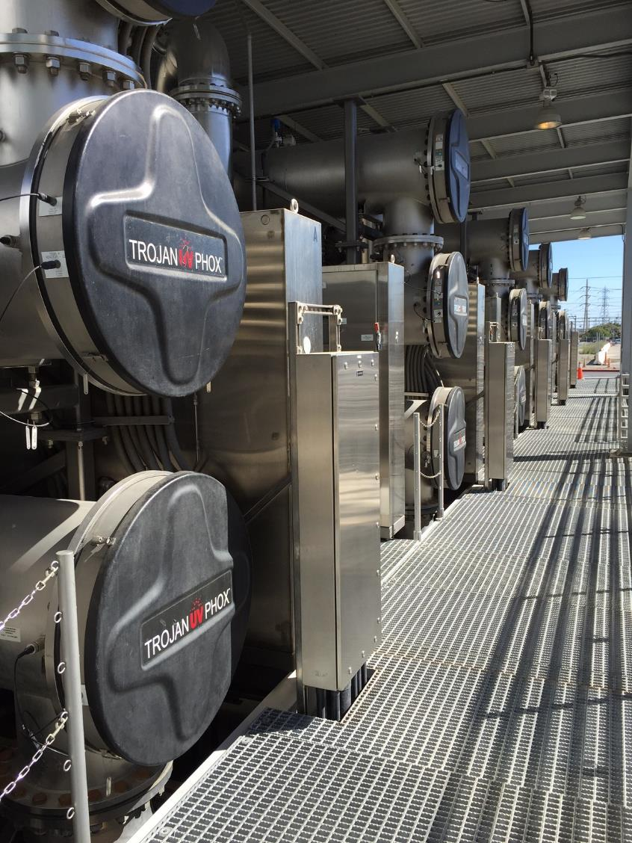
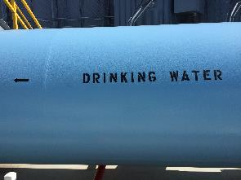
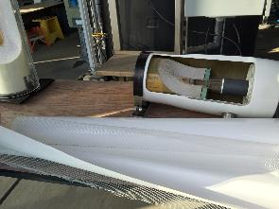
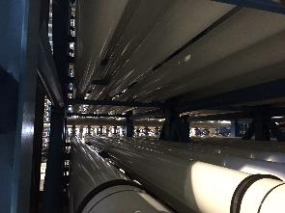
A difficult path to security
How do we unleash this potential?
Political/cultural issues
Limited sensitivity to water risks, entrenched engineering approaches, complexity of cooperation and demand management, cultural resistance to recycling, desalination
Institutional issues
Lack of accountability/autonomy of service providers, lack of mechanisms for integrated planning, rigid regulatory frameworks limiting innovations (recycling, trading, PPPs)
Technical/economic issues
Limited awareness of solutions, insufficient capacity for design/O&M, lack of robust economic assessment tools, limited financial resources
Notes:
We see four main barriers to the realization of this potential:
Lack of political prioritization or cultural acceptance – until there’s a crisis
Lack of integration across the relevant stakeholders to agree on common challenges and plan for integrated solutions
Limited awareness of the possible solutions or their applicability to the local context
Lack of resources (human and financial)

Slide 8
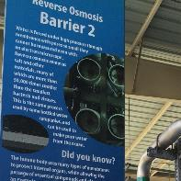
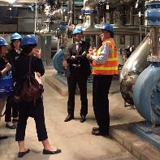
The Water Scarce Cities Initiative
Bolster awareness of effective approaches to build
urban water security and climate resilience
Generate knowledge
Case Studies
Build on the review of water scarce cities experiences around the world to demystify options for urban water security under scarcity
Facilitate exchanges
Network
multi-stakeholder dialogue, knowledge flow and collaboration through establishing a global network of practitioners and experts
Engage our clients
Support
Facilitate technical assistance to interested cities, to establish feasible pathways to water security
Notes:
So the Bank launched the Water Scarce Cities initiative organized around 3 pillars
Case studies to generate knowledge on how cities have dealt with scarcity
A network to share this knowledge among practitioners
And direct operational support for our clients to integrate this knowledge with project support from the WB

Slide 9
New urban water management principles
Reducing city’s dependence on abundant water
Hedging against risks through diversification
Relying on solutions not vulnerable to climate change
Ring fencing systems from outside competition
Adaptive design/operations to cope with uncertainty –
Integration with other sectors to promote circular economy
Notes:
Integration with drainage, solid waste, urban planning help promote circular economy
Across the broad variety of contexts and challenges, cities’ strategies have consistently been framed along these few principles

Slide 10

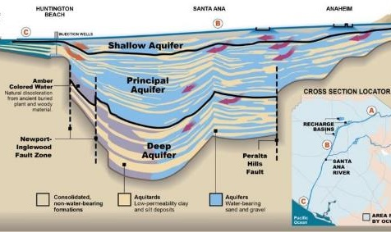
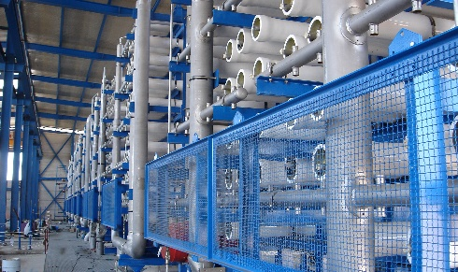
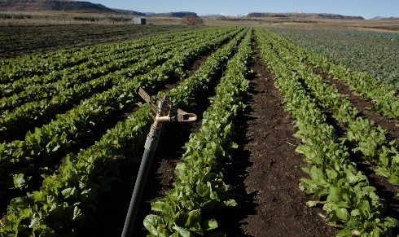
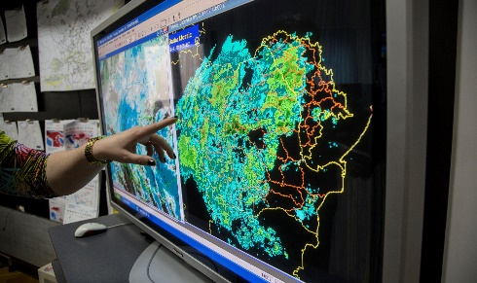
A range of solutions to operationalize these principles
Reducing dependence on abundant water
Although many of the solutions and success stories are known, few are documented, available or accessible
Beyond desalination, reuse, etc., the optimized and collaborative management of surface, and even more so groundwater can bolster resilience to urban water scarcity
The majority of solutions are not technological, but rather relate to sector governance and utility management strategies
Promoting water conservation
Improving infrastructure efficiency
Innovative surface and groundwater management
Optimizing groundwater management
Water banking and virtual transfers
Non-conventional water resources
Stormwater management and rainwater harvesting
Wastewater reuse
Seawater desalination
Cooperation with other users
Managing water at scale
Cooperation for optimized allocations
Water trading
Adaptive water system designs and operations
Planning under uncertainty
Resilient water system operations
Notes:
There are different solutions that can help us operationalize these principles, and each case will demand its own tailored set of solutions.
I will present some examples in the next slides – which are mostly drawn from the case studies in the water scarce cities report.

Slide 11
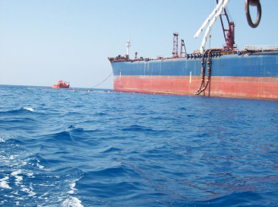
Reducing dependence on abundant water
Cities worldwide have grown economically while drastically reducing water demand
Measures such as restrictions, pricing, education, public outreach can effectively reduce water demand
Crises as policy windows. Only in best cases (Australia), restrictions are recognized as good water use practices, gains are maintained post-drought
Keys to social acceptance: equity, communication to sensitize on impacts, feedback on progress achieved
Financial incentives to install water-efficient devices, tax incentives and rebates for rainwater harvesting, drought-proof landscaping, greywater recycling, etc.
Aggressive IBT tariffs, but adjusted to ensure fairness across household sizes (Malta, Singapore), to maintain cost recovery when consumption declines (Irvine)
Multi-stakeholder platforms (utility, businesses, research…) useful to identify and promote water conservation in their respective sectors (Las Vegas, Zaragoza)
SPAIN AVERAGE
Tanker water delivery to Cyprus from Greece in 2008: a symbol of drought impacts, burned in public’s mind
Notes:
No country wants to get to the point that Cyprus did in 2008, when they had to have water delivered by boat from Greece.
Reducing water demand can be the first measure to address mindsets and make sure consumers value water for the scarce resource that it is.
Crises are policy windows – and often it is hard to maintain those gains. In Windhoek, where drought is the new normal and resources keep dwindling, the utility actually has to maintain an aggressive media campaign to ensure users are aware that the situation keeps worsening – and continue to watch their usage.
Promoting social acceptance through communication and equitable measures, encouraging feedback from consumers so that they feel heard and to consumers so they know about the impact of their actions.
Financial incentives can be a strong motivator and in the long run will save the utility money on expanding water sources
- One of the first measures put in place in Cape Town was to increase charges to large water users (specifically industry)
Tariffs play a big role in signaling the value and scarcity of water to consumers, and can be creatively designed
- Irvine Ranch Water District has tailored increasing block tariffs for households based on their property area, number of family members, and the weather of that particular month.
Multi-stakeholder platforms (bringing together different perspectives) help identify the best areas to conserve water and ensure there is consensus around the measures in place

Slide 12
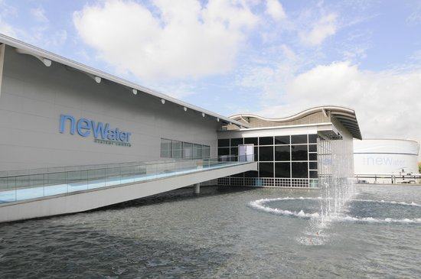
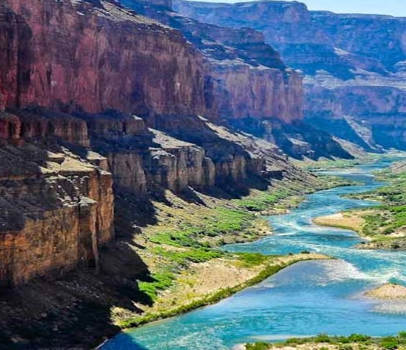
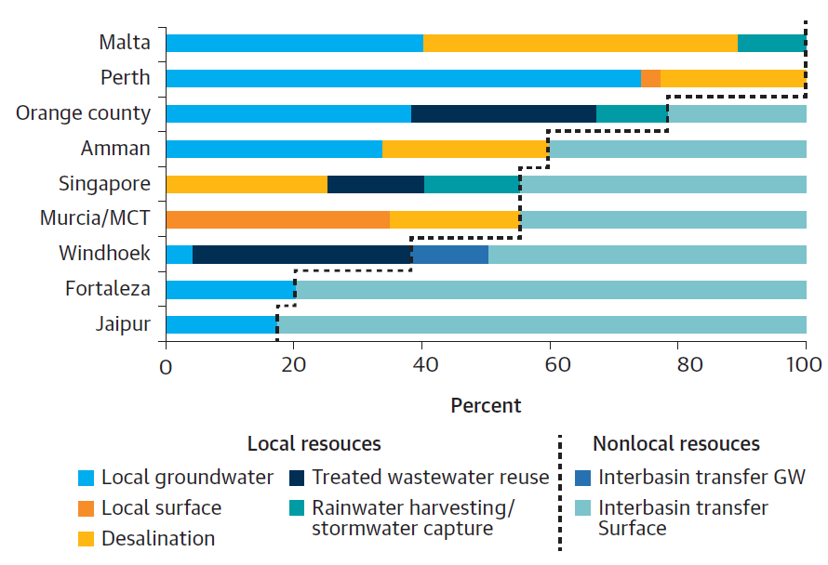
Hedging against risks through diversification
Diversification can occur through different types of resources or geographical spread of resources
Cities reviewed rely on average on 3+ key distinct sources
Sample:
Cyprus
Singapore’s four
national taps
Las Vegas water banking schemes
The utility developed a balanced portfolio where sources have different risk and cost profiles. This includes: local catchment, imported water, desalination and direct potable reuse
The utility banked 2,200 Mm³ across three states of the Lower Colorado River basin. Those can be abstracted in case of water shortages.
This bolsters utility’s resilience to localized droughts in the region.
Notes:
This graph on the left shows the different sources that the cities reviewed for the water scarce cities report relied on. As you can see, on average most cities relied on 3 or more resources, and most had a mix of local and non local resources.
Singapore’s four taps: (imported water, stormwater, desalination and NEWater)
Las Vegas banks water locally in its own aquifer and in other states, using the water rights agreements to trade water across boundaries. This water can then be extracted in times of shortage.

Slide 13
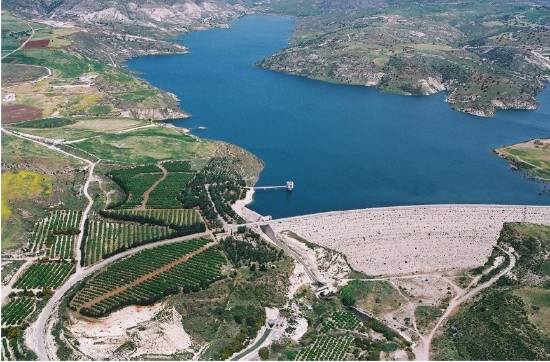
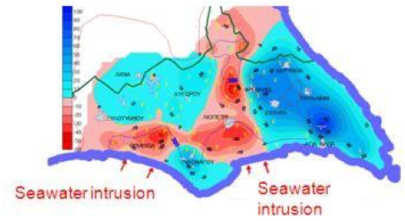
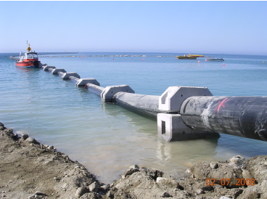
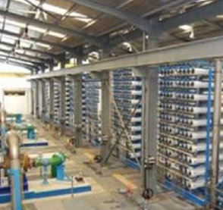
Relying on solutions not vulnerable to climate change
The case of Cyprus – a common water sector trajectory leading to massive reliance on desalination
1960-80’s
1990’s
2000’s
2010’s
Surface and groundwater production capacity to max capacity
Wet early 2000’s → desal program postponed, dams largely emptied for agriculture
Severe drought 2008-09
Rapid tourism, population increase
Average:
- rainfall  20%
- runoff  40%
Reluctance to impose restrictions before elections
Aquifers depletion, saline intrusion
Catastrophic water shortage
Large scale desalination program to make municipal water supply independent of weather conditions (and political decision-making)
+ Development of wastewater reuse for agriculture
Notes:
Another story of building resilience: Cyprus
Started with reliance on groundwater and surface water, but soon reached capacity in the 60-80s.
Drought and tourism increased in the 1990s leading to Aquifers depletion, saline intrusion
A first respite in the early 2000s led them to postpone their desalination program,
Which, compounded by a severe drought, competition with agriculture and reluctance to impose restrictions before elections led to a Catastrophic water shortage
In the 2010s, they developed Large scale desalination program to make municipal water supply independent of weather conditions (and political decision-making)
To deal with pressing water challenges in the face of climate change, cities need a robust decision-making framework the can increase resilience while taking into account uncertainties.
We need to shift our focus from seeking highly precise predictions and adjusting our planning for potential multiple scenarios on climate change can avoid costly surprises and help reach consensus – there are a number of tools available that can help with this process.

Slide 14
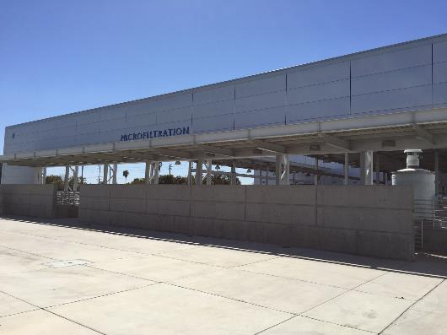
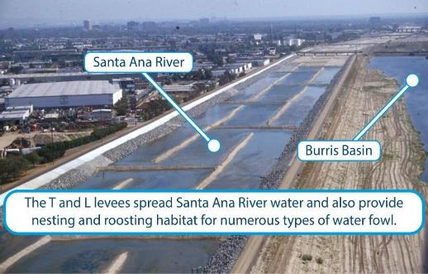
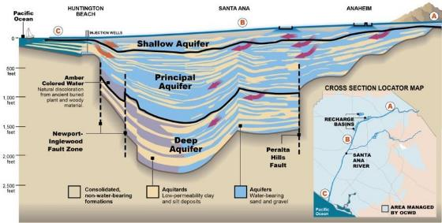
Ring fencing water systems from external competition
Orange County Water District’s (OCWD) experience mobilizing local, non-conventional resources
to reduce dependence on imported water
Groundwater Governance
Wastewater Recycling
Stormwater Capture
OCWD created as a collaborative effort to manage the aquifer on behalf of local water agencies. Developed wastewater recycling and stormwater capture to recharge the aquifer, prevent saline intrusion and reduce dependence to imported water
,
OCWD built a 400,000 CM/day water purification facility (GWRS), operational since 2008, producing near distilled quality to recharge the aquifer
OCWD also built a dam on the only existing (seasonal) river in its jurisdiction, and manages the river bed into recharge basins, controlled by inflatable rubber dams
Notes:
Developing local resources means less competition from other users (other sectors or competing cities depending on the same watershed)
Orange County Water District is a good story of diversification to promote independence from increasingly expensive imported water
Depend on Colorado River and Northern California water – lots of competition in these two systems
More control over these local sources
Started using their aquifer as storage and developed a collaborative governance structure, including agreements on pumping allowances for users
Capture stormwater to actively recharge the aquifer
Complemented recharge with wastewater reuse

Slide 15
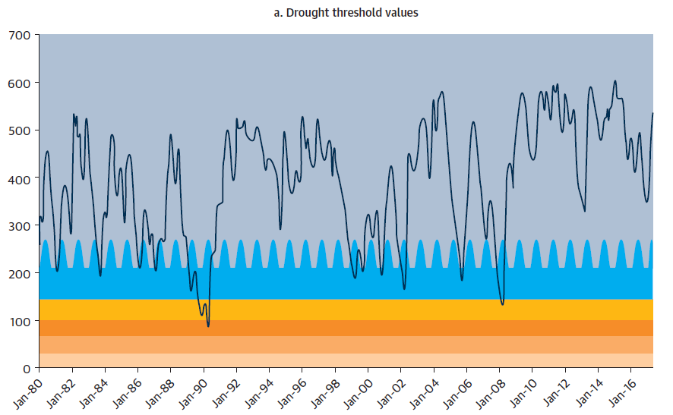
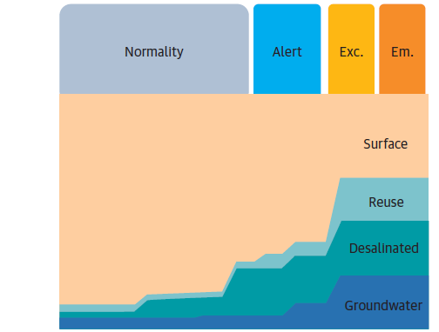
Adaptive design water system designs, operations
In Barcelona, the water utility has set up a Drought Plan to maximize drinking water supply and minimize economic impacts of dry shocks:
Predefined measures based on water levels vs. drought thresholds: alert, exceptional, emergency
Progressive water sources mix and conservation measures
Permanent surveillance through defined KPI’s: reservoir levels, accumulated rainfall, piezometric levels of aquifers
The process has been refined iteratively through consultations with users and analysis of previous droughts
Drought
threshold
Water
sources
mix
Groundwater treated as ultimate strategic reserve
Surface vs. desalination based on cost profiles
Notes:
Contingency plans are extremely important to ensure that cities are prepared in the event of a drought or other extreme event. For example, based on specific thresholds, Barcelona’s Drought Plan defines what mix of sources they will use.

Slide 16
Technology is not the major concern
Most technologies are mature
Some solutions (reuse, aquifer recharge) still require careful preparatory engineering work
Technology rarely highlighted as key challenge
In the definition and implementation of water scarcity solutions, governance and communication were much more prominent
Capacity to plan and implement can still be a concern
Public-private partnerships can help fill the capacity gap in some cases (desalination, reuse)
Notes:
It’s important to note that technology is rarely the issue

Slide 17
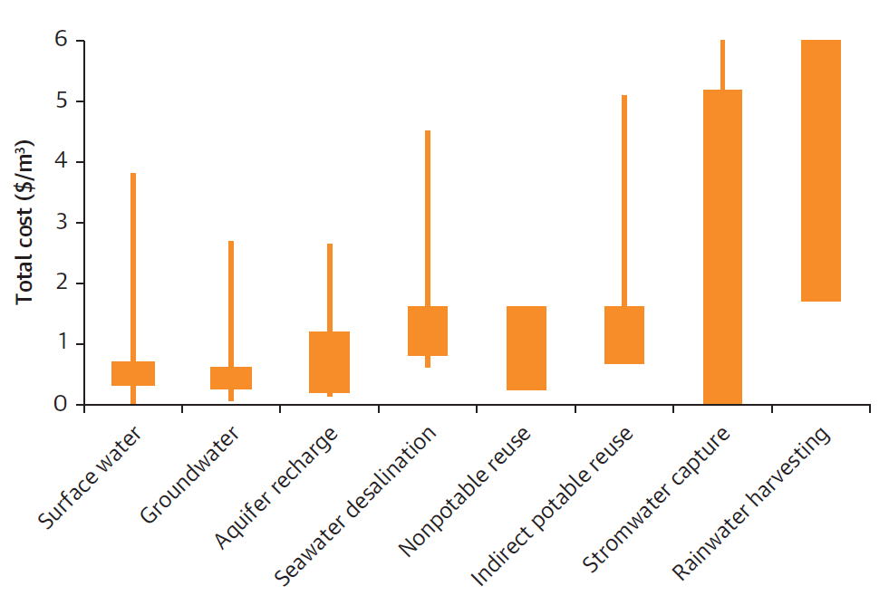
Good economics is key
…but is rarely verified
Costs (CAPEX+OPEX, $/m³) of several supply solutions
Water production costs are shifting
Nonconventional solutions are becoming often more affordable than the expansion of conventional ones
Economic costs & benefits analyses are rare
Even in the most advanced cities, policy windows tend to dictate water resources choices more than cost-benefit justifications.
The economics of certain measures remain elusive
Leakage reduction, demand management include a mix of soft, long-term activities, and are seldom isolated as cost items and assessed economically

Slide 18

Inclusion and good communication are critical
Social acceptance is critical to the success of many solutions
Programs require deep behavior change (water conservation), increased awareness (groundwater management), change of perceptions (reuse), etc.
Communication efforts: stepping stones to social acceptance
They address public’s doubts, offer a platform for feedback. Effort need to be continuous. Support of long-term programs is key to avoid changes after each political cycle.
Inclusive decision-making processes help garner strong support
Advanced cities rely on participatory decision-making models (advisory committees, citizen juries, etc.) to build ownership and prevent future opposition.

Slide 19
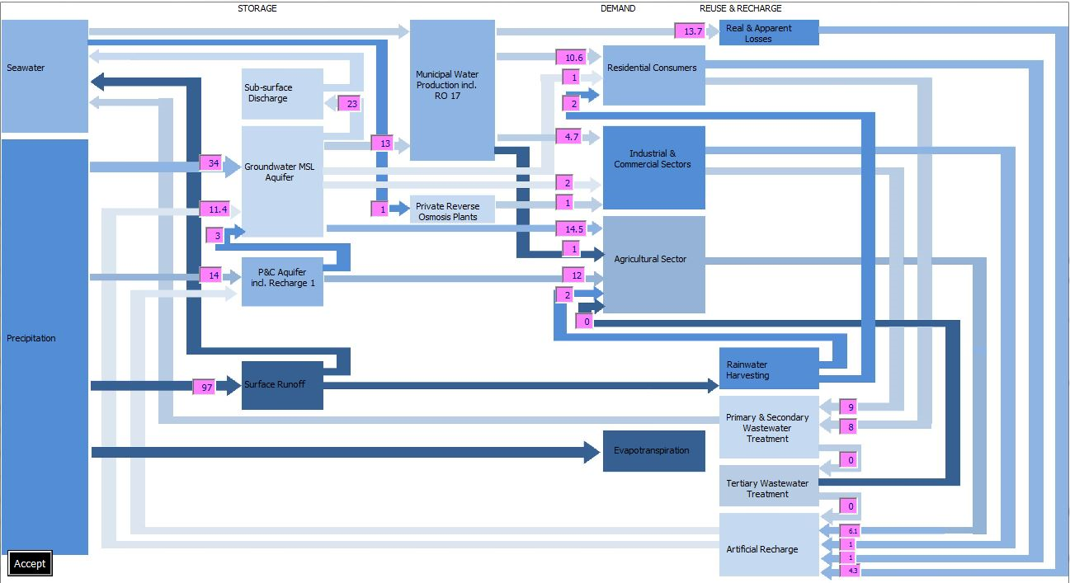
Integration is a critical enabler
Water cycle managed by Malta Water Supply Corporation
Thriving as a stakeholder in a competitive river basin
This requires effective WRM by a river-basin agency, and a utility actively involved in this management. Less influent urban centers can garner political support through regional public entities representing them.
Municipal
Water
Product.
Incl. SWRO
NRW
Seawater
Sub-surface discharge
Residential
customers
Ground-
water
Industrial
Commerc.
Sector
Benefits of integrating WSS and other mandates
Utilities managing water services + resources have highest incentives to seek efficiencies, and form a unified front in negotiations with other parties. Integration with drainage, solid waste, urban planning help promote circular economy
Agricultural
Sector
Precipi-
tation
Surface
runoff
Rainwater
harvesting
Prim/Sec. treatment
Evapotranspi-
ration
Reflecting the paradigm in utilities’ internal organization
A culture and governance shift is required to enhance non traditional functions (WRM, marketing, communication), to overcome conflicting goals of demand management and profitability, to diversify technical and procurement skills, etc.
Tertiary treatment
Artificial
recharge

Slide 20


Thank you for your attention
Our
email
Waterscarcecities
@worldbank.org
Our blogs
https://blogs.worldbank.org/water/category/tags/water-scarce-cities-initiative
Your main contacts
Stephane Dahan, Amal Talbi, Richard Abdulnour, Clementine Stip
And our main partners
ReNUWIt, CRCWSC, UCLA, AWP, IWA, GWP Med

