Slide 1
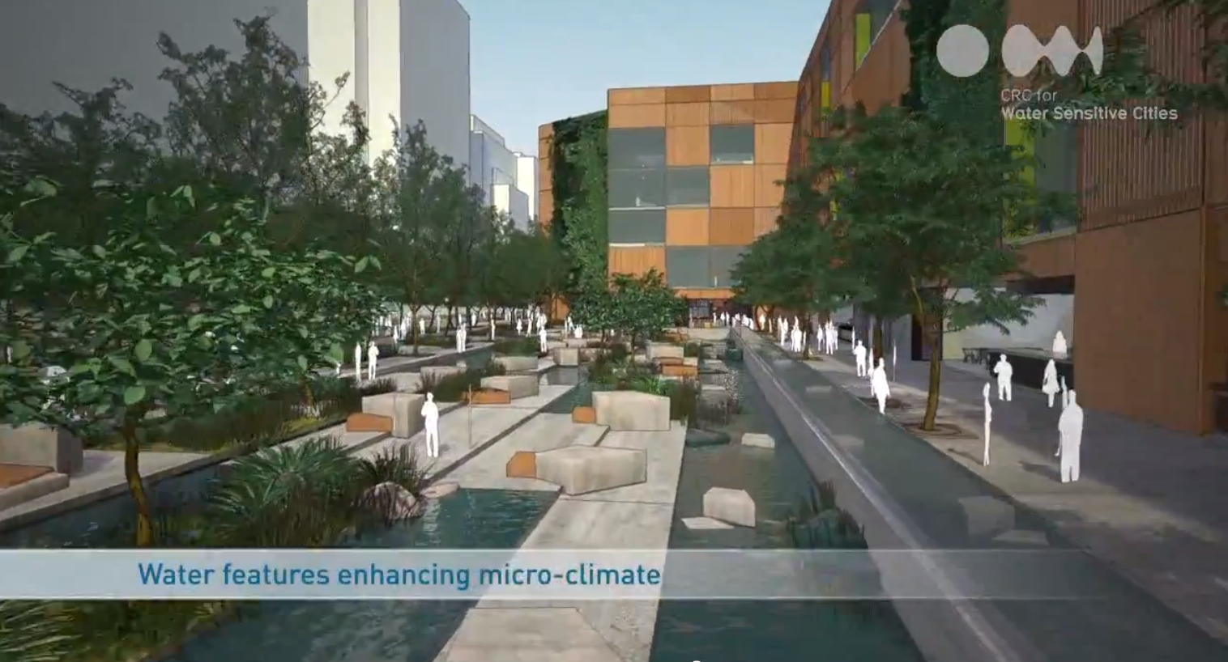


Cape Town delegation
A water sensitive approach to more resilient cities
6 March 2018

Slide 2
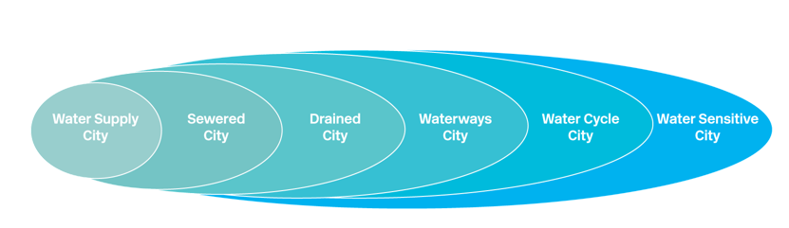
Cities tend to transition through a number of stages but leapfrogging is possible

Slide 3
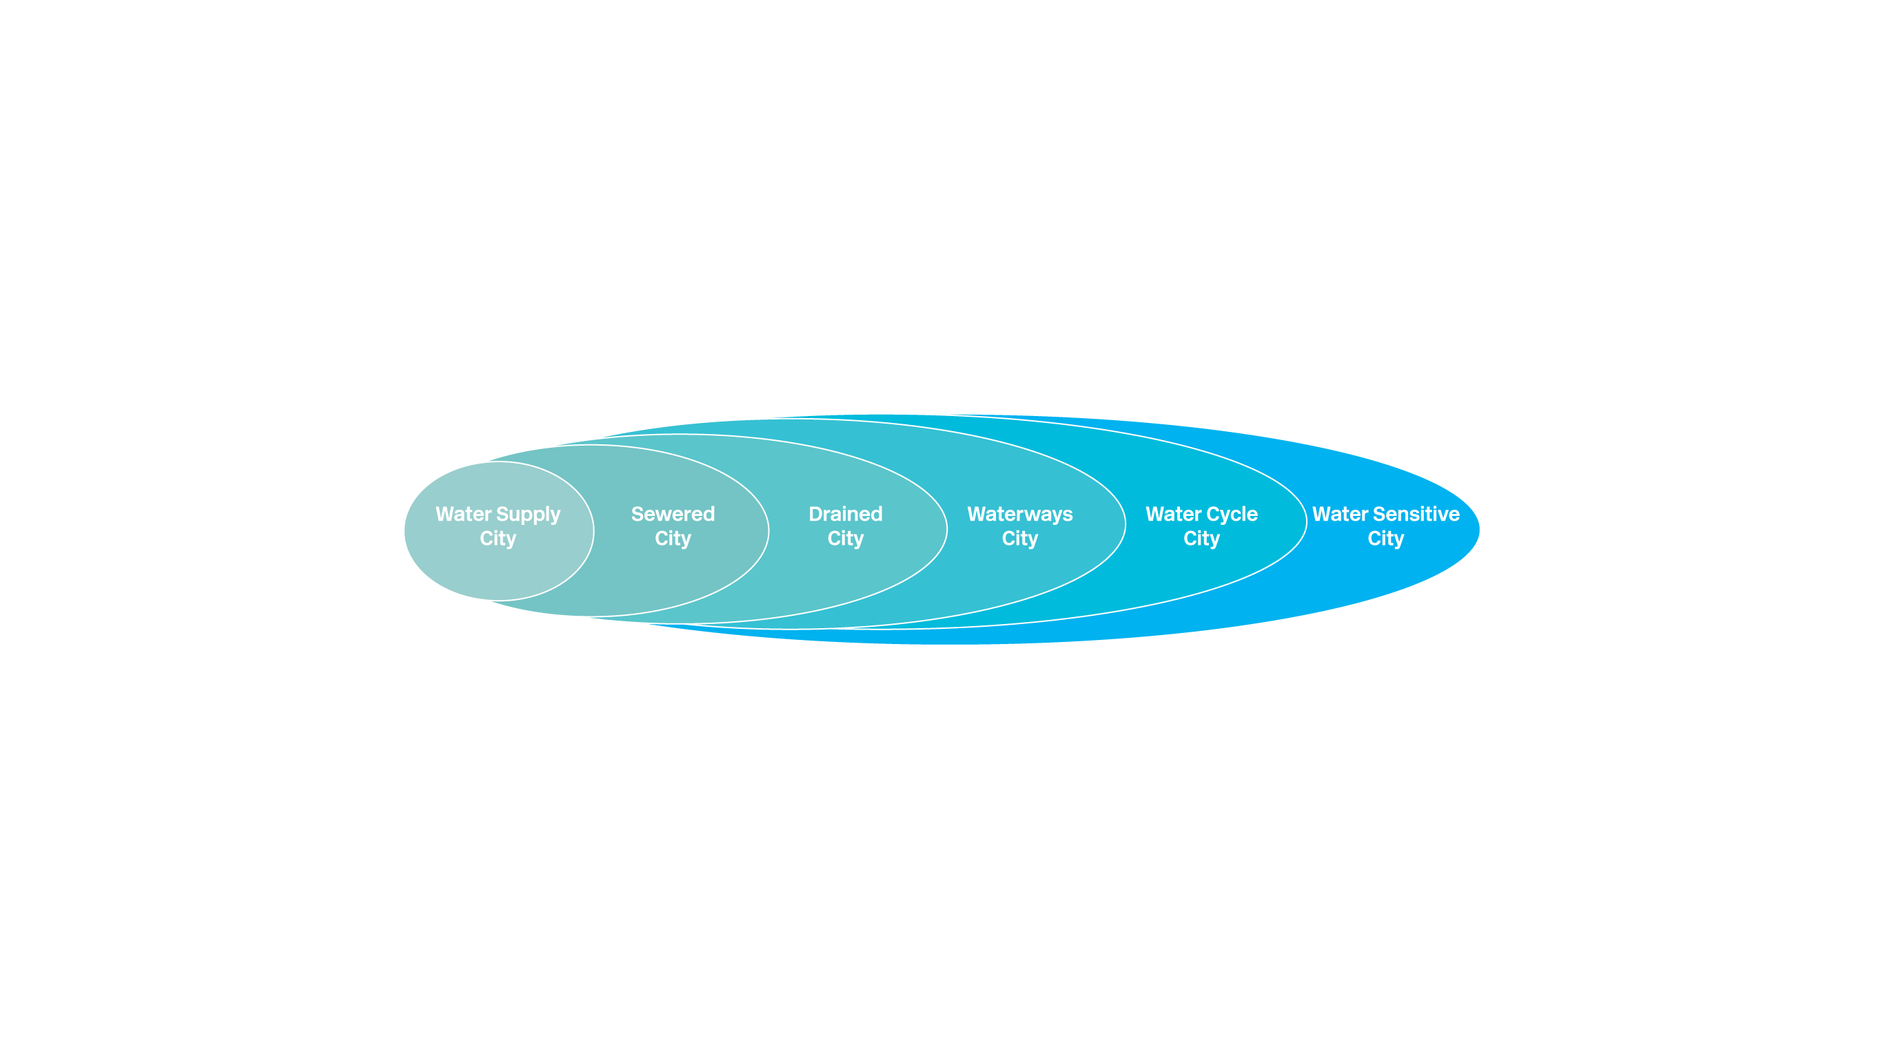
Opportunities and challenges
Speed
Scale
Scope
A systems perspective
Options

Slide 4
Cities tend to transition through a number of stages but leapfrogging is possible
Key enablers of change:
An engaged and empowered community (culture)
Better use of nature based solutions (nature)
The city as a water supply catchment (structure)
Notes:
Blance three things

Slide 5

An engaged and empowered community

Slide 6
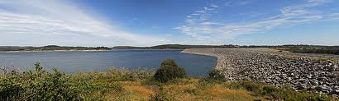
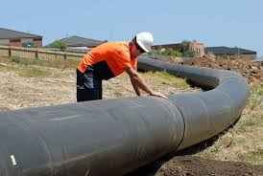
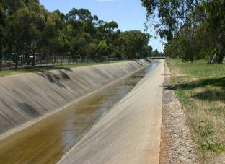
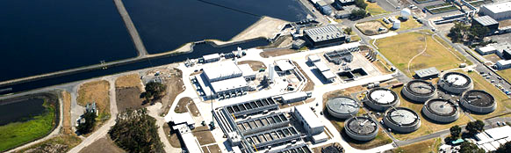
Traditional water management
Water supply
Drainage
Sewerage

Slide 7
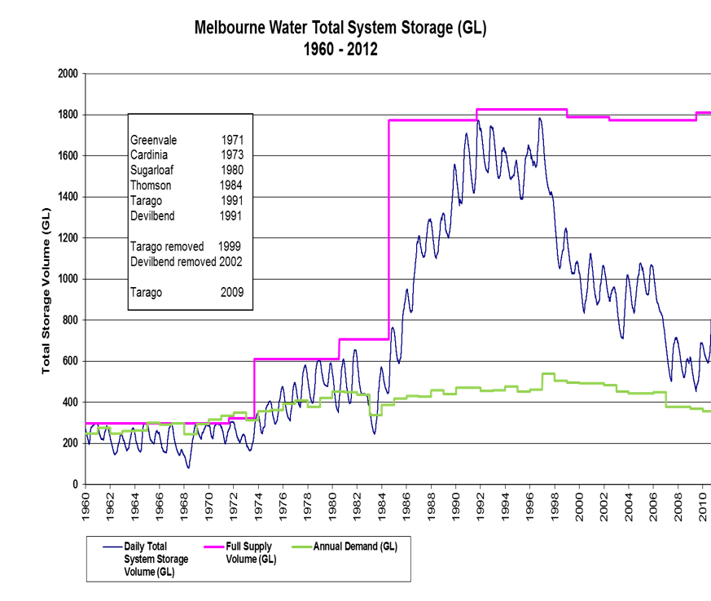
Source: Melbourne Water

Slide 8
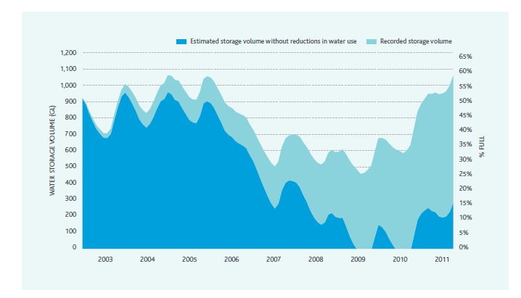
Community played a key role in drought response
Clear target
Support to succeed
Feedback and accountability

Slide 9

Balancing infrastructure and community resilience
Infrastructure resilience
Community Resilience
Plan Respond Recover

Slide 10
Nature based solutions

Slide 11
Nature-based Solutions for Water
“For too long, the world has turned first to human-built, or “grey”, infrastructure to improve water management……….
Three years into the 2030 Agenda for Sustainable Development, it is time for us to re-examine nature-based solutions (NBS) to help achieve water management objectives.”
Gilbert Houngbo, Chair of UN-Water

Slide 12
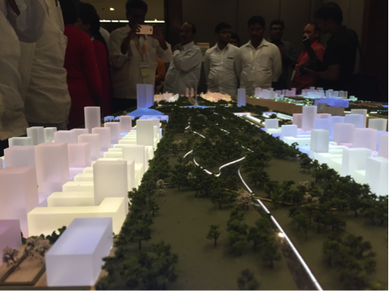
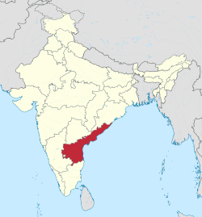
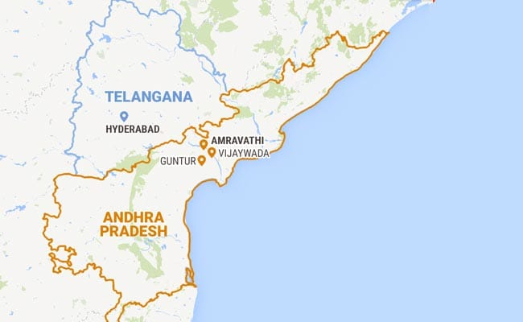
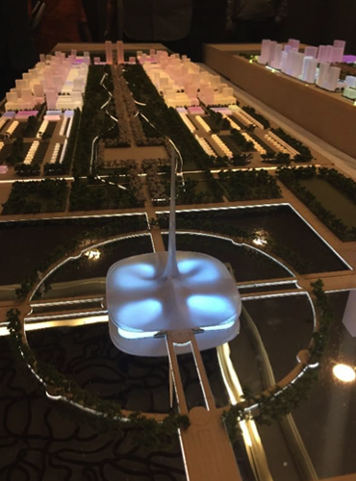
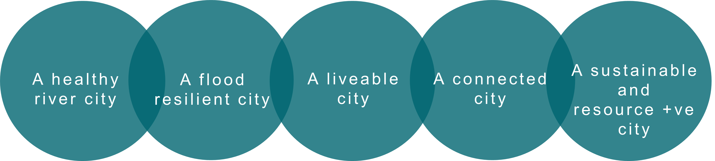
City of Amaravati, India
Five City Objectives

Slide 13
Existing – blue and green zones separate
Stormwater (Arterial Road)
Treated waste water
Stormwater (Arterial Road)
Stormwater (Local Road)
Stormwater (Local Road)
Green Zone
Blue Zone
Green Zone

Slide 14

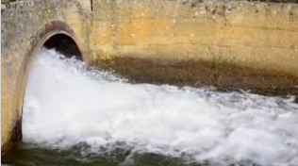
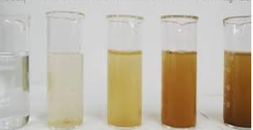
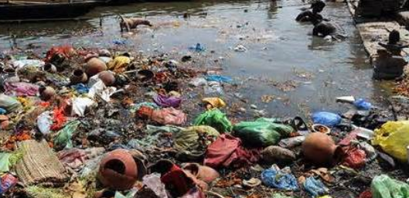
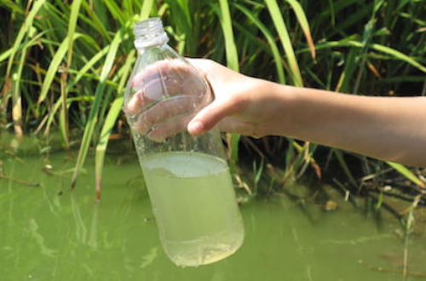
Flow and water quality in Vagus

Slide 15
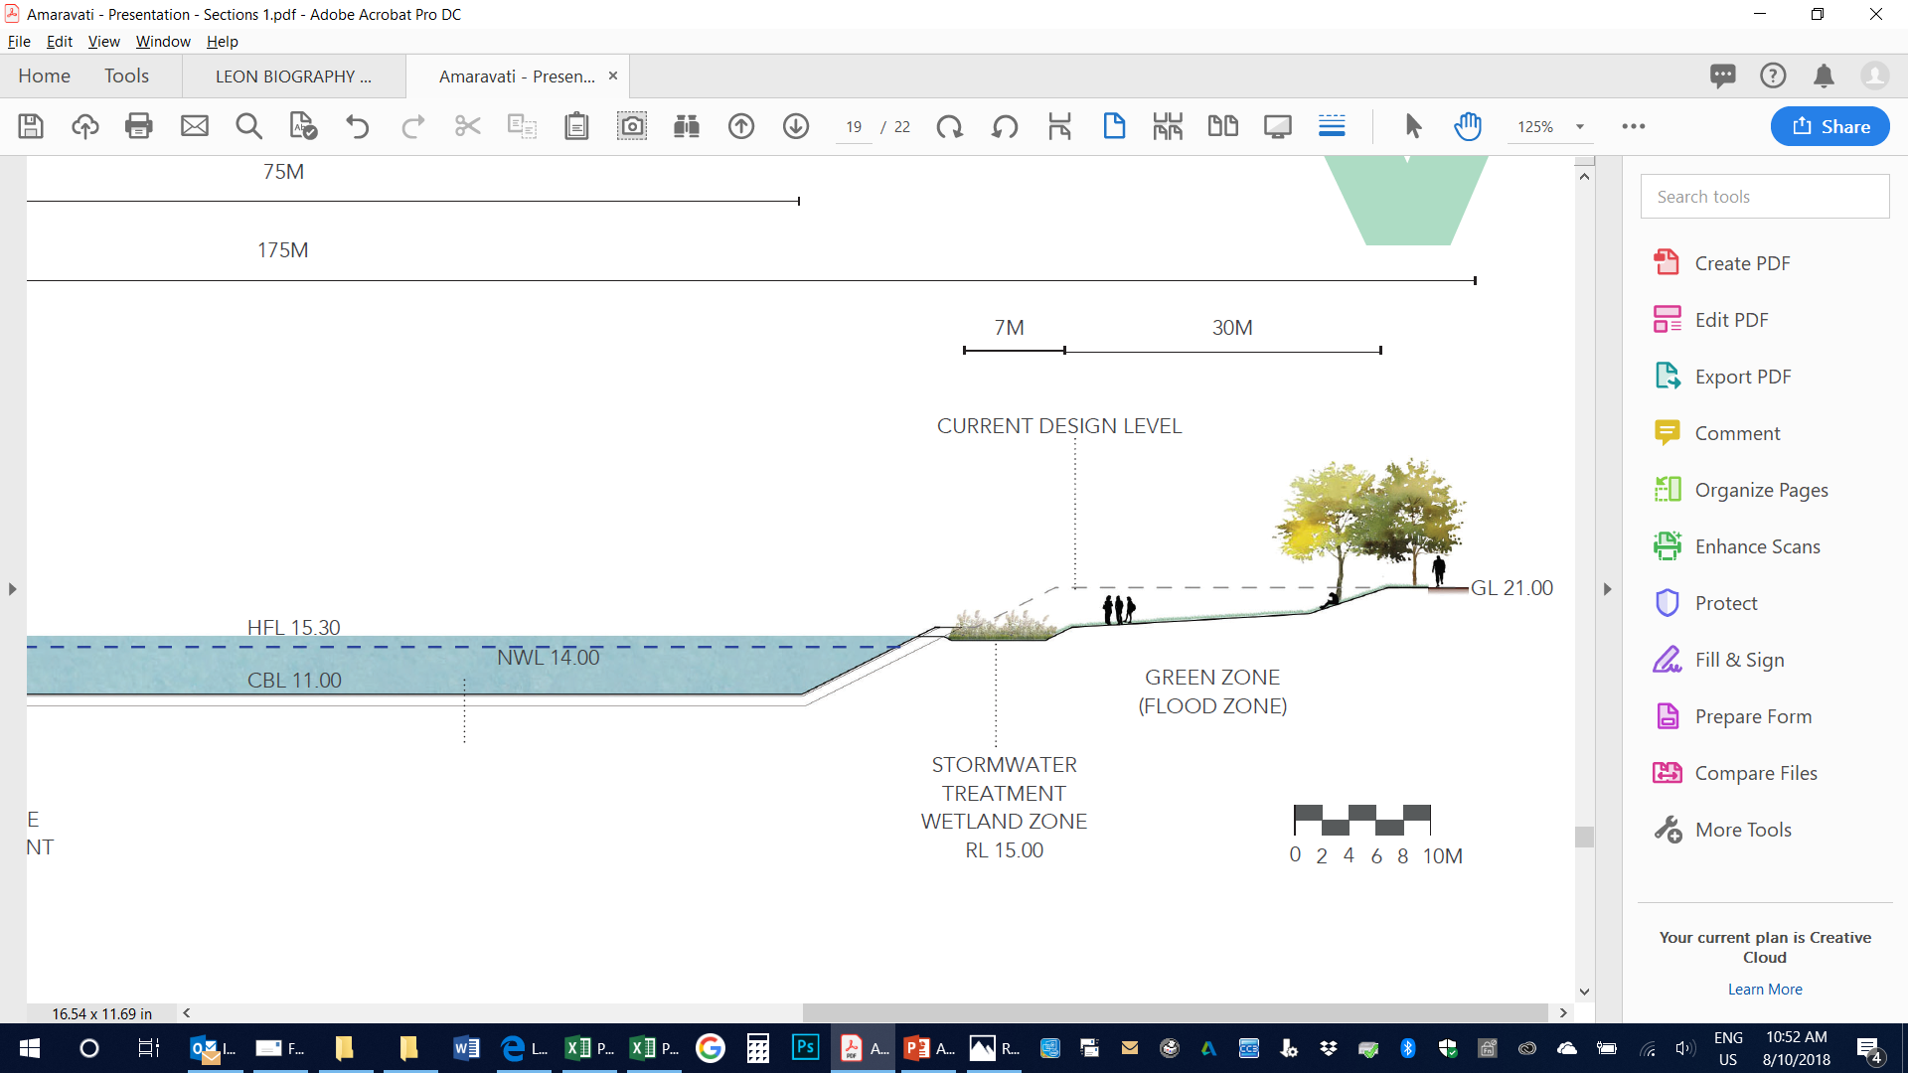

Slide 16
Proposed: Merging blue and green
Stormwater (Arterial Road)
Treated waste water
Stormwater (Arterial Road)
Floating wetlands
Low flow diversion
Stormwater treatment wetlands take low flows
Stormwater (Local Road)
Stormwater (Local Road)
Low flow diversion

Slide 17
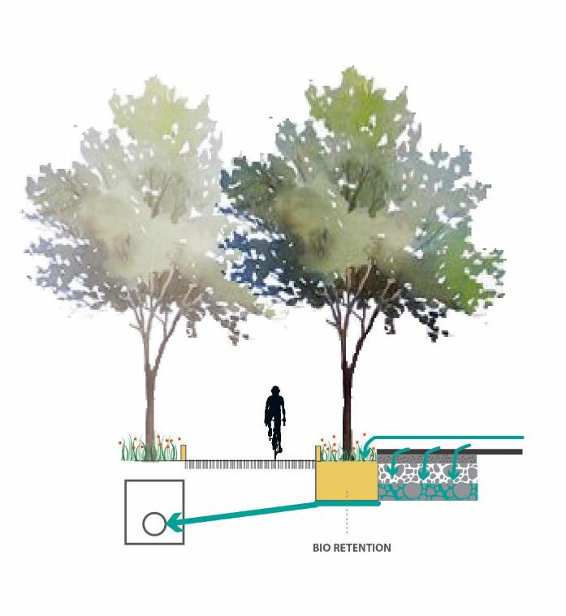
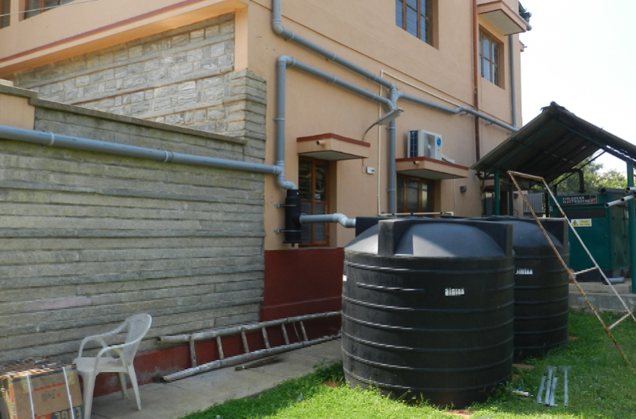
Plot scale
Street scale
Vagus
Stormwater quality runoff management across scales

Slide 18
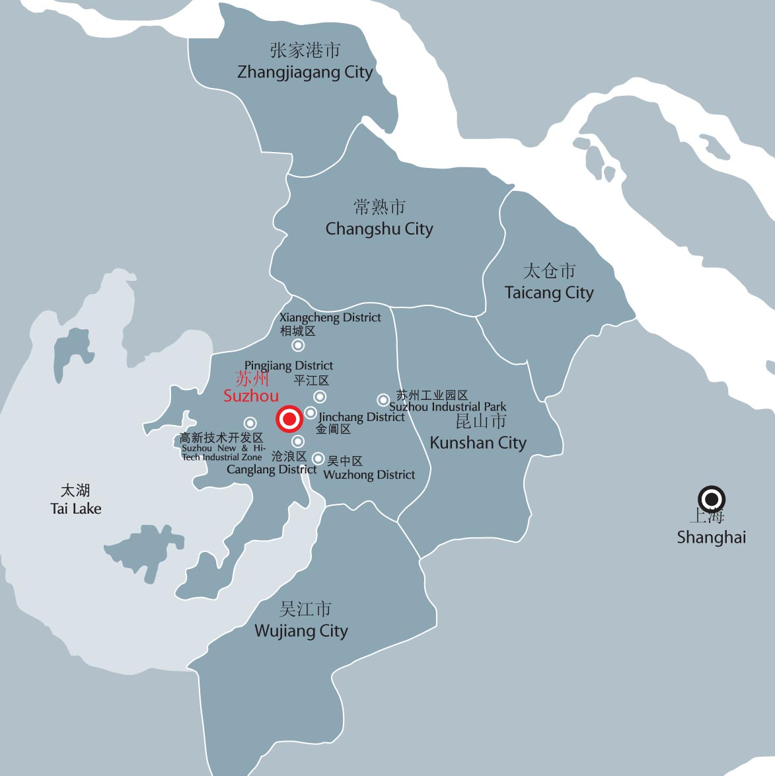
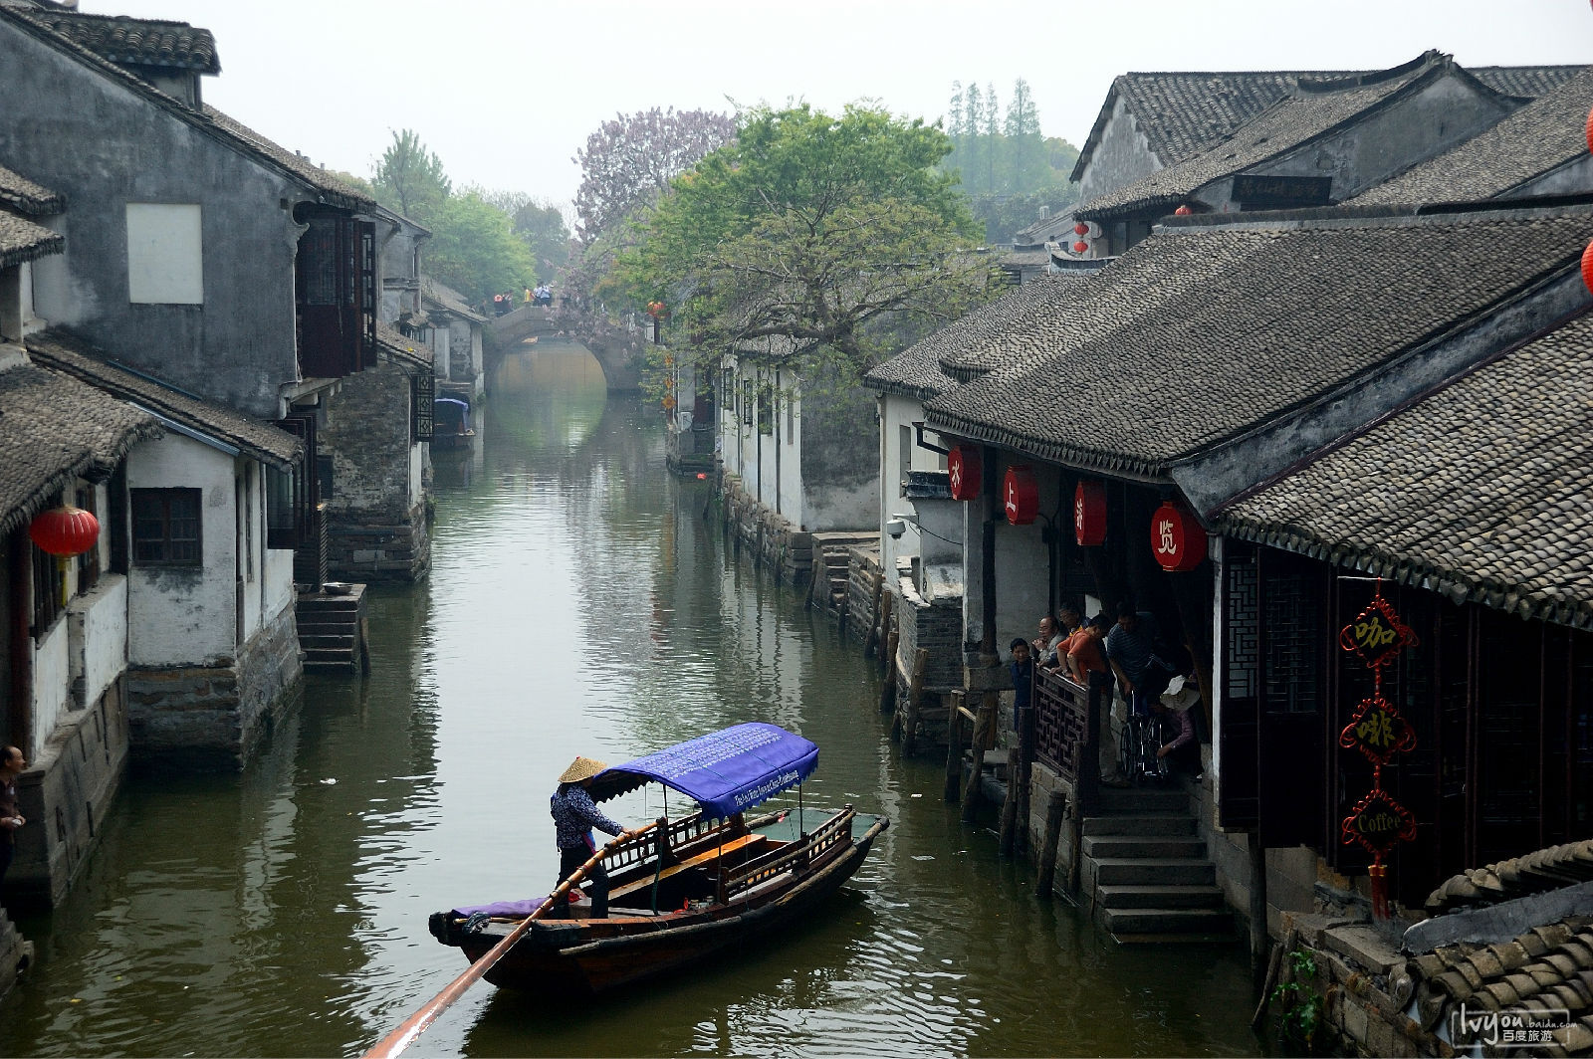
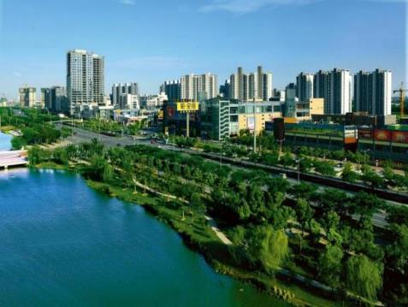
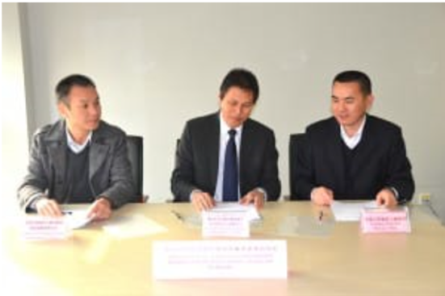
Kunshan city – growing opportunities and challenges

Slide 19
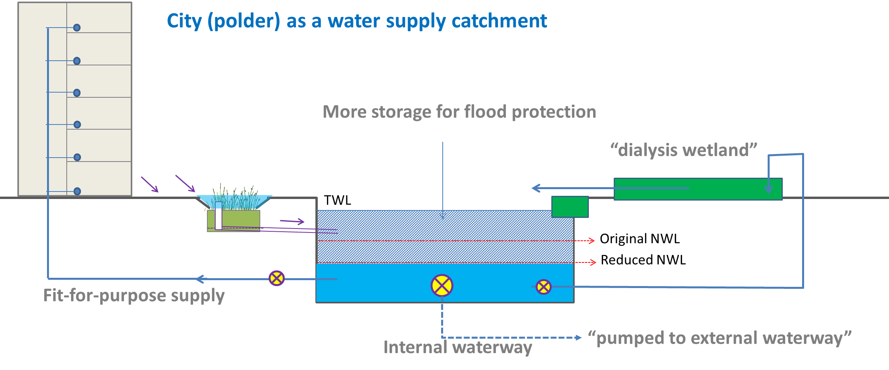
Nature based solutions providing multiple benefits
“Dialysis wetland” as kidney for water cleansing
More storage in internal waterway for flood protection
Reduce potable water demand and support future population growth
parks for water cleansing, amenity and extreme flood events

Slide 20
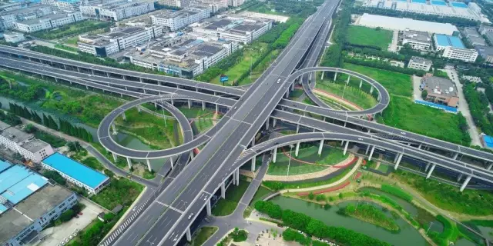
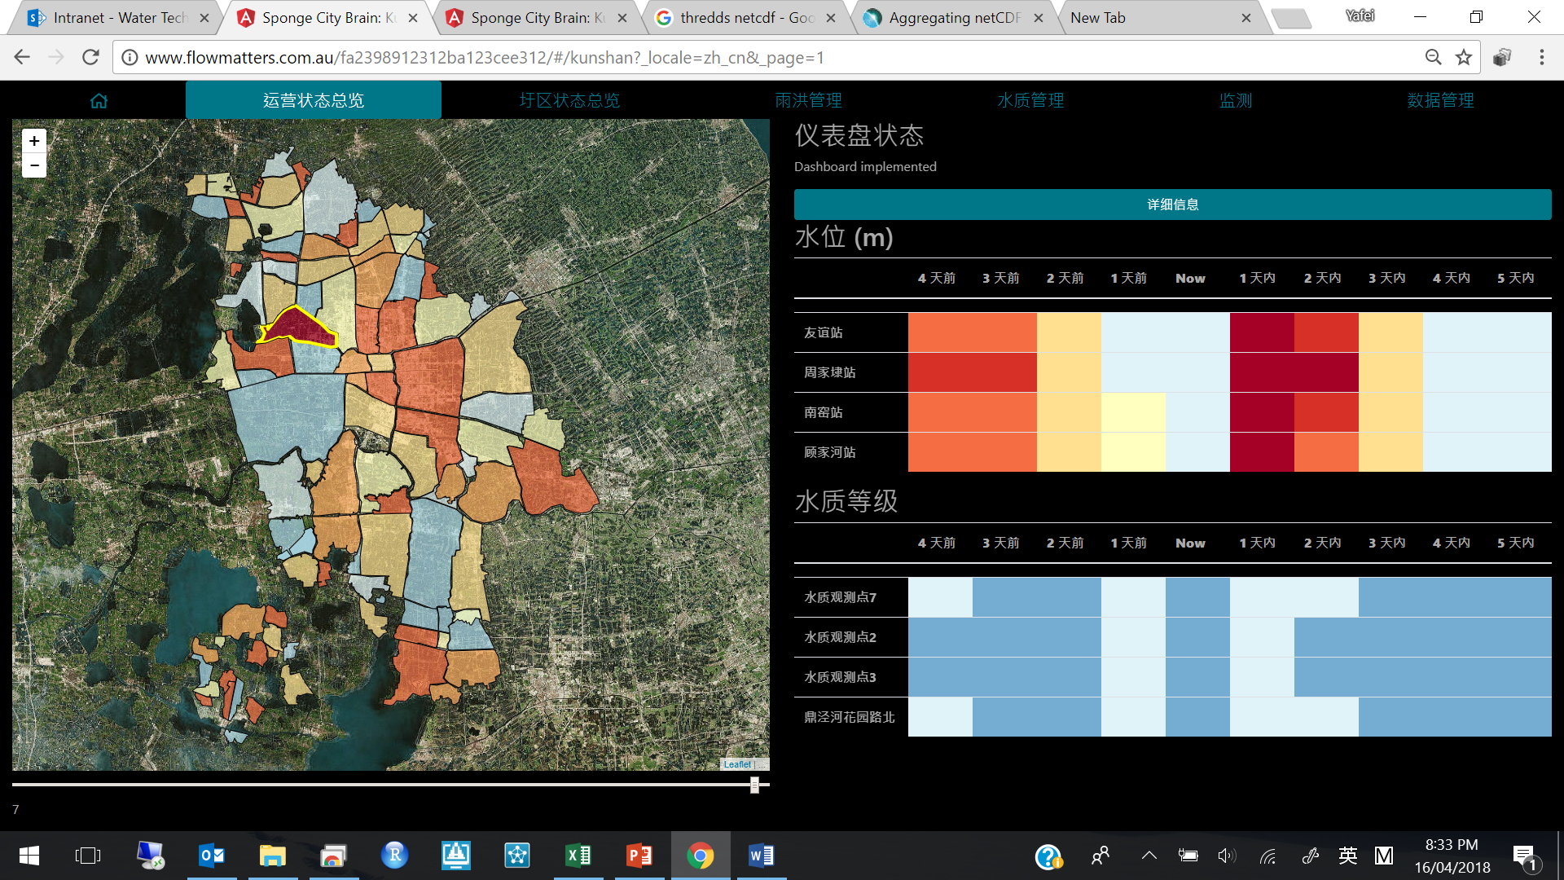
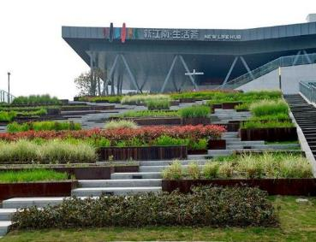
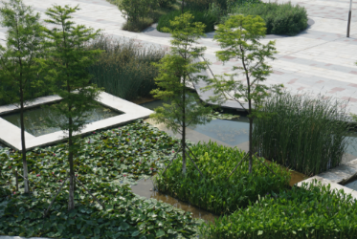
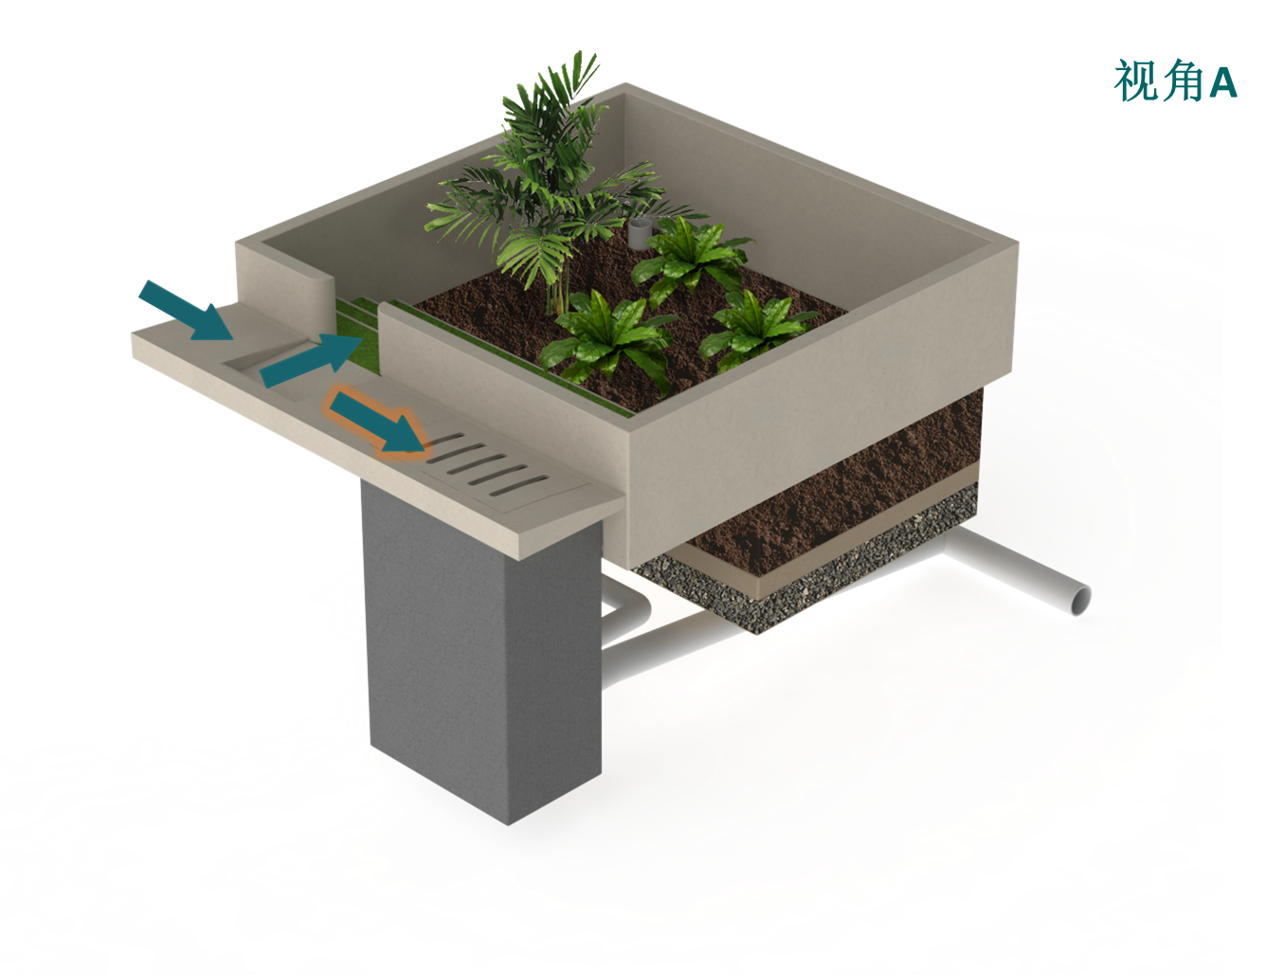
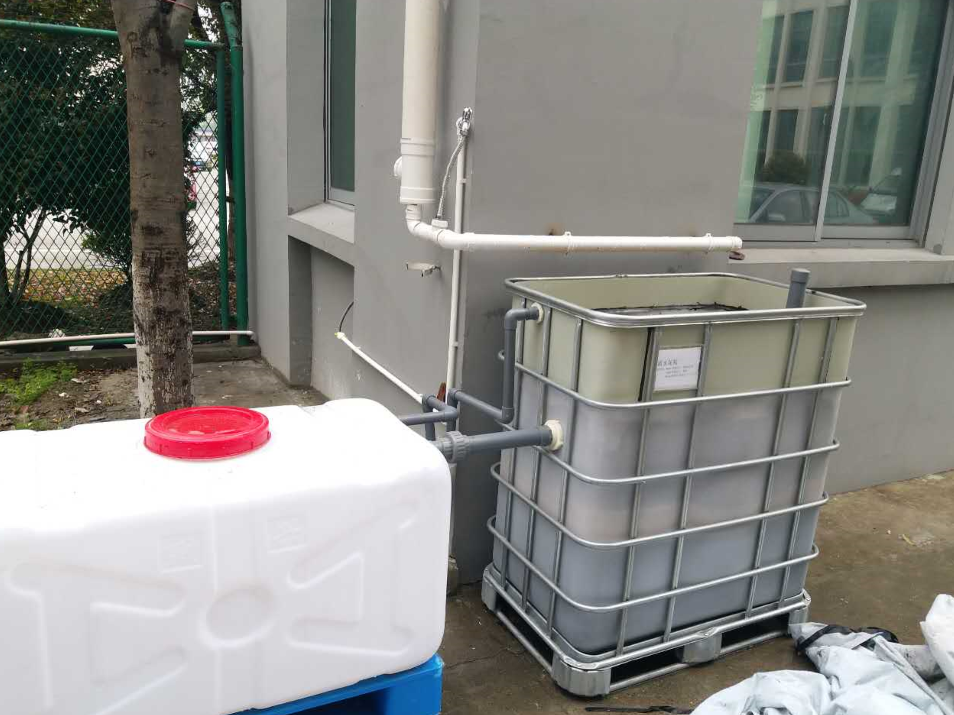
Action over a range of scales and timeframes
Spatial scale of implementation
Large
Urban Planning & Design
Architecture & Landscape
Industrial Design
Small
Short
Long
Temporal scale of implementation

Slide 21
The city as a water supply catchment

Slide 22
Our cities are water supply catchments
Water security
Source: Prime Minister Science Engineering and Innovation Council Working Group on Water for Cities (2007)

Slide 23
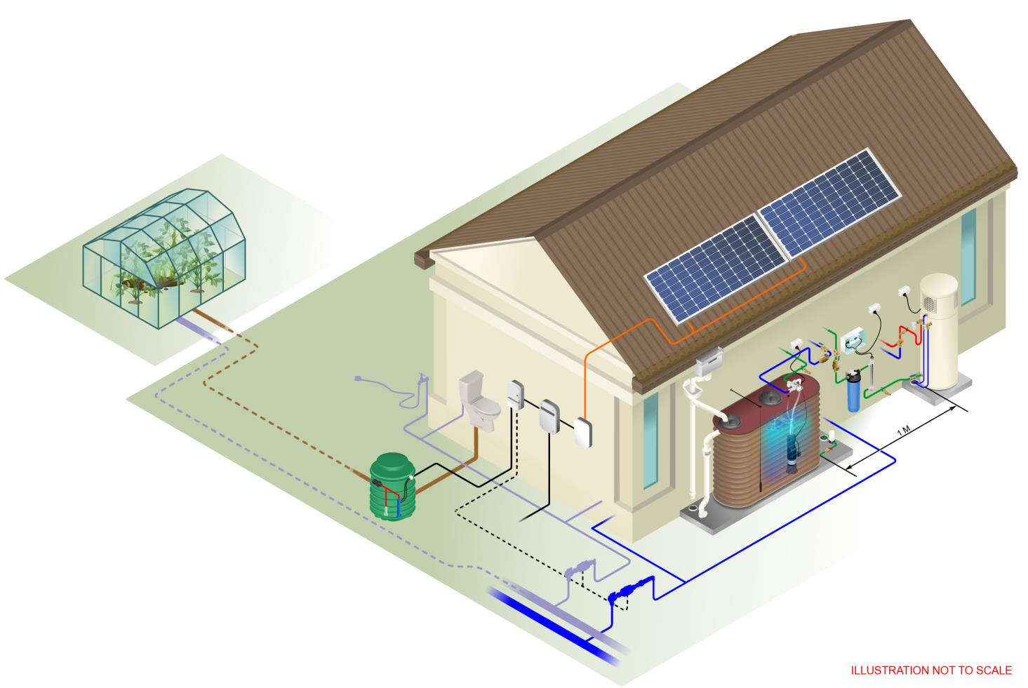
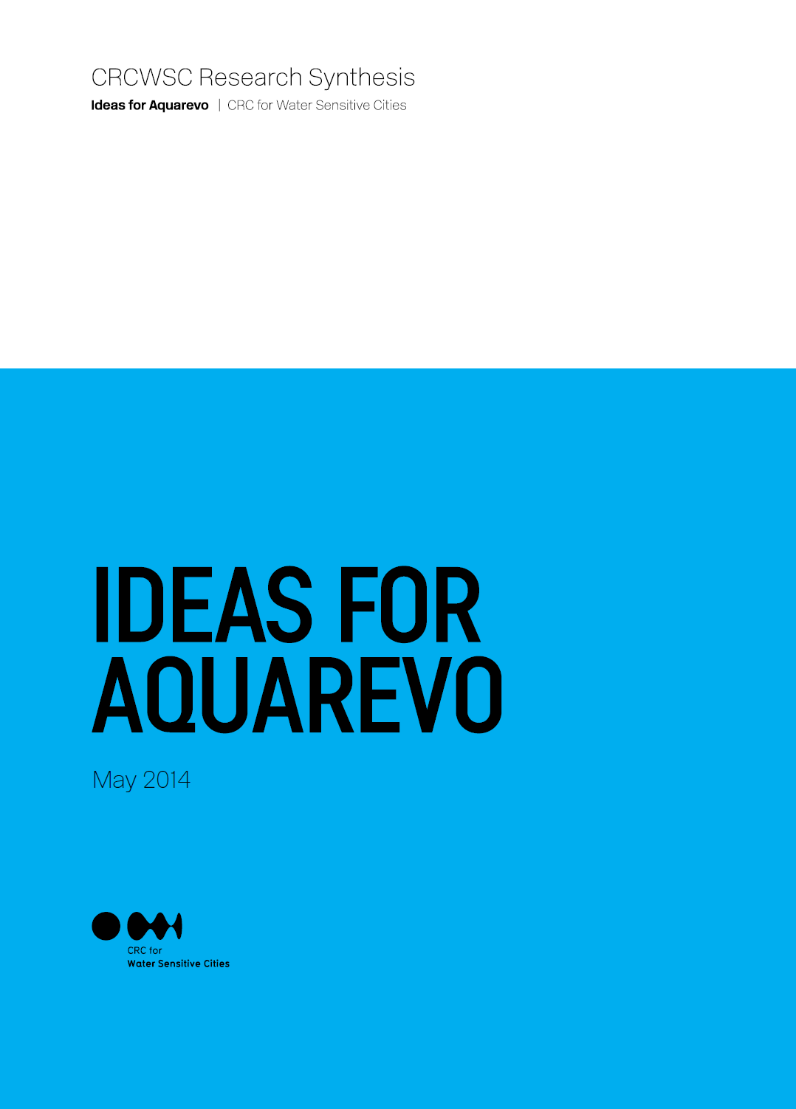
A new approach for property development
Household scale
Illustration not to scale

Slide 24

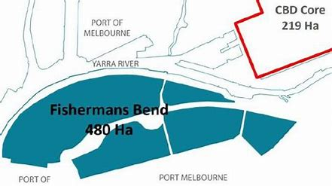
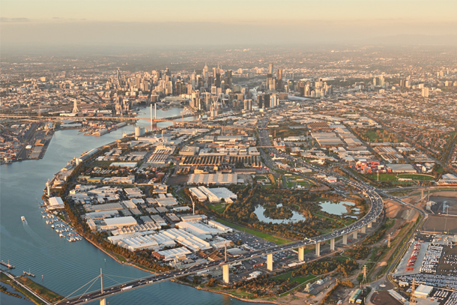
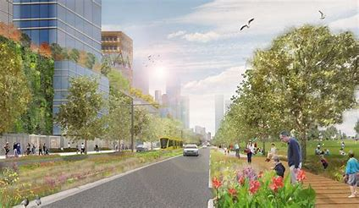
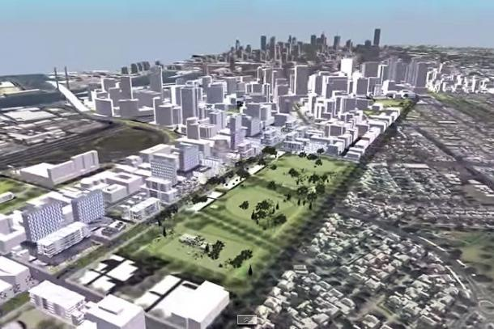
Precinct scale
Australia’s largest urban development

Slide 25
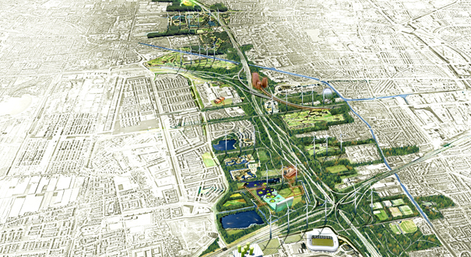
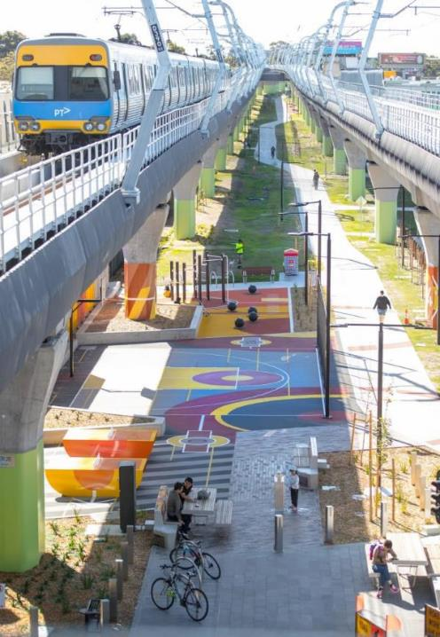

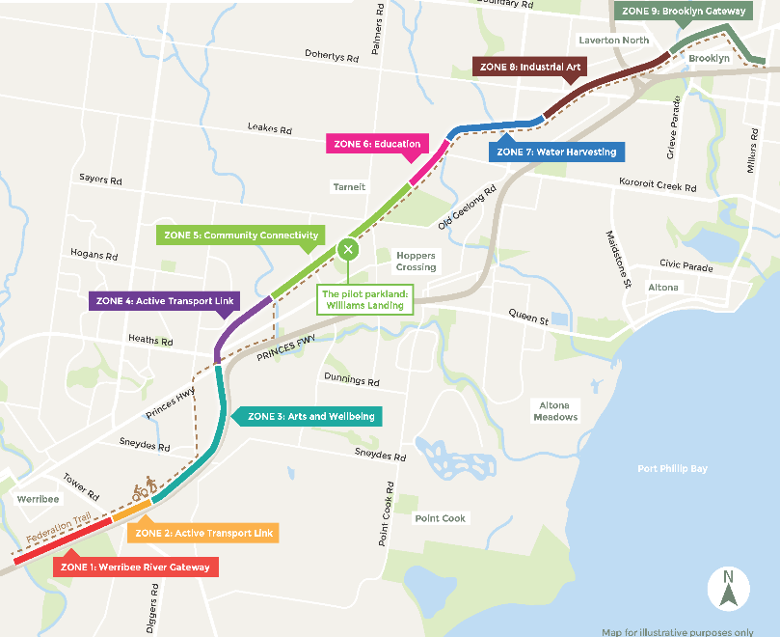
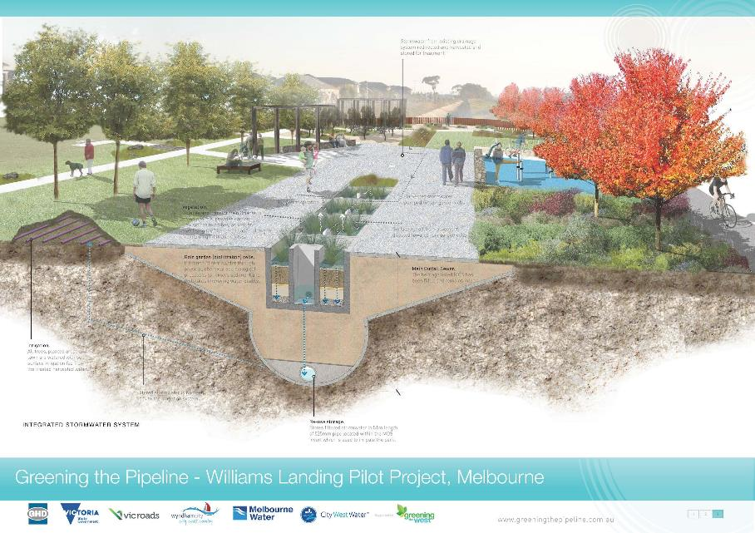
Linking ecological landscapes
City scale
City scale

Slide 26
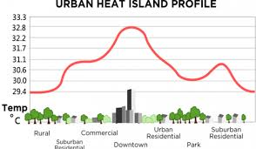
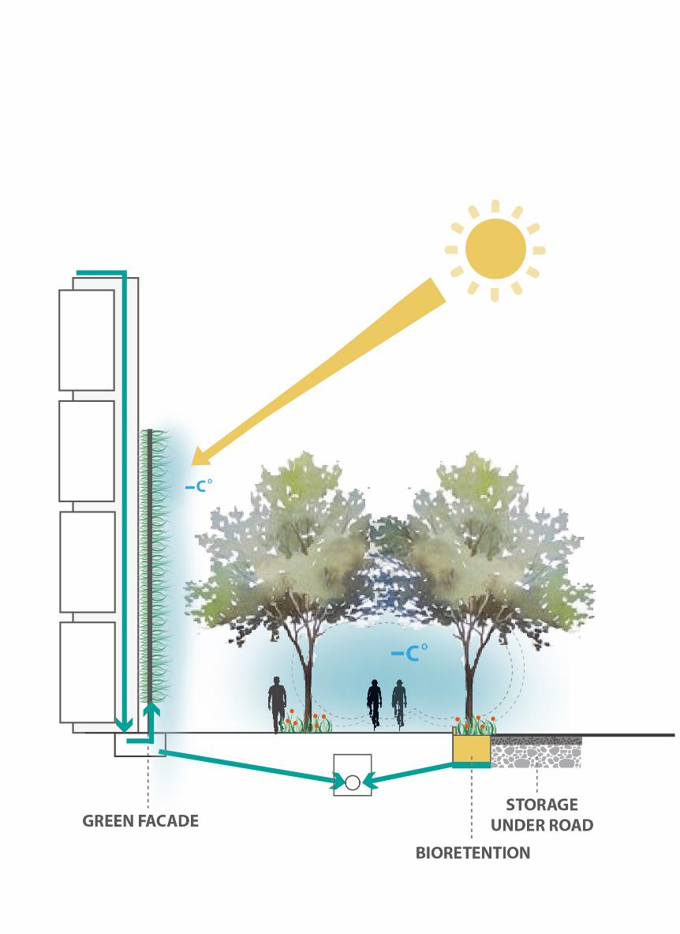

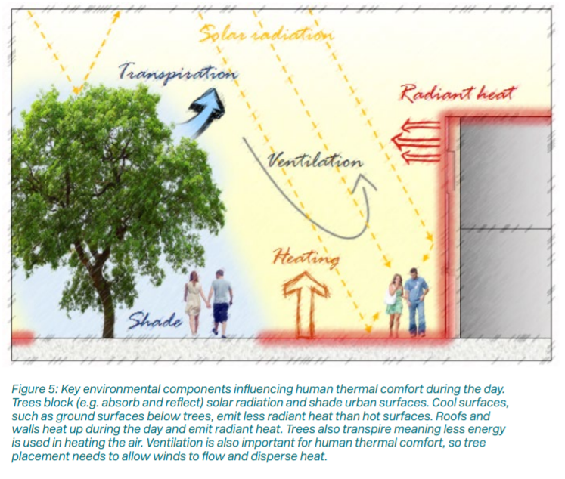
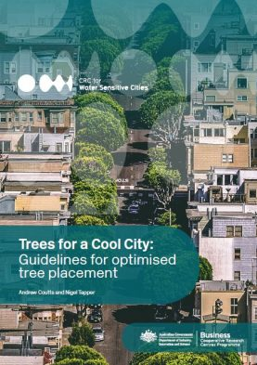
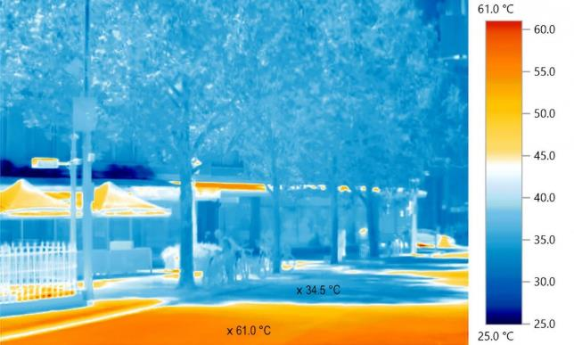
Urban heat island effect and potential benefits of green infrastructure
but where does the water come from?

Slide 27
Implementation

Slide 28
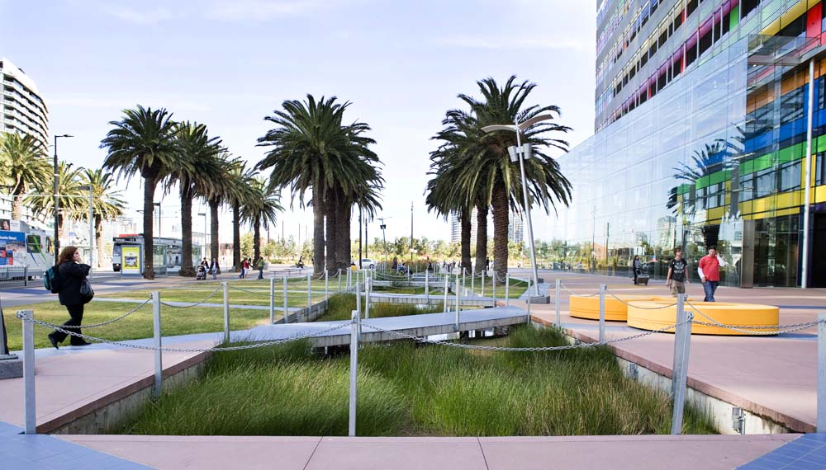
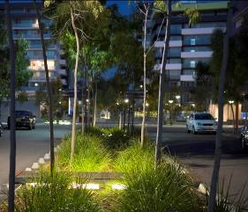


Transitioning to water sensitive cities
Flexible, integrated, distributed, closed loop, context sensitive, …
Water Sensitive City
Path-dependant lock-in
Large-scale, centralised, linear, universal, …
Backlash
Current System
System breakdown
Van de Brugge and Rotmans (2007) Futures

Slide 29
ABC Waters Implementation Framework for Stormwater Management in Singapore
Regulatory and Administrative Framework
Technology Development & Implementation
Building Industry Capacity
Linked to broader sustainability policies
Protection of Marina Reservoir
Catchment Planning Policy
Precinct & regional stormwater management plans
Performance Targets
Rating Tool & Compliance Validation
Singapore Stormwater Quality Research Initiative
Demonstration Projects
Technical Tours
Research & Development
Engagement with other professionals
Field Experiments & Monitoring
Design Guidelines & Standards
Training
Local catchment characterisation
Operation & Maintenance
ABC Waters Certification
Tertiary Education

Slide 30
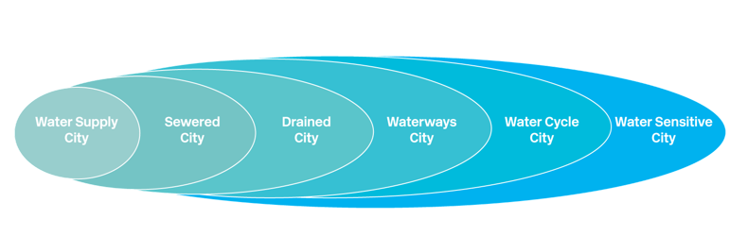


Where are you now? Where do you want to be?
- Water Sensitive Cities Index

Slide 31
Once you know where you want to go how do you get there?
- Transition stages

Slide 32
Transition enablers
Champions
Platforms for connecting
Knowledge
Projects and applications
Tools and instruments

Slide 33









Process just as important as tools and reports
Build shared data, experience and understanding, trust and commitment to vision and action
Collaboration in planning, accountability in delivery

Slide 34

Follow us on Twitter
@CRCWSC
Follow us on YouTube
/WaterSensitiveCities
Thank you.

Slide 35


