Slide 1
History of Land Subsidence in Tokyo
Introduction
High Economic Growth Period and Land Subsidence
Environmental Problems due to Land Subsidence
Countermeasures against Land Subsidence
Conclusion
Shibaura Institute of Technology
Vice President
Masaru MORITA
1

Slide 2
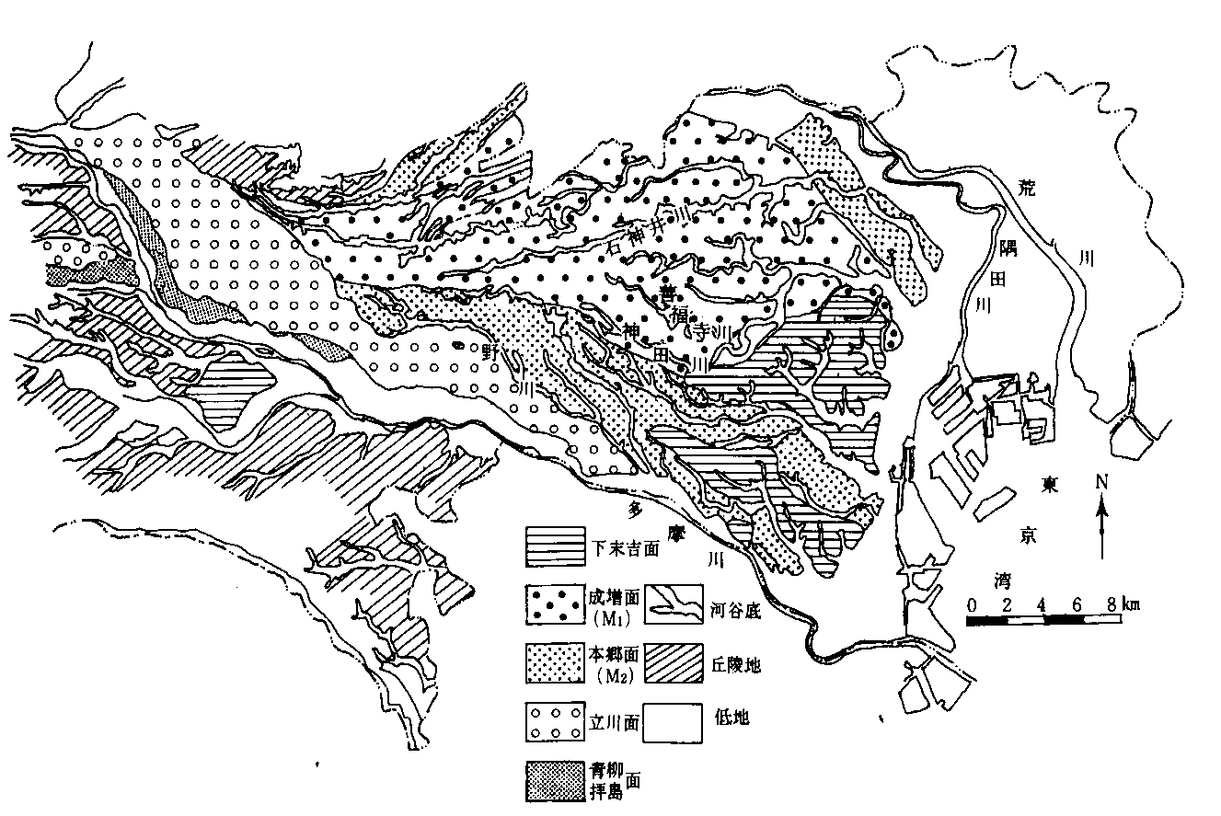
Introduction
Tokyo Metropolis
Tama area
23 ward area
Land Subsidence
Musashino upland
Tokyo lowland
N
Tama hill
Tokyo Bay
hill
lowland
「東京都総合地盤図（Ⅱ）」に加筆
2

Slide 3
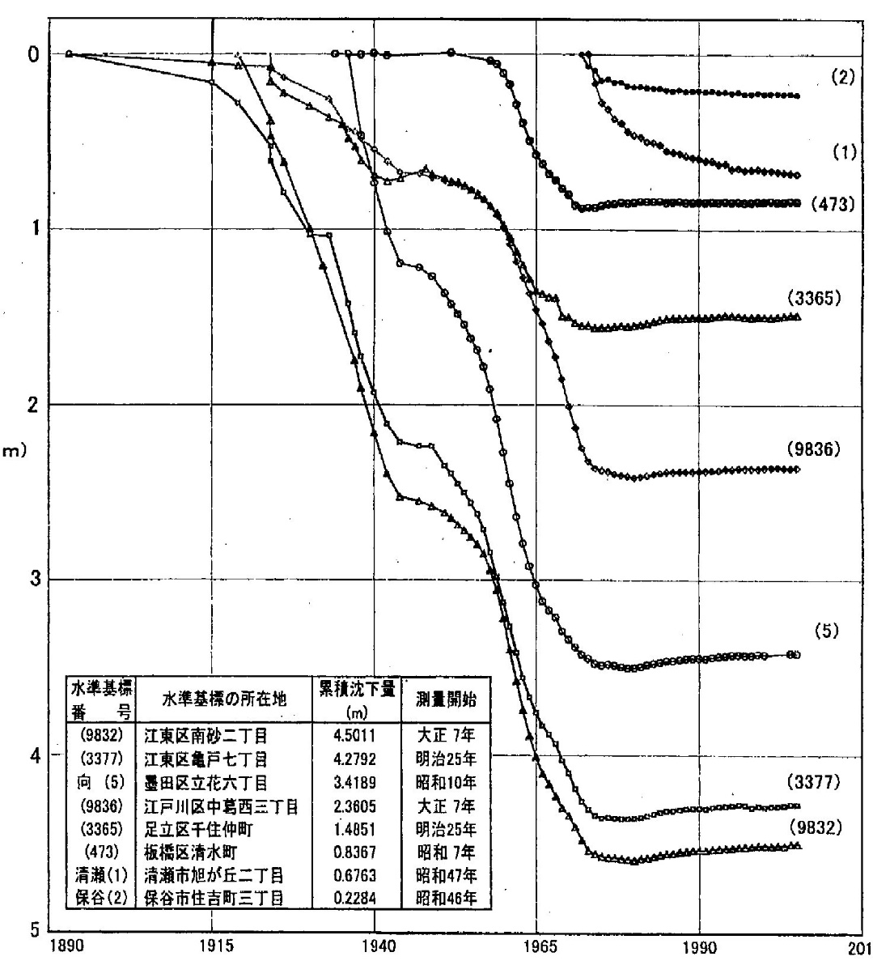
Historical Process of
Land Subsidence
in Tokyo
0
1
2
Cumulative subsidence : m
3
4
5
1890
1915
1940
1965
1990
2015
3
year

Slide 4
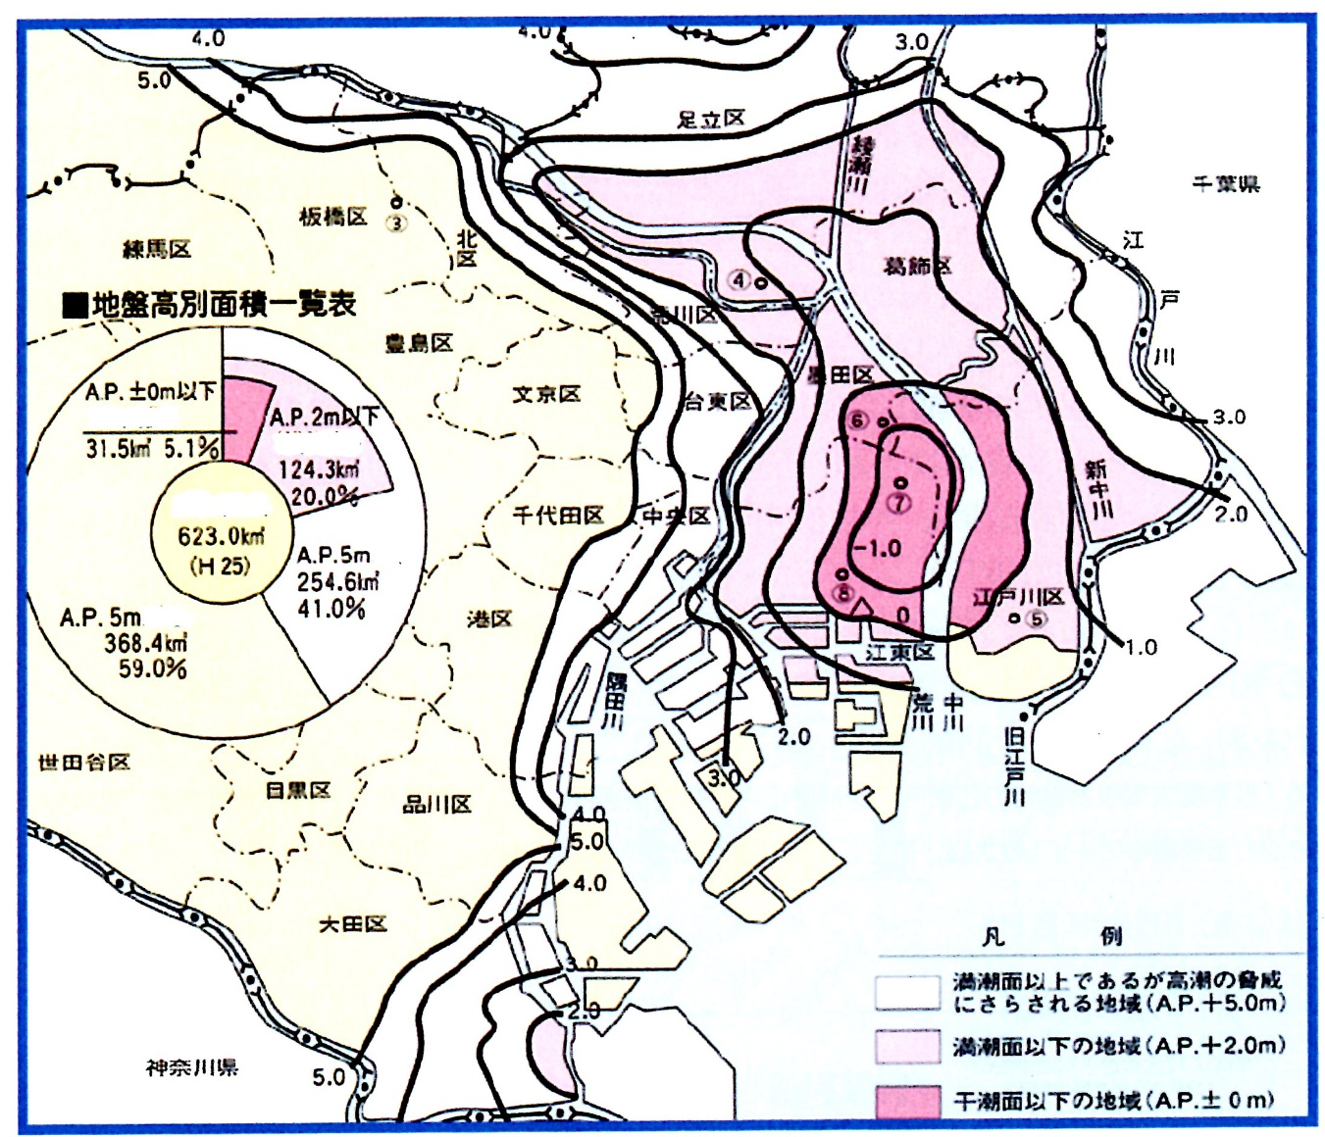
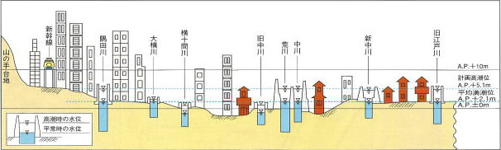
“Tokyo Zero Meter Area”
Adachi ward
Ayase
River
Chiba Prefecture
Itabashi ward
Most of the Tokyo lowland area is lower than the average high tide level.
Nerima ward
Kita
ward
Katsushika ward
Edogawa River
Percentages of Areas by Ground Level
Arakawa ward
Toshima ward
Equal or Lower than A.P. ± 0m
Bunkyo ward
Taito ward
Sumida-ku
Equal or Lower than A.P. 2m
Total Area of Tokyo 23 wards: 623.0㎢ (2013)
Chiyoda ward
Minato ward
Shinnaka
River
Equal or Lower than A.P. 5m
Tokyo zero meter area is prone to storm surge damage and difficult to drain the inundation water from the area.
Higher than A.P. 5m
Minato ward
Edogawa ward
Koto ward
Sumida River
Naka River
Setagaya ward
Arakawa River
Meguro ward
Shinagawa ward
Kyuedo River
Ota ward
LEGEND
Shinkansen
Sumidagawa river
Oyokogawa river
Yokojyukkengawa river
Kyu-Nakagawa river
Arakawa river
Nakagawa river
Shin-Nakagawa river
kyu-Edogawa river
Areas above high water level, but under threat of high-tide
Yamanote plateau
Kanagawa Prefecture
Areas below high water level
Areas below low water level
plan high-tide level
Once a destructive earthquake would hit the area and destroy the coastal dikes, the sea water would flow into the area and bring the huge inundation damage.
average high tide level
W.L.. at high tide
W.L.. at normal tide
Kita-ku
Arakawa-ku
Adachi-ku
Katsushika-ku
Misato
City
Matsudo
City
4

Slide 5
High Economic Growth Period (1955 – 1973)
0
After the Second World War, Japan economy had the high economic growth period.
Industry had been rapidly growing and the population had been concentrated into the major cities , especially into Tokyo area.
This rapid increase in the number of factory and in population naturally demanded huge amount of industrial and domestic water in urban areas.
Private companies for industrial water and local governments for domestic water resumed their groundwater exploitations more intensively than before.
However they had learned that groundwater overwithdrawal causes serious land subsidence.
LAND SUBSIDENCE AGAIN !!
1
2
Cumulative subsidence : m
3
4
5
1890
1915
1940
1965
1990
2015
5
year

Slide 6
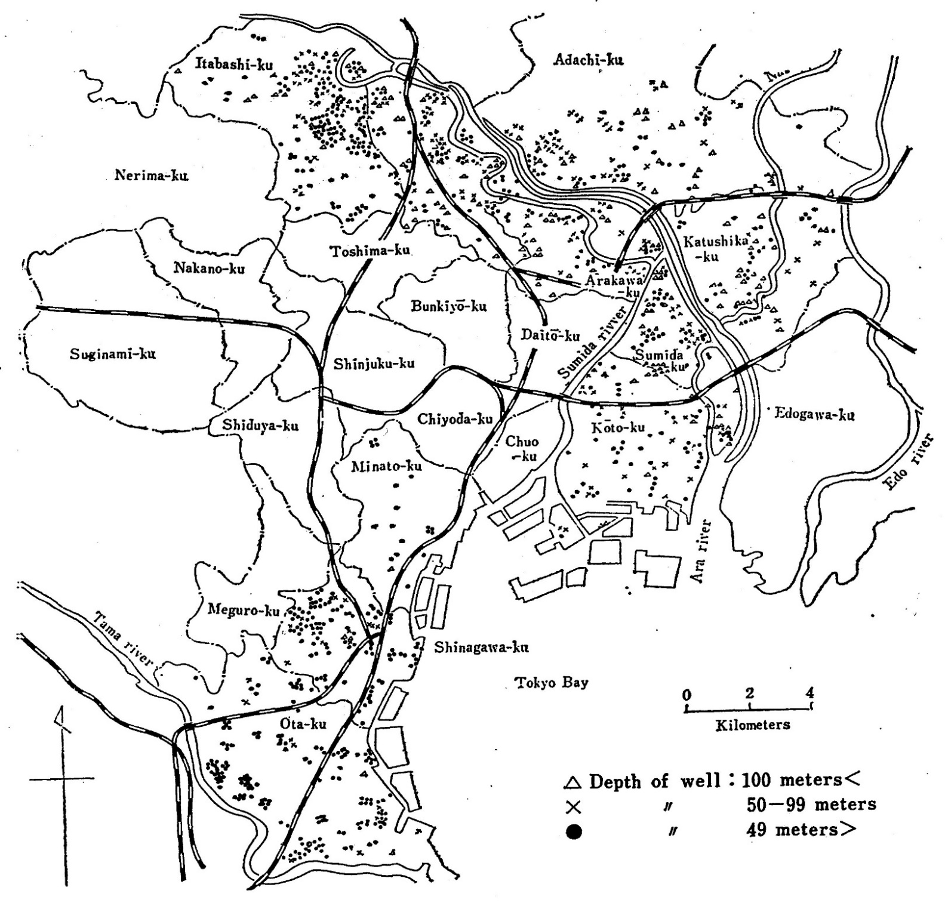
Distribution of pumping wells
Groundwater Exploitation in Tokyo lowland Area
A huge amount of deep wells were drilled for industrial water by the private companies in the Tokyo lowland area during the period from 1950s to 1960s.
This groundwater exploitation brought about the groundwater level drop and serious land subsidence.
「地盤沈下と工業用水法」
(蔵田延男）昭和４６年
より
6

Slide 7
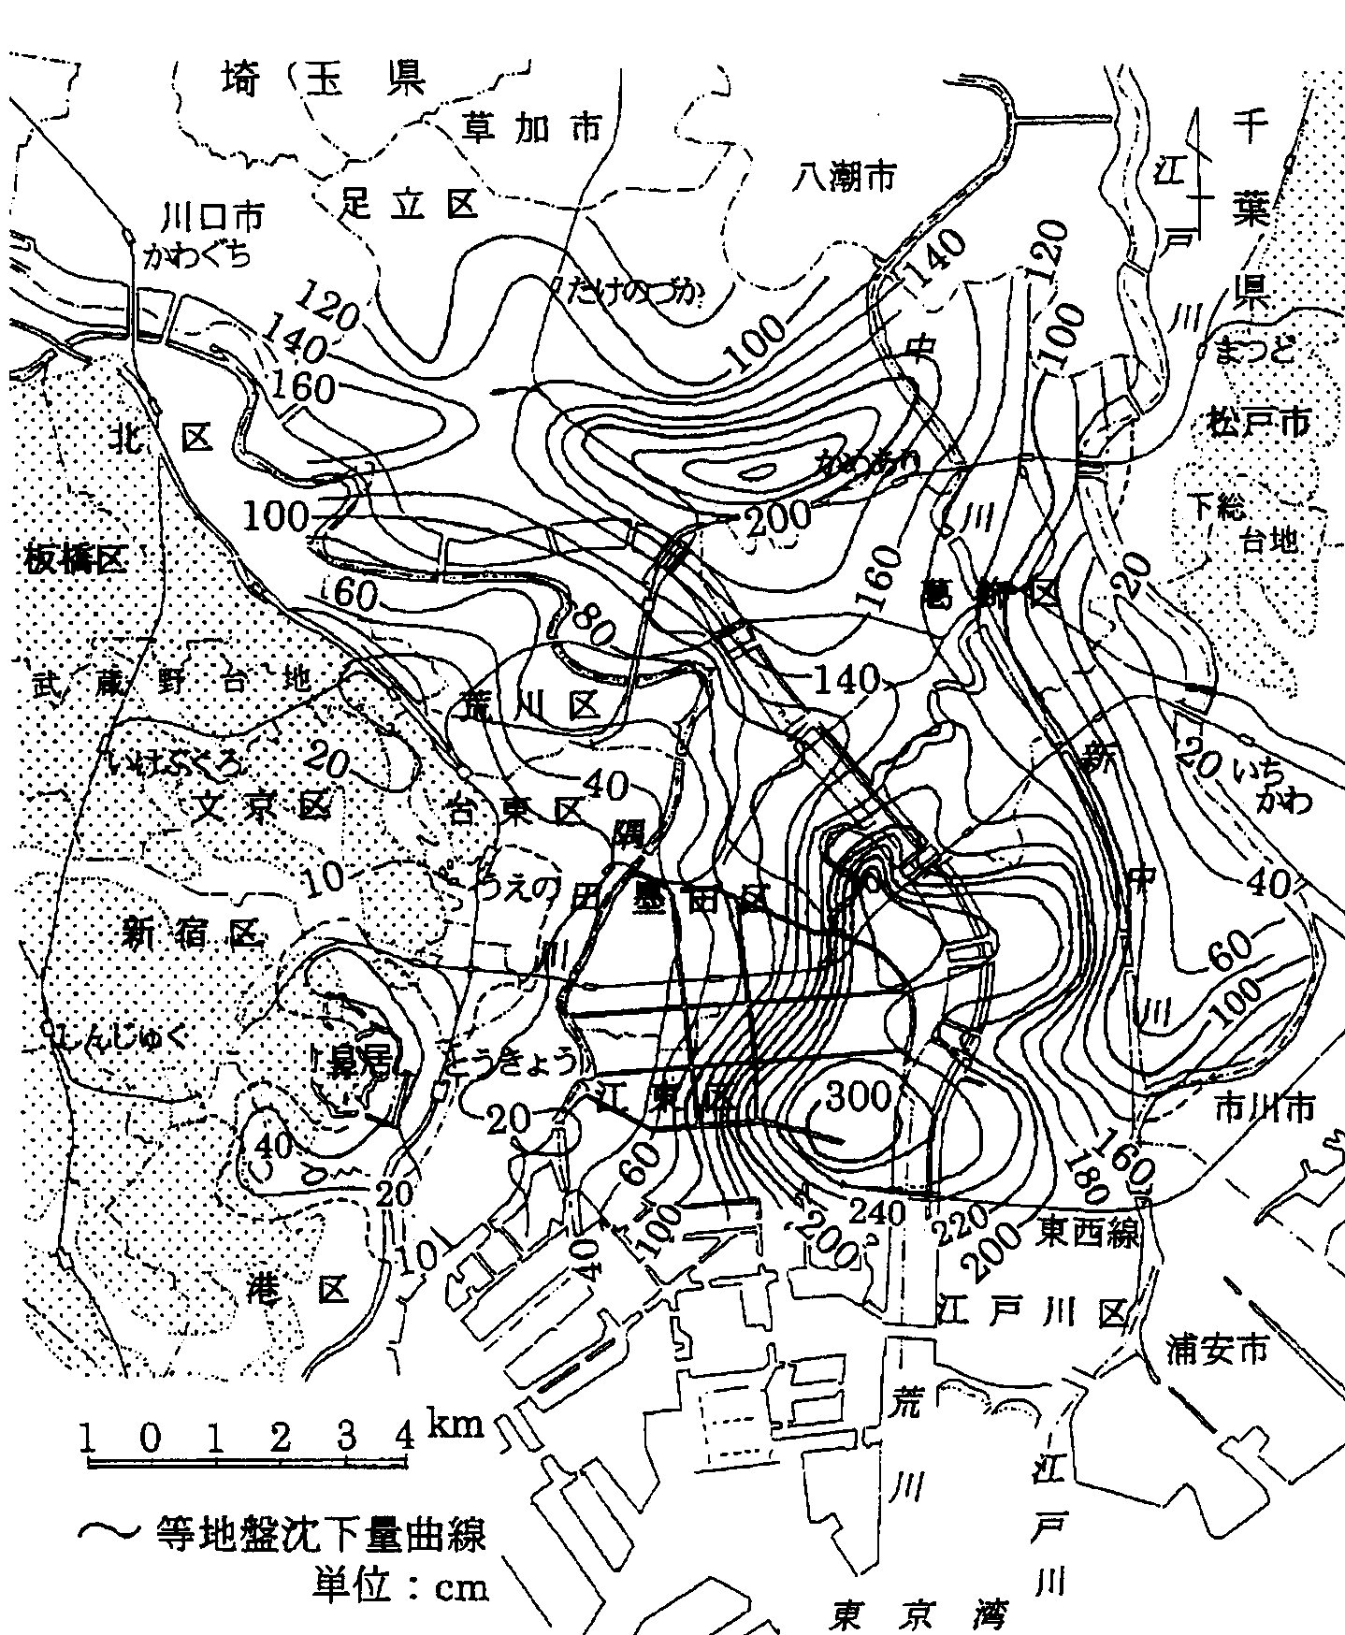
Land Subsidence in Tokyo Lowland Area
Arakawa downstream area
The cumulative land subsidence during the period of 40 years from 1938 to 1977
Almost the whole area of the lowland have the subsidence over 1 m.
There should be serious land subsidence area in the eastern part of Koto ward with the cumulative subsidence over 3 m.
遠藤毅「荒川下流域における地盤沈下の展開とその社会的背景」（荒川下流誌・２００５）より
Contour line of cumulative land subsidence
7
Unit: cm
Tokyo Bay

Slide 8
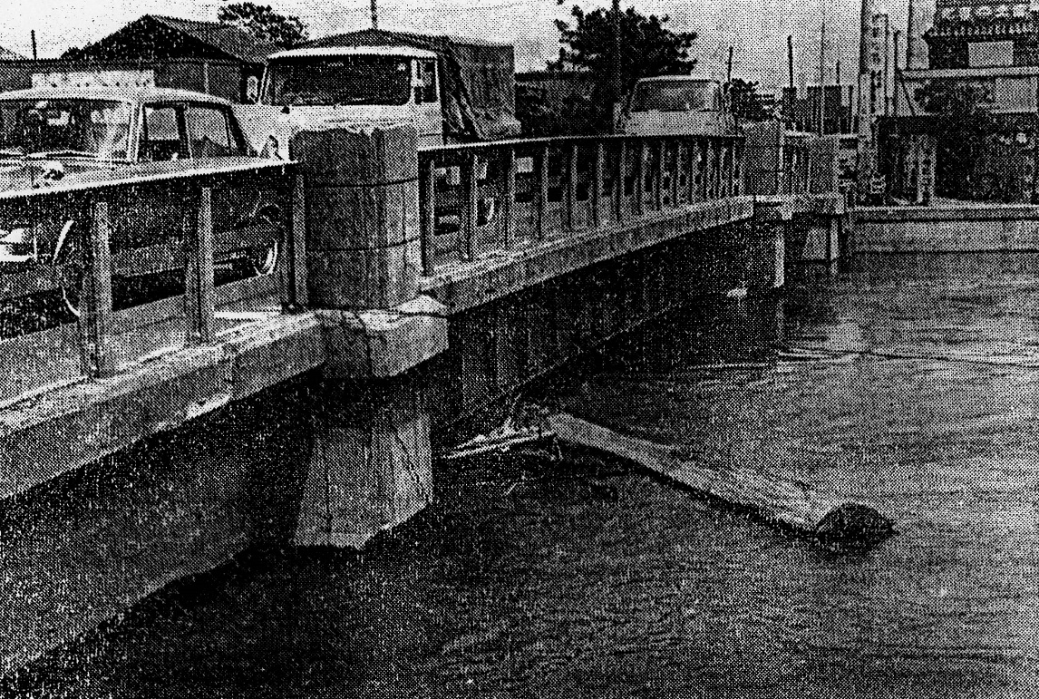
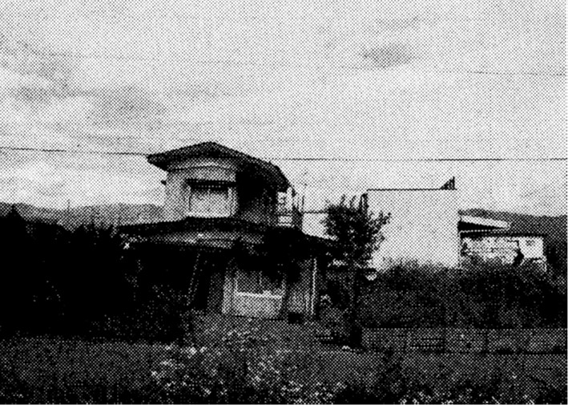
Damage of Land Subsidence
Ships could not go through under the bridge owing to the land subsidence.
The house has leaned slightly because of land subsidence.
8

Slide 9
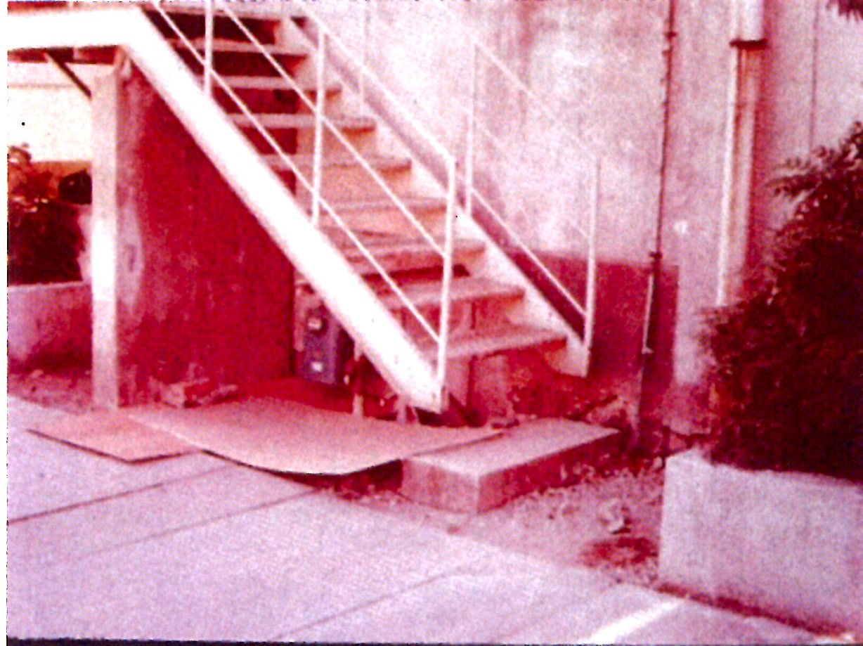
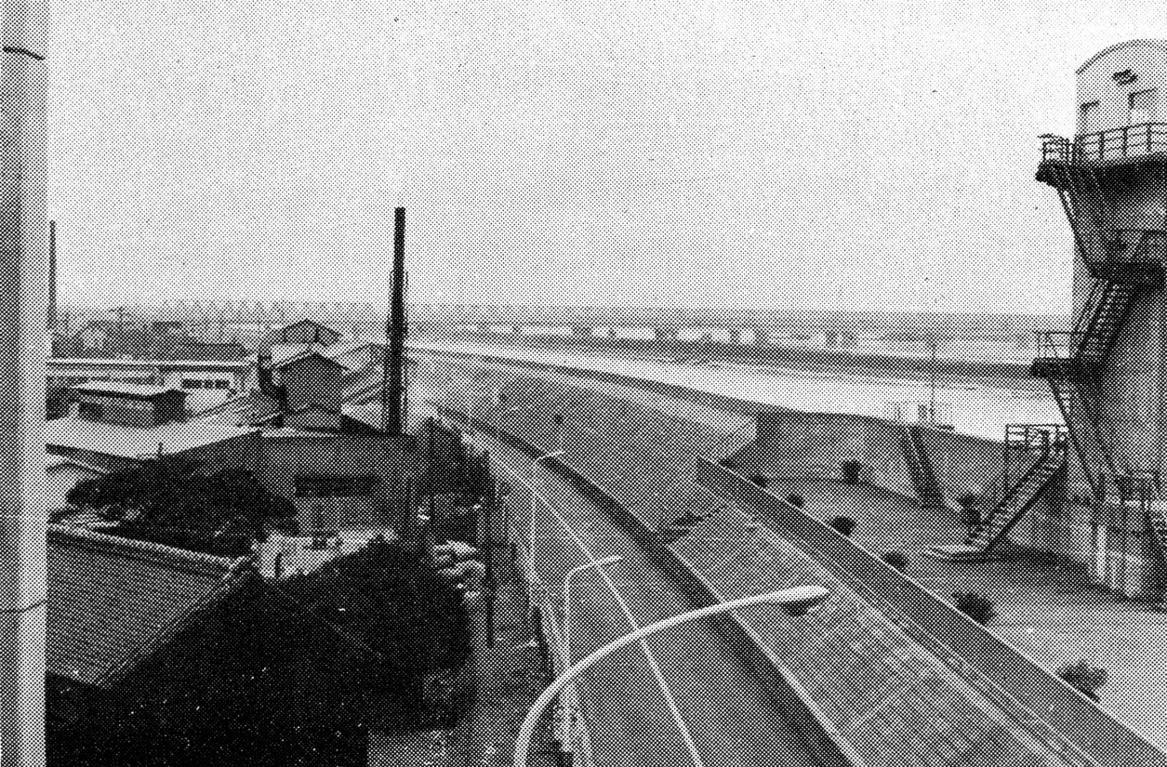
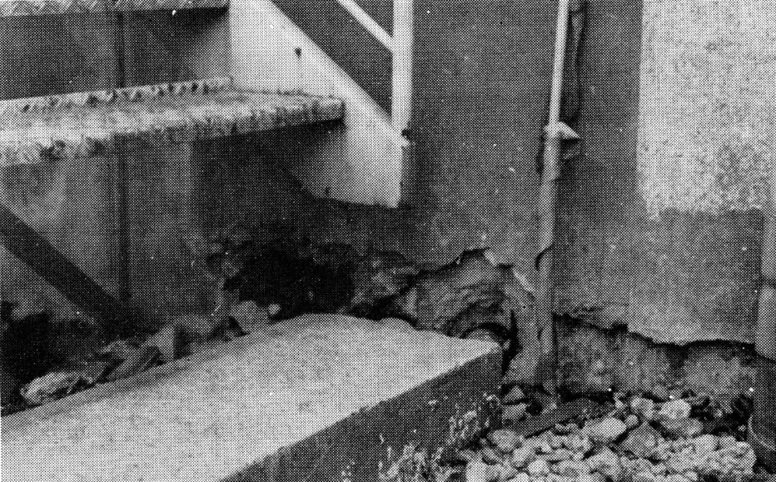
Damage of Land Subsidence
Uprise of Building
The ground surface is lower than the sea level.
9

Slide 10
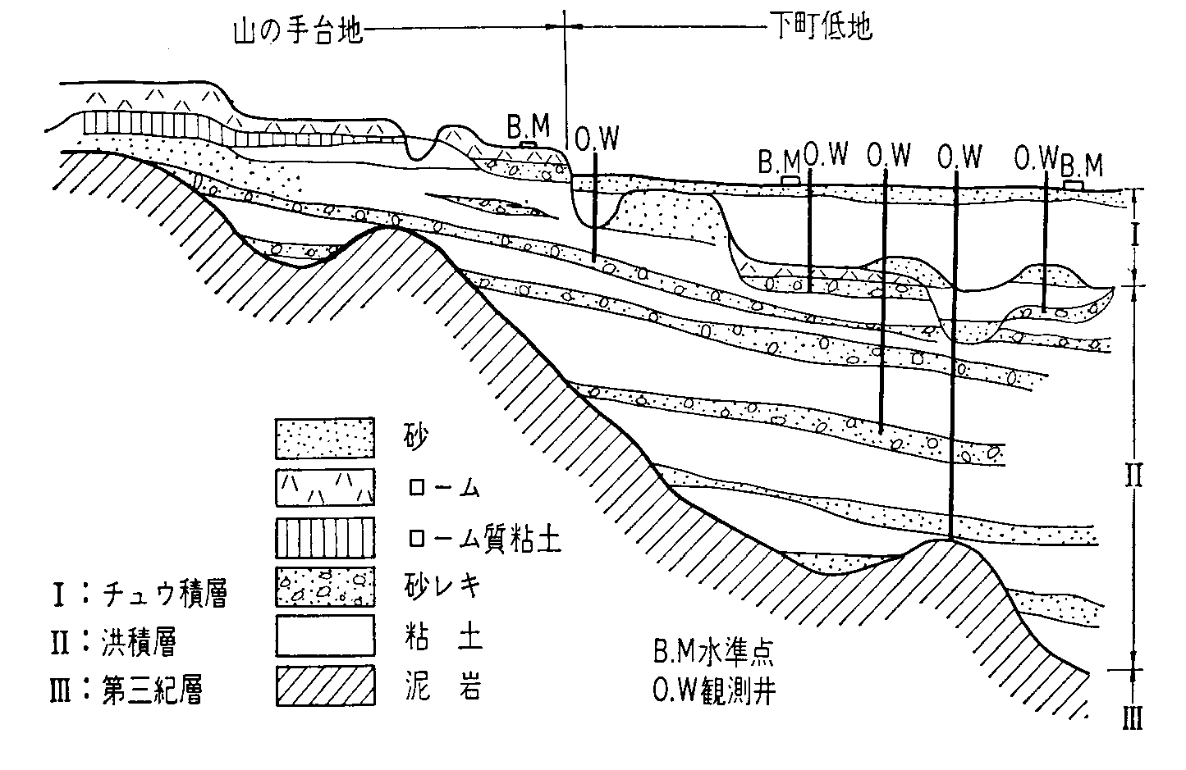
Two Type s of Land Subsidence
Upland
Lowland
Surface Layer Subsidence
Alluvial Layer
Sand
Loam
Loam - clay
Sand Gravel
Clay
Mudstone
Deep Layer Subsidence
Loam - clay
Sand Gravel
Clay
Mudstone
Diluvial Layer
Alluvial
Diluvial
Tertiary
Benchmark
Observation
Well
10

Slide 11
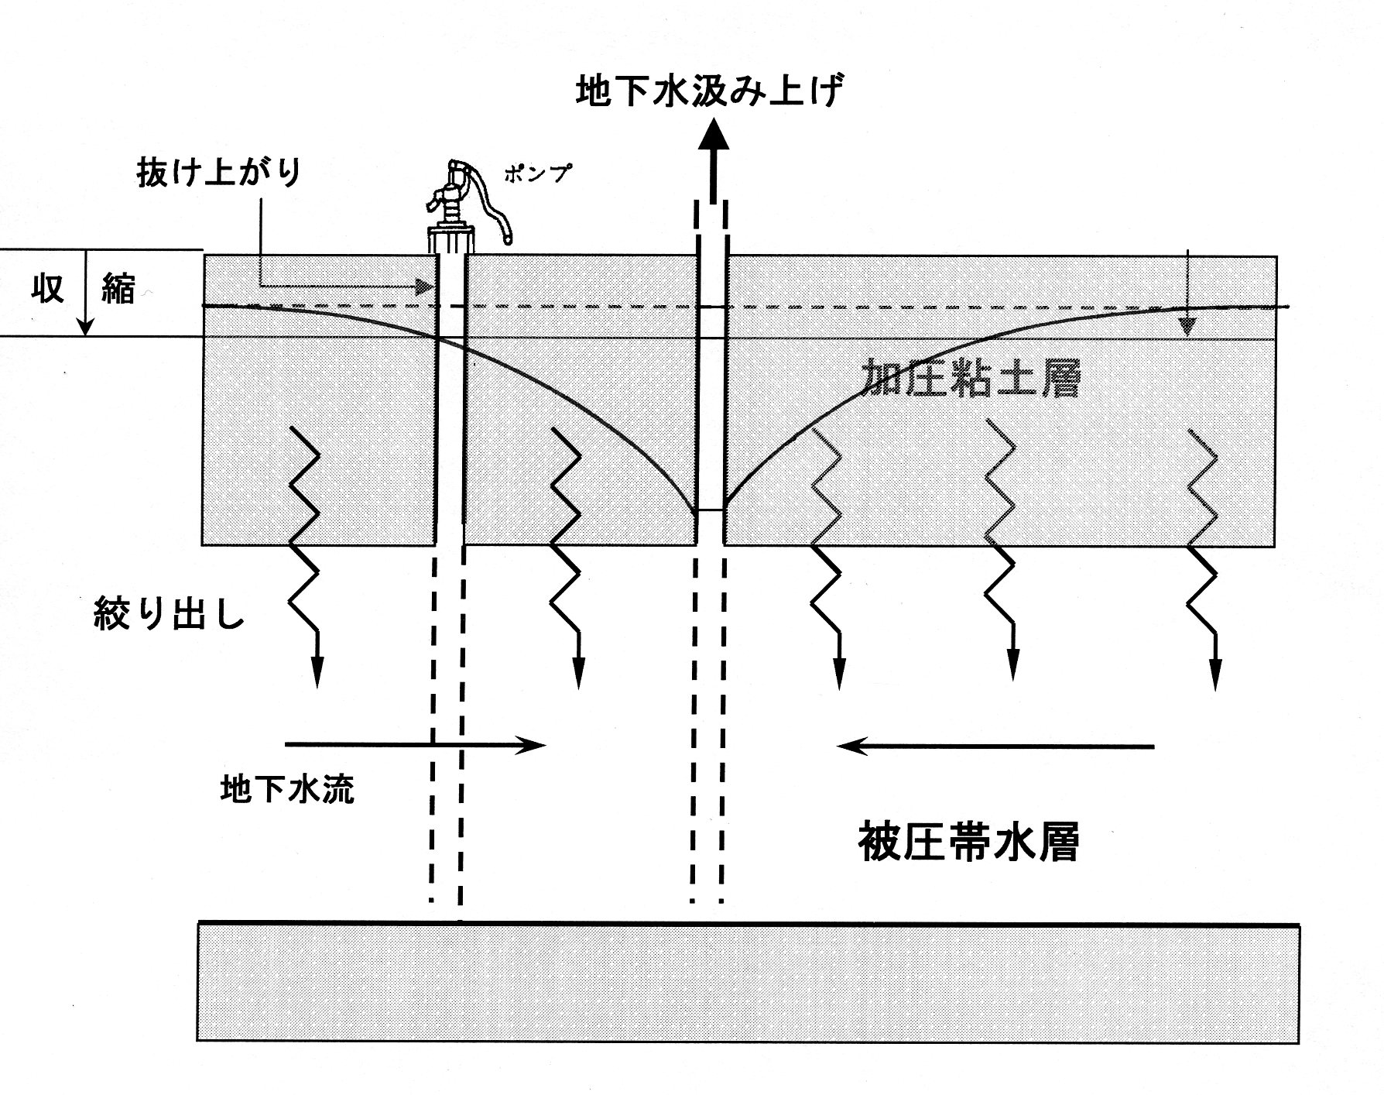
Mechanism of Land Subsidence (Surface layer subsidence)
Overpumping
Protruding
PUMP
Shrinkage
Land Subsidence
Aquiclude (clay)
Overpumping
Groundwater level drop
Squeeze of water in aquiclude
Shrinkage of aquiclude
Land subsidence
Squeeze
Groundwater Flow
Confined Aquifer
11

Slide 12
“Protruding” Well as an Evidence of Surface Layer Subsidence
Over the sunken area, old well casing has gradually risen above the ground surface.
This suggests that the sinking is caused by consolidation distributed throughout the layer penetrated by wells.
Old ground surface
Old ground surface
Shrinkage of surface layer
Shrinkage of surface layer
Present ground surface
Present ground surface
12

Slide 13
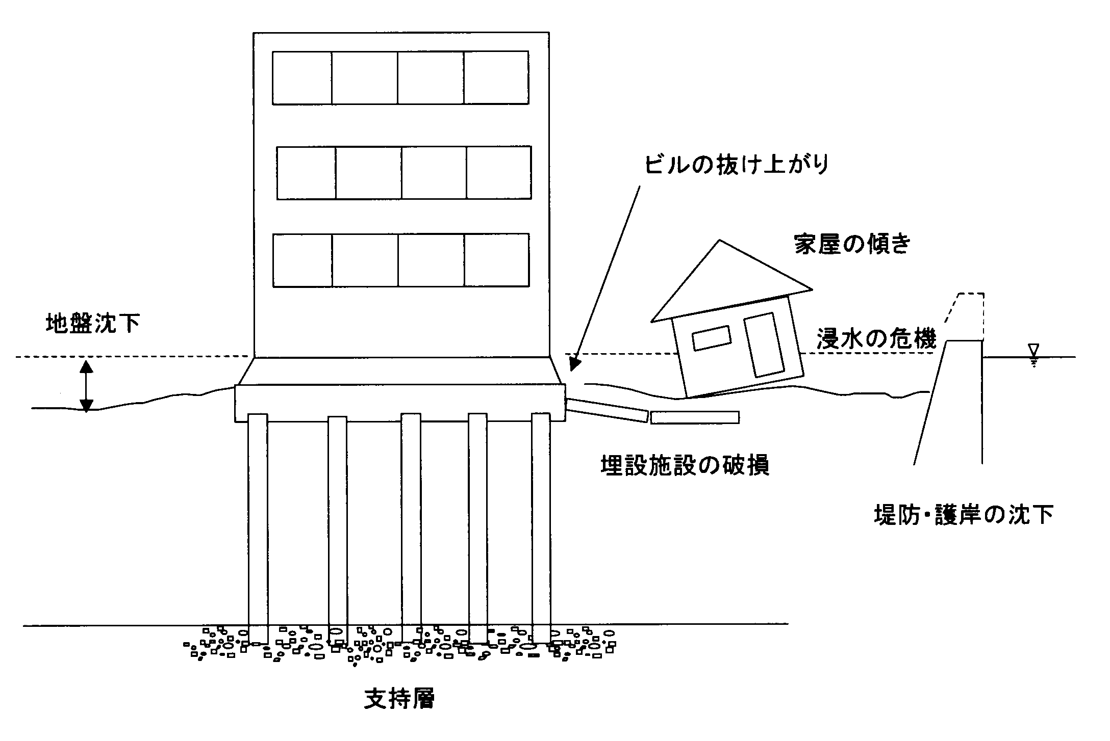
Physical Damage from Surface Layer Subsidence
Surface Layer subsidence caused visible damages :
Uprise of buildings
Leaning of house
Collapse of underground facilities
Cracks of buildings and houses
Uprise of building
Leaning of house
prone to inundation
Land subsidence
Settlement of dike and levee
Increasing the inundation prone area
Collapse of
underground facilities
Settlement
of dike and levee
Support layer
13

Slide 14
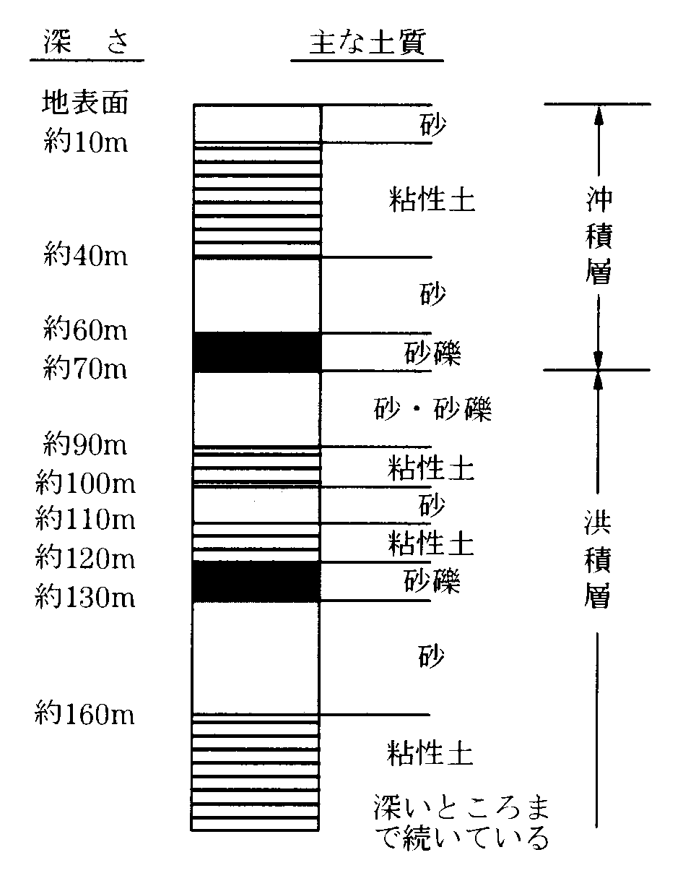
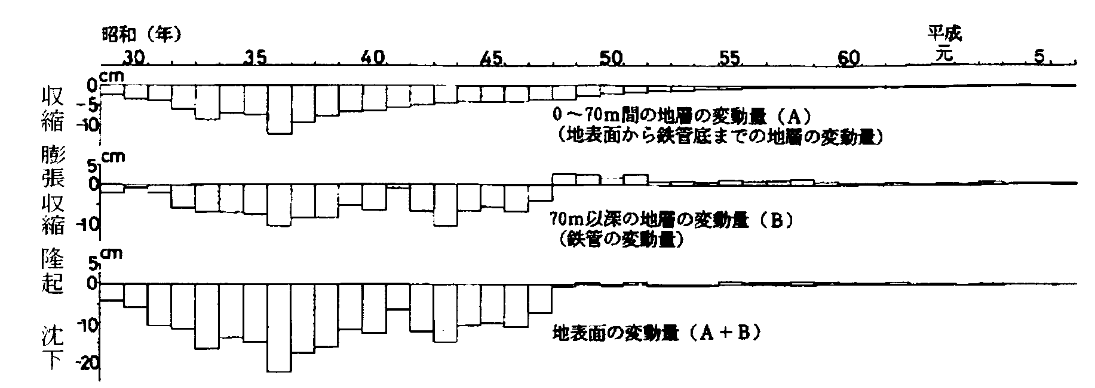
From Surface Layer Subsidence
to Deep Layer Subsidence
Depth (m)
Soil Type
Surface
sand
clay
Alluvial
Deposit
sand
Minamisuna No.1 Observation Well (Koto-ku)
1955
1960
1965
1980
sand gravel
1970
1975
1985
sand /sand gravel
Shrinkage A
(0m < depth <70m)
Diluvial
Deposit
Sand gravel
Shrinkage B
( depth >70m)
Shrinkage of layer ( cm )
sand
clay
Shrinkage A + B
14

Slide 15
Physical Damage from Deep Layer Subsidence
Deep Layer subsidence caused invisible damages :
Increasing the inundation prone area
Increasing the storm surge prone area
prone to inundation
prone to storm surge
Land subsidence
Settlement
of dike and levee
Support layer
15

Slide 16
Countermeasures against Land Subsidence in Tokyo
Industrial Water Law
Alternative Source of Water Use
16

Slide 17
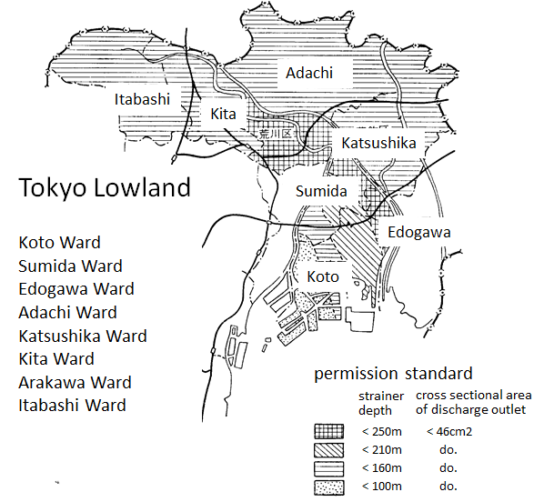
Industrial Water Law(1956)
for Tokyo Lowland
>> National Government
Enactment of law which aims to reduce the amount of groundwater pumping
Designation of the areas where the permission standard of the law should be applied for the groundwater withdrawal reduction
Prohibition of groundwater exploitation with new pumping wells unsatisfactory to the standard of the law
Prohibition of using the existing wells unsatisfactory to the standard of the law through the development of alternative water resources (e.g. treated sewage water or river water).
>> Prefectural Government (local government)
*standard of the Law : strainer depth and cross sectional area of discharge outlet
17

Slide 18
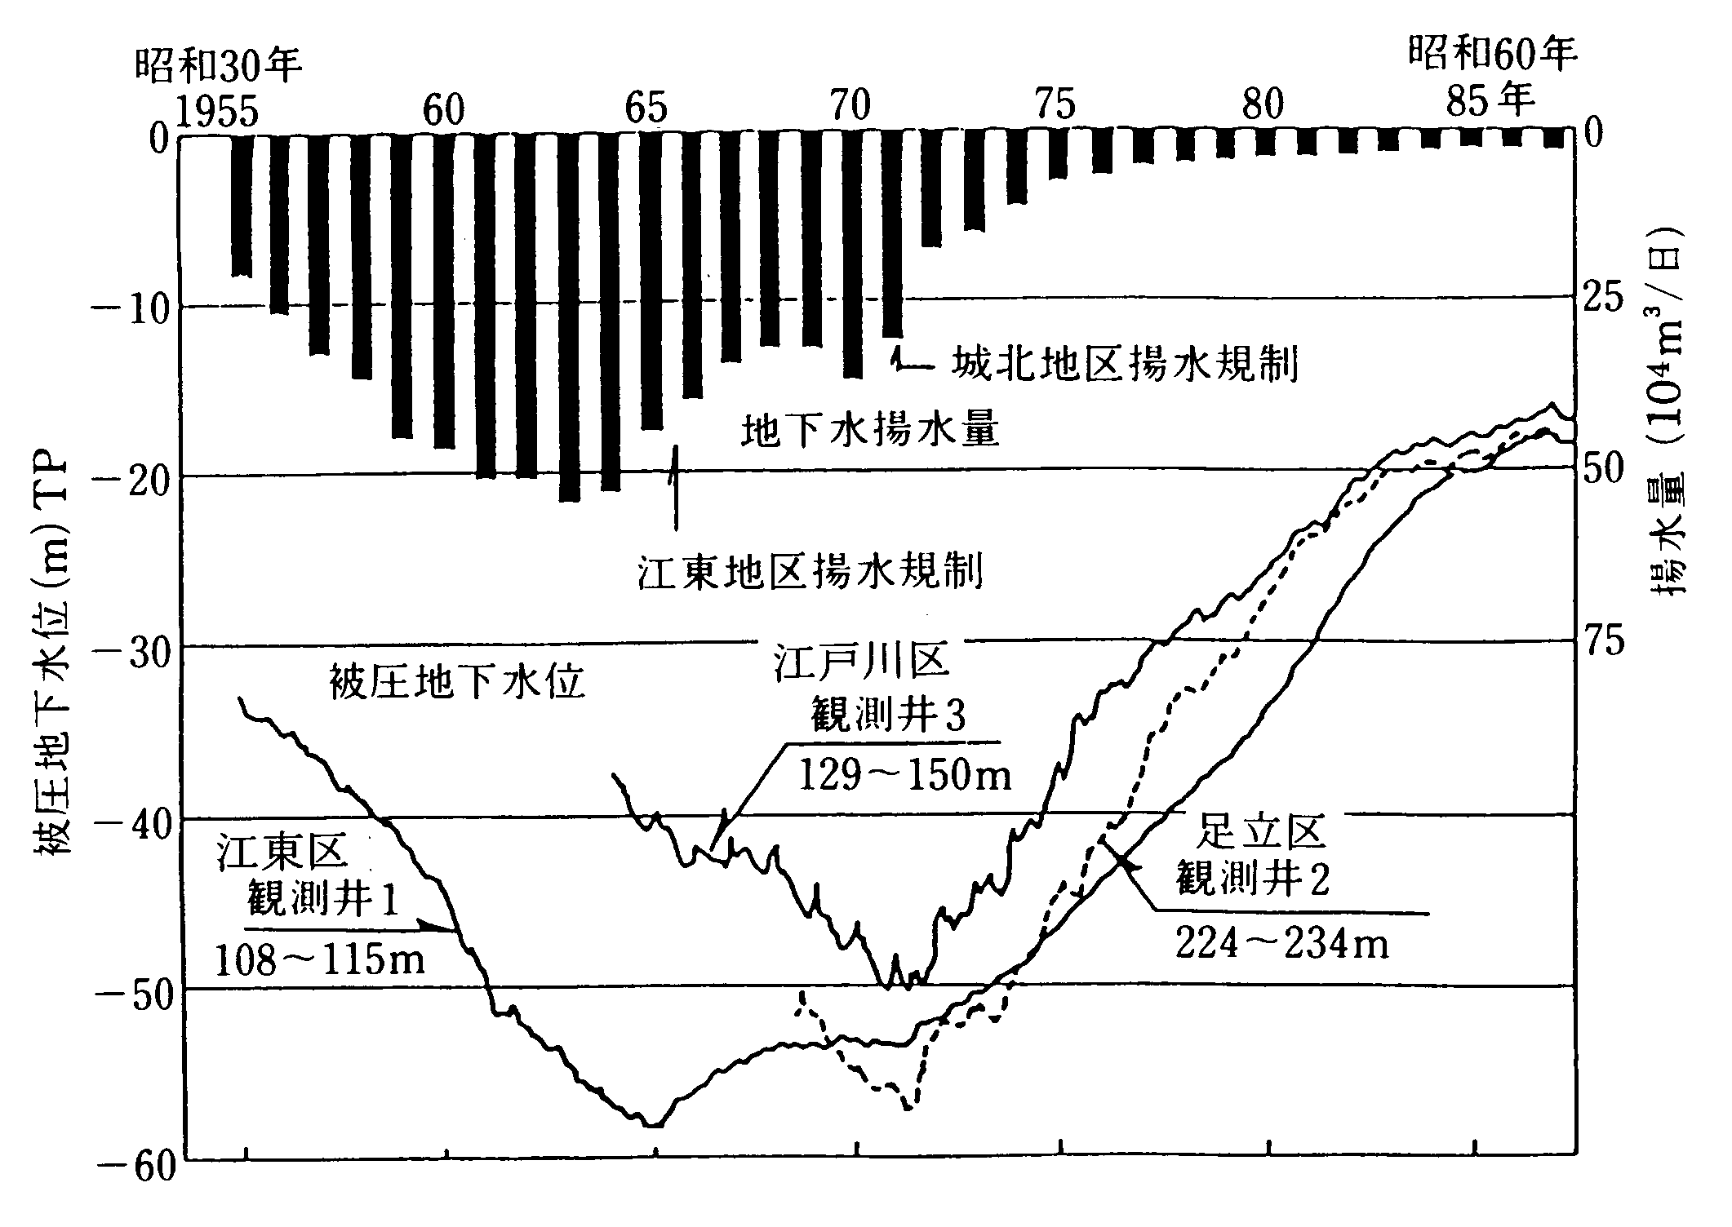
Groundwater Withdrawal Regulations and
Groundwater Level Rise
Regulation for Johoku Area
Groundwater Pumping
Regulation for Koto Area
Edogawa
Well
Groundwater withdrawal : 10⁴ m³/day
Groundwater Level
Industrial Water Law worked effectively to raise the groundwater level owing to the development of alternative water resources.
Groundwater level : m (T.P.)
Groundwater level
Koto
Well
Adachi
Well
18

Slide 19
Groundwater Withdrawal Regulations and Land Subsidence
Owing to the regulations of groundwater withdrawal, the groundwater levels went up clearly.
However, the ground surface never recovered to the original level with a very slight rebound.
The ground surface sank over 4 m in Koto ward.
We should know that the land subsidence could never recover even if we would prohibit the groundwater pumping.
19

Slide 20
Why did the Tokyo Area succeed in stabilization of land subsidence?
The main cause of the land subsidence was the overwithdrawal of groundwater for industrial water use. The industrial water was the most demanded during the high economic growth period.
The Industrial Water Law was efficiently applied to the factories located in the Tokyo lowland area that suffered from the land subsidence.
It is difficult to restrict the water use for domestic and agricultural purposes. Because there are no laws to restrict domestic and agricultural water use.
The alternative water sources, recycled water and river water, were efficiently introduced to the industrial areas.
The factories were forced to move away from the industrial area owing to the three laws related to the factory location.
>> Accumulation of the geologic data and monitoring system of groundwater level and land subsidence
20

Slide 21
Conclusion - Countermeasures against Land Subsidence
Mitigation
Regulations by law, ordinance, administrative guidance
Alternative water resources development
Effective water use – Water supply system improvement
Adaption
Raising of coastal dikes and river levee
Raising of ground level
Flood inundation prevention
Monitoring
Level survey
Groundwater level observation
Investigation of groundwater use
Management
Optimal groundwater use and conservation of groundwater resources
21

