Slide 1
Urban Water Challenges in Singapore
Olivia Jensen PhD
Senior Research Fellow
Institute of Water Policy, National University of Singapore

Slide 2
Singapore River: 1960s & Today

Slide 3
Integrated management of multiple sources & networks

Slide 4
Strategic Approach: Four National Taps

Slide 5
Source Diversification Targets

Slide 6
Integrated management of multiple sources & networks

Slide 7
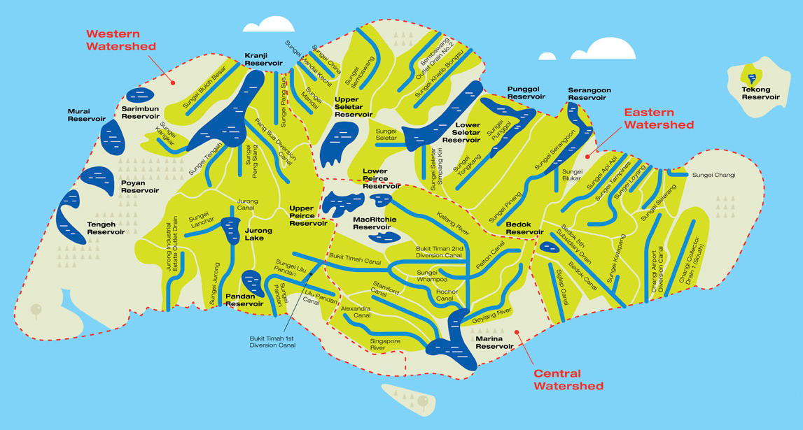

Slide 8
NEWater

Slide 9
NEWater (Water reuse)

Slide 10
Sewerage Infrastructure

Slide 11
Building support for NEWater

Slide 12
Desalination

Slide 13
Public-private partnerships
Project | Type | Consortium | Concession period | Capacity | Bulk water tariff “First year price”
Singspring | Desalination | Hyflux | 2005-2025 | 30 mgd | S$0.78 [US$0.58]/m³
Ulu Pandan NEWater | NEWater | Keppel Seghers | 2007-2027 | 32mgd
Sembcorp NEWater | NEWater | Sembcorp | 2010-2035 | 50 mgd
Tuaspring | Desalination | Hyflux | 2013-2038 | 70 mgd | S$0.45 [US$0.33]/m³
BEWG-UESH NEWater Plant | NEWater | Beijing Enterprises Water Group Limited & UES Holdings Pte Ltd | 2017-2042 | 50 mgd | S$1.26 [US$0.94/m³
Marina East | Desalination | Keppel | 2020-2045 | 30 mgd | S$1.08 [US$0.80]/m³
Jurong Island | Desalination | Tuas Power & Singapore Technologies Marine Consortium | 2020-2045 | 30 mgd | S$0.91 [US$0.68]/m³

Slide 14
Water demand reduction

Slide 15
Tariffs
2016
2017
2018

Slide 16
 | Av. HH bill based on 20m3/month SG$ nominal | Av. HH bill/% of average HH expenditure | Av. HH bill/% of HH expenditure (bottom quintile)
2002 | 44.55 | 1.3% | 2.6%
2007 | 44.55 | 1.2% | 2.5%
2012 | 44.55 | 0.9% | 2.0%
2017 | 47.8 | 1.0% | 2.1%
2018 | 54.8 | 1.2% | 2.5%

Slide 17
Per capita water consumption

Slide 18
Household water demand reduction

Slide 19
Residential Units

Slide 20
Industrial water demand
Policies for large non-domestic users (2015)
Install private water meters
Prepare a Water Efficiency Management Plan annually and submit to PUB
Certify at least 1 employee as a Water Efficiency Manager

Slide 21
Stormwater management
Regulations on new build (2014)
Expand drains and canals, construct diversion canals
Regulations on platform and crest levels
Increase land reclamation levels

Slide 22
Flood prone areas 1970s to 2010s

Slide 23
Governance

Slide 24
Singapore Income per capita 1960-2013

Slide 25
