Slide 1
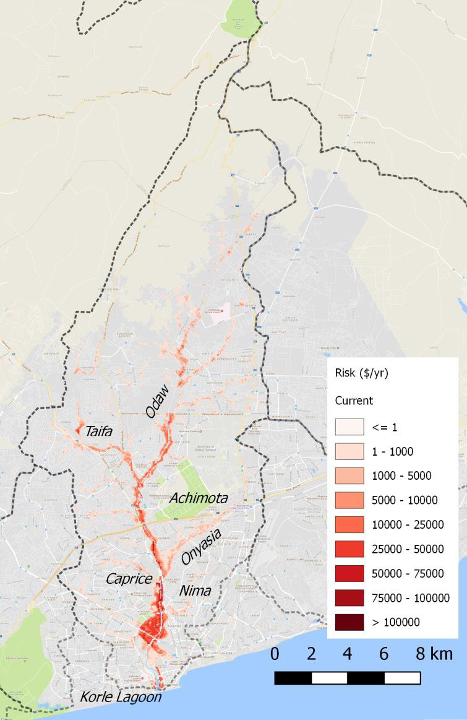
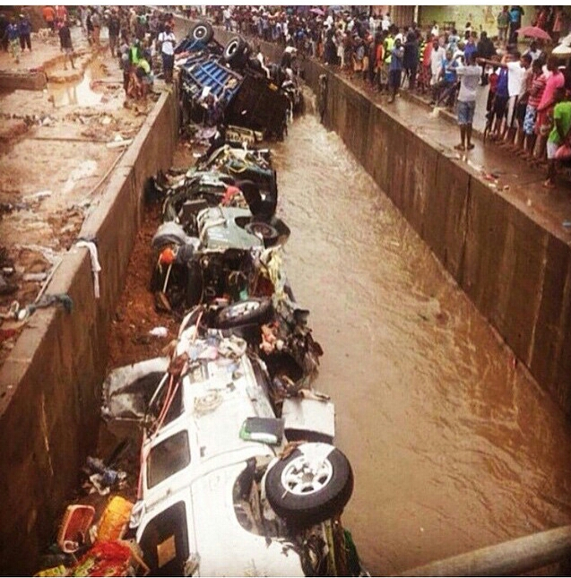
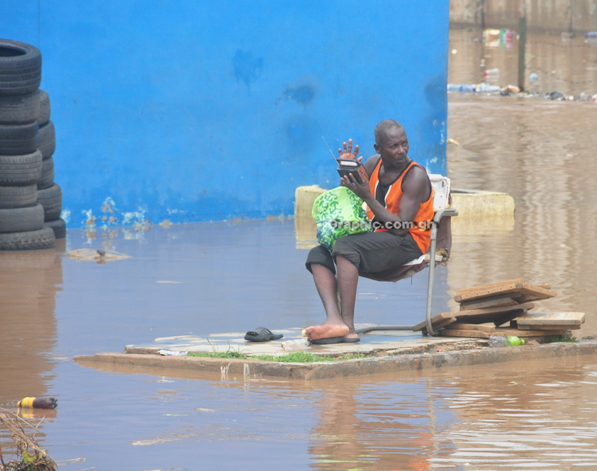
INTEGRATED URBAN WATER MANAGEMENT STUDY TOUR
ACTION PLAN - GHANA
GREATER ACCRA RESILIENT AND INTEGRATED DEVELOPMENT PROJECT & GAMA SANITATION AND WATER PROJECT
(GARID + GAMA SWP)

Slide 2
1. KEY TAKEAWAYS FROM STUDY TOUR
Good governance, effective institutional arrangements & strong coordination across all levels
Federal-State-Metropolis-Municipalities
Public-Private-Communities
Strong local liaison engaged on output-based contracts
Community engagement driven by collective welfare / public goods messaging
Identifiable Champions
Long-term horizon, multi-phase approach, dedicated agency
Committed staff and effective project management
Engineering as solution
Use of nature as an asset
The water cycle systems integration
Integrate liquid and solid waste treatment
Finance
Clear mechanisms for cost recovery
Everybody pays something

Slide 3
2. CRITICAL PATH ACTIVITIES - GARID
Streamlining institutional framework for project implementation
Staffing Project Coordination Unit
Procurement,
Safeguards,
Financial Management,
Project Assistant
Establishing Ministerial-level Project Steering Committee
Inception Meeting (10th July)
Monthly meetings
Activating local-level project coordination committee (from Act 936 & Act 925) leading to GAMA JDPB (LI 2232)
Inception Meeting (10th July)
Monthly meetings
Government level bi-weekly project coordination meetings (July 5th 2018)
Inter-project coordination
GARID; GAMA-WSP; GASLIP; GIZ-Allianz; GAPTE; GAMA Urban Transport; Marine Drive Project; MWH Infill Development; Ministry of Railway Rail Project; GAMA Master Plan; 100RC; WHO Air Pollution Study; RIPS Early Warning etc.
Fast-tracking Project activities
Procurement, implementation, completion, and disclosure (July 31st)
Waste transfer stations
Capping of dumpsites
Preliminary dredging
Consultation and Procurement
O&M and Asset management Study
Community-based innovative waste management
Visioning GAMA 2050 & Land Value Capture
Procurement & Implementation
Community Profiling
Community Liaison
DED Transfer Stations
DED Dumpsite Capping
Sanitation Policy Review and Guidelines
Site Information
Korle-Bu Transfer station?
Disposal of dredge materials
Stakeholder Engagement and Project Communication
Presentations
Ministerial level (MWH, MSWR, MICZD & MLGRD)
Economic Management Team
Greater Accra RCC
Public Procurement Authority
Cabinet
Parliamentary Select Team on Finance; Works & Housing; Sanitation & Water Resources; and Local Government & Rural Development
Engagements
CONIWAS-type (CSOs and NGO communities)
Affected communities (Components 1, 2, & 3)
Research & Academia (Online learning and sharing platforms)
Built Environment Professional Groups (GIA, GhIE, GIP, & GhIS)
National Urban Platform meetings
Ga Traditional Council / Greater Accra House of Chiefs
Formal Launch
Local Private Sector and interests (Insurance companies)
Political Parties

Slide 4
3. LEARNING FROM STUDY TOUR - ADAPTABLE ACTIVITIES
Connecting lowered flood plains and capped dumpsite (downstream Odaw) using as urban parks
Think water cycle – run-off drainage, sewerage treatment, percolation, water supply, solid waste management
Overlapping levels of difficulty + upwards linkages with hierarchies of water-based visions and city development
Simple → Complicated → Complex
Champions across levels
Community level (
Professional level (Prof Tucci)
Political level (Mayor)

Slide 5
4. NEXT 12 MONTH (URGENT) STEPS
Formal Launch of GARID – ensure all key stakeholders are involved in planning (Launch during National Workshop??)
Establish Steering Committee is setup for GARID.
GAMA Steering Committee should meet two times in a year (next meeting before 31st July)
Land acquisition for at least three retention ponds should be finalised
Finalise selection of options for flood mitigation (T-10 options; T-25 options; T-50 options)
Finalisation of sites for Transfer Stations (ensure environmental sustainability and effective O&M mechanisms)
Launch community based solid waste management initiative & public awareness initiative on Solid Waste Management
GAMA Household Toilet construction – meet interim target of 12,000 toilets (from 6,500 May 2018 to 12,000 June 2019)

Slide 6
5. KEY STAKEHOLDERS NEEDED FOR IMPLEMENTATION
AUTHORITY FOR EXECUTION
Office of the President
Ministry of Finance
Implementing Ministries (MWH, MSWR, MICZD & MLGRD)
Other Ministries
MESTI, MRH, MoT, RCC,
Agencies
HSD, NADMO, WRC, GASA(?),
MMDAs – AMA, AdMA, Ga East, Ga West, LaNMMA, +
MCEs, Planning, Works (Drainage Maintenance Unit), Waste Management, GAMADA)
TECHNICAL CAPACITY
Regulatory & Coordinating Authorities –
EPA, NDPC, RCC, Lands Commission,
Professional Bodies
GhIE, GIP, GIA, GhIS
ACCESS ISSUES
Traditional Authorities (Retention ponds, widening of channel)
University of Ghana (Transfer station)
Ghana Atomic Energy Commission (Transfer station, retention pond)
Korle-Bu Teaching Hospital (Transfer station)
COMMUNICATION ISSUES
Media
Print, Broadcast, Online, Social Media
Direct contact
Neighbourhood/Youth groups

Slide 7
6. TIMELINE FOR MILESTONES
Milestones | Due Date | Comments
Local Project Coordination Committee set up | July 24, 2018
Set up of Steering Committee | July 31, 2018
Transfer Station ESIA Disclosure | July 31, 2018
Dumpsite Capping ESIA Disclosure | July 31, 2018
Dredging ESIA Disclosure | September 11, 2018
O&M Study Concluded | September 18, 2018
PCU Set Up | September 30, 2018 | Procurement, FM Safeguards, Com. Spec. etc
Construction of additional 3,000 toilets completed | December 31, 2018 | GAMA
Construction of Faecal Sludge Treatment Plant Commences | December 31, 2018 | GAMA
Detailed Engineering Designs for Capping Dumpsite completed | January 15, 2019
Community Profiles completed | February 14, 2019
Detailed Engineering Designs for Transfer Stations completed | February 28, 2019
Performance-Based Contract for Dredging signed | March 2019 | MoF agrees

Slide 8
7. OPPORTUNITIES / BARRIERS
Coordination – Inter-ministerial, metropolitan, MMDAs
Timing for involving communities/public support for the project
Engineering solutions depending upon availability of land in dense urban core
Private sector involvement
Capacity of stakeholders Vs. timely completion of activities
Vibrant media (traditional and social) for mobilization
Political cycle (local and national elections)

Slide 9
8. CONCRETE SUPPORT / ASSISTANCE NEEDED
Quick turnaround on STEP.
Finalisation of Simulation Models on volumes for potential retention ponds.
Safeguards…
Structured capacity building.

