Slide 1
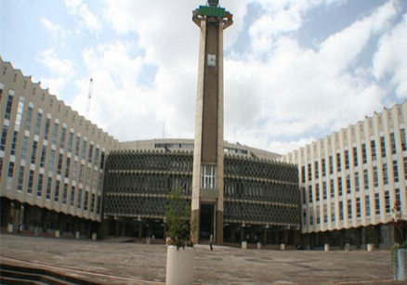
INTEGRATED URBAN WATER MANAGEMENT STUDY TOUR IN BRASIL (IUWM)
Action Plan for the Next 18 Months
Presented by the Ethiopian Delegation
Date: June 27, 2018

Slide 2
Key takeaways from Brasil
Connect the unconnected; critical to have different approach for servicing the poor(SABEPS)
Effective urban planning critical for inclusive local development (e.g capela do so Corro neigbourhood (SP); Lagoas do Norte (Teresina)
Resettlement effective if it happens within existing locations and w/ active stakeholder engagement to provide viable options.
Due attention should be given to protection of water source areas and preventing water contamination through community consultation, participation.
Water supply and sanitation provision more effective when involving the private sector and presence of solid regulatory framework (SABEPS);
Integration and coordination key for effective urban water management (water supply, storm water, solid waste and land use)

Slide 3
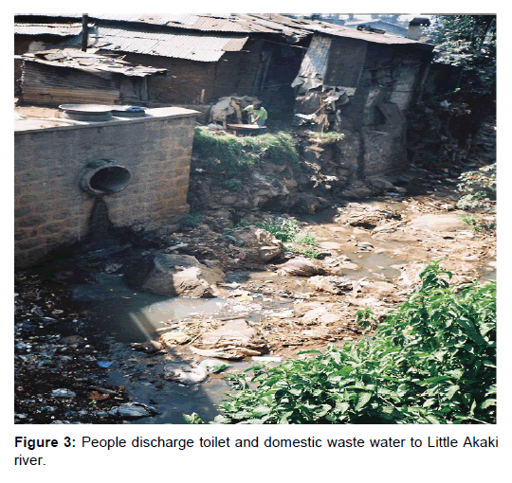
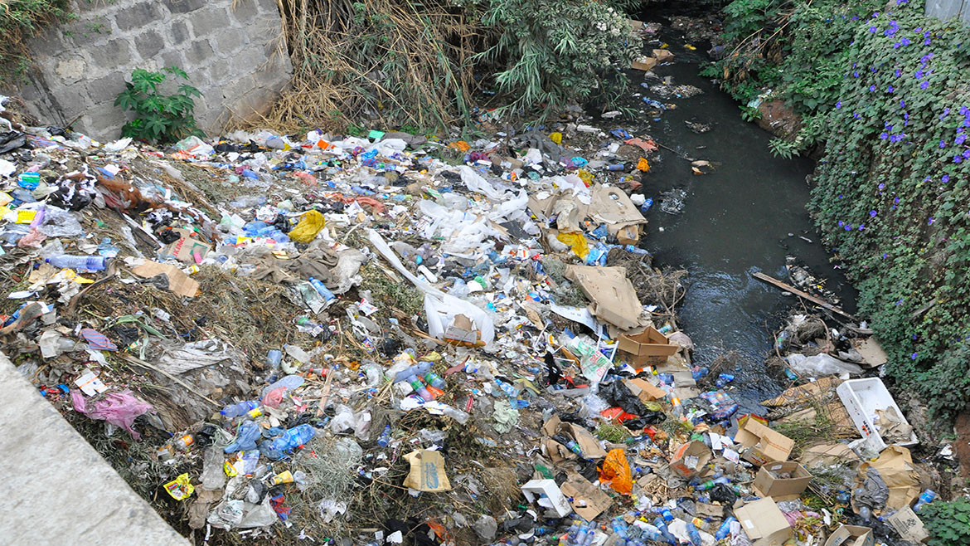
What needs to be accomplished to address priority challenges?
Integrated planning and piloting to provide proof of concept and then scale up with:
Clear delineation of responsibility and acceptance of stakeholders
Implementation without having intergrated and consultative planning and shared accountability should be avoided
Awareness creation and training to key stakeholders, including politicians to start thinking out of the box
Capacity building and exposure of key stakeholders in the subject matter

Slide 4
What are opportunities and barriers for implementing the action plans?
Opportunities/Strengths:
Ongoing Institutional reorganization and restructuring in Addis Ababa city and strong political will
Newly established planning commission, ratified new integrated and flexible master plan
Agency for green development, watershed management, and flood management under process
Increased investments in expansion of water supply and sewerage services
Newly approved WB support for urban water supply and sanitation, Urban Institutions and Infrastructure Development Program
Barriers Expected:
Institutional resistance, lack of coordinated implementation & regulatory bodies
Shortage of skilled manpower and budget
Time to gain public awareness and acceptance
Limited use of larger menu of technological options

Slide 5
Actions & Milestones
Dissemination and stock taking national workshop with key stakeholders in December 2018
Prepare and implement a showcase project for Addis Ababa under the River Development agency (catchment management, urban parks, access to water & sanitation, drainage, solid waste, flood protection, etc) - Plan prepared by end December 2018
Prepare and implement a showcase project for a secondary city ( catchment management, urban park, access to water & sanitation, drainage, solid waste, flood protection, etc) - plan prepared by February 2019
Training and awareness creation on IUMM to federal and city officials, and technicians in six months (with the support of IUMM) – FY 19
Short term and long term training and international expert support on developing and implementing the show cases.

Slide 6
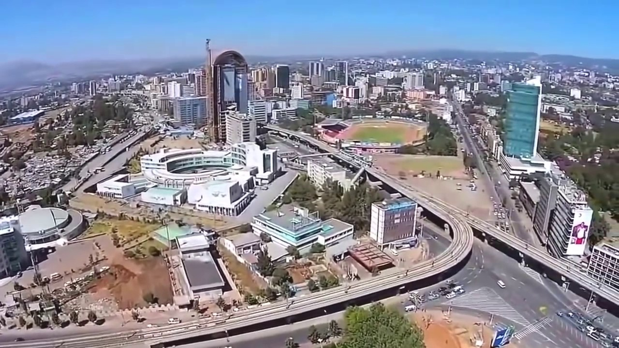
Concrete Technical support from WB/IUWM
Training and awareness creation on IUMM to federal and city officials, and technicians
Short and long term training and international expert support on WSS service delivery (and viable technologies), flood management
Support on best practices and implementation of resettlement practices & social mobilization; integrating job creation and livelihood activities
Support in the development of the show cases in the two cities
Workshop on IUWM in Addis Ababa bringing together officials and technicians from different cities in Ethiopia
Exposure visits to best practice cities
Expand financing support through ongoing lending operations (for WSS and urban development)

Slide 7
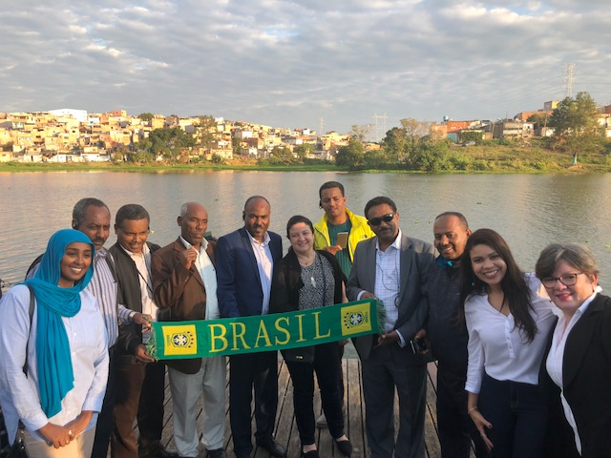
THANK YOU!

