Slide 1
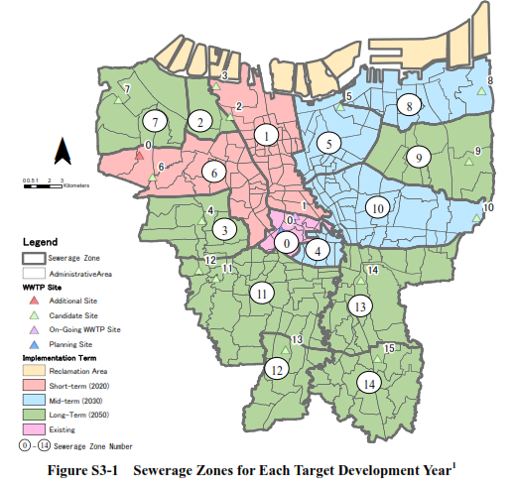
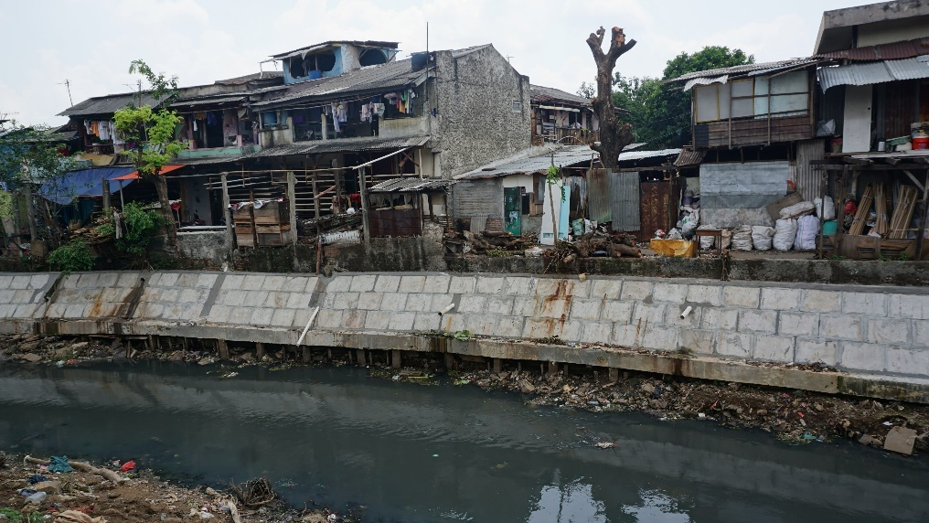
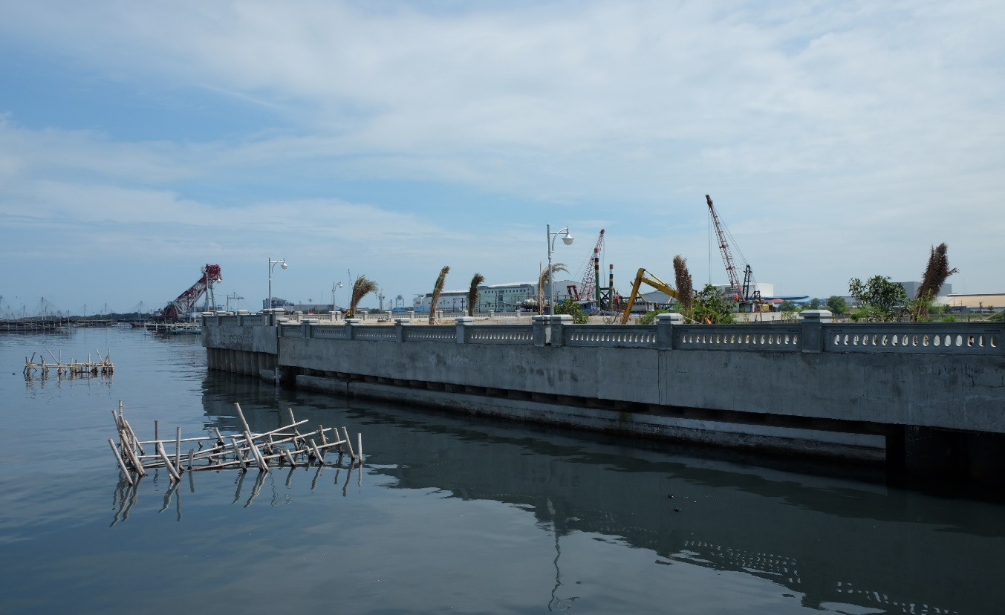
INDONESIA ACTION PLAN
Sao Paulo, 27th June 2018

Slide 2
OUTLINE
Key takeaways
Things to be accomplished
Approaches
Action Steps
Key Stakeholders
Timeline
Opportunities and Barriers
Support from World Bank

Slide 3
1. Key takeaways
Program implementation (area based) with central issue to integrate all efforts
All efforts are conducted in holistic and integrated mannerd
In Sao Paulo: solving flood problem
In Teresina: saving lagoons as a mean for socioeconomic development
Consistent urban planning taking into account water resource as constraint
Other related problems that have to be solved to reach the objective: slums alleviation, housing provision, land tenure, etc
Determination of priority location
Having clear stages of development
Long term financing scheme
Case study: saving the Gulf of Jakarta with major outputs of piped drinking water provision and wastewater services

Slide 4
2. THINGS to be accomplished
The need for comprehensive master plan along with adequate legal standing and financing mechanism (synergizing all exisiting master plans)
Institutional setting (Project/Program Management Office, Coordination Team, etc)
Monitoring and evaluation

Slide 5
3. approaches
Integrated development program across all related sectors
Physical intervention with strong emphasis on social and economic aspects (eg. resettlement)
Establish strong leadership and commitment to mobilize resources and support from related stakeholders
Develop a collaborative and participative platform

Slide 6
4. Action Steps (Next 6-12 Months)
Establish Preparation Working Group (alumni Brazil Plus)
Implement workshop (as kick-off meeting) to agree on comitment and collaborative action (platform)
Establish Workable Collaborative Working Team
Mapping: Plannings, stakeholders, on-going and future projects (what we have, what we don’t have, ineffective program/projects), progress
Policy Matrix and Program Memorandum (who is doing what and when, pooling resources) for all stakeholders
Prepare detailed action plan for each stakeholders/sectors

Slide 7
5. Key Stakeholders
Local governments: Local governments in Greater Jakarta (provincial, municipalities and districts), water and sanitation utilities
Central government: Ministry of Public Works and Housing, Ministry of Planning, Ministy of Environment, Ministry of Home Affairs, Ministry of Maritime and Fisheries, Land and Spatial Planning Agency
Others: PJT II, Development Partners, NGOs and community associations, universities, private sector (private property developers)

Slide 8
6. Timeline
1. July-September: Preparation and work plan development, establishment of Task Force (central collaboration management unit)
2. November: National Workshop→ inputs for mid term development plan
3. December: Detailed Sectoral Workshop → inputs for mid term development plan
4. January: Mapping masterplans and existing programs
5. February : complete development of policy matrix
6. March: complete development of Program Memorandum

Slide 9
7. Opportunities and Barriers
Opportunities:
Upcoming New Development Plan 2020-2024
On-going program from various development partners
Existing master plan,
Barriers:
Ego sectoral dan teritorial,
Conflicting regulations,
Political will and leadership,
Inconsistency agenda

Slide 10
8. support/assistance from world bank
Provide technical assistance
Bring global experience and experts
Linkage to existing and pipeline WB activities (projects, TAs and studies)
Convince and confine other development partners

Slide 11
OBRIGADO!

