Slide 1
IUWM Financial + Economic Module
Simulation Game
Introduction Round 1

Slide 2
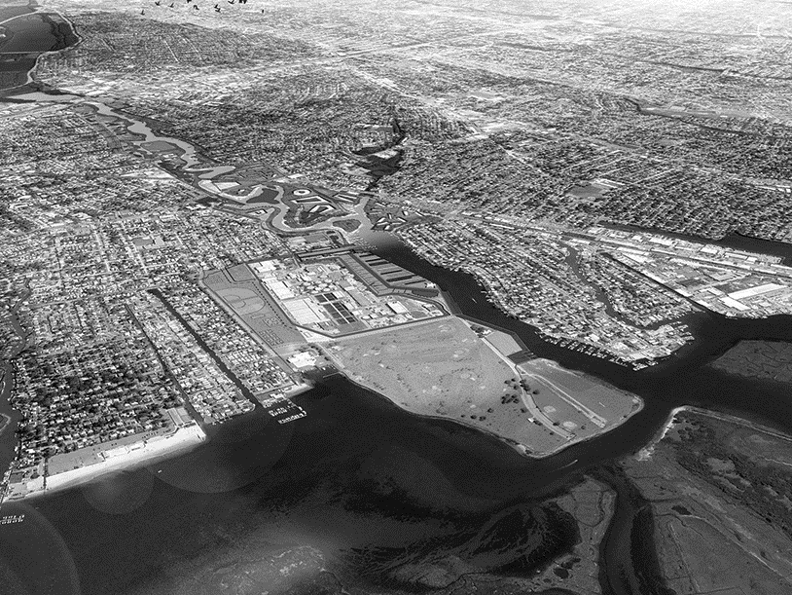
Welcome!
…to the expert session of Bay City’s Water Management Investment Program
Notes:
Facilitator 1:
- Introduces himself as the head of the water management investment program of Bay City
Welcomes the participants as ‘his’ team
Starts introducing the case
Next slide: Introducing Bay Case

Slide 3
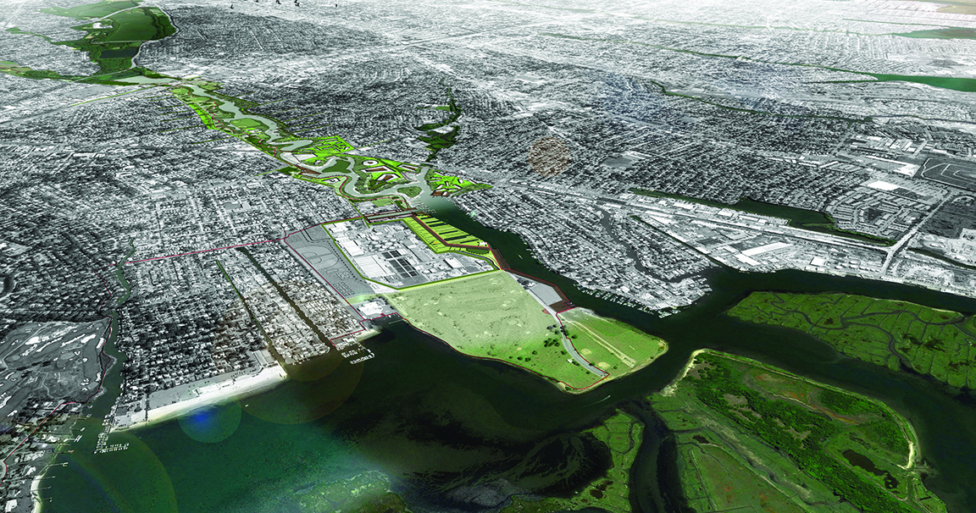
Bay City – a growing city in the delta
Lake & Ponds
River
wastewater treatment plan
Bay & Marshes
Notes:
Facilitator 1:
- Introduces the case – first, the location:
Bay City is located in a delta area.
The natural water system of Bay City consists of one main river with some lakes and ponds, which discharge into a bay that is linked with the wider ocean.
A wastewater treatment plan is located downstream along the river at the bay, which collects sewage from the city and conducts primary treatment of sewage before discharging it directly into the bay.
Next slide: The wastewater problem explained in more detail

Slide 4
Bay City is facing problems with regard to urban development and wastewater
Increasing urbanization
Recreation
Water quality degradation
Under-capacity of WWTP
wastewater discharge into bay
Tourism
Ecosystem damages
Population growth
Property value
Notes:
Facilitator 1:
Introduces the case – second, the problem that needs to be solved.
Start with current situation
The discharged wastewater increasingly causes water quality degradation and ecosystem damages in the bay. This has significant negative effects on recreation and tourism activities and surrounding property values.
- Then the external development that aggravates the situation:
With increasing urbanization and population growth in the city, the capacity of the wastewater treatment plant is no longer sufficient. Therefore, enhancing the capacity of the plant is necessary.
- Next slide: YOU (the participants) are responsible for this expansion

Slide 5
Your task and your budget
Your responsibility: the water management investment program
Your budget (based on results of a revenue study):
Annual revenue stream of $ 1 million over the coming 30 years (from levies/ taxes)
Available for investments in capacity expansion of the WWTP
Your task: Determine the optimal solution for the wastewater problem
Notes:
Facilitator 1:
- Explains the task and budget:
You are the Bay City officials responsible for the water management investment program.
The city is expecting to have an annual revenue stream of $1,000,000 in earmarked tax revenues available for the investments in capacity expansion over the coming 30 years.
The participants need to choose 1 solution for the problem….
Next slide: … from an economic/financial perspective out of 3 alternatives

Slide 6
Alternatives and choices
The working group responsible for developing alternative technical investment programs came up with three technically feasible alternatives
We now need an assessment of these alternatives from an economic and financial perspective
Notes:
Facilitator 1:
Introduces the starting point for the task:
In a multidisciplinary approach, three alternatives have been developed that are technically feasbile
Now one solution needs to be chosen – based on economic and financial arguments.
We want you to perform an assessment – and make a choice.
The ‘how to’ of this assessment is explained by ‘my colleague’ (= Facilitator 2)
Facilitator 2:
Explain the ‘how to’:
Use the score sheet to summarize the results of your analysis
Choose the best alternative and present it to the other experts
Time: 40 minutes
The following materials/tools will be at your disposal:
A financial-economic assessment tool on your laptop
Handouts with the most important information
A scoring sheet to summarize the results

Slide 7
IUWM Financial + Economic Module
Simulation Game
Round 1 – Results

Slide 8
Results
NPV
Alternative 0
NPV: 4.569
eNPV: 0
Alternative 2
NPV: 1.894
eNPV: 1.304
1000
-1000
1000
Alternative 1
NPV: -345
eNPV: 1.542
eNPV
-1000
Notes:
Facilitator 1:
Gathers results from experts, as his/her team members.
Thanks the experts for their assessments and choices
Facilitator 2:
Explain the scores of the different alternatives
Next slide: Lessons learned

Slide 9
Lessons learned
Financial feasibility is not just about investment costs, but also about life cycle costs, as well as revenues.
The “without project” alternative is not just “doing nothing”, often some action is required in a situation with autonomous growth (population, economy)
The economically optimal solution is not always the same as the financially optimal solution, but economic result can be a justification for government contribution, which then improves financial feasibility.
Notes:
Facilitator 2:
First posts open question to the group
Then summarizes the prepared lessons learned

Slide 10
In real life…
…there is uncertainty about pretty much all parameters in financial and economic feasibility analyses.
…several factors – especially benefits – cannot be quantified or monetized, but are still relevant in decision making.
…this typically leads to ranges of monetized outcomes and qualitative discussions of additional considerations.
Notes:
Facilitator 2:
Continuation of lessons learned
Hands back to the Facilitator 1 for Round 2
Next slide: Start Round 2

Slide 11
IUWM Financial + Economic Module
Simulation Game
Introduction Round 2

Slide 12
Welcome!
…to the 2nd expert session of Bay City’s Water Management Investment Program
Notes:
Facilitator 1
Is back ‘in his role’.
Welcomes the participants as his team again for the 2nd expert session for the Water Management Investment Program
The Mayor participated in an international conference and was inspired by a session on IUWM.
After commissioning a quick diagnostic in his city and a stakeholder mapping exercise (concluding that the problems in his town were affecting different sub-sectors and stakeholders), he called for a meeting with different stakeholders.
The Mayor already instructed to have the policy on groundwater recharge adjusted, to protect water quality.

Slide 13
Bay City is facing problems with regard to urban development and wastewater
Increasing urbanization
Recreation
Water quality degradation
Under-capacity of WWTP
wastewater discharge into bay
Tourism
Ecosystem damages
Population growth
Property value
Notes:
Facilitator 1
Re-introduces the problem of Round 1 (same slide)
- Next slide: additional problem: groundwater

Slide 14
Bay City is also facing problems with regard to groundwater
Increasing urbanization
Reduced river flows (climate change)
Ground water quality (salty)
Water supply cost
Increasing water demand
Over-abstraction groundwater
Lowering groundwater table
Land subsidence + flood damage
Property value
Population growth
Notes:
Facilitator 1:
Goes through the flow chart
Intensified urbanization is causing significant increases in water demand…
…leading to over-abstraction of groundwater and the lowering of the groundwater table.
This depletion of groundwater plus reduced river flows cause salt water intrusion…
Degrading groundwater quality in the coastal aquifer.
The lower groundwater levels + poorer quality increases costs of pumping and treatment for water supply.
In addition, land subsidence due to lower groundwater levels causes damages to properties, increases flood damages, thereby reducing property values.
Next slide: additional problem: stormwater

Slide 15
Bay City is also facing problems with regard to stormwater
Tourism + recreation
System overflow discharge
Pollution of rivers and lakes
Public health risk
Climate change-heavy rainfalls
Urban flooding
Insufficient drainage system
Notes:
Facilitator 1:
Goes through the flow chart
The current combined sewerage system in the city collects and transports untreated storm water to the WWTP. In the event of major storms the system discharges into freshwater streams (rivers, lakes) surrounding the city, which eventually reach the bay.
Untreated sewerage system discharges leads to pollution issues in rivers and lakes
which have traditionally been used for recreational and tourism activities.
The pollution is a potential public health risks.
In addition, the current capacity and design of the drainage system is insufficient to efficiently convey storm water during heavy rainfall events to near-by streams.
This causes frequent urban flooding problems and is likely to aggravate in the future due to climate change.
Next slide: your task and budget

Slide 16
Your task and your budget
Your task, again: Determine the optimal solution for the wastewater problem but now also integrating stormwater and groundwater issues
Your budget, again: Annual revenue stream of $ 1 million over the coming 30 years (from levies/ taxes)
New approach: pursue an integrated approach by:
Considering other urban water challenges
Seeking input from stakeholders!
Notes:
Facilitator 1:
- Explains the task and budget:
Responsibility, task, budget are the same as in expert session 1 / round 1.
New approach:
The city has been embracing an integrated approach to urban water management
This includes analyzing urban water challenges in parallel
And also considering other challenges and opportunities in the urban context
An important element: stakeholders engagement
Next slide: … stakeholders for Round 2

Slide 17
Stakeholders
Three main stakeholders were identified:
the Bay City water utility,
the regional blue-green infrastructure program, and
ABCD, a major developer in the region.
Potential advantages of stakeholder engagement:
New alternatives / solutions
Better solutions due to integrated approach
Additional funding
Potential disadvantage of stakeholder engagement:
More effort/ time required: transaction costs
Notes:
Facilitator 1:
Introduces the three stakeholders the teams should ‘talk to’:
The mayor has asked your team to reach out to the following stakeholders in order to explore opportunities to work together on several of these challenges and to seriously consider any proposals they may bring forward:
the Bay City water utility,
the regional blue-green infrastructure program, and
ABCD, a major developer in the region.
Please be aware that working together with stakeholders and exploring alternative and integrated solutions will take time and will therefore result in transactions costs. At the same time, they can lead to better and more integrated water management strategies, resulting in more benefits and potentially additional funding.
Hands over to Facilitator 2
Facilitator 2:
Read the case description
(Decide if you want to) talk to stakeholders (‘request the information’)
Use the tool for the assessment
Use the score sheet to summarize the results of your analysis
Choose the best alternative and present it to the other experts
Time: 30 minutes

Slide 18
IUWM Financial + Economic Module
Simulation Game
Round 2 – Results

Slide 19
Results
NPV
Alternative 0
NPV: 4.569
eNPV: 0
0
1
2
Alternative 2
NPV: 1.894
eNPV: 1.304
2
Alternative 3
NPV: 920
eNPV: 3.287
2
2
1000
3
1
3
2
3
-1000
1
1000
1
1
Alternative 1
NPV: -345
eNPV: 1.542
eNPV
2
-1000
1
Notes:
Facilitator 1:
Thanks the experts for their assessments and choices
Hands over to Facilitator 2 who will be summarizing the scores of the second round and wraps up with the lessons learned
Facilitator 2:
Explain the scores of the different alternatives
First showing the original 3 outcomes
Then the new Alternative 3
Then all others
Next slide: Lessons learned

Slide 20
Lessons learned
Understanding the water system is crucial in understanding the true benefits and costs of urban water investments
Understanding the cause-effect relations of the problem
Understanding the effect of the intervention(s)
Understanding and engaging stakeholders/beneficiaries can help in the identification of different funding sources
Starting from one urban water challenge and widening the scope to others is an effective approach to IUWM
Notes:
Facilitator 2:
First posts open question to the group
Then summarizes the main lessons learned.

Slide 21
In depth discussion
Why would real life be even more complicated?
What is your experience with ‘transaction costs’?
What could have been other integrated solutions?
What demand management solutions, behavioral interventions and other non-hard-infrastructure measures contribute to overcoming water management challenges?
What other stakeholder groups would be relevant?
How can economic benefits be turned in financial revenues?
Notes:
Facilitator 2:
Let the group brainstorm about these key questions.
Include example of nutrient recovery or energy generation from wastewater.
Add a small discussion on transaction costs (time/ effort/ complexity, etc.)
Indicates the end of the game and thanks all the participants

