Slide 1
Tegucigalpa, Honduras
Strategic Plan for DRM and Urban Resilience along the Choluteca River.

Slide 2
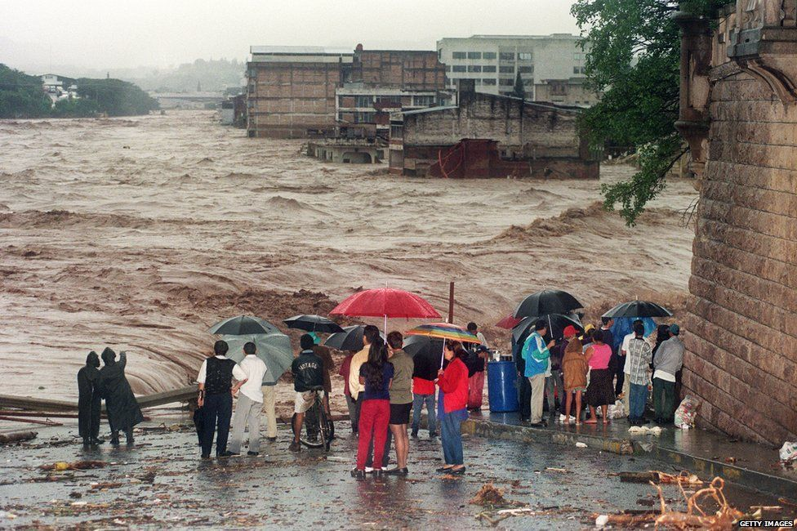

Slide 3
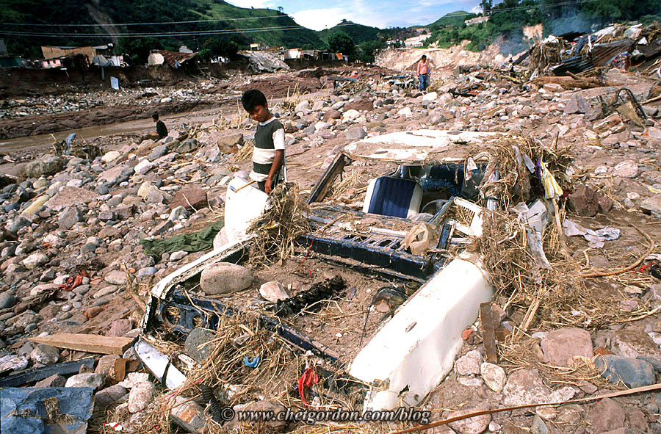

Slide 4
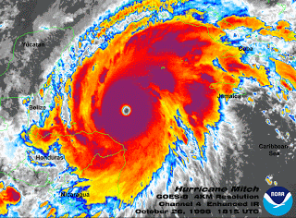
Tegucigalpa
18% of all risk events registered in the country
Average annual losses sum US$ 105 million (4% of Honduras’ GDP).
32% of its housing stock and 23% of the basic services infrastructure are located in areas exposed to floods and landslides
1.5 million inhabitants (25% of the country’s urban population).
40% of the city's residents without access to piped water supply, 68% for sewerage coverage, 80% for solid waste, and only 17% for wastewater treatment.

Slide 5
Key Takeaways
Long Term Strategic Planning: Based on a 20 or more year goals which can guaranty an efficient and sustainable process, while leading short and medium term goals.
1
Multisector Approach: To promote integral solutions which can optimize resources (Risk Management, Urban Resilience and Integrated Urban Water Management)
2
Consultation, Coordination and Follow Up: Considering different points of view and needs; and “honoring” agreements is the key for an effective coordination and follow up
3

Slide 6
What Needs to be Accomplished
Identify Key Stakeholders: To maximize the return of the investments
01
Inclusive Consultation process: Identification of needs, challenges and information gaps as well as the expected results.
02
Define the Strategic Plan (vision) and Specific Projects: Once the needs are on the table, prioritize and prepare a work plan.
03
Financing and sustainability: including different sources, considering local contributions

Slide 7
Approaches applicable to Tegucigalpa’s context
Due to both formal and informal city growth: We need to integrate the water and sanitation programs as part of a multi-sectoral approach, considering urban resilience and disaster risk in order to maximize the impact in a multi-hazard context.
Focus on a Green Policy: One that provides a sustainable and healthy environment for future generations.
Medium/Long term vision: the benefits of large investments in infrastructure will be captured in the medium/Long term

Slide 8
Some Action Steps/Timeline
Up to 6 months: Develop the Strategic Plan/ through a broad consultation process:
Inter-institutional consultation and coordination:
Across teams at the municipal level + national entities
Building indicators to monitor the strategic plan
Up to 9 months: Establishing financing strategy
Approval, public presentation and dissemination
Find sources of financing + endorsement from Ministry of Finance
Up to 12 months: feasibility studies
Detailed design of projects to be implemented

Slide 9
Key Stakeholders
Exposed communities
Social organizations and NGO
Universities
Public entities:
Municipality
SANAA (Servicio Autónomo Nacional de Acueductos y Alcantarillados)
Secretaría Técnica de Planificación y de Cooperación Externa (STPC, National Planning Agency)
Ministry of Energy, Natural Resources, Environment and Mining
Ministry of Finance
Disaster Risk Management Agency (COPECO)
Others

Slide 10
Opportunities/Barriers
Opportunities:
High priority in the political agenda (municipal level)
Networking with other countries/cities with similar challenges (partnership)
Development partners already working with the city, opportunity to enhance synergy and coordination
Barriers:
Economic constraints which needed to be tackled
Lack of technical expertise

Slide 11
Concrete Support/Assistance from TDLC
Knowledge exchange with Japan: Enhancing Integrated Water Management + Urban development + DRM through Technical assistance
Follow up Regional TDDs: Focused on similar cases to build baselines and benchmarks

Slide 12
THANK YOU

