Slide 1
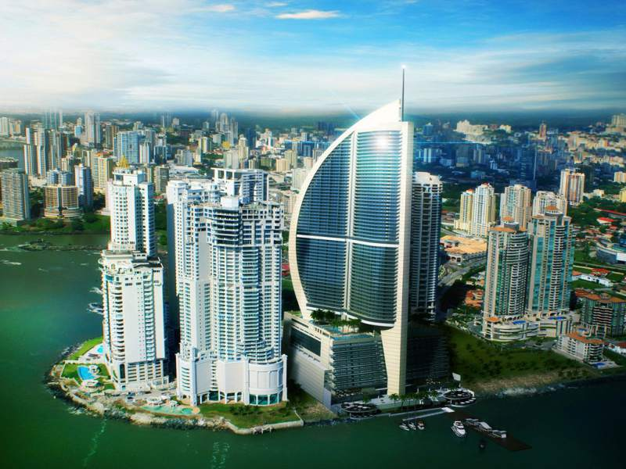
IUWM TDD Action Planning
Panama
29th September, 2017
Haydee Osorio, Municipio de Panamá
Frida Archibold, Programa Saneamiento de Panamá
Miguel Vargas, TTL WB

Slide 2
1. Key takeaways from IUWM TDD
Engage stakeholders to maximize participation
Develop and integrate data to visualize a place in a holistic manner
Start small and aim for a doable project
Do not expect quick wins, IUWM is a slow and gradual process
Re-brand projects to make them more marketable for politicians and communities (not only technical or scientific perspectives)
Importance of having plans ready for when there is a window of opportunity
Planning and implementation must include citizen participaciton

Slide 3
2. What needs to be accomplished
Get stakeholders together and find common ground
Prioritize a microbasin
Structure a platform or method for data sharing
Maximize institutional resources for implementing IUWM project in a microbasin
Develop non-structural measures, such as urban and drainage regulations

Slide 4
3. Action Steps in the first 6 months
Coordinate a first meeting among stakeholders
Determine a microbasin to act upon
Develop data products and indicators
Structure a data sharing platform and/or mechanism

Slide 5
4. Key stakeholders
Panama City Municipality
Sanitation Program
Arraijan City Municipality (TBD)
Mninistry of Public Works
National Water Authority
Ministry of Environment
Ministry of Housing Territorial Development
National Solid Waste Management Authority
Garbage Collection Companies
National Civil Protection Agency
Developers
Universities
Multilateral Agencies

Slide 6
5. The timeline (18 months)
First workshop: Identify a microbasin and a data sharing method.
Third workshop: Devvelop a Plan to implement a small pilot project.
Implement a pilot project.
1
3
6
9
18
Second workshop: Integrate data products for visualization of microbasin.
Develop marketing strategy and materials for engaging other stakeholders and related communities.

Slide 7
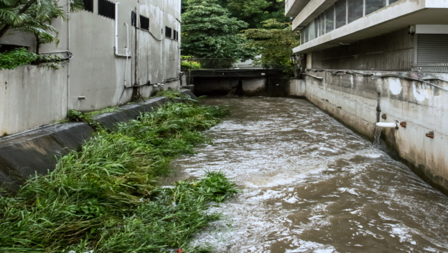
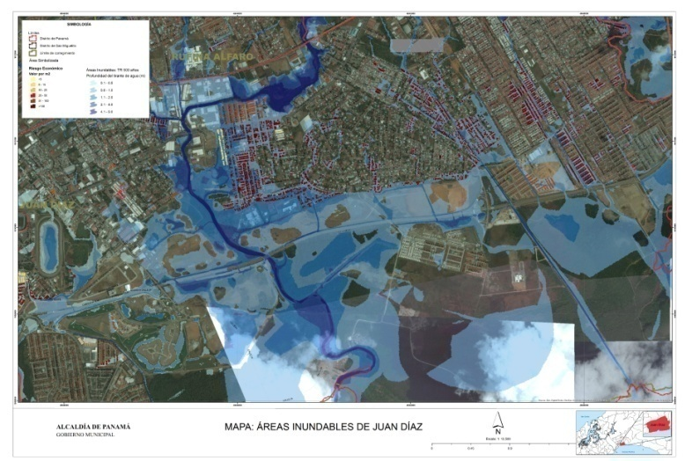
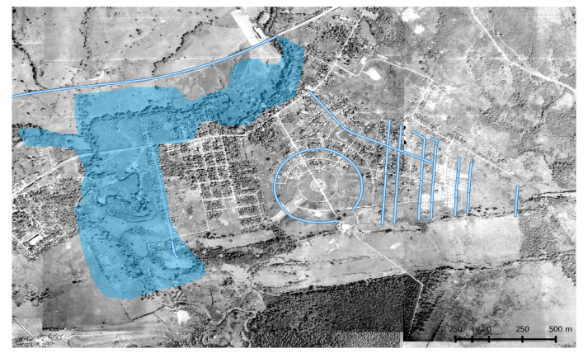
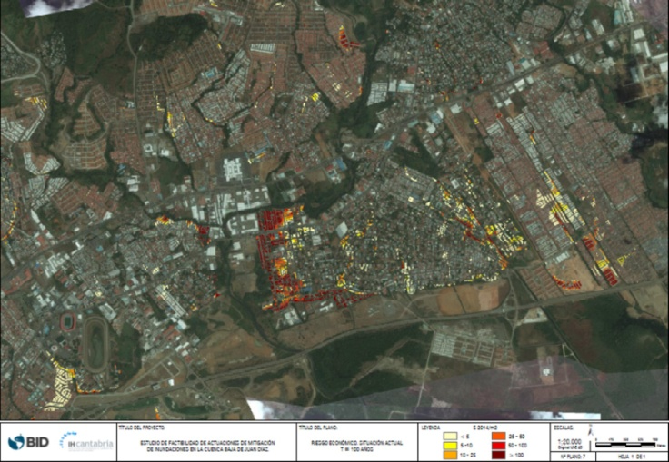
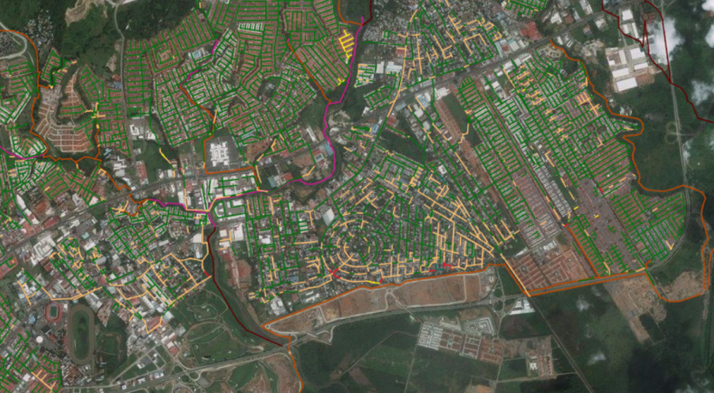
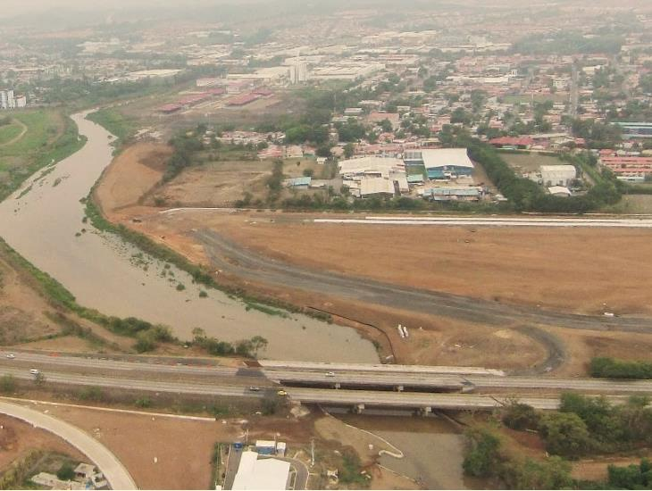
6. Opportunities and Barriers
Opportunities: - Existing Diagnostics and Data - Available funding resources
Barriers:
- Differing Political Interests
- Silo mentality
- High technical and political officials turnover

Slide 8
7. Needs for assitance
Assesment on non-structural measures, particularly on urban and drainage policy and regulations.
Technical assistance for workshop and tranining organizing with the objective of implementing an IUWM pilot project.
Experts visits for knowledge sharing and platforms for working bilaterally with countries.

Slide 9
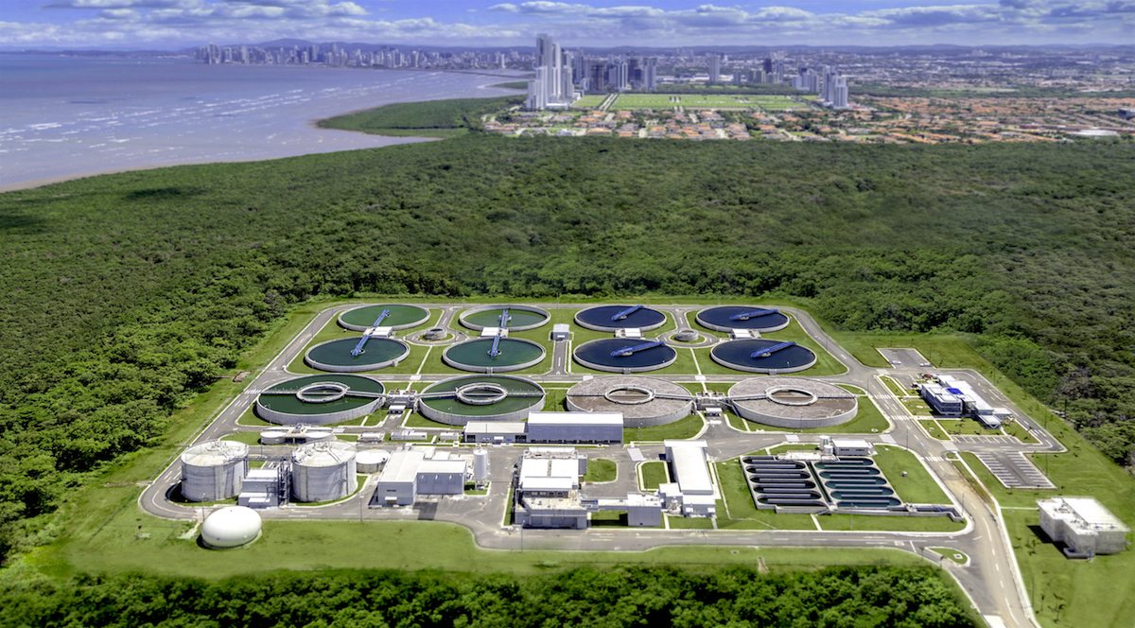
Panama Sanitation Experience
Panama Sanitation Program can be a model for other central american countries at the starting stage of developing a sanitation program for their cities.
1
1
LLI
LLI
LLI
I
I
I
3
2
2

