Slide 1
WATER & WASTEWATER
PUNJAB, PAKISTAN
Pakistan Delegation
IUWM TDD, Tokyo, Japan
25-29 September, 2017

Slide 2
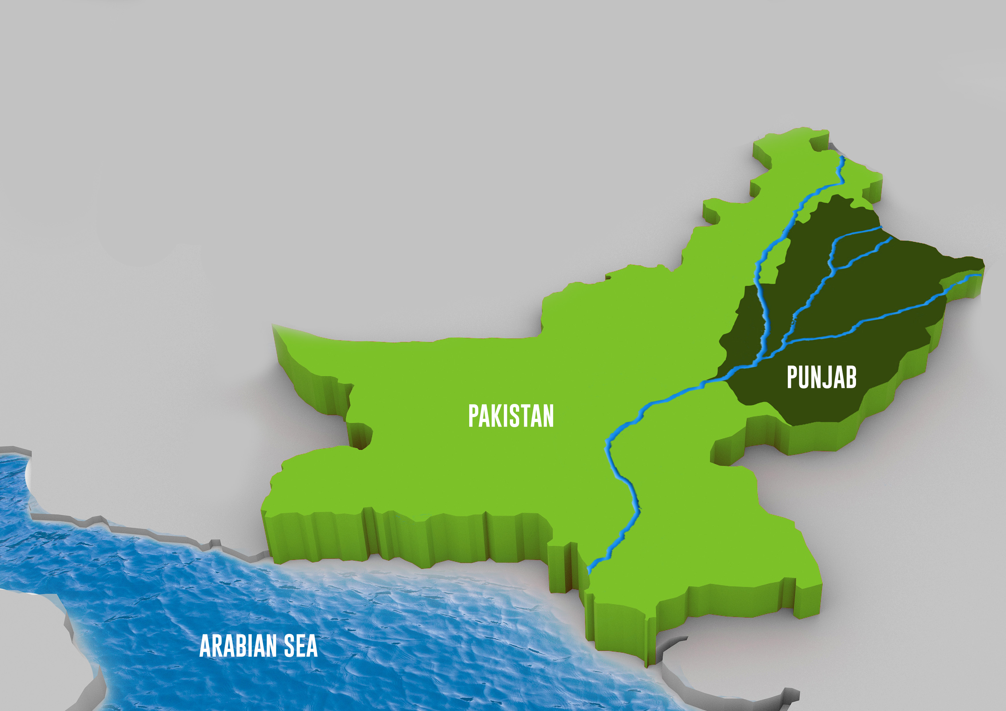
Punjab
Most populous province of Pakistan
Population = 110 million
Administrative Structure: 9 Divisions, 36 Districts
Local Governments comprising of:
1- Metropolitan Corporation
11- Municipal Corporations
182- Municipal Committees
35- Rural district Governments
CHINA
AFGHANISTAN
194 Urban Local Governments
IRAN
INDIA

Slide 3
Challenge
Expected Change
Depletion of fresh water
Deterioration of ground water quality
Preservation of fresh water reserves
Water balance in fresh water aquifers
Current Status
Lessons Learnt
Lining of water courses completed to save fresh water
Lining of canals in progress
Water conservation by consumer metering initiated in public water supplies of five largest cities
More needs to be done

Slide 4
Challenge
Water wastage
Unequal distribution of water to consumers
Water shortage in some areas
Current Status
Provincial Government live to metering consumer connections
Consumer metering already in process in five largest cities.
Water conservation campaign being initiated
Expected Change
More equitable distribution of water to consumers
Conservation of fresh water.
Balancing in fresh water ground aquifers
Reduction in operation & maintenance cost
Lessons Learnt
Need adoption of all tools and methods to conserve fresh water and reduce O&M cost of water & waste water services

Slide 5
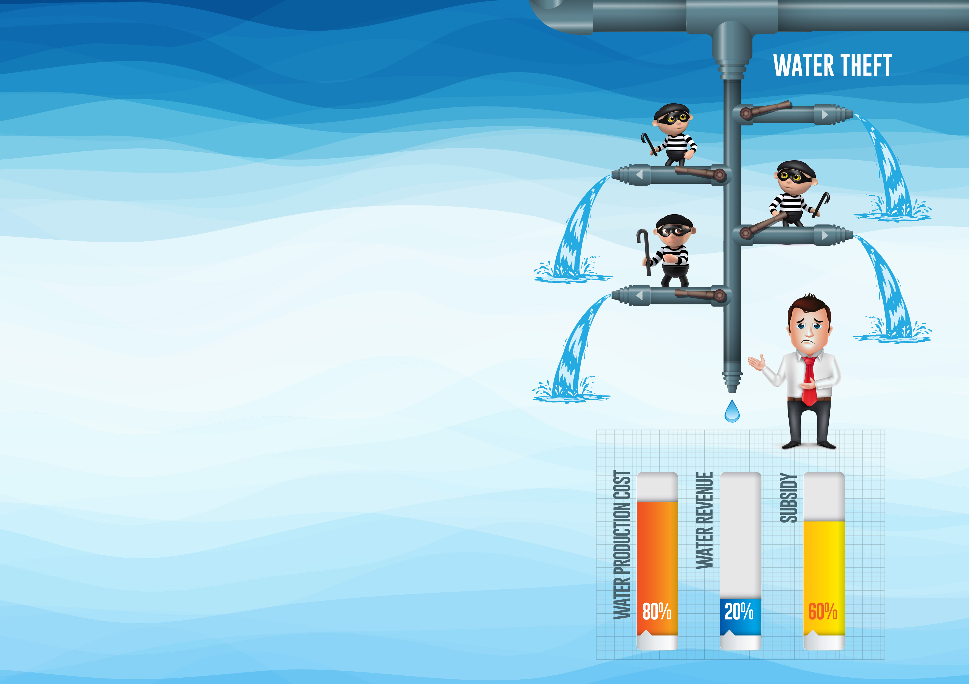
Challenge
Water theft
Low revenues and high subsidies
Current Status
Both being addressed in this FY’s provincial development plans
Expected change
Reduced need of water production and fresh water conservation
Enhanced revenue & reduced subsidies.
Lessons learnt
Urban Local Governments unable to provide optimal service to consumers unless water theft is eliminated and is tariff commensurate with water production cost.

Slide 6
Challenge
Poor water quality in urban areas
Sub-standard consumer connections key cause of contamination
Current Status
Over 590 nos. ultra filtration & RO plants installed in 14 cities of Punjab (all cities of Punjab to be covered)
Substandard consumer connections being replaced
Expected Change
Supply of potable drinking water to the consumers.
Reduction of water borne diseases
Lessons Learnt
Difficult to supply potable drinking water through existing networks, hence the need for introduction of ultra filtration

Slide 7
Challenge
Expected Change
Outlived sewers; frequent crown failures
Absence of waste water treatment
Improved liquid waste management
Positive effects on human and animal health
Current Status
Lessons Learnt
Outlived sewers being replaced
Waste stabilization ponds being developed for cities
Untreated waste water polluting water bodies, ground water, and environment and needs immediate treatment at least at primary level in the first stage

Slide 8
Challenge
Expected Change
High energy consumption on production of water that is wasted and its disposal
Energy wastage due to inefficient installations
Energy Conservation
Reduced operation & maintenance costs of water production and waste water disposal
Current Status
Lessons Learnt
Energy audit completed in five largest cities and being planned for secondary cities
Energy audit be introduced in management of all water & waste water facilities in all urban areas of the Province

Slide 9
Challenge
Weak capacity of the Urban Local Governments (ULGs) in;
Water & waste water management
Billing and collection of water revenues
GIS mapping of municipal services and assets
Computerized Billing & Collection System
Introduction of Operation & Maintenance Framework
Performance Management System of municipal service delivery
Complaint Tracking System
On-job-trainings of ULB staff
Current Status
Interventions under way on Institutional Development and Capacity Building of ULBs
The ULGs top men and the key officers need to be sensitized and trained for better management of water and waste water facilities
Management and technical capacity of the supervisory and field staff is required to be improved for satisfactory service delivery level
Expected change
Better management of water and waste water facilities.
Increase in water revenues and reduction in water subsidies
Lessons learnt

Slide 10
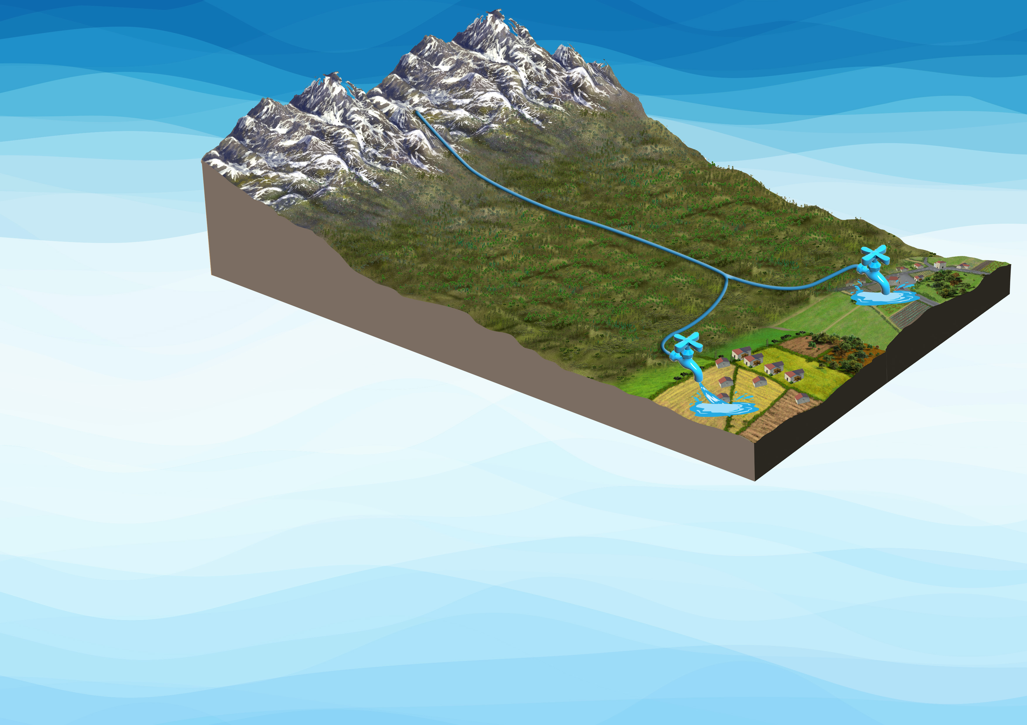
Working Well in Pakistan
Tapping of springs in Northern Punjab and supply of water by gravity.
Tapping of subsoil flows in the hill torrent beds for supply of water.
Supply of water is 24/7 in both these installations
Operation maintenance cost is very low

Slide 11
Relevant Bank Portfolio
Active Projects
Punjab Cities Governance Improvement Project (PCGIP) - US $ 150 million
To support the cities in strengthening systems for improved planning, resource management, and accountability, and to improve capacity to respond promptly and effectively to an Eligible Crisis or Emergency
Lending Pipeline
Punjab Cities project (PCP) – US $ 200 million
To improve governance, management, and service delivery in the selected cities of Punjab
Relevant Analytical Activities
Water Supply and Sanitation ESW - USD $ 500,000
To provide a comprehensive assessment of sectoral issues for the Government and the Bank, to forge an agreement on policy reforms and investment priorities in the sector based on the findings, diagnostics, and recommendations of the Report

