Slide 1
The
Smart
City
Jennifer Evans-Cowley, PhD, AICP
@evanscowley

Slide 2
“The technology-enabled city is an untapped source of sustainable growth and represents a powerful approach for tackling unprecedented environmental and economic challenges.”
Information Marketplaces: The new economics of cities, Arup, The Climate Group, Accenture and the University of Nottingham, 2011
Notes:
Boston: I’m sure we have all had a bad pothole experience that led to your drink to slosh, your car to be knocked out of alignment, or a bicycle tire to poop. The City of Boston created an Office of New Urban Mechanics that is charged with solving city problems through technology. The City released a free app that detects potholes called Street Bump. The goal of Street Bump is to allow residents to improve their neighborhood streets. As the person drives, the mobile app collects data about the smoothness of the ride. The City uses this real-time information to fix potholes and to plan for capital improvements. The app uses the phone’s accelerometer and its GPS. Likely potholes are reported via the city’s Open311 system so that they will be investigated and fixed. The City patches 19,000 potholes per year. The City hope that this will help prevent massive potholes and save public works crews time. The creators of Street Bump are planning to role this out in Austin, London, and New York as well.

Slide 3
Smart Environments and Infrastructure

Slide 4
Notes:
Peru’s University of Engineering and Technology has designed a billboard that creates clean drinking water from atmospheric humidity. Lima, Peru, a city on the edge of a desert, has 700,000 residents with no access to clean water for drinking or bathing. Luckily Lima’s Pacific coast locations experience humidity of more than 90 % on summer days from December to February. Facing a slump in enrollment and a water shortages throughout the city; the University of Technology and Engineering wanted a way to attract more engineering students to the university. An ad-campaign partnered with engineers from the school provided a visible demonstration of the university’s engineering projects and the water-collecting billboard was born.

Slide 5
Notes:
The billboard works similarly to the way condensers in your home air conditioner work. Like the condenser in your home air conditioner, the ones in the build board are cooler than the air outside. When air contracts the cooled surfaces of the condensers, the air also cools, and the water vapor in the air condenses into liquid water. After reverse-osmosis purification, the water flows down into a 20-liter storage tank at the base of the billboard. The billboard generates about 96 liters of water each day, and a simple faucet gives local residents access to the water. The billboard only cost about $1200 to install.

Slide 6
Torre de Especialidades
Notes:
Plenty of green buildings around the world cut down on pollution and energy usage through design features, but a hospital in Mexico City on the other hand actually eats smog! The Torre de Especialidades façade is shielded with a new type of tile called Prosolve370e. The shape and chemicalcoating can help to neutralize the chemicals that compose smog by a large amount. Equivalent to 1,000cars each day. The smog eating process is twofold. The paint applied on the tiles is made from titanium dioxide—a dye used to make things like sunblock white but it also doubles as a facilitator in certain chemical reactions. When ultraviolet light cuts through smoggy air and hits the titanium dioxide paint on the tiles, achemical reaction occurs between the tiles and chemicals in the smog. Throughout the chemical processthe result of the reaction is that the smog is broken down into small amounts of less noxious chemicals,including calcium nitrate (salt fertilizer), carbon dioxide, and water

Slide 7
Notes:
The titanium dioxide is not the only variable that makes the reaction work. The shape of the tiles, a “quasicrystalline grid, creates an Omni-directional, and surface enlargement, which enhances the abilityto receive and scatter ultraviolet light.” The shapes slow wind speeds and create turbulence for betterdistribution of pollutants across the buildings surfaces. The quasicrystalline geometry is chiefly fit tocatch things from all directions. The shape of the tiles distributes more light and accumulates morepollutants, which means more smog eating chemical reactions. In addition to brilliant smog intake thebuilding is designed to be aesthetically pleasing and ties the general public to solutions of hazardouspollution that is visible in Mexico City

Slide 8
Energy and Intelligent use of Resources

Slide 9
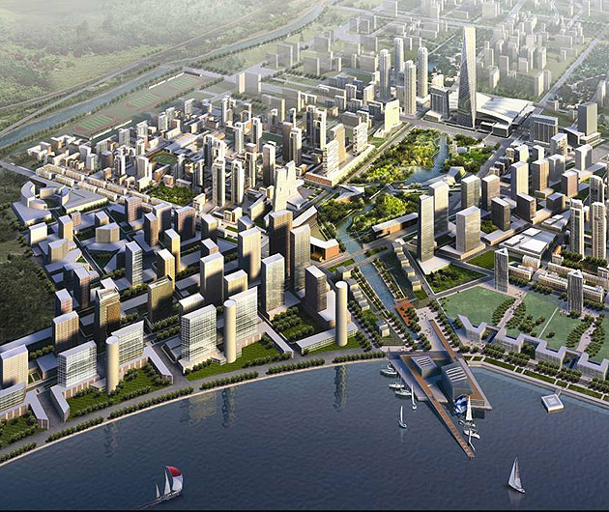
New Songdo, South Korea
First time users were able to visualize map
Riders and drivers were able to learn entire system
Users realized they can use better routes for cross town travels
Notes:
In 2000 the location of city was a marshy expanse of tidal flats, but in 2003 the Korean government filledthe area with 500 million tons of sand in an effort to construct a business district near the airport.Dubbed an “aerotroplis” because of its proximity to an airport the city is an hour away from Seoul bybus and a short flight from one third of the world’s population. You might recognize the city from the“Gangnam Style” music video filmed on location.
ParkCirca: Now finding an open parking space is great in congested places, but what if you could rent a parking space? Two residents of San Francisco talked about how irritating it is to endlessly circle the block waiting for a public parking space when they saw lots of empty driveways they weren’t allowed to park in. They then thought what if they could just knock on the door and ask to park in someones driveway for $20 for a few hours. From this idea they built an app. The ParkCirca app allows people who own a parking space to be able to rent it when it is unused. A parking space owner can list times that the space is available. The parkers then search for available spaces and then simply “check in” via the ParkCirca app. The check in process starts a time and when they return to their car and “check out” of the space money is then transferred to the parking space owner. This app is being used in San Francisco, Los Angeles, New York, Cleveland, Tornonto and a number of other cities.Perhaps you are thinking that parking isn’t such a big issue in your community. Being a professor I see all the time people standing outside offering the ability to park for a football game for $20. Wouldn’t it be better if I could just rent my parking space in my driveway without having to stand outside for example.

Slide 10
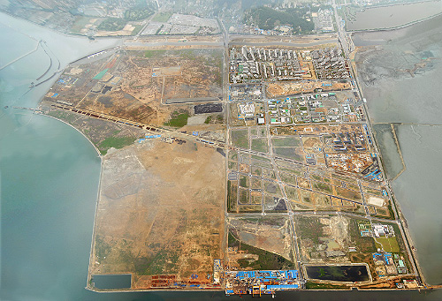
New Songdo, South Korea
Built on filled tidal flats
Planned for 200,000
40% open space
Currently 60% complete
Notes:
ParkCirca: Now finding an open parking space is great in congested places, but what if you could rent a parking space? Two residents of San Francisco talked about how irritating it is to endlessly circle the block waiting for a public parking space when they saw lots of empty driveways they weren’t allowed to park in. They then thought what if they could just knock on the door and ask to park in someones driveway for $20 for a few hours. From this idea they built an app. The ParkCirca app allows people who own a parking space to be able to rent it when it is unused. A parking space owner can list times that the space is available. The parkers then search for available spaces and then simply “check in” via the ParkCirca app. The check in process starts a time and when they return to their car and “check out” of the space money is then transferred to the parking space owner. This app is being used in San Francisco, Los Angeles, New York, Cleveland, Tornonto and a number of other cities.Perhaps you are thinking that parking isn’t such a big issue in your community. Being a professor I see all the time people standing outside offering the ability to park for a football game for $20. Wouldn’t it be better if I could just rent my parking space in my driveway without having to stand outside for example.

Slide 11
Notes:
11 years and $35 billion dollars later 60% of the city’s planned infrastructure and buildings have beenbuilt. The city is home to around 70,000; about one third of the anticipated population. The city’s area isabout half the size of Boston proper and enjoys 40% open space. Included in this open space is a 101acre central park. Plenty of pedestrian thoroughfares and urban farms are found throughout the city.

Slide 12
Notes:
In addition to being a green an open city it is also multi-modal. Song-do enjoys subways, buses, and 20miles of bike paths. Cars are accommodated throughout the city as well with numerous charging stations for electric vehicle options

Slide 13
Notes:
The city is immensely sustainable from a trash perspective. Systems of pipes are connected to all of theapartment and office buildings. All of the trash is sucked into the underground pipes and automaticallysorted, recycled, buried, or burned for fuel. Since this system is in place there are no need street cornertrash cans or garbage trucks. It only takes 7 employees in the entire city to run the system.

Slide 14
Notes:
Futuristic technology, building design, and eco-friendly practices are found everywhere you look. The telepresence is remarkable. All of the schools, homes, and businesses are connected to a network that enables regulation of electricity and water use in all of the city’s buildings. Even the escalators are controlled by sensors. They only go up and down when people are riding them. All of this sensing technology has enabled the city to run on 30% less energy reduction.

Slide 15
Mobility and Transportation

Slide 16
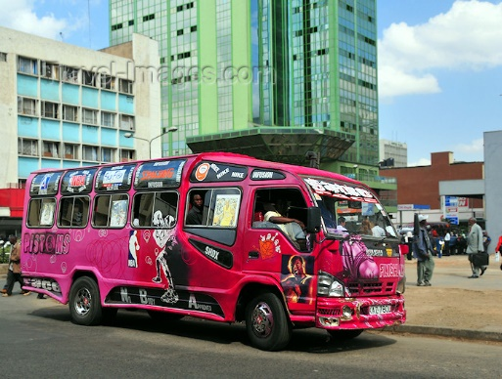
Nairobi’s Matatus
130 unregulated lines
30,000 privately owned minibuses
Notes:
With an estimated 130 unregulated matatu lines in metro Nairobi, a transit system has emerged in theabsence of a formal public transit and people have created it by themselves. For the first time thesystem has been fully mapped.
Shareabouts: The Folks at open plans are turning their ideas for public engagement into mobile apps. For example, a current project is Shareabouts an app that allows users to suggest a location, add a comments and support others suggestions. An app like this would allow the public to interact in a planning process sharing their own ideas about what they’d like to see in their neighborhood, park or city. I’m sure you can imagine other apps that you could use in your own work.

Slide 17
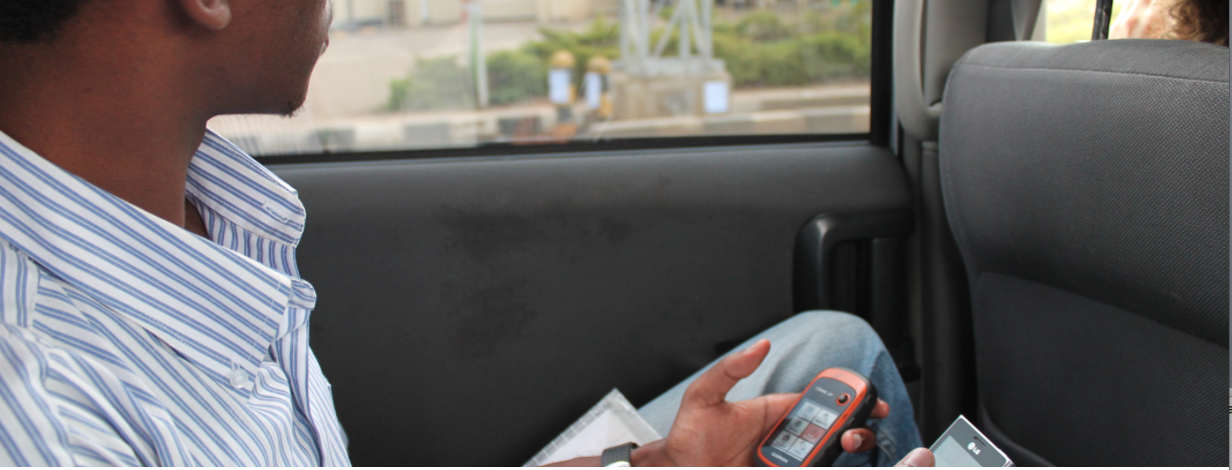
Nairobi’s Matatus
Researchers at University of Nairobi, The Center for Sustainable Development at Columbia University, and the Civic Data Design lab at MIT produced map
Notes:
Researchers and students at the University of Nairobi, the Center for Sustainable Urban Development at Columbia University, and the Civic Data Design lab at MIT produced the map –and underlying databehind it—by carrying their cell phones and GPS devices along every route in the network. The informalstation list was created by using cell phone and GPS data. Until now the “official” stops had never beenlisted or mapped out. For the first time ever “Matatu” can be visualized.
ParkCirca: Now finding an open parking space is great in congested places, but what if you could rent a parking space? Two residents of San Francisco talked about how irritating it is to endlessly circle the block waiting for a public parking space when they saw lots of empty driveways they weren’t allowed to park in. They then thought what if they could just knock on the door and ask to park in someones driveway for $20 for a few hours. From this idea they built an app. The ParkCirca app allows people who own a parking space to be able to rent it when it is unused. A parking space owner can list times that the space is available. The parkers then search for available spaces and then simply “check in” via the ParkCirca app. The check in process starts a time and when they return to their car and “check out” of the space money is then transferred to the parking space owner. This app is being used in San Francisco, Los Angeles, New York, Cleveland, Tornonto and a number of other cities.Perhaps you are thinking that parking isn’t such a big issue in your community. Being a professor I see all the time people standing outside offering the ability to park for a football game for $20. Wouldn’t it be better if I could just rent my parking space in my driveway without having to stand outside for example.

Slide 18
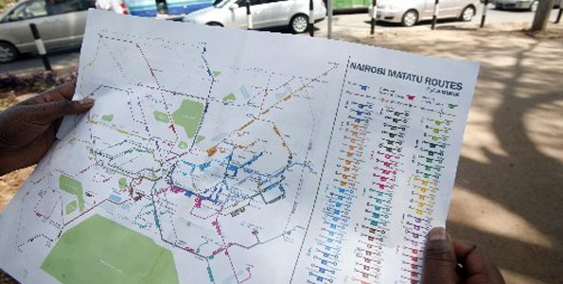
Nairobi’s Matatus
First time users were able to visualize map
Riders and drivers were able to learn entire system
Users realized they can use better routes for cross town travels
Notes:
If the system is was going to ever see improvement people needed to be able to see it and visualize it. Not only would this allow for people to speak to each other about areas for improvement, riders anddrivers would be able to learn the entirety of the system. For the first time riders can look at the mapand realize they can travel cross town by a better route. Anyone looking at the map can notice thepattern of heavy traffic in the downtown core. This undoubtedly contributes to congestion in the citycenter but now the data is available to improve it. The largest beneficiary to mapping out the systemmay be government officials who distribute matatu licenses for specific routes but have given up tryingto plan the system.
ParkCirca: Now finding an open parking space is great in congested places, but what if you could rent a parking space? Two residents of San Francisco talked about how irritating it is to endlessly circle the block waiting for a public parking space when they saw lots of empty driveways they weren’t allowed to park in. They then thought what if they could just knock on the door and ask to park in someones driveway for $20 for a few hours. From this idea they built an app. The ParkCirca app allows people who own a parking space to be able to rent it when it is unused. A parking space owner can list times that the space is available. The parkers then search for available spaces and then simply “check in” via the ParkCirca app. The check in process starts a time and when they return to their car and “check out” of the space money is then transferred to the parking space owner. This app is being used in San Francisco, Los Angeles, New York, Cleveland, Tornonto and a number of other cities.Perhaps you are thinking that parking isn’t such a big issue in your community. Being a professor I see all the time people standing outside offering the ability to park for a football game for $20. Wouldn’t it be better if I could just rent my parking space in my driveway without having to stand outside for example.

Slide 19
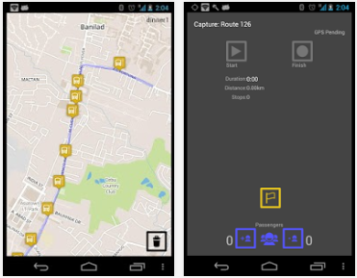
TransitWand
Notes:
Pittsburgh: Cities across the country have begun to provide real-time parking availability information. For example, the Park PGH app provides real-time parking availability for Pittsburgh’s Cultural District. This allows users to see which garages have spaces, where the closest parking is to the user’s destination and the cost of the parking

Slide 20
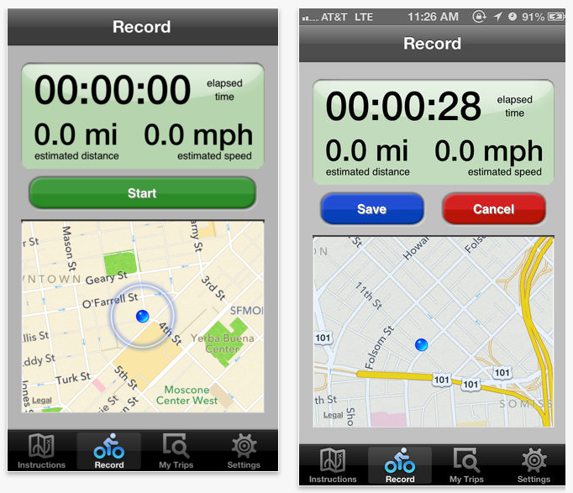
Cycle
Tracks
Notes:
Toronto: Other apps such as Hit the Pothole use crowdsource potholes. All the jolts experienced are recorded and the data then instantly shows up on the map. The Pothole Radar allows the user to be warned of immanent danger both with an audio and vibration alert. For those who like to listen to music while riding, the alerts mix into the current music that is playing. The popularity of this app has grown and now users in other communities can use this as well.

Slide 21
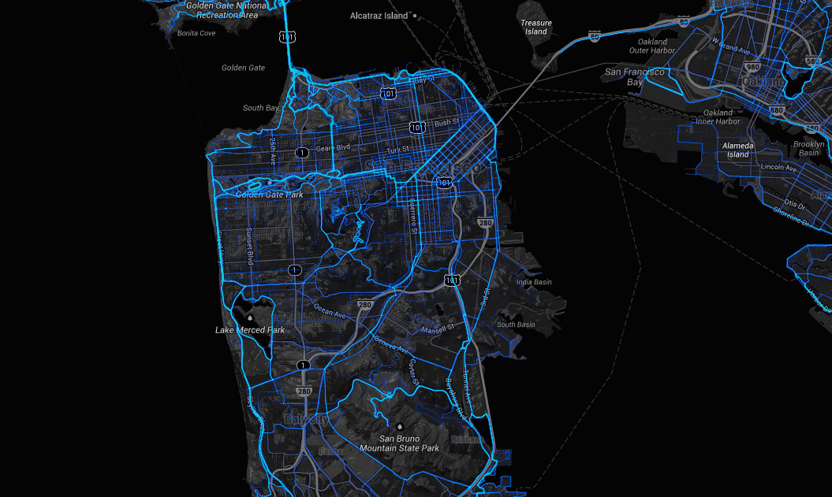
Notes:
Shareabouts: The Folks at open plans are turning their ideas for public engagement into mobile apps. For example, a current project is Shareabouts an app that allows users to suggest a location, add a comments and support others suggestions. An app like this would allow the public to interact in a planning process sharing their own ideas about what they’d like to see in their neighborhood, park or city. I’m sure you can imagine other apps that you could use in your own work.

Slide 22
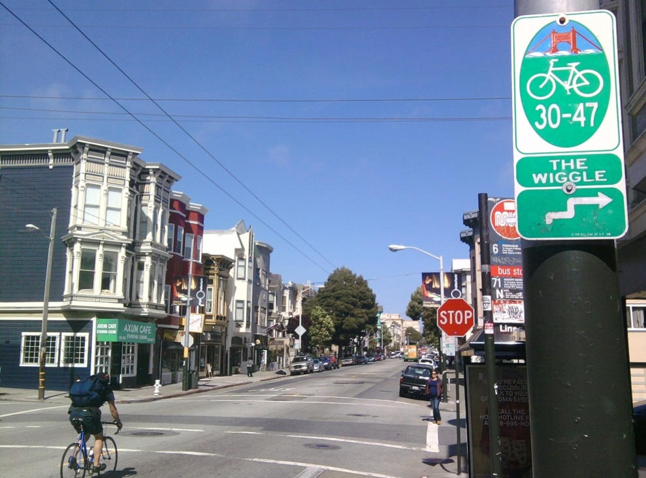
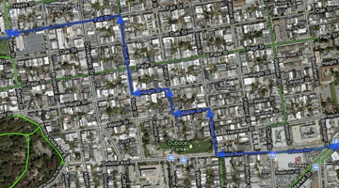
Notes:
ParkCirca: Now finding an open parking space is great in congested places, but what if you could rent a parking space? Two residents of San Francisco talked about how irritating it is to endlessly circle the block waiting for a public parking space when they saw lots of empty driveways they weren’t allowed to park in. They then thought what if they could just knock on the door and ask to park in someones driveway for $20 for a few hours. From this idea they built an app. The ParkCirca app allows people who own a parking space to be able to rent it when it is unused. A parking space owner can list times that the space is available. The parkers then search for available spaces and then simply “check in” via the ParkCirca app. The check in process starts a time and when they return to their car and “check out” of the space money is then transferred to the parking space owner. This app is being used in San Francisco, Los Angeles, New York, Cleveland, Tornonto and a number of other cities.Perhaps you are thinking that parking isn’t such a big issue in your community. Being a professor I see all the time people standing outside offering the ability to park for a football game for $20. Wouldn’t it be better if I could just rent my parking space in my driveway without having to stand outside for example.

Slide 23
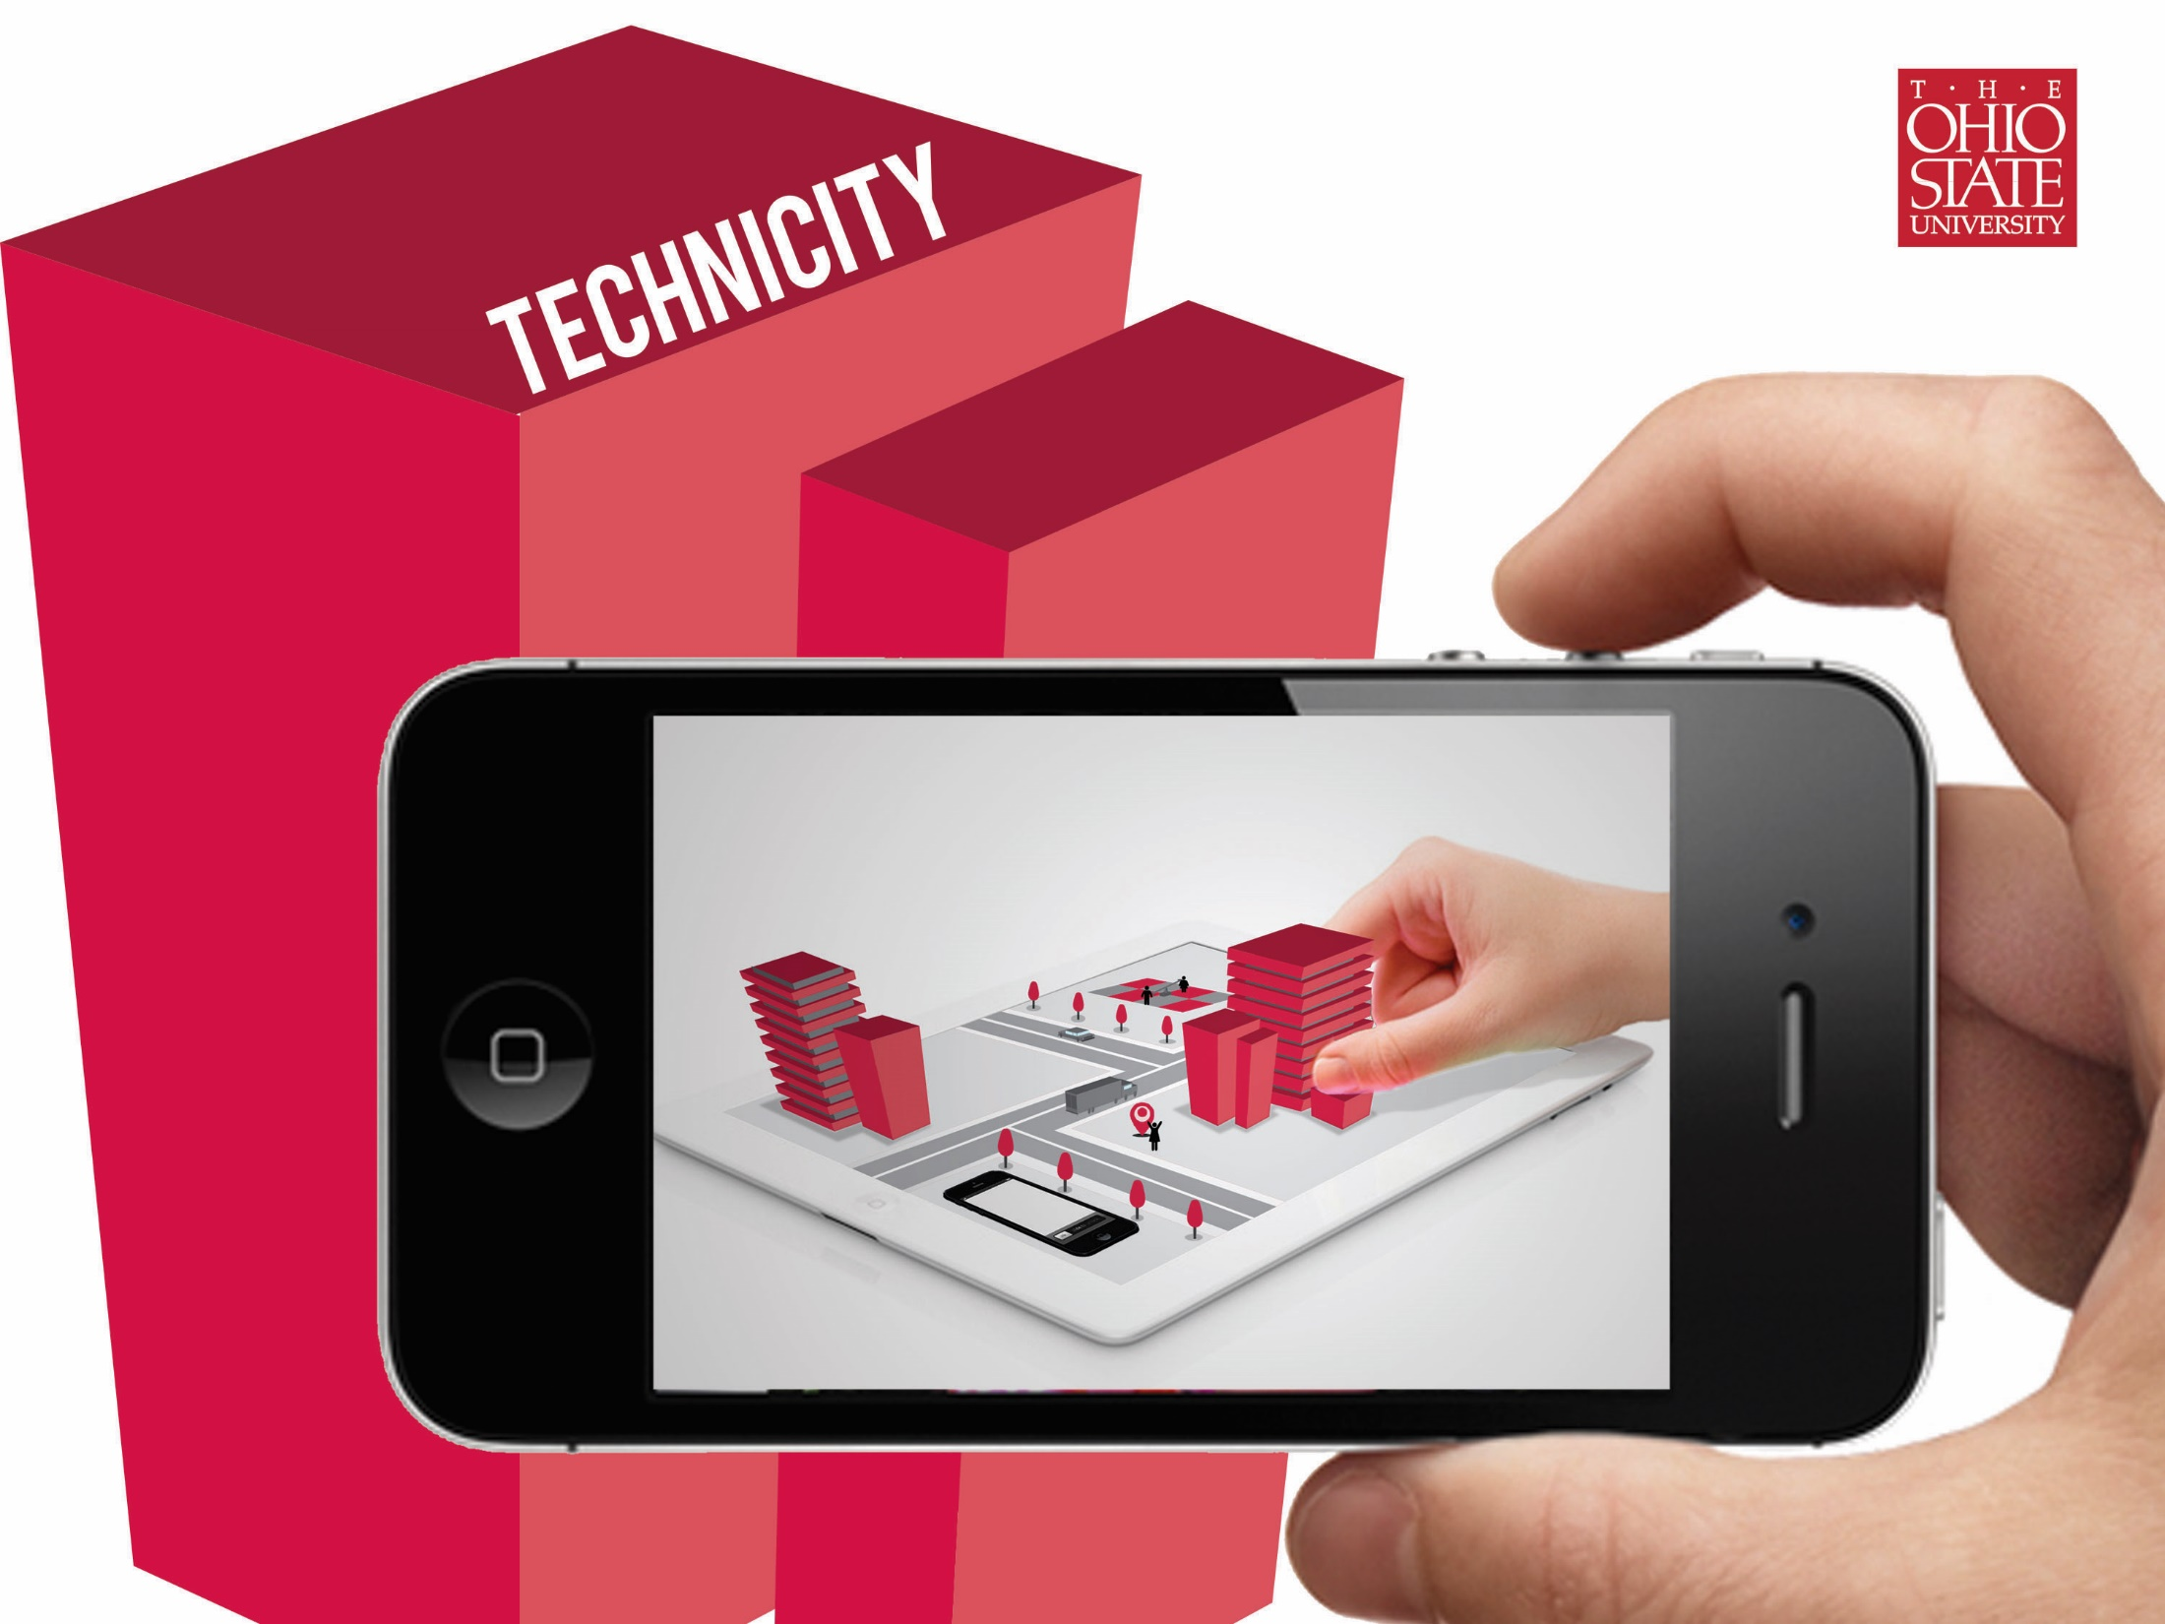
Questions?
@EvansCowley

