Slide 1
Apeldoorns Innovation Quarter
Leading the way in smart mobility
Frans Jorna, Executive director public services, City of Apeldoorn
f.jorna@apeldoorn.nl
World Bank GSCP, Smart mobility Study Tour NL, 23 Feb 2022

Slide 2
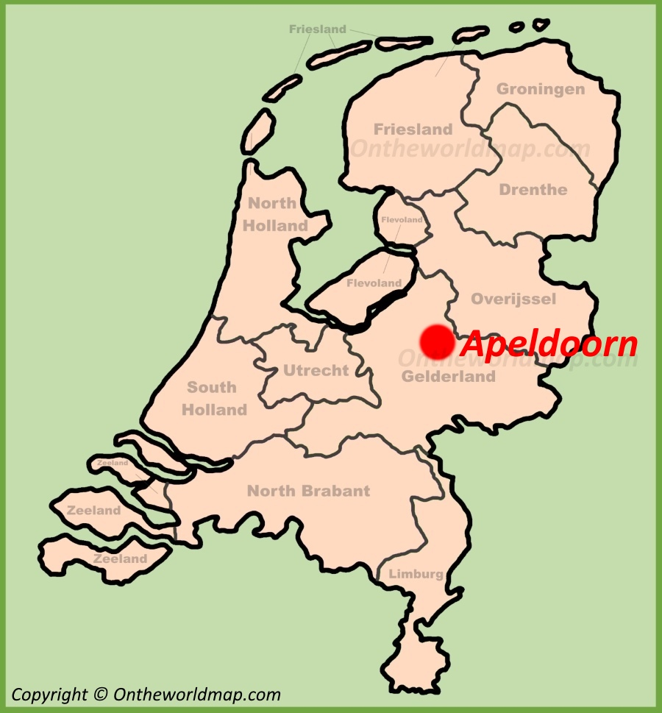
City of Apeldoorn
11th of 40 large Dutch cities
Royal Apeldoorn: Home to The Netherlands Versailles/Potsdam national summer palace
Capital of the Veluwe, NL’s largest national park (-> 1mln municipal trees)
HQ of 3 National Armed Forces: security first
“Most average Dutch city”
Home to the National Land Registry: leading the geospatial wave
Growth from premodern industry town to an IT-city
Challenges: energytransition, climate-change (aridisation, emissions, national migration)
Smart mobility Lead city in NL Smart cities Alliance, Partner in WorldEconomicForum sensing programme
Transition and innovation programme (2022-2026) following Smart City programme (2018-2022)

Slide 3
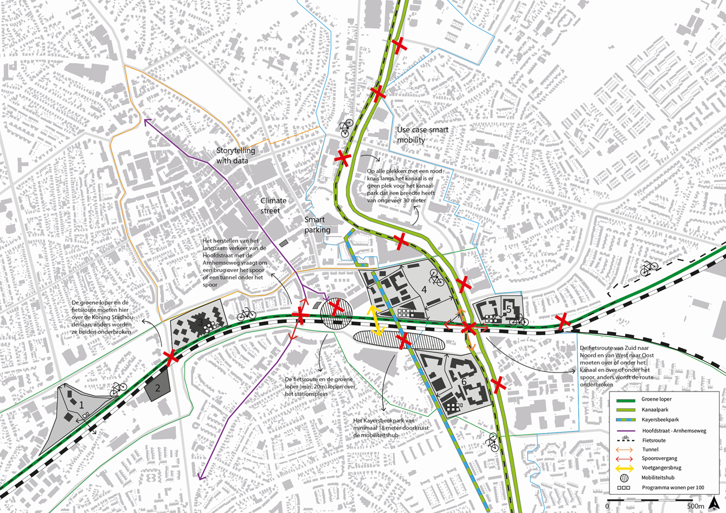
Inner city: innovation district

