Slide 3
Dutch Delta

Slide 5
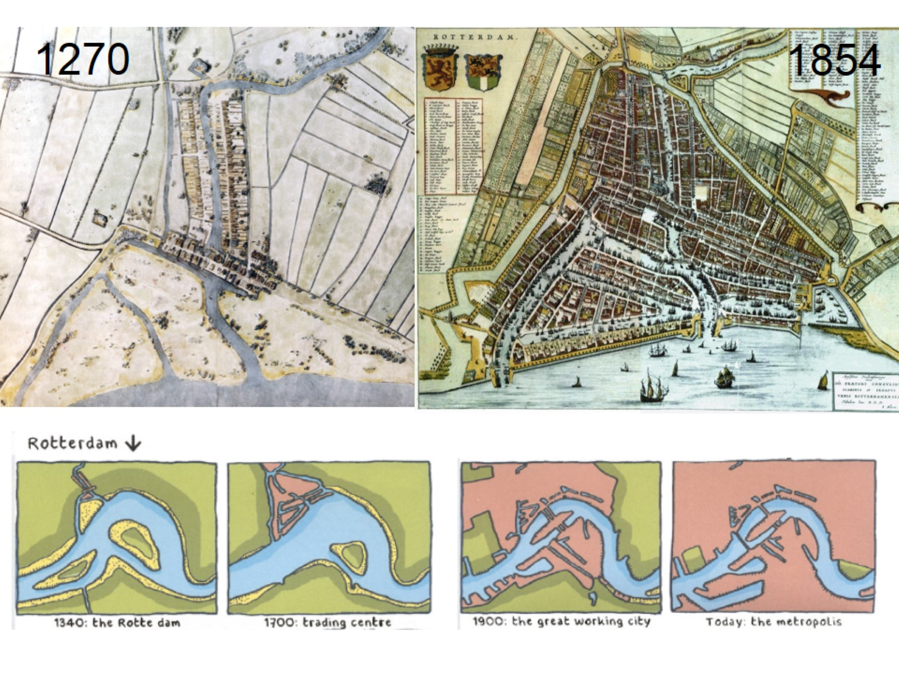

Slide 18
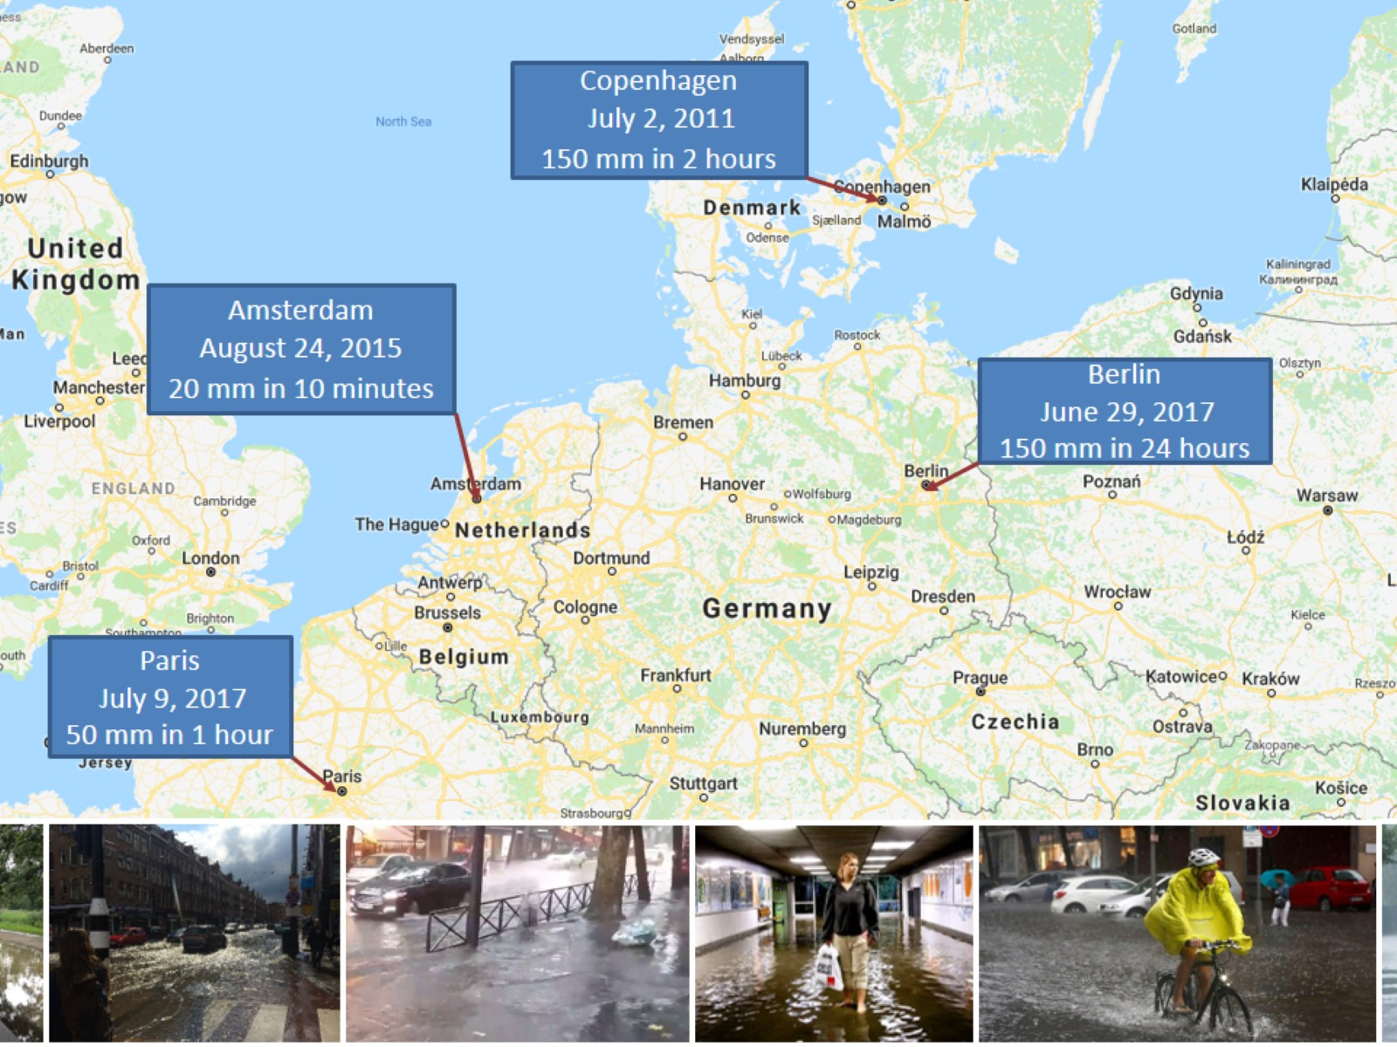

Slide 34
