Slide 1
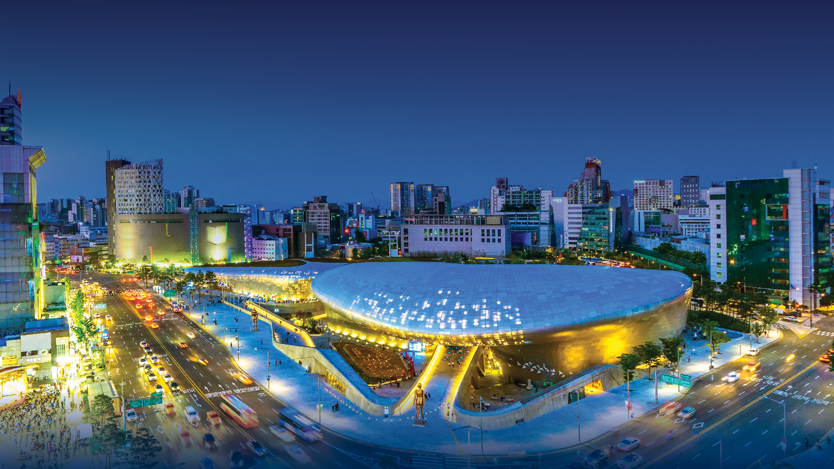
Virtual Knowledge Exchange World Bank – The Netherlands Smart Cities for Climate Resilience - Participating Project Pitch – February 23-24, 2022

Slide 2
Participating Projects
COUNTRY | PROJECT
EGYPT | Integrated Land and Urban Management in Egypt
JORDAN | New Planning Bylaw for GAM: Designing for communities to promote walkability
MONGOLIA | Ulaanbaatar Sustainable Urban Transport Project
SOUTH AFRICA | Buffalo Municipality Smart City Strategy
TURKEY | Izmir Smart City
UGANDA | Physical Planning and Urban Management Information System (PPUMIS)

Slide 3
Integrated Land and Urban Management in Egypt
[Egypt/Cairo]

Slide 4
Who we are
Country & City | (Where is your team from? Regional/geographical/cultural/social characteristics?) Our team is from Cairo, Egypt. We live in Cairo governorate and some of us live in new cities such as New Cairo and Sheikh Zayed.
Smart City Needs and Opportunities | (What smart city needs do you have in your country/city? Where do you see smart city solution relevant in your country/city? You may use the menu of options provided in Slide 4) Mobility infrastructure and assets, Solid Waste Management, Business Models and Financing, Performance Management and City-Wide Planning.
Project Overview | (What smart city projects/initiatives are you working on? Brief description of the project including objective, components, progress, stakeholders, etc.) The Program Objective: to foster sustainable and resilient urbanization in Egypt’s New Urban Communities through supporting, and enhancing the capacity of, local and national authorities towards enhanced property registration, tenure security and urban management. The program components: 1st Pillar: Street Addressing System 2nd Pillar: Asset Management System 3rd Pillar: Property Registration 4th Pillar: Own Source Revenue 5th Pillar: Smart Cities Counterparts: Ministry of Housing, Utilities and Urban Communities & NUCA; Ministry of Justice & REPD. Implementer: The World Bank Financier: Government of Switzerland via State Secretariat for Economic Cooperation (SECO) Timeline: January 2022 – December 2025 (4 years).

Slide 5
What we seek from this TDD
Describe gaps or challenges in your project (You may refer to the smart city topics in slide 4)
Readiness of new cities to implement smart city concept in terms of infrastructure and services, governance, technology and data sharing.
Capacity of the governmental staff to work in a smart city.
Lack of digital compliance.
Pose them as specific questions about the kind of Smart City solution/answers you are seeking for (e.g. What smart technologies are effective in monitoring and addressing traffic congestion?)
What are the main infrastructure services that need to exist in a city to be labeled as a smart city?
What type of trainings should be provided to governmental staff to be prepared to work in a smart city?
What kind of smart technologies are effective in data sharing including security considerations?
What type of branding is used to promote for new cities as smart cities?
How to prepare citizens to live in a smart city?

Slide 6
[New planning bylaw for GAM] Designing for communities to promote walkability
[ Reham Bataineh :Jordan /Amman/ Urban Planner
Head of Local plans division /comprehensive planning department ]

Slide 7
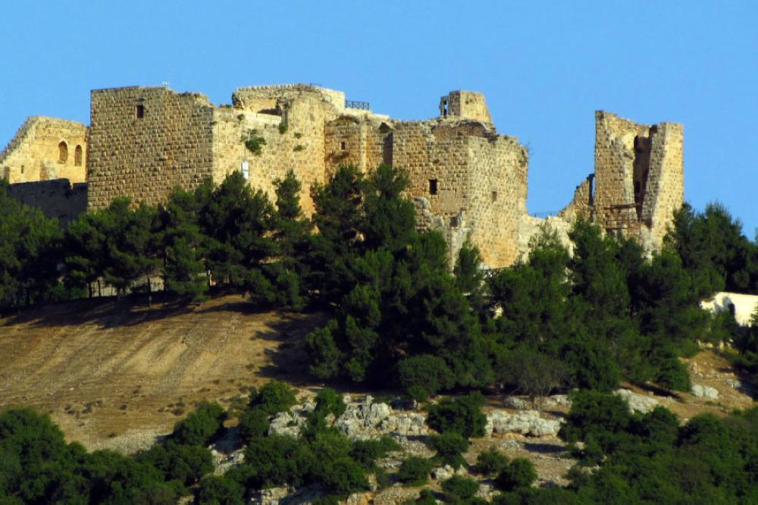
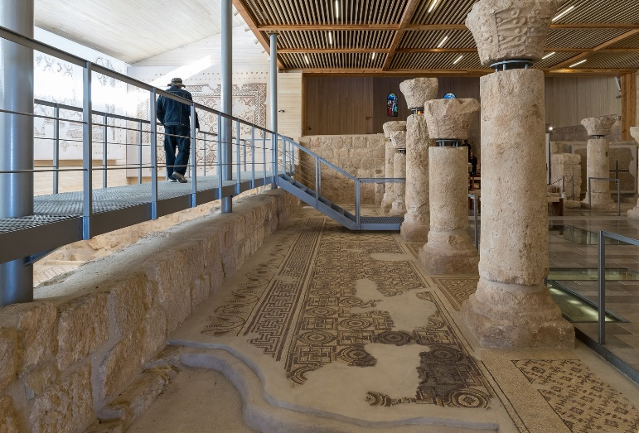
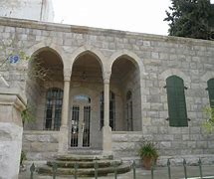
Country and city :
We are from Jordan /Amman /Greater Amman Municipality .
Regional/Geographical: Jordan has an area of about 35,475 square miles (91,900 square kilometers) and population of around 11 million inhabitants as of 2021. It lies in the center of the Middle East, sharing its northern border with Syria, eastern border with Iraq, it's southern and eastern borders with Saudi Arabia, and western border with the Jordan River, the Dead Sea, and Israel.
Cultural/social characteristics: a typically Islamic Arab country for its people are very warm. Jordan values its ethnically and religiously diverse population, and its popular food Mansaf .it is the country of Petra one of the seven wonders of the world ,and our ancestors are the Nabataeans.
It is filled with historical sites, interesting geography, friendly people, and delicious food, please visit Jordan you are most welcome here .

Slide 8
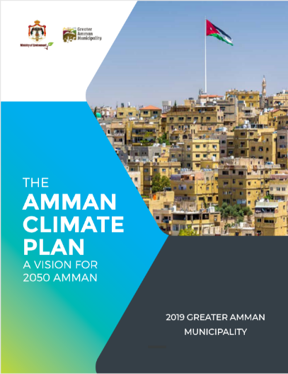
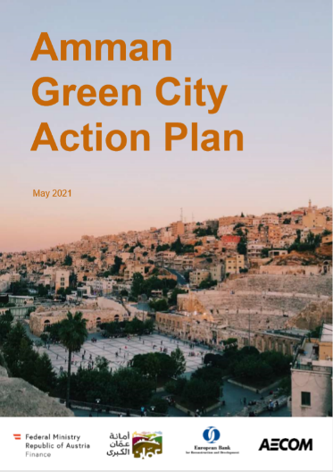
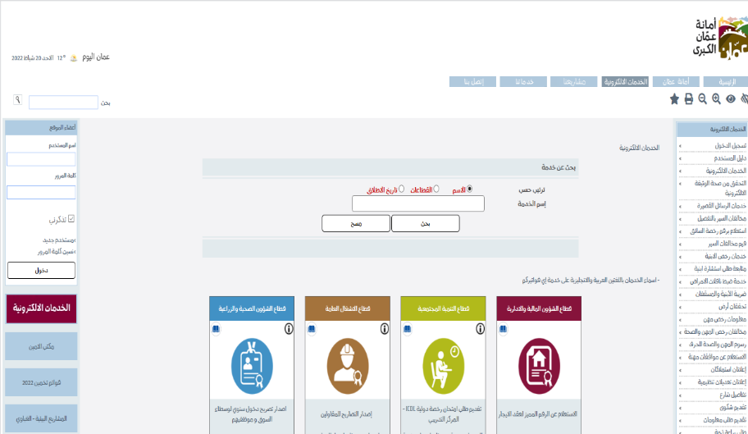
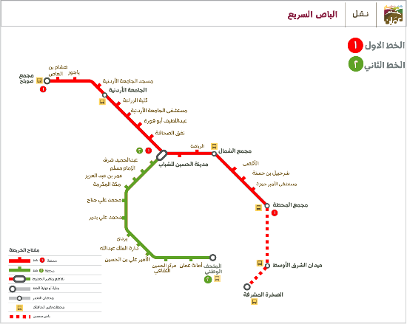
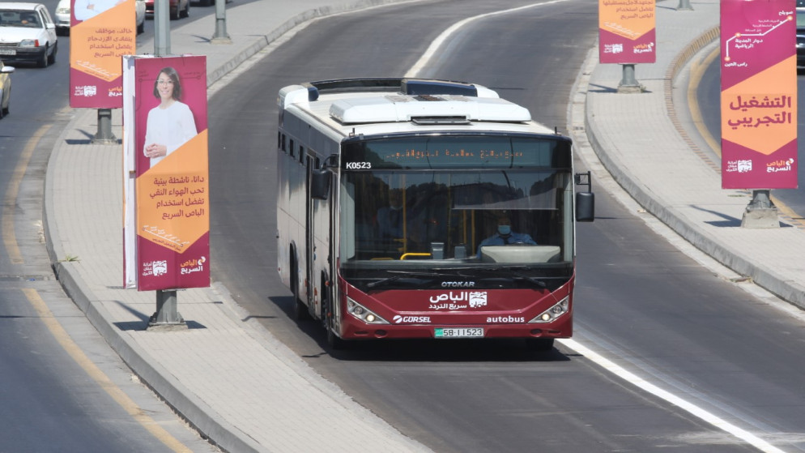
Smart City Needs and Opportunities
GAM lately created its Resilience Strategy followed by many important plans ,projects, initiatives as follows :
Climate Change Action Plan ,Green Growth Plan and many other plans strategies that are concentrated around sustainable development and smart city solutions and its main objectives are :
Improve the mobility systems, promote walkability, connect the city digitally and institutionalize the planning in the city.(existing projects almost in final stages )examples :BRT system 25 km finished and now in the second stage ,digital transformation project :more than 77 services on the website .
Manage and fulfil climate change commitments, improve energy efficiency and security, including the diversification of energy sources, apply green building guidelines, manage the water resources efficiently, and improve the waste management system(Existing Projects )
Leverage the existing human capital to create employment, support entrepreneurs, start-ups and incubators, and empower women.
Integrate and engage young people equally and support the youth through cultural campaigns
Promote a sense of belonging amongst citizens and promote participation and engagement

Slide 9
Project Overview
Regulation : New planning bylaw for GAM.
Objectives :To cover existing gaps that found in laws ,create new building and planning typologies which is produced by MGP (Metro growth plan for Amman2025),and to enhance social, environmental and economic themes to ensure livable, workable sustainable cities, and address urban resilience through urban planning and design process.
Enhance and Set a clear legal frame work to standardize and promote walkability .
Components :Regulations ,guidelines , standards ,and consultation and engagement process .
Progress and stockholders :Now it is in the stage of stockholders mapping and classification .(Internal & External )

Slide 10
What we seek from this TDD
What Urban Planning standards are effective in achieving and promoting walkability ?
What are the best practices to community engagement, Segmentation in the planning process ?
How we can overcome lack of budgeting and topography issues to achieve walkable city ?
How we can communicate with public to raise awareness and increase the desire to use public transportation and increase walking in the city and reduce the use of private vehicles?

Slide 11
Ulaanbaatar Sustainable Urban Transport Project
[Ulaanbaatar, Mongolia]

Slide 12
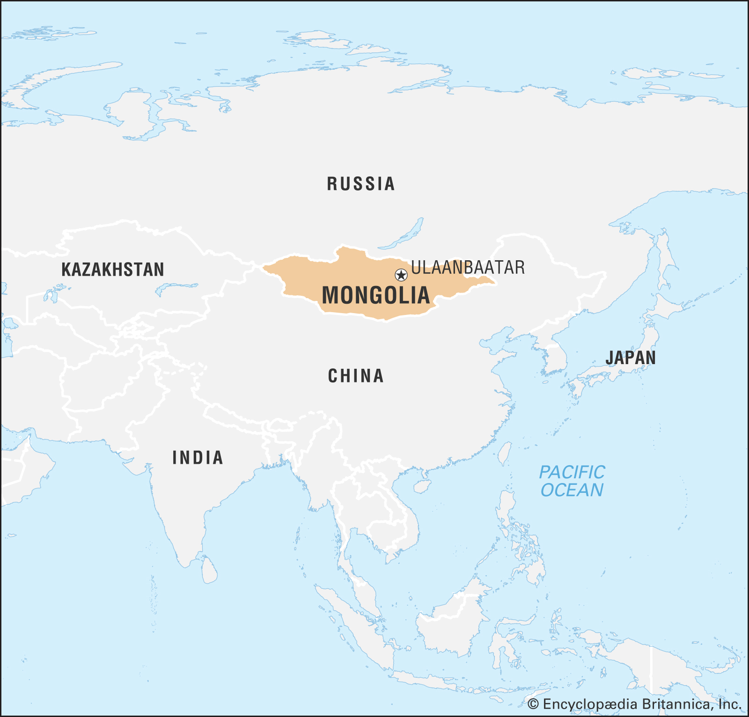
Who we are
Location: Central Asia (Between Russia and China)
Time zone: UTC +8, +9
Land area: 1.5 million km²
Climate: Extreme climate condition (summer +30C, winter -30C)
Population: 3.3 million
Density: 2.07/km²
Capital city: Ulaanbaatar
Population of Ulaanbaatar city: 1.6 million
Source: Britannica

Slide 13
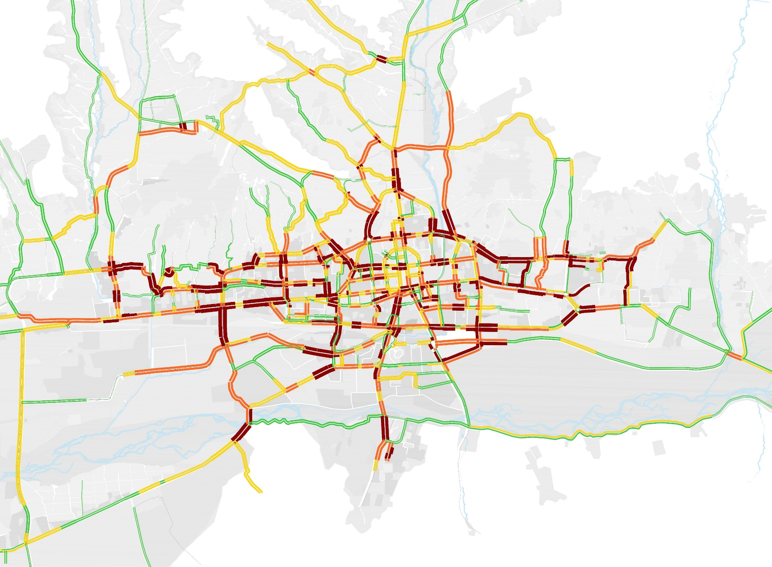
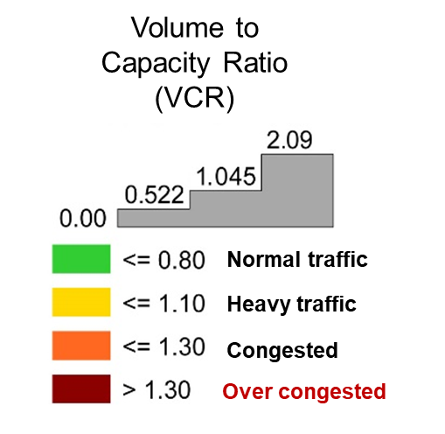
Smart city needs
TRAFFIC CONGESTION PRESENT SITUATION
Ulaanbaatar city road network of 78% is congested
Average travel time of 1 km road trip: ^{10 min}

Slide 14
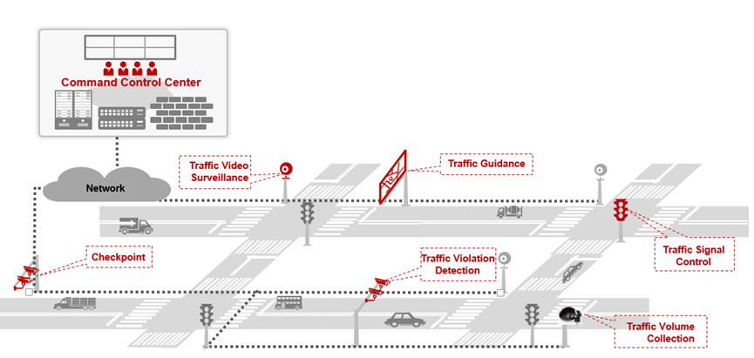
Smart city solution
“Vision-2050”, Mongolia’s long-term development policy; Mongolia’s five-year development guidelines for 2020-2025; Action program for 2020-2024 of Government of Mongolia, Five-year guidelines for the development of the Capital city for 2021-2024; Action plan of the Governor of Capital city and Mayor of Ulaanbaatar, city administration shall implement the “Smart City” project. The primary goals of the project are to reduce traffic congestion by developing integrated intelligent transportation system with its relevant infrastructure and necessary information systems.

Slide 15
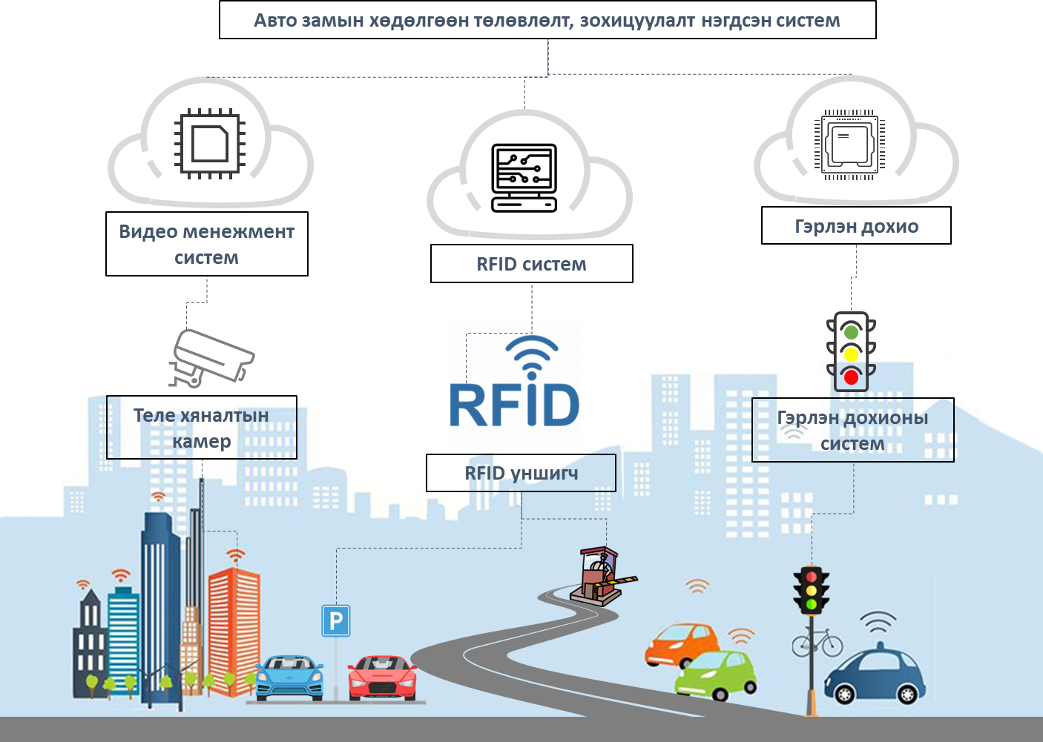
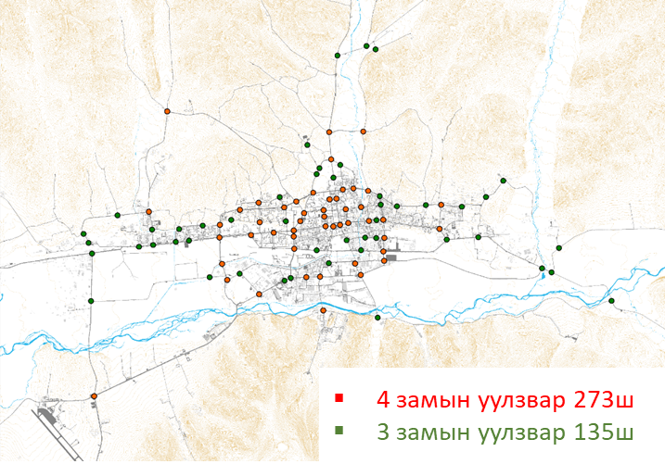
Smart city solution
ITS based Car registration + Radio-Frequency Identification system /RFID/
RFID – system software completed
RFID reader location
Expected result
Real time traffic data
Improvement of street monitoring
Road traffic information data
Locate road traffic bottlenecks based on real time traffic data
Four leg intersection 273 unit
Three leg intersection 135 unit

Slide 16
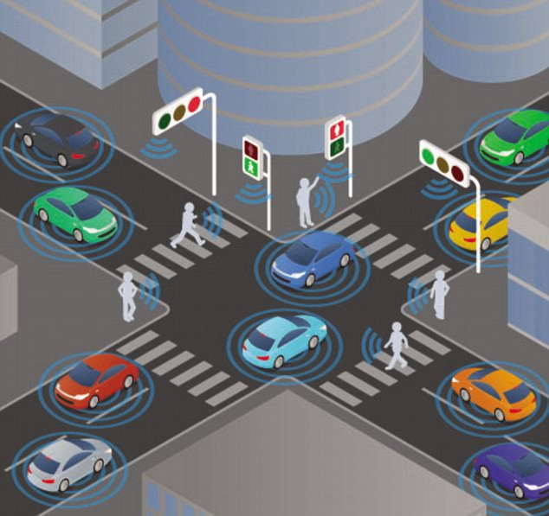
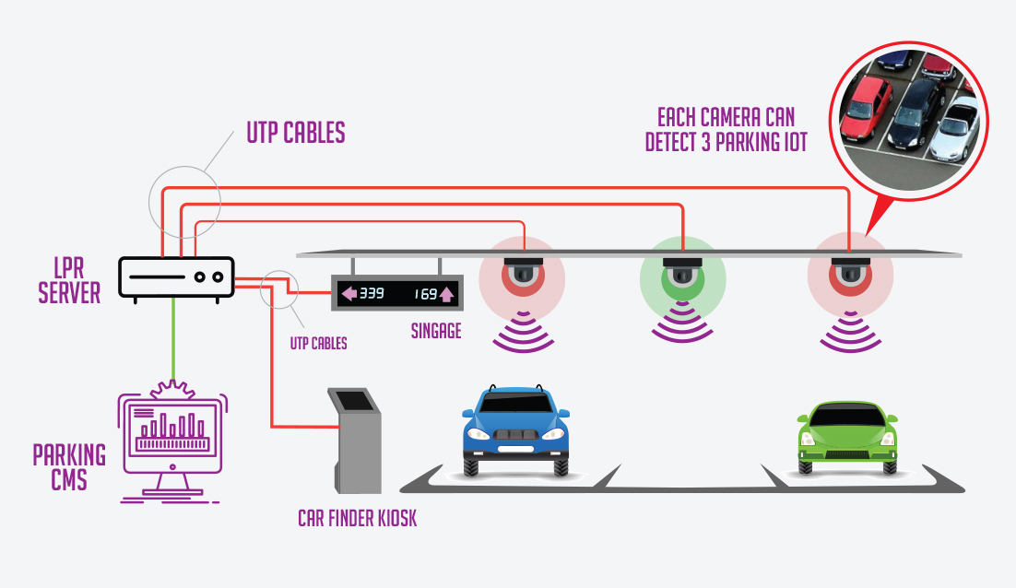
Smart city solution
WORLD BANK PROJECT COMPONENTS
INTELLIGENT TRANSPORT SYSTEM
SMART PARKING MANAGEMENT SYSTEM

Slide 17
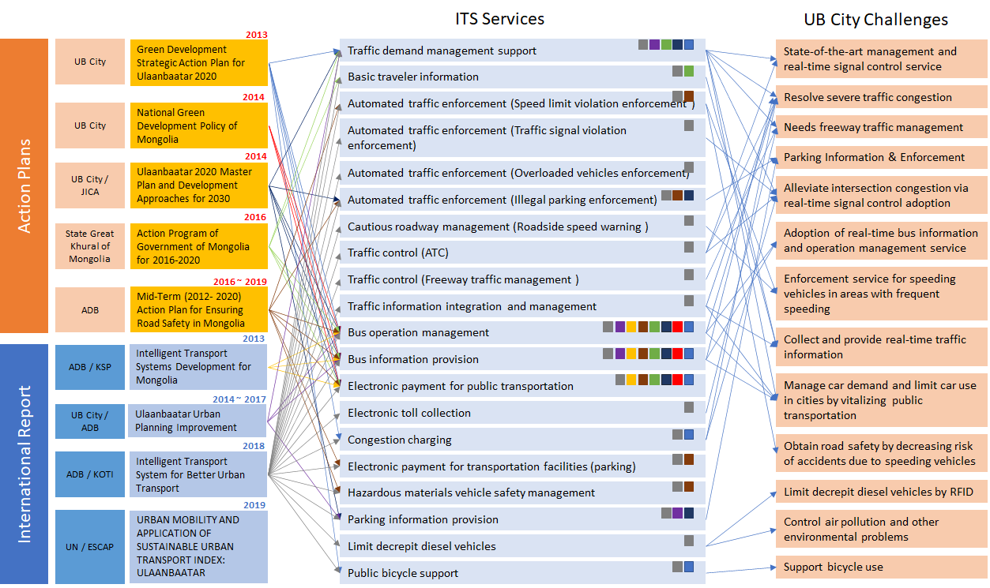
ITS Ulaanbaatar city challenges
Source: world bank study team

Slide 18
What we seek from this TDD
Describe gaps or challenges in your project (You may refer to the smart city topics in slide 4)
Pose them as specific questions about the kind of Smart City solution/answers you are seeking for (e.g. What smart technologies are effective in monitoring and addressing traffic congestion?)

Slide 19
Buffalo Municipality Smart City Strategy
[South Africa]

Slide 20
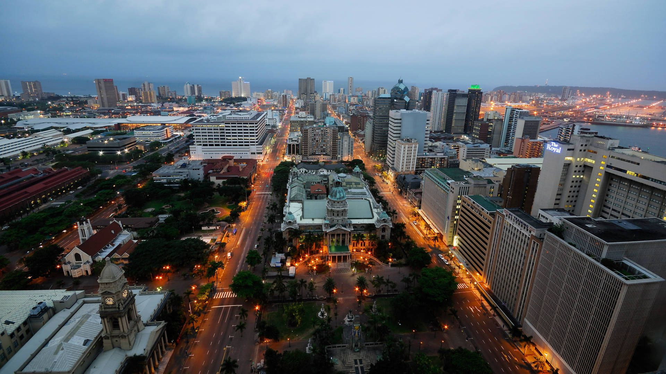
Dbsa/world bank Smart cities programme south Africa
programme overview
World Bank
RAS
SDG’s
(Financing Ops)
Smart Cities
(Metros)
Urban Transport
(Transport & Logistics)
The DBSA and the WB have collaborated in the following areas:
Identifying viable options and developing integrated solutions for urban transit systems
Create efficiencies, eliminate redundancies and improve service delivery through a smart cities approach to key service delivery areas.
Research into quantifying the funding gap for infrastructure needed to reach the SDG targets
The DBSA SMART CITIES RAS will help South Africa to transcend its infrastructure development challenges and growth stagnation by:
Identifying and preparing implementation plans in support of Smart City strategies (TOR for pre-feasibility studies in 3 sector projects per city).
Exploring innovative approaches to infrastructure financing (blended finance options).
Introducing change management approaches for smart city project implementation, specific to pilot cities

Slide 21
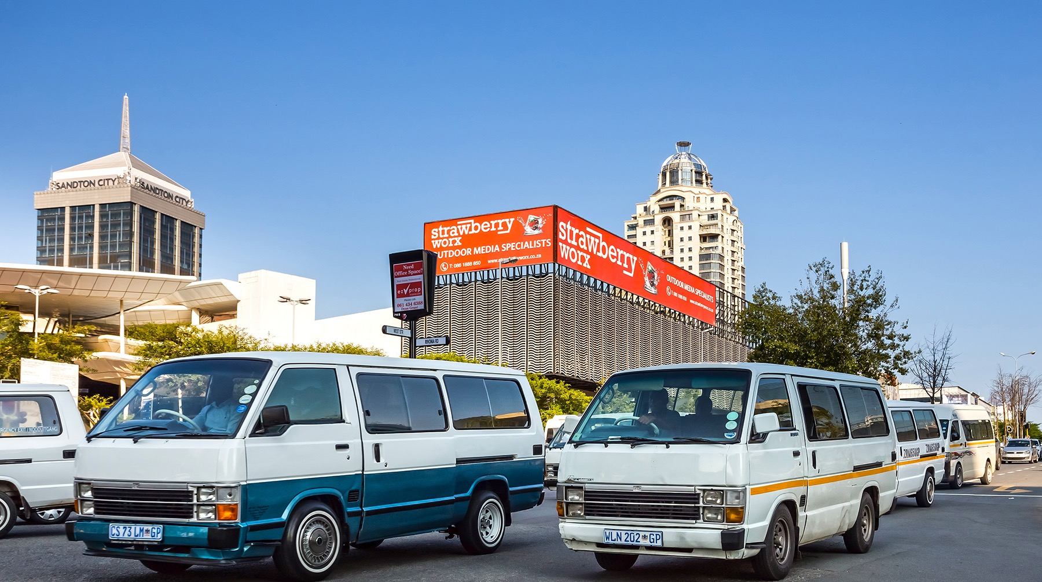
Smart City Needs (What smart city needs do you have in your country/city? ) | Citizen centric smart city to:. Enhance the customer experience- Service Delivery App. Phase out of conventional technology Enable 4IR & IoT (Drone Technology, Future Mobility, 5G connectivity). Improve and enable economic growth and development Planning strategies & investments to meet climate and sustainability targets (upgrade water supply infrastructure) | Smart city approach to respond to: rapid urbanization, infrastructure backlogs, climate change, apartheid spatial legacy; digital divide, 4IR opportunities, and innovation driven opportunities for economic development. Efficient service delivery systems and processes Citizen centric development. Smart city to solve to budget and skills maximization | Smart city pursued through: Customer centered app(s)- (e-services) Public-WIFI Smart Metering projects Tshwane Safety app Integrated Bus Rapid Transport System (AreYeng) Innovation platform to shift change and drive new areas of operating.
Opportunities Where do you see smart city solution relevant in your country/city? | Non-revenue losses minimized through innovative technologies PPPs and collaboration with other state-owned enterprises. | Adoption of new technologies for service delivery; Encouraging start ups to innovate; and Enhance service delivery through technology. | Investment maximization Collaborative work with other institutions for greater learning
City of Ekurhuleni
City of Johannesburg
City of Tshwane

Slide 22
What we seek to learn from this Technical Deep Dive
Challenges
Addressing constraints in implementing innovation. Current challenges include but are not limited to: Legislative red tapes Funding Human resource Management constraints. | What would fast-track a Smart City Implementation Process? What types of professionals are required to implement SC approaches? What types of professionals can implement SC approaches?
Centralized decision-making Multiple leaders in Municipalities Departments/Units involved | What does a good smart city governance structure look like? Who should lead a Smart City Project to full implementation phase? How can inter-departmental conflicts be resolved in trying to gain Smart City status?
Meaningful value add | How is Smart City effectiveness measured? When can a City celebrate meaningful implementation?
Transferring lessons learnt to effective service delivery | How can residents be included from inception of a smart city project? How can public participation be improved in such projects?

Slide 23
Izmir Smart City
[Izmir, Turkey]

Slide 24
Who we are
Turkey, Izmir | WB/IFC long term engagement with the City of Izmir Investments: >$500m investment and mobilization in the City Infrastructure Technical Support: Advice on investment projects, development of Izmir Open Data Strategy and Implementation Roadmap, development of Izmir SC strategy and operationalization of Izmir SC Unit SC project team: City-wide stakeholders (including Muni leadership), Joint WB/IFC team + 4 experts from GB, Rep. of Korea, Turkey
Smart City Needs and Opportunities | SC Opportunities One of the most ‘smart’ cities in Turkey and the region, several smart technologies, enabling environment, digitalization, citizen engagement etc. Engaged Mayor and leadership team on the smart city topic SC Needs/priorities City Infrastructure and Services: Transport, mobility and logistics, Telecommunications Institutional Enablers: Leadership and governance Digital Transformation: Data management and analytics, Business model and financing
Project Overview | WB/IFC GSCP Izmir City Project objectives: Technical advice on operationalizing Izmir’s Smart City Unit Guidance on how to develop a Smart City strategy Contribute ideas on public and private investments in smart urban interventions Achieved: Engagement with City leadership, Analysis of SC Challenges and Opportunities (Survey), Development of SC Initiative portfolio (2 workshops with Service Providers) Ongoing: Mayoral Storyboard / A Smart City Strategy Visual representation + capacity building on SC unit operationalization

Slide 25
What we seek from this TDD
Gaps or Challenges in the Smart City space for Izmir
Lack of a unifying Smart City strategy based on international standards and best practices around the world.
The operating model of Izmir SC Unit, recently set up, is still nascent and hence there is a need to build the capacity of municipal staff through an assessment and recommendation of its functions, roles, interoperability with other units etc.
Lack of a mapping of the pressing challenges and investment opportunities in City Infrastructure and Services (e.g., Transport Planning & Intelligence Systems, Renewable Energy, Skills & Entrepreneurial Opportunities, Health & Human Services, Smart Lighting Expansion); need to improve the business-friendliness through institutional enablers (e.g., Urban Planning, Asset Mgmt, Societal Insight, Engagement & Participation, Resilience etc.) and provide a platform for Digital transformation in the Smart City space (e.g., platforms to share data to and from the Municipality to its citizens, App Consolidation, GIS, Data Mgmt, Urban Platforms).
Expectation from the TDD:
Learn from experience of the Netherlands on its Smart City Strategy and operating model
Learn new and emerging technologies in Smart Cities
Use of data in Smart Cities

Slide 26
Annex

Slide 27
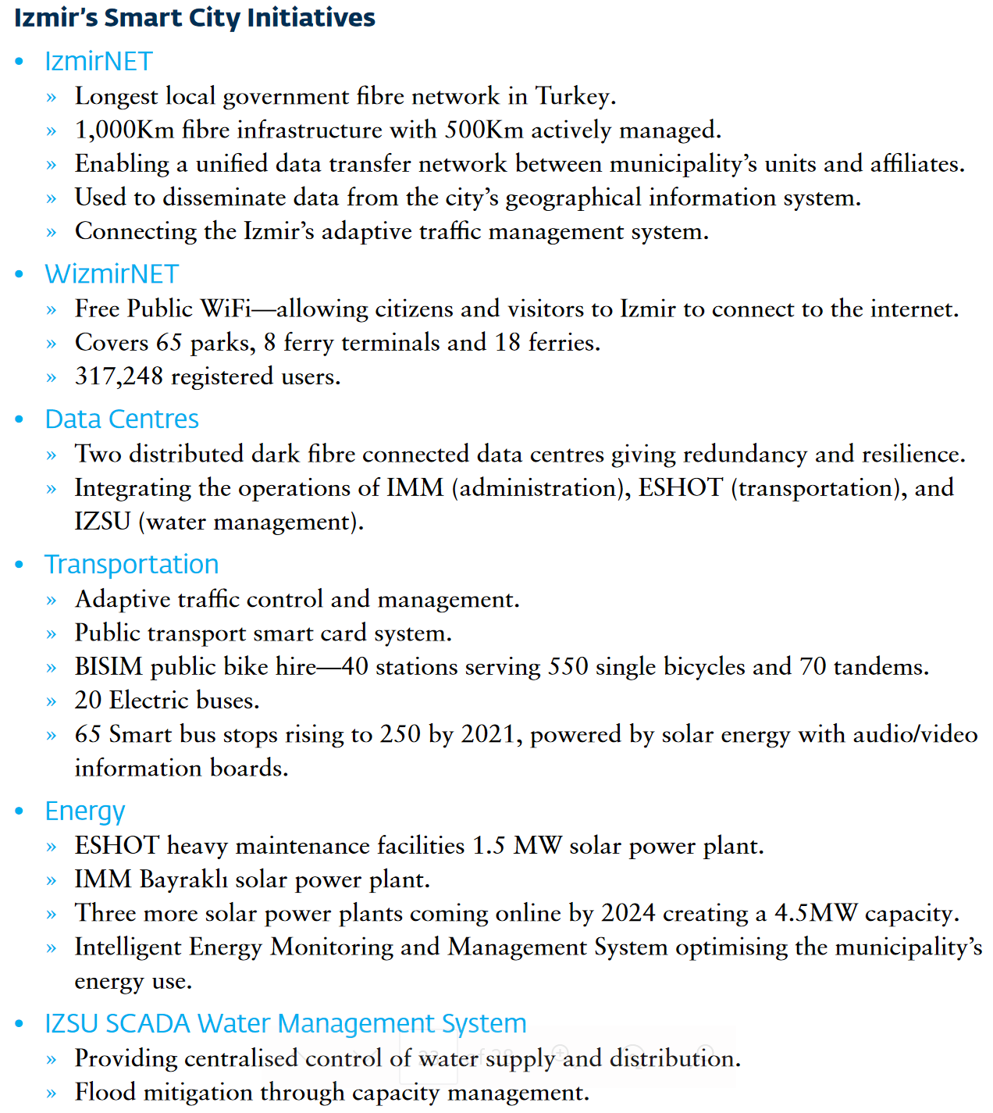
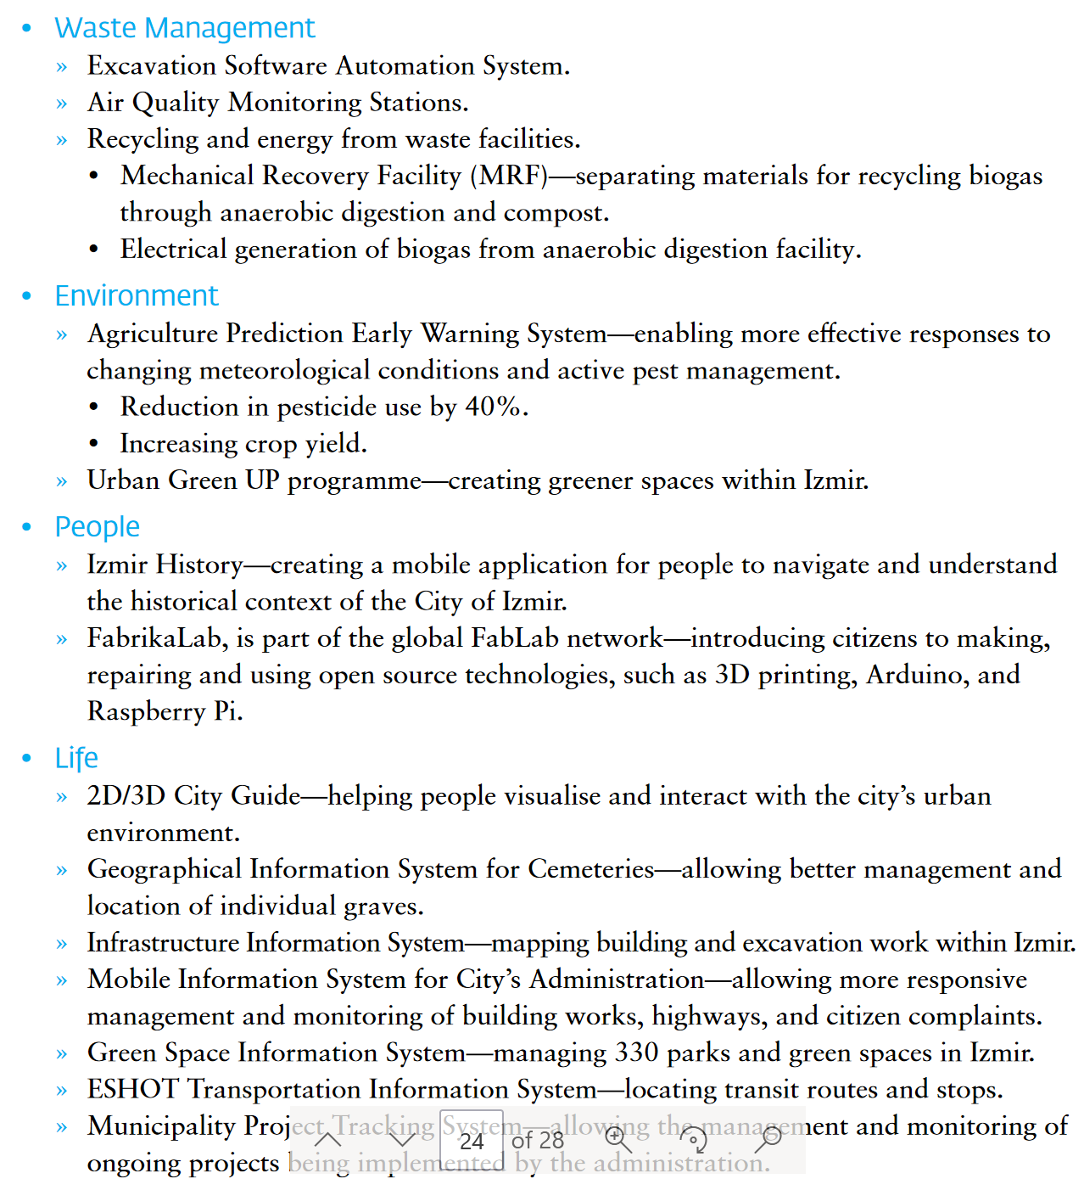
Izmir’s Ongoing Smart City Initiatives

Slide 28
Izmir Smart City “Current State” Assessment (source: BSI PD 8100)
Component | Characteristics | Maturity Assessment
 |  | 1 Lagging | 2 Developing | 3 Competent | 4 Progressive | 5 Excelling
Leadership Environment | Providing a strong city leadership network that advocates a common vision; operates as an effective leadership team; role-models open transparent style; sets priorities; creates and maintains a coherent roadmap; and ensures city success | Fragmented Leadership | Top-down silos | Compliant process-led | Driven Ldrshp Network | Inspired Sustained Ldrshp
Customer / Stakeholder Focus | A city that is built around its citizens, business community and visitors (as key stakeholders / customers); that truly understand them; engages them in an open and transparent relationship; and proactively ensures their active contribution to progress | Internal customer focus | Customer = Citizen | Customer Segmentation | Customer Focused | Customer Led
Service Enablement | Providing the enabling context for success: including policy, planning, common protocols; means of collaboration; capability / capacity mgmt.; financing; business models; procurement processes; & an underpinning operating model | Service Siloed | Inter-Service Cooperation | City-Wide Perspective | City-Wide Collaboration | City-Led Innovation
Service Delivery | Offering and managing quality services to city stakeholders, through direct or indirect means. Selecting the most appropriate business models and delivery agents (including society) to deliver most efficiently and effectively. | Isolated Service Delivery | Cooperative Service Delivery | Integrated Service Delivery | Collaborative Service Delivery | Innovative Service Delivery
Digital Asset Mgmt | Exploiting the power of open data sharing and modern technologies (e.g. social media, analytics, mobile, cloud, sensors) through investment in and mgmt of digital assets; including respect of privacy and digital abilities | Silo ICT management | 1st steps to ICT alignment | City-Wide ICT Architecture | Reporting Data for City Purposes | Exploiting Data for City Innovation
Physical Asset Mgmt | Inventorising and exploiting physical assets; for multi-purpose; managing life-cycles and investments; and integrating physical and digital assets; complete capture and open sharing of asset information | Silo Asset Mgmt | Aligned Asset Mgmt | City Perspective | Cross-Sector Asset Mgmt | City-Wide Asset Exploitation
Performance Mgmt | Setting appropriate goals and targets; establishing measures and monitoring practices; ensuring a performance culture; predictive use of data; robust public value measurement; open reporting of value to stakeholders | Low Performance Culture | Reactive to Measurement | Compliant to Goals & TArgets | Insightful Performance | Predictive Value Mgmt
+3-5yr Ambition
Current Assessment

Slide 29
Izmir Smart City Assessment - Synthesis of Feedback (14 participants in Survey)
Challenges
Opportunities
…to Potential Action!
Shared Vision
Feedback from Citizens
Cooperation and coordination in (Muni) decision making
Need for cross-tier (Natnl/Local) alignment and collaboration
Cross-Sector collaboration locally
Clarity of roles in Municipality
Role clarity regarding data production/governance
Leadership sponsorship of the ‘smart’ (betterment) agenda
Cross institution data synthesis; quality; overall governance
Standardisation to support efficiency / quality service delivery
Finalising internal digitalisation
Real-time performance mgmt.
Integrated multi-channel services
Asset inventory data capture
Service quality metrics & measurement
Purchasing process innovations
Common vision – translated to functional roadmap / strategic plan, and (most important) targets
Creative mgmt. policies
Integration between units
Better integration of and collaboration with partners beyond city hall – with clarity of involvement and role
Regular review of plans
Citizen engagement (vision/strategy/plans/co-design services/participative decision making/service satisfaction)
Predictive service design & visualisation thru innovative new technologies
Investment in digitalisation, including exploiting what already exists (e.g. social media)
Supportive enabling platform for data sharing
Improved pragmatic (transparent / open) service performance monitoring
Evidence from ‘smart’ / ‘open data’ initiatives to strengthen leadership resolve
Finalise asset register, and ensure a strategic review of assets
Exploit international benchmarking
Explore new business models and financial instruments
Merit-based people performance mgmt. system
Innovative strategic framework
Cascade across stakeholders
Innovative community insight tools.
Building on Open Data Strategy to Urban Data Platform design
Review pragmatic performance approaches.
Asset platform as service foundation leading to Digital Twin
Working session to explore and match to priority opportunities

Slide 30
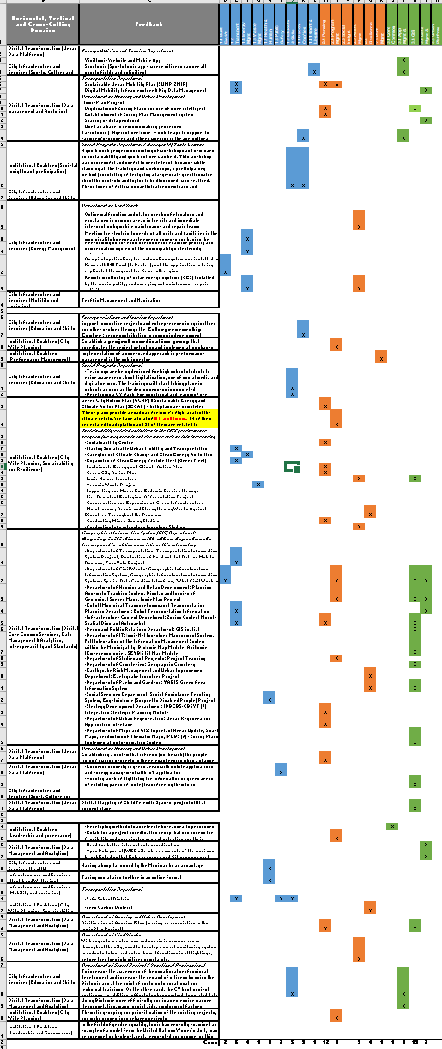
Smart City Priority Topics and Opportunities
SC Initiatives Generation and Mapping
Assessment of Main Themes & Priorities
SC Initiatives Portfolio
In progress
82 Opportunities, 14 Strong Themes:
1. Infrastructure & Services
Transport Planning & Intelligence Systems
Renewable Energy
Skills & Entrepreneurial Opp’ties
Health & Human Services
Smart Lighting Expansion
2. Institutional Enablers – strong links with digital e.g., GIS
Urban Planning
Portfolio, Programme, & Project Excellence
Asset Mgmt
Societal Insight, Engagement & Participation
Resilience
3. Digitalisation
App Consolidation
GIS
Data Mgmt
Urban Platforms
Development of Izmir’s SC initiative portfolio through the ‘Smart City Capture’ form
Commonilities and interconnectedness among initiatives
Smart City projects implementation (engagement with Izmir Leadership and Service providers)

Slide 31
Physical Planning and Urban Management Information System (PPUMIS)
[Uganda]

Slide 32
Who we are
Country & City | UGANDA – Ministry of Lands, Housing and Urban Development (MoLHUD)
Smart City Needs and Opportunities | Smart City Challenges Data fragmentation and disintegrated systems (GIS database, land information) Lack of experienced professionals Low usability of end users Inconsistent network connectivity Cybersecurity risks Smart City Solutions Data integration and management, and system enhancement Connectivity improvement Training and capacity building (e.g. GIS) Digitization of planning procedures and urban management
Project Overview | The Project supports the MoLHUD in the development and implementation of its Physical Planning and Urban Management Information System (PPUMIS) with the aim to enhance physical planning and urban management at the national and local level in Uganda. Activities include: Support for the development of a 5-year strategic plan (together with MoLHUD and consultancy firm) Technical support for data integration and system enhancement (to MoLHUD) Identify quick wins and provide capacity support to enhance functionality of PPUMIS

Slide 33
What we seek from this TDD
Gaps and Challenges affecting PPUMIS Implementation
Absence of a National Spatial Data Infrastructure
Capacity Gaps in software usage (especially GIS)
Poor and outdated equipment gaps
Database management data accessibility
Questions
How can smart technologies be fully integrated into policies, institutional and legal/regulatory frameworks both at national and local government level of administration?
What smart technologies are effective in managing socio-economic and spatial data (availability, costs, technologies, standardization, sharing protocols, etc)?
What smart technologies are effective in dealing with Physical Planning and Urban Management Service delivery standards, procedures, approaches, policies, laws etc)?
What smart technologies are efficient in managing physical environment including space, housing, transport and 3D modelling – scenario testing?

