Slide 1
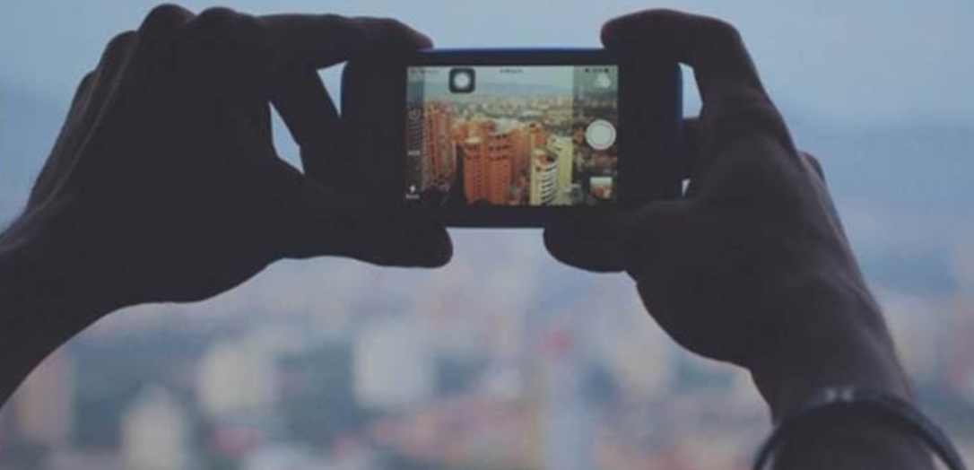
Machine Learning for Cities From Key Concepts to Smart City Applications Workshop outputs Smart Cities KSB – November 20, 2018
October 27, 2017

Slide 2
Summary: Machine learning (ML), a set of methods to recognize patterns from large datasets, has a growing range of applications in cities. This workshop walked through the five key steps in building a supervised learning model – a family of algorithm widely used in smart city applications. Transport planning example: We built a model to help plan transport investments by training a decision tree classifier on survey data about how 54 participants travel to work. Open source ML methods were used to create the exercise, and annotated source code is available here. Brainstorming session: Participants then broke into six groups to brainstorm potential future ML applications in a city of their choice. The proposed uses ranged from identifying vulnerable buildings in Jakarta, to strengthening building code implementation in Kingston, to detecting cholera outbreaks in Harare – see following slides for details. Next steps: Please continue the dialogue! Contact relevant teams¹ / the workshop presenters with questions or ideas for urban ML. ¹ Teams with urban ML expertise include DEC DG, GFDRR Labs, GSUGL, GOST, Smart Cities KSB, and others.
Machine Learning for Cities

Slide 3
The workshop illustrated five key steps to building a machine learning model
An approach to model fitting
Use Case & Data
Model training
Tune (calibrate)
Predict
Evaluate
Determine the use-case you are interested in and source data.
Split the data into training and test sets. Fit model to training set.
Tune model parameters to moderate complexity & interpretability
Use the model to make predictions about test set
Compare the predictions with the actual values

Slide 4
Workshop outputs

Slide 5
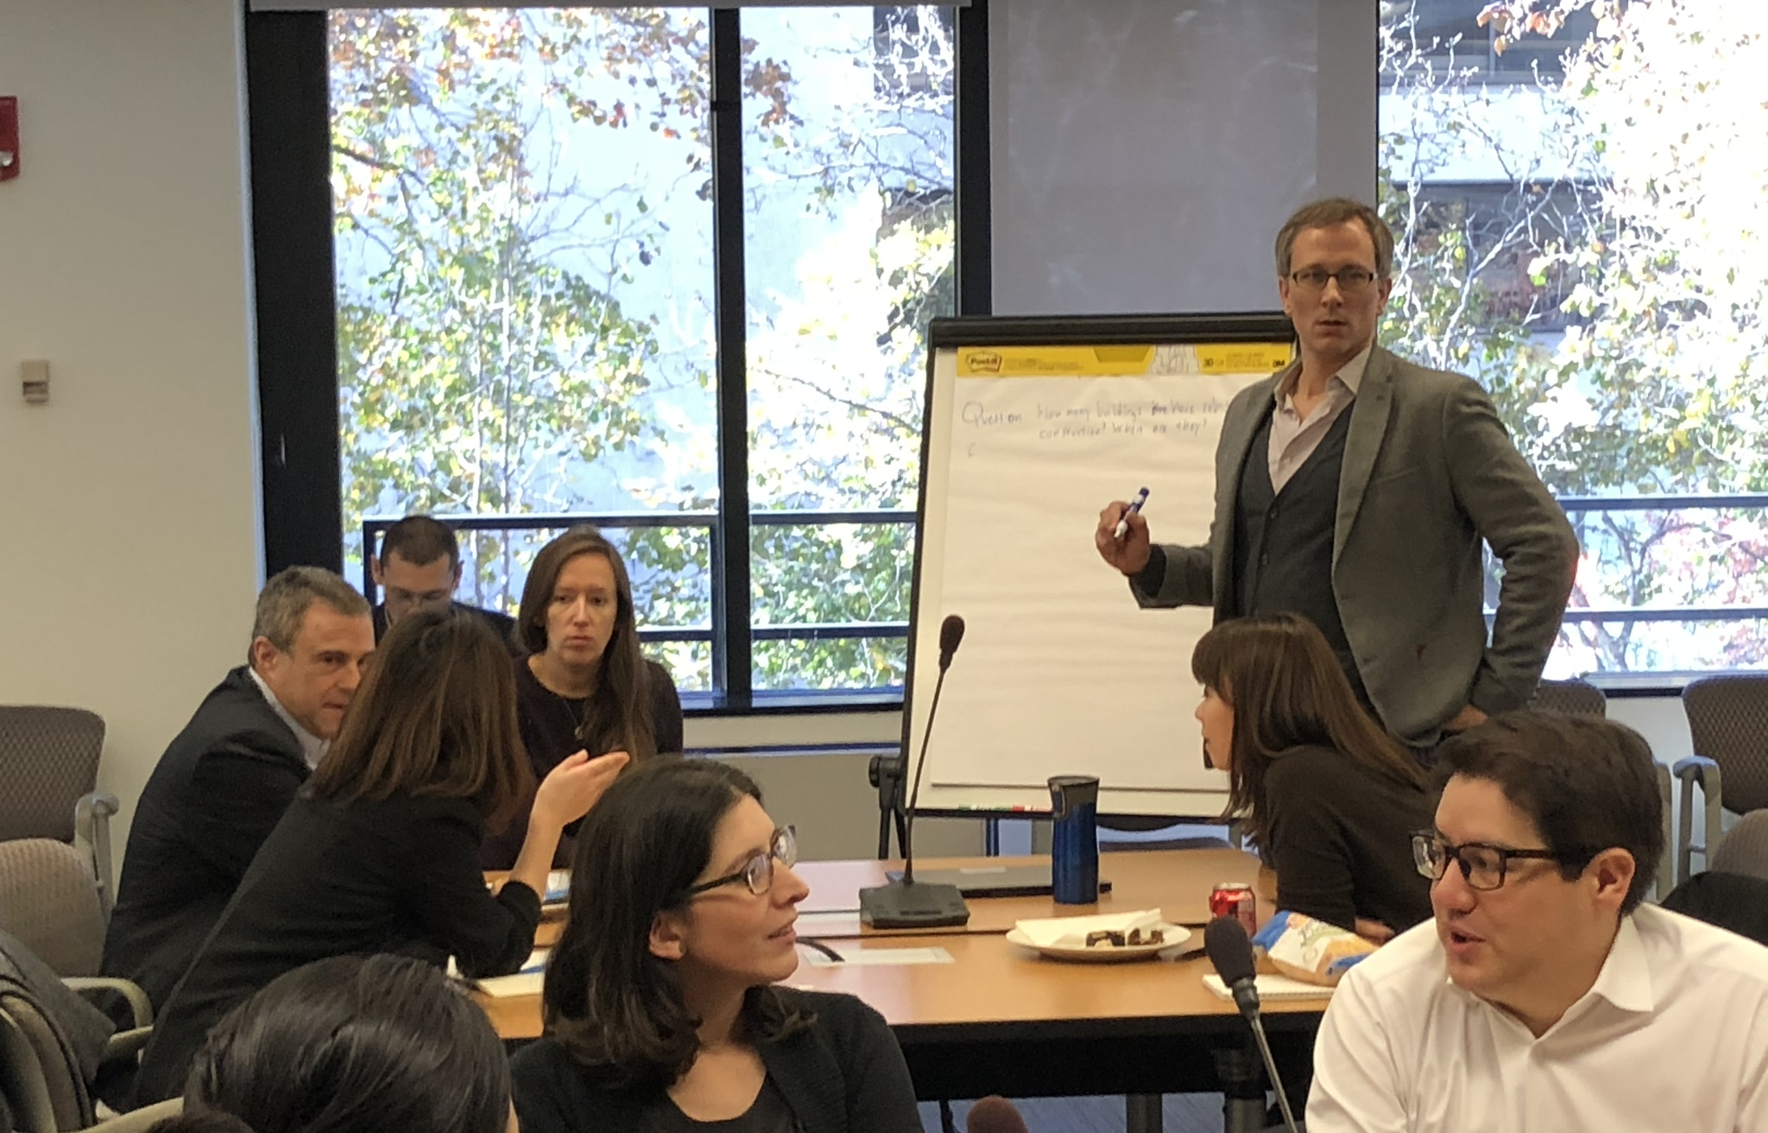

Slide 6
Group 1: Infrastructure reconstruction
City: Kathmandu, Nepal
Question: How can we use ML to better identify vulnerable households and infrastructure for reconstruction prioritization?
Insight: Identify infrastructure affected. Categorization of replacement value. Rehabilitate v.s. Reconstruct.
Track reconstruction progress
Actions: Targeted interventions. Corrective action
Data:
Supporting data would include:
Social, Online, News, UAV
Micro-data registries
Vulnerability map (drone mapping)
OSM
HRSL
Ground-view (street-view)
Crowd-source
High frequency
Challenges:
Data accuracy – establishing ground-truth
Partnership
Local government
NGOs
Interpretability – trust in algorithm and approach
Regulatory
Privacy
INTERNAL USE ONLY

Slide 7
Group 2: Disease early warning
City: Harare, Zimbabwe
Question: Can we use machine learning to predict the next cholera outbreak?
Impact: Disease control – for most vulnerable communities with targeted projects and interventions
Users: MoH, Water & Sanitation utilities, NGOs and MoW
Beneficiaries: General population
Data:
Supporting data would include:
Outbreak data (GPS)
Water sources (drinking)
Sanitation facilities
Public gathering spaces
Flood prone areas, drainage
Precipitation
Health facility availability
Poverty factors
Population density
Household composition
Transportation / Ease of mobility
Ideal to:
Compare data across cities
Compare with historical data
Challenges:
Dynamic factors:
Population movements
Granularity & reliability of data
Privacy & Disclosure
Bias
Budget
INTERNAL USE ONLY

Slide 8
Group 3: Building code implementation
City: Kingston, Jamaica
Question: Identify buildings facing high natural hazard risk (incl. seismic). Prioritize building inspection resources to reduce risk.
Impact: Target specific buildings for retrofitting. Avert property damage and loss of life.
Users: Building authorities and municipal corporations
Beneficiaries: Inhabitants and municipal bodies
Data:
Supporting data would include:
Aerial data
Envelope, cars, parking locations
Cell phone usage
Trees scattered
Cityscape
Utility data
Population density
Crime statistics
Already damaged property
Economic activities
Building typology; materials
Transportation network
Traffic flows
Wind map
Topological map
Income, Tax, Wealth
Household data
Challenges:
Data acquisition and fusion.
Identifying buildings based on non-compliance with codes.
INTERNAL USE ONLY

Slide 9
Group 4: Predicting road quality
City: General application
Question: Can we use machine learning and new data sources to predict road quality?
Impact: Improve preventative maintenance and transport outcomes.
Users: City administration and municipality
Beneficiaries: Road users, and tax-payers
Data:
Supporting data would include:
Construction material record
Construction date
Traffic information
Maintenance data
Weather data
Trees/vegetation
Land use
Condition of road
# of crashes
Traffic risk data
LIDAR data
Soil layer
High-resolution satellite
Challenges:
No TS for detailed data
Model complexity
INTERNAL USE ONLY

Slide 10
Group 5: Identifying vulnerable buildings
City: Jakarta and others
Question: How many buildings have substandard construction? Where are they? Where are they likely to appear?
Impact: Safer housing. Economic loss reduction. Fewer fatalities
Users: National - Planning, Bappenas, Pev (Public works), Homeowners; Sub-national – Jakarta province
Beneficiaries: Residents, Building owners, Jakarta province
Data:
Supporting data would include:
Building stock
Street view and OSM
Inspection data
Previous loss information
Population / census data
DRM mapping
Hazard mapping
Construction characteristics
Challenges:
Stakeholder sensitivity
Privacy
Data collection operational aspects (logistics)
Creating data use-case
E.g. Retrofitting, Design, subsidy
INTERNAL USE ONLY

Slide 11
Group 6: Mobility and Congestion Modeling
City: Cap-Haitien, Haiti
Question: Can we build an algorithm to identify hotspots for congestion to help improve efficiency of transport across the city and mobility patterns?
Data:
Supporting data would include:
Cell-phone data
Origin-Destination pairs
Accessibility of the city
Time of day
Street camera data
Traffic accidents
Challenges:
Data availability and formatting
Disparate sources
Representativeness
e.g. cell phone data informative about high-income segment
Interpretability
Training and skills of users

Slide 12
Case study template
Question:
Develop a use-case which you would like to address using Machine Learning
Choose a city for which this would be useful?
Consider the:
Impact,
Users, and
Main beneficiaries
Data:
What data will support the development of this algorithm?
What data is available?
What are your data ‘wishes’ and ‘dreams’?
Challenges:
What challenges may be involved in developing this ML application, and how might you resolve them? For example:
Privacy
Stakeholder sensitivity
Partnerships
Data granularity
INTERNAL USE ONLY

Slide 13
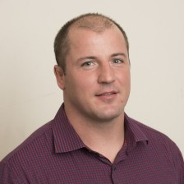
Thanks!
Nick Jones
njones@worldbank.org
Jon Kastelan
jlk635@nyu.edu

Slide 14
Imagining urban use cases
How could WB apply machine learning techniques to better support cities?

Slide 15
Three example cases:
Case studies
Prioritize building inspections
Target land-bank interventions
Detect polluting plumes

Slide 16
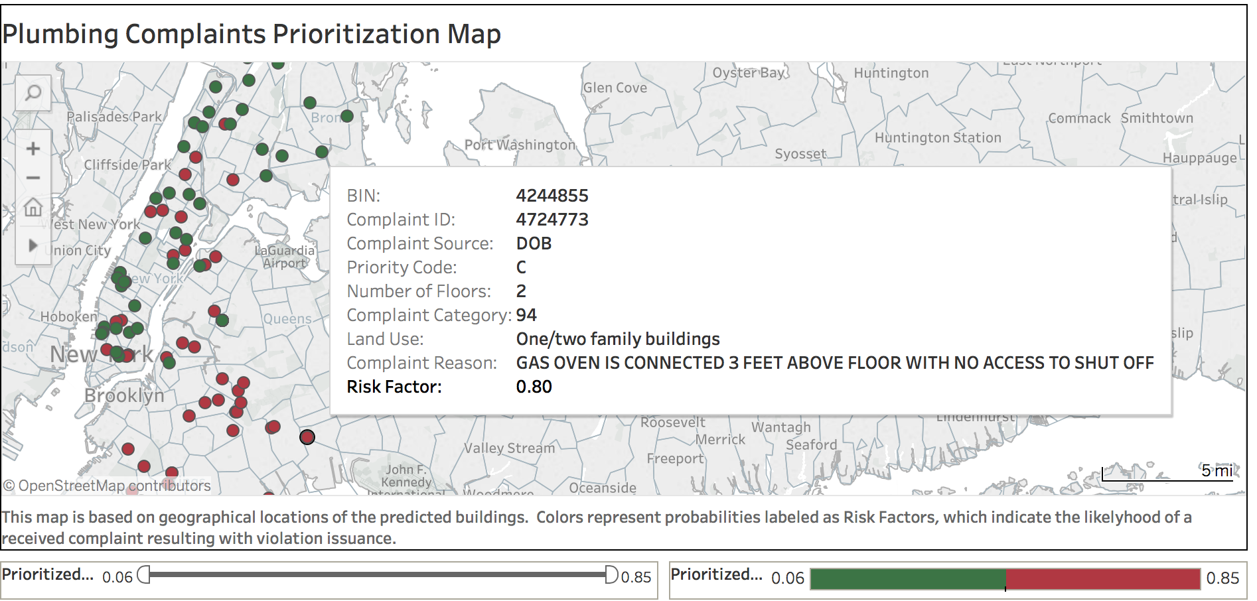
Question: Could an algorithm reduce risk in the built environment by sending building inspectors to the most dangerous cases first?
Case 1: Prioritize building inspections
Challenges:
Buildings data can be fragmented across agencies.
Time-consuming to build training set.
Management was initially hesitant about ML. Deploying as an interactive dashboard helped make outputs intuitive.
Data used:
Building characteristics (year built, number of floors, retail/residential)
Neighborhood demographics (median income, percent homes owner-occupied)
City records of prior code violations and construction filings.
Source of the complaint or referral.
Outputs / visualisation:
Best model is a Gradient Boosting Classifier. Trees: 750; max depth 9.
Trained on data from 2015-2017.
Achieves 70% accuracy on the unseen test data (1,200 plumbing complaints from 2017-2018).

Slide 17
Question: Can we train a classification algorithm to identify vacant homes for possible intervention by the Detroit Land Bank, without sending officers to look?
Case 2: Target land bank interventions
Challenges:
Targeting properties for buyback or demolition required detailed lot-level data.
Negotiating agreements with utilities and postal service took time.
Outputs / visualisation
Data used:
Voter registration data
Fire records
Postal delivery
Utility bill payment
Volunteer ‘Blexters’ (blight texters) labeled derelict buildings

Slide 18
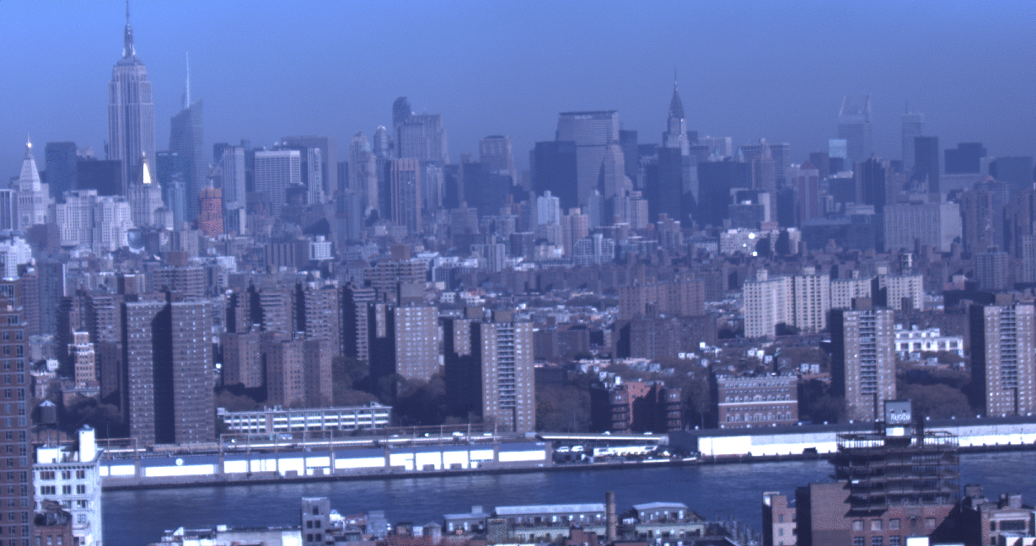
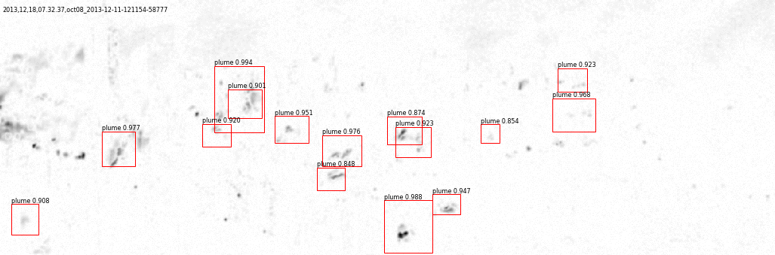
Question: Can we develop an algorithm to automatically detect polluting plumes (ash clouds) from images of buildings
Case 3: Plume detection (images)
Challenges:
No readily available plume dataset for model training
Requirement to build the training set by reviewing lots of images
Biases such as weather and lighting conditions impact ability to see plumes
Visualisation
Data used:
Images of New York City, Eastern Manhattan skyline
Continuously sampled every 10 sec
Approx. 1,000 buildings in the field of view
Figures: Plume detection examples
Reference: CUSP Urban Observatory, New York University

