Slide 1


WePOWER – The Value Proposition
WePOWER Interim Secretariat

Slide 2
The WePOWER Charter
Section C – Mission
The mission of WePOWER is to promote women in the energy and power sector in the eight South Asian countries: Afghanistan, Bangladesh, Bhutan, India, Maldives, Nepal, Pakistan, and Sri Lanka.
Section D – Objective
The objectives of WePOWER are to: (i) support workforce participation of women in energy projects and institutions; and (ii) promote normative change for women and girls in STEM (Science Technology, Engineering, and Mathematics) education.
Section E – Governance
Interim Secretariat => day to day Administrative, Coordinating, Convening and Comms
Steering Committee => Authorization and Guidance on Key Decisions
Strategic and Institutional Partners => Implement Activities, Reporting and Guidance/Learning

Slide 3

The WePOWER 5 pillars Framework
STEM Outreach
Professional Role Models
Mobilizes Partners to:
Set Targets
Implement Specific Gender Activities
Learn/Share/Collaborate
Improve/Scale-up/Innovate
Which ultimately reduces gender barriers and helps more women to join/stay in the power sector.
Socio-Cultural Gender Barriers
Institutional/Structural Gender Barriers
EARLY EDUCATION
Stereotypes of Power Sector
people
value of work
Negative Stereotypes and Perceived Biases in the Sector
Womens Ability
Perceived gender bias and discrimination
work
income potnetial
work-family balance
Pushback by men
Lack of Role Models in the Sector
Female Role Models
Relatable Role Models
Other
Gender Gap in Self-Effacy (Impacted by Gender Bias)
Formal Discrimination
Low Early Experience/Interest in STEM
Lack of Internship/Training Opportunities
Employer Bias (Hiring, at work)
Wage Gap
Lack of Gender Friendly Programs/Faculty
Recruitment
Internship/Networking
COLLEGE
Development
Professional/Personal Dev. Trainings
CAREER
Retention
Facilities/Returning Parents
Policy and Inst. Change
Gender D&I Policy/Strategy, HR/SH-SEA Trainings

Slide 4
Value Proposition of WePOWER
WePOWER Banner
Improve Visibility, Sharing and Learning for your gender activities.
Scale up your impact by leveraging partnerships/resources
Participate in Local and International Convening Events, Workshops/Tranings
Exclusive WePOWER Training Opportunities
STEMCom Training (Community of Practice Formed in India)
USAID Engendering Utilities Workshop (Scholarships)
Technical Trainings/Sessions by international HR D&I experts (Clare, SHRM)
Communication Support through WePOWER social media/products
Monitoring/Reporting and Advisory Support/Resources
WePOWER Gender Modules
HR and Employee Gender Surveys, Gender Reports
Gender, Diversity and Inclusion Policy adoption
Convening
Visibility
Engagement
Analysis

Slide 5
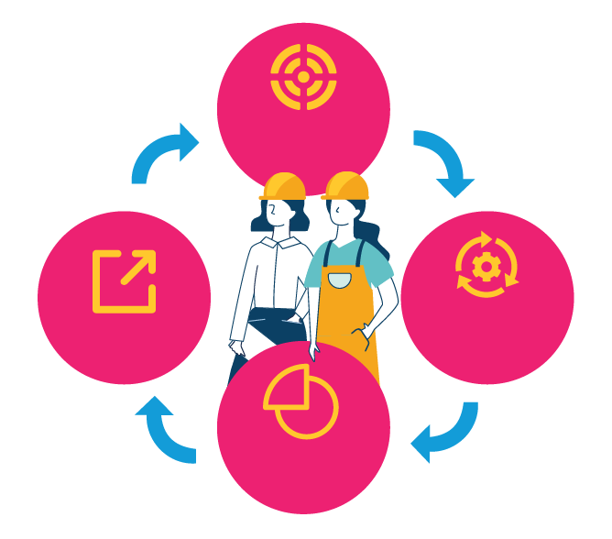
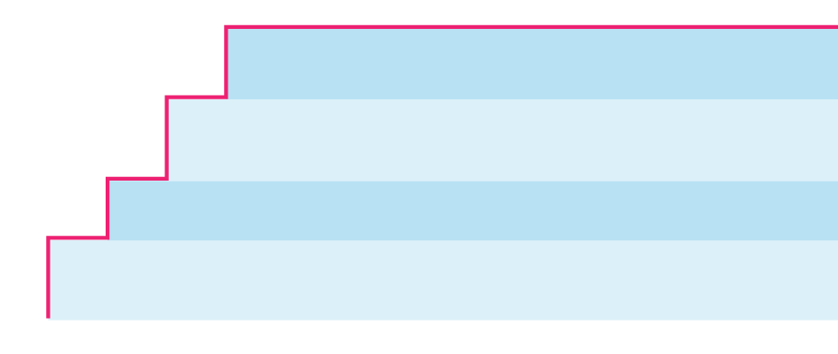

The WePOWER
Process
5
Congratulations! Now you are a WePOWER Partner
Set
Targets
4
Partner Senior Management endorses the List of Activities
3
WePOWER works with Focal Point to develop Gender Activities with Realistic Targets (List of Activities: LoAs)
2
Share
Implement
Activities
5 Simple Steps to Becoming a WePOWER Partner
Partner nominates a WePOWER Focal Point
1
WePOWER approaches selected Partner
Report
WePOWER inspires my work every day”
Ivy Nahar Tisha,
assistant engineer at the Bangladesh Rural Electrification Board (BREB)
Joining the international training was a good way of exchanging our knowledge, experiences, and skills.”
A female engineer from Afghanistan
Bringing more than half of the population - females - into the professional energy sector space will improve its performance.”
Demetrios Papathanasiou
Global Director, Energy and Extractives at The World Bank
Notes:
STEP 1: Approaching Prospective Partners
Official signed invitation letter is sent to the CEO requesting organization to join WePOWER and to designate a focal point
The invitation package also includes WePOWER Brochure and Charter
Either Institutional (Utilities) or Strategic (Networks, Development Agencies etc) Partners
STEP 2: CEO/Chairman endorses WePOWER’s mission/charter and nominates a focal point
Through a simple email response or an official letter
Focal point is usually a senior HR and or Senior Female Manager

Slide 6
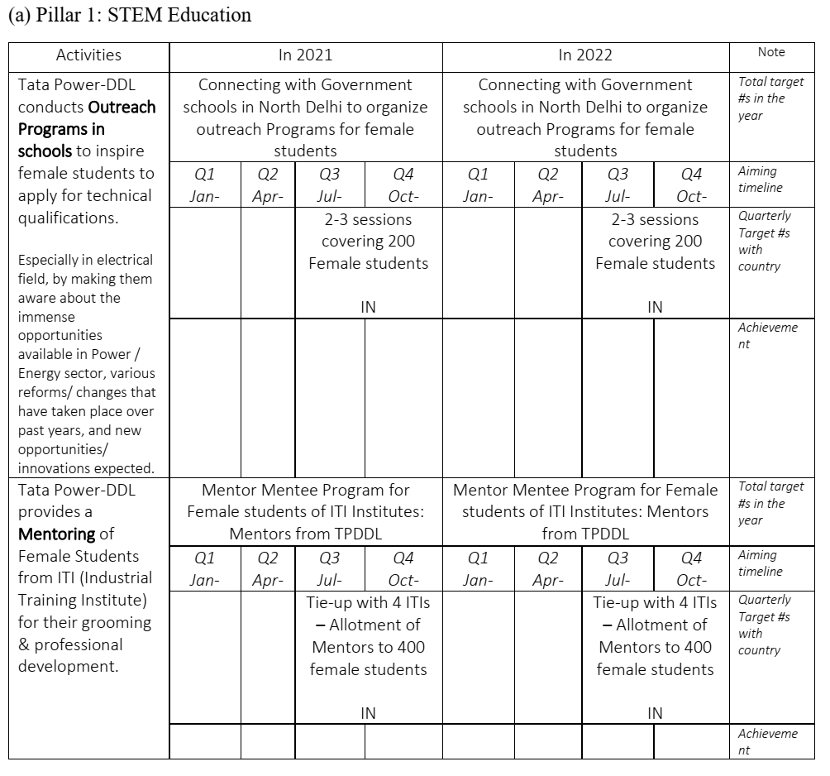
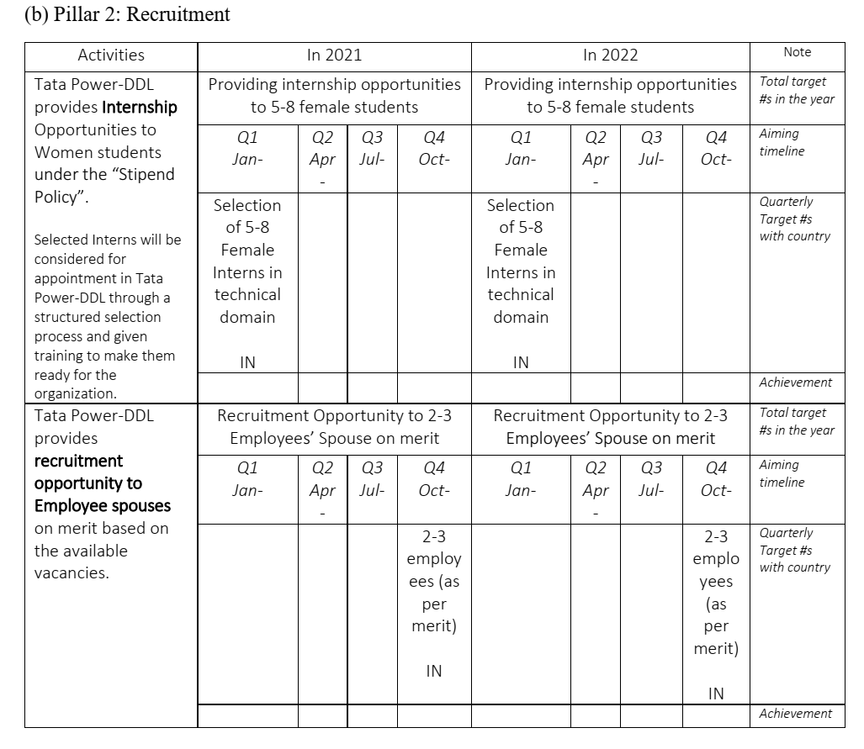
What is the tool of engagement – List of Activities (LoA)
Please Note:
Simple document - It is not a binding or legal agreement but an aspirational/goal setting document
Can be existing activities scaled- up within the capacity of your organization – does not need to cover all 5 pillars.
Goal is to showcase your gender activities and encourage partners and potential partners to share best practices and opportunities for synergies.
WB DOES NOT directly finance the gender activities. Indirect TA and supplementary costs can be covered (e.g. web platform, event space).
*WB Project resources can be allocated towards WePOWER activities for Clients.

Slide 7
Why make a LoA?
Systematic, Progressive and Consultative Approach
Five Pillars allow a holistic approach w/ supply and demand side
Gives template to map your internal gender and DNI initiatives
Helps identify gaps and take affirmative actions
Gives management a data driven M&E reporting systems
Engaging with other partners over a common roadmap allow faster learning

