Slide 1
Gender and Energy -The Evolution*-
Nathyeli Acuna – nacuna@worldbank.org
Gender Specialist

Slide 2
Why?

Slide 3
Gender Gaps are Present in the Energy Sector
For Ghana…
Women are less likely than men to be enrolled in tertiary education (13.6% vs. 17.7%)
(WEF, 2021)
Women work less than men (65.4% vs. 72.9%) and when they do it is in the informal sector (91%).
(WEF, 2021)
Women are more likely to use pollutants as fuel for cooking than men (e.g.: charcoal 41.9% vs 34.4%) (DHS, 2019) .
88% of time women are in charge of fuel collection
Slightly more homes run by women have electricity than men (83.9% vs 83.2); but not in urban areas
(DHS, 2019)
Only about 20% of employees working in the energy sector are women
(USAID)
Women have low access to financial services (53.7% vs. 61.7% (World Bank, 2021) and entrepreneurship is low among them (31.6% of firms with women as a head). (WEF, 2021)

Slide 4
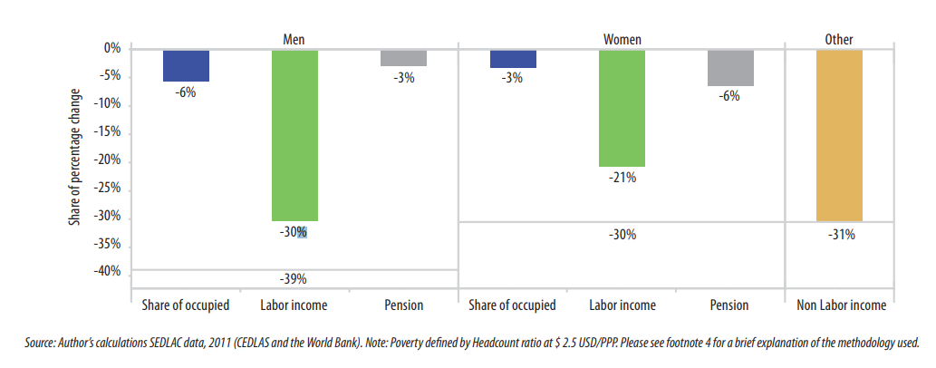
Investing in Gender Equality Works:
In LAC region: Female income contributed 30% to extreme poverty reduction (2000-2010, $2.5 USD/PPP)

Slide 5
The ESMAP Gender and Energy Program has evolved over the years
Very general gender issues
In depth and contextual gender analysis, actions and monitoring tools

Slide 6
Here’s How It Started

Slide 7
The ESMAP Gender and Energy Program has evolved over the years
ESMAP
BUSINESS PLAN
She was right!
Gender is now a central part of our Business Plan

Slide 8
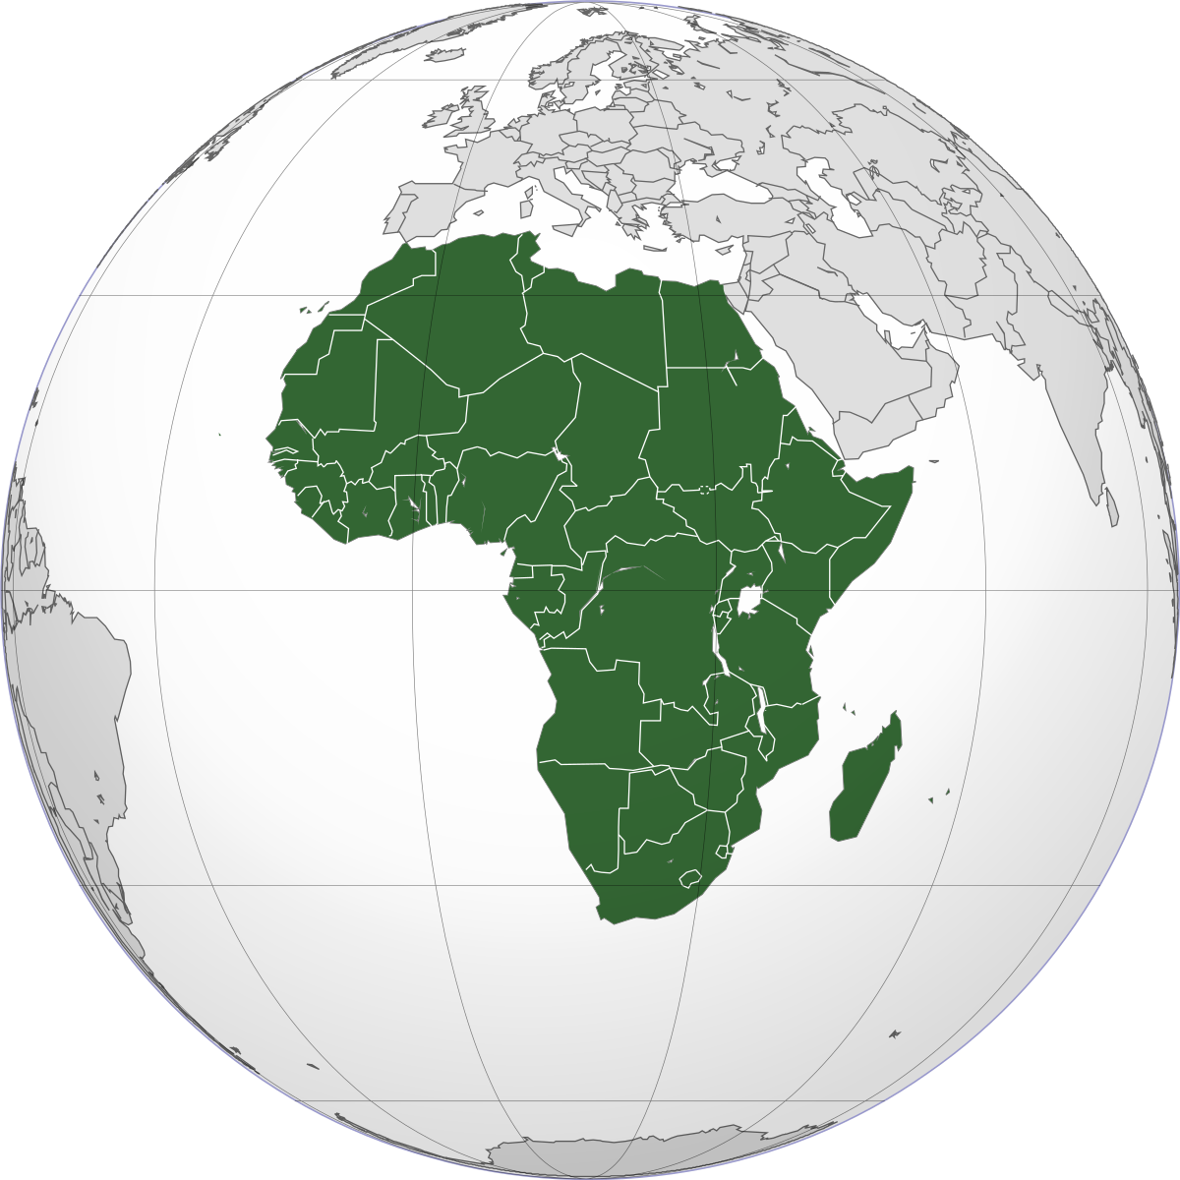
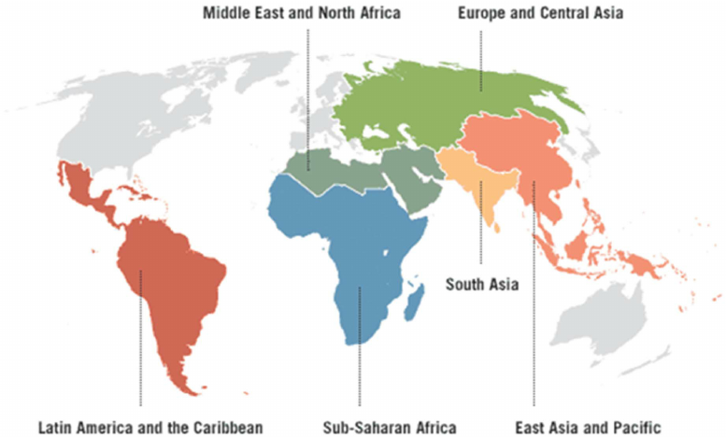
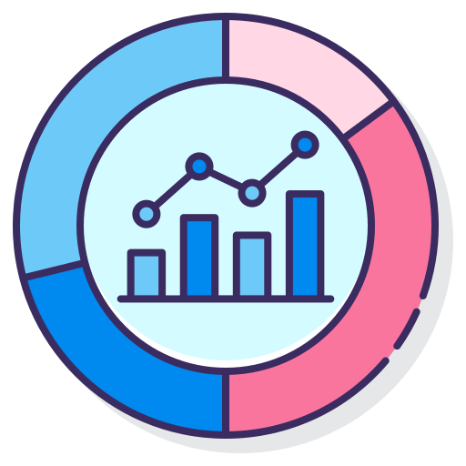
The Story is not Linear
Now we have initiatives and teams in all 6 WB regions
We started with a
pilot project in
the Africa region
Activities and actions that seek to close the specific gender gaps.
Inclusion of indicators that monitor how we are contributing to improve gender equality.
Contextual assessments associated to energy operations

Slide 9
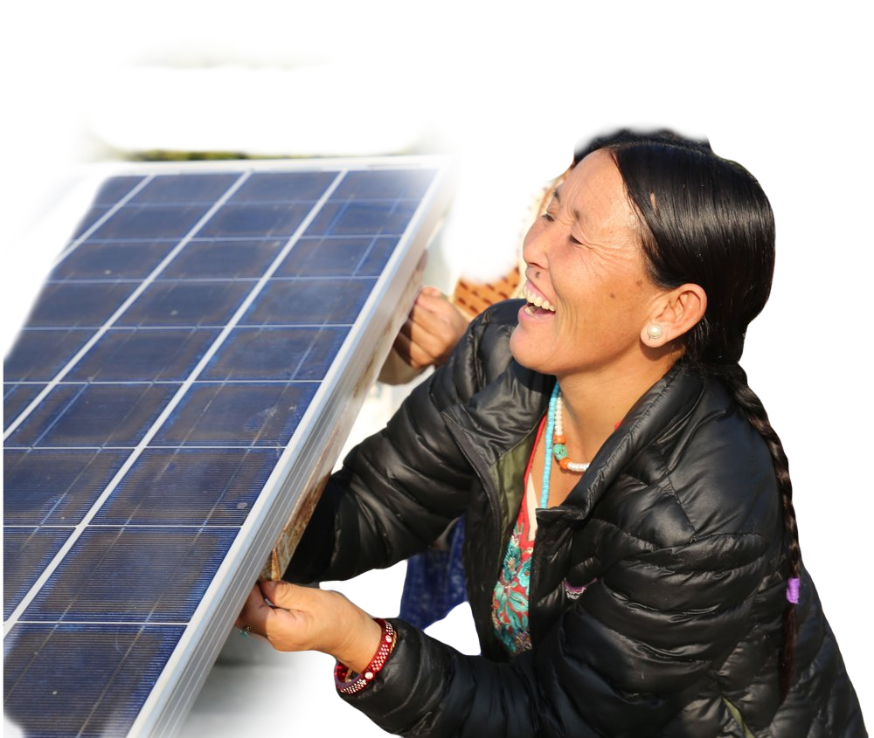
We Have Set Priorities and Goals
ESMAP’s Gender and Energy program works through 3 pillars:
Women’s Employment and Leadership
Women’s Productivity and Livelihoods
Women’s Access to Modern Energy Services

Slide 10
How do we do it?
Operational technical support.
Producing new cutting-edge knowledge and data & information.
Advocacy, and consolidation & creation of partnerships.
Special focus on SIDS countries and Women's employment in RE.
Producing new cutting-edge knowledge and data & information.
We know there are persistent knowledge gaps.
Operational technical support.
We participate as team members in lending operations.
Advocacy, and consolidation & creation of partnerships.
We know we need to collaborate.
Special focus on SIDS countries and Women's employment in RE.

Slide 11
We Ensure Quality and We deliver
Energy and Gender Mainstreaming in Bank’s Lending Operations
(FY18-FY22)

Slide 12
But… there are Challenges We Are Trying to Solve
Cultural constraints. Resources (financial and human). How to position gender a priority
Methodologic issues. Lack of data. How to be innovative.

