Slide 1
BASICS OF RENEWABLE ENERGY
Zuzana Dobrotkova

Slide 2
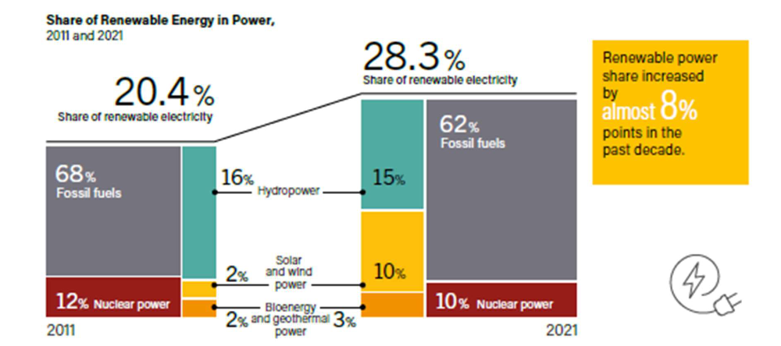
Renewable energy in global energy mix
Renewable power generation remains relatively small in the global energy mix while RE heat and RE transport are even smaller (11.2% and 3.7%)
Traditional uses of biomass represent almost half of renewable energy consumed worldwide
Source: REN21, Renewables Global Status Report 2022

Slide 3
Hydropower
The largest source of RE power, mature technology and in many countries the least costly electricity source
Reservoir plants, run-of-river installations, pumped-hydro storage
Contributing to balancing of power systems
Notes:
Hydropower is the largest renewable energy power-generation source contributing significantly to the global power-generation mix
Hydropower is a mature technology and for many countries it is the least costly power-generating source (provided they have hydro resources)
Hydropower resource remains largely unexploited in Africa and Asia
Hydropower installations are divided to 3 main categories: reservoir plants, run-of-river installations and pumped hydropower storage plants
Hydropower can in many cases a flexible power resource and can contribute to balancing of power systems

Slide 4
Wind power
Onshore installations dominate wind market, offshore developed in a few countries
Onshore wind mostly competitive with fossil fuels, offshore starting to be very affordable
The most complex RE source for grid integration
Source: Global Wind Energy Council (GWEC)
Notes:
Wind power is the largest renewable energy power-generation source after hydropower
Onshore wind is by now considered a relatively mature technology and dominates by far the wind market. Offshore installations are developed mainly in Europe and China, with relatively modest developments also in Japan and Korea
Competitiveness of onshore wind has improved significantly over the last decade and wind, in places with good resource, is becoming competitive with fossil alternatives in some countries. For example, in Brazil wind is beating gas in capacity auctions for new power plants. (Details on competitiveness to follow in a later slide)

Slide 5
Solar Photovoltaics
Rapid growth in the last few years
Highest modularity between technologies: from solar lanterns to utility-scale plants
Most “democratic” technology: small-scale systems within reach of individuals, communities, small businesses, etc.
Notes:
Solar PV is the fastest growing renewable power technology
It’s a highly modular technology, size varies from solar lanterns to large utility-scale plants
It’s the most “democratic” technology: small-scale systems within reach of individuals, communities, small businesses, etc.

Slide 6
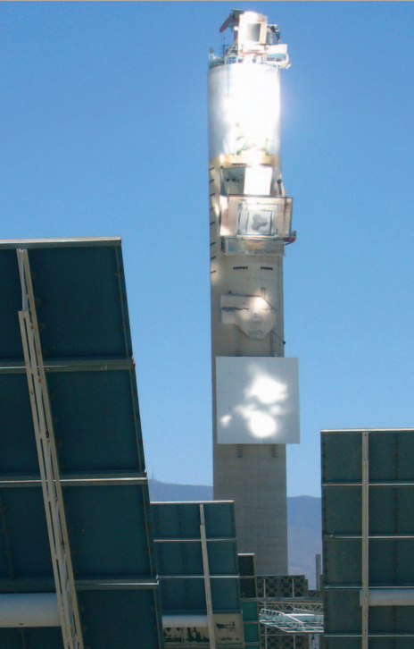
Solar thermal electricity
Produced in concentrating solar power (CSP) plants
Technology well known but in early stage of deployment
Storage capabilities ensure excellent complementarity with wind and solar PV
Possibility of hybridization with fossil fuels
Notes:
Solar thermal electricity is generated in concentrating solar power (CSP) plants
Technology well known but in early stage of deployment
Storage capabilities ensure excellent complementarity with wind and solar PV
Possibility of hybridization with fossil fuels (gas, coal) as a booster

Slide 7
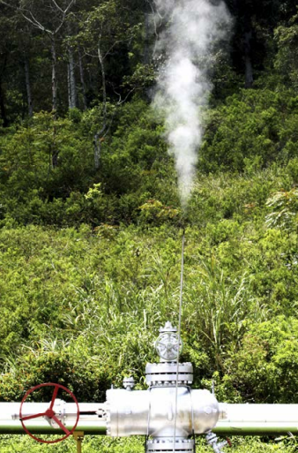
Geothermal Electricity
Mature technology providing low-cost baseload power
High-temperature geothermal resources are available only in some regions of the world
Resource risk (exploration) is capital intensive and represents the biggest challenge for development
Source: ESMAP
Notes:
Geothermal is a mature technology that can provide low-cost baseload power. First use of geothermal steam for electricity started over 100 years ago in Italy.
The exploitable geothermal energy potential in several parts of the world is far greater than the current utilization
However, high-temperature geothermal resources are available only in some regions of the world (estimates are that geothermal resources in the form of hot steam or fluids are only available on 1/4 to 1/3 of the planet’s surface)
Resource risk (exploration) is capital intensive and represents the biggest challenge for development

Slide 8
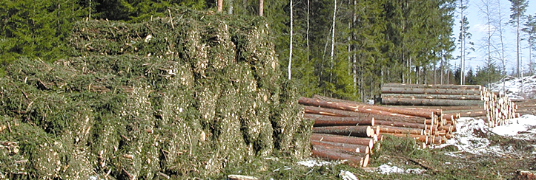
Bioenergy-based electricity
Many technologies available using diverse feedstocks
Rapid development since 2000
Most projects are of smaller size (10-50MW) and operate in co-generation mode
Notes:
Bioenergy is the largest source of renewable energy today and can provide heat, electricity, as well as transport fuels.
For power-generation many technologies available using diverse feedstocks
Bioenergy power markets have experienced a rapid evolution since 2000, reaching some 104GW globally by the end of 2015.
Most projects are of smaller size (10-50MW) and operate in co-generation mode (producing power and heat). Larger projects typically use internationally traded feedstocks like wood pellets and require large systems for storing and handling of the feedstock
In recent years, a number of utilities have invested in biomass power generation, in particular in the form of co-firing, where a share of biomass is co-fed into a coal-fired power plant. Co-firing offers a transition towards bioenergy-only generation, particularly in markets moving away from coal-fired generation.

Slide 9
Ocean Energy
Resource potential is significant and widespread
Current global market a little above 0.5GW, concentrated in a few countries
Largest installations are tidal barrages that are considered environmentally controversial
Notes:
Ocean energy is considered the least mature of RE technologies
Resource potential for ocean technologies is significant and widespread
Current global market a little above 0.5GW, concentrated in a few countries
Largest installations are a few tidal barrages (in France, Korea and Canada) that are considered environmentally controversial (due to the building of barrages across bays or estuaries)

Slide 10
Comparison of RE technologies
Technologies differ in:
Resource availability
Suitability for different climates
Suitability for the given power system
Maturity of technologies
Initial and lifetime costs
Grid-integration aspects
Environmental impacts
Social impacts
Notes:
The choice of deployment of a particular renewable energy technology depends on an interplay between multiple parameters:
Resource availability
Suitability for the given climate
Suitability for the given power system
Maturity of technologies
Initial and lifetime costs
Grid-integration aspects
Environmental impacts
Social impacts

Slide 11
Variability of solar, wind and ocean
Individual solar PV plants show rapid output fluctuations (variability) but aggregation over several sites some fluctuations cancel out (as weather front moves across country).

Slide 12
Flexibility is the key to dealing with variability
Conventional power system
Sources of flexibility:
Flexible power generators (gas, hydro)
Interconnections
Energy storage
Demand response
Variable renewables

Slide 13
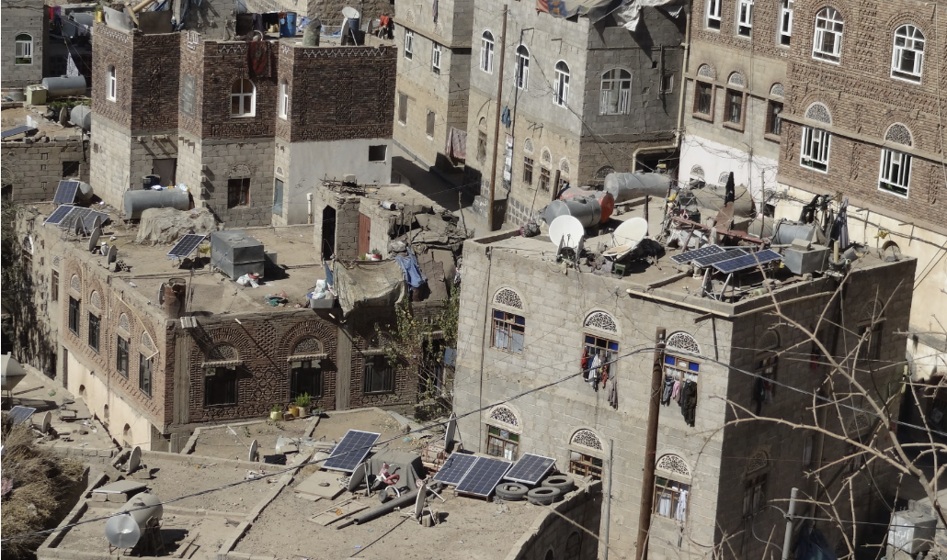
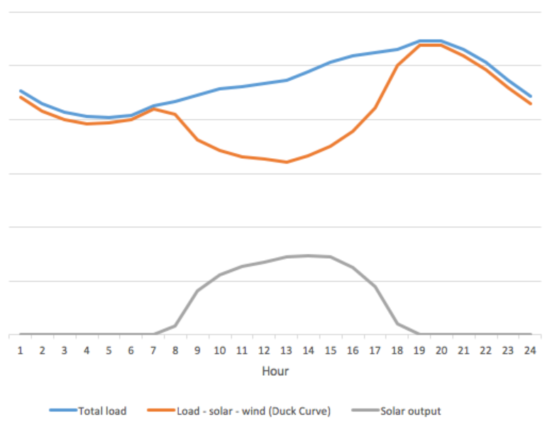
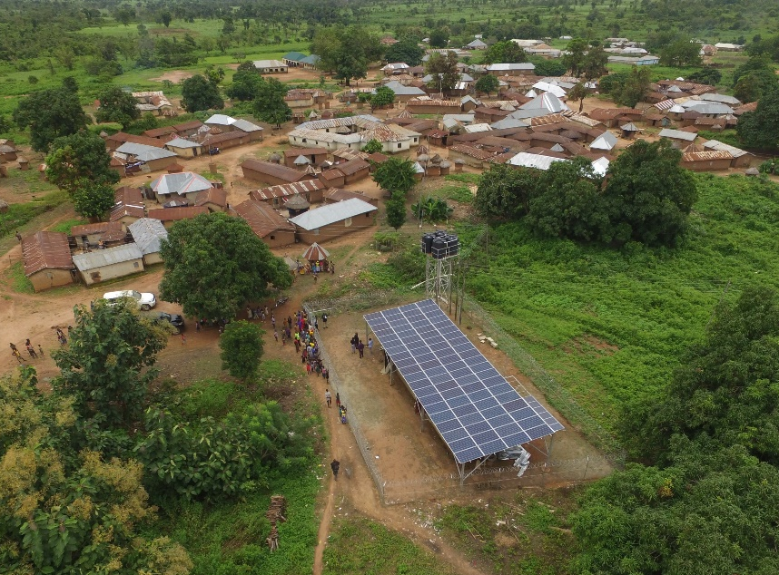
Distributed solar is coming and needs managing
“Duck curve” shape of net system load

Slide 14
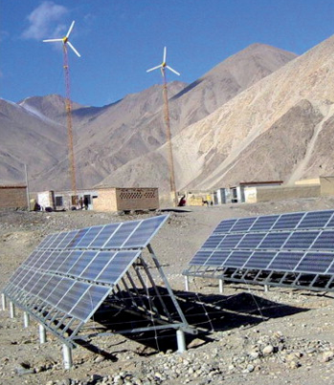
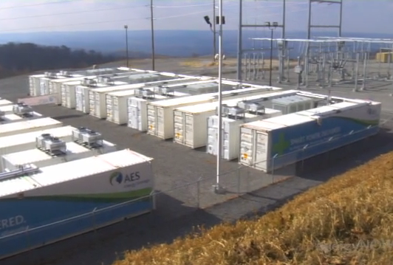
Hybrid systems, including storage
Increased deployment in developed and developing countries
Combination of resources brings less variable power and often better prices
Combination with energy storage (through Energy Management Systems) can bring stable power and cover evening peaks that occur in many countries

Slide 15
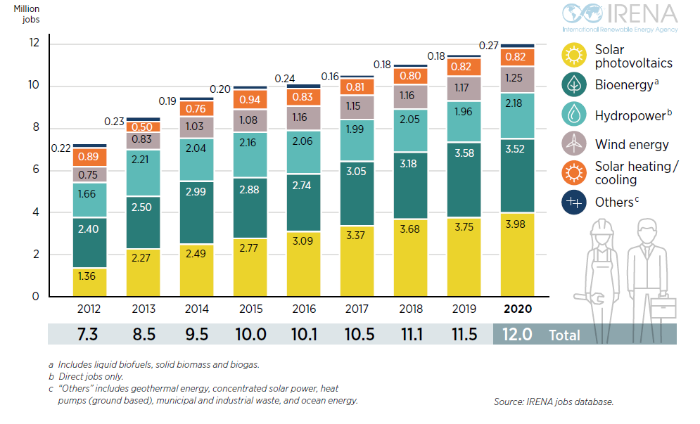
Social impacts - job creation
Renewable energy sector has become a significant employer
Source: IRENA, Renewable Energy and Jobs – Annual review 2021,
Notes:
RE technologies are often considered to have more positive social impacts than fossil fuels – while little research has been done on the topic early indications are that the involvement of local communities in RE production tends to be higher than for fossils and RE technologies produce more jobs per MW installed than fossil fuels, however, job-creation estimates vary widely (due to local factors as well lack of established methodologies for measurement of job-creation factors)

Slide 16
Selected World Bank projects

Slide 17
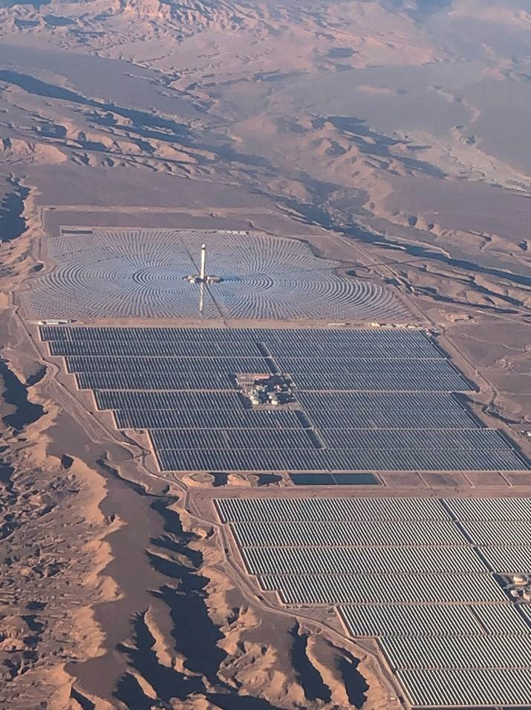
Morocco – Noor Ouarzazate complex
3 CSP plants + PV plant
Developed over a decade, with several MDBs support
Under the vision of the King of Morocco for development of local RE resources and local industry and job creation
Lessons now applied to Midelt complex – a hybrid plant, also supported by the WB

Slide 18
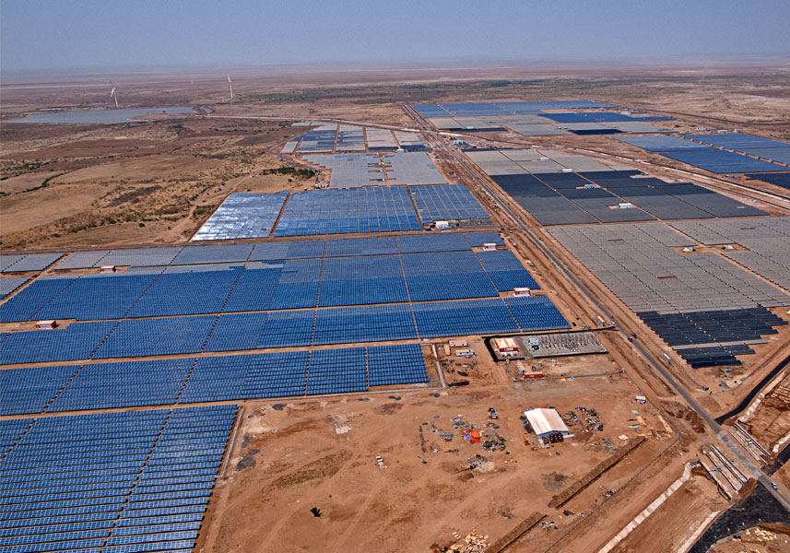
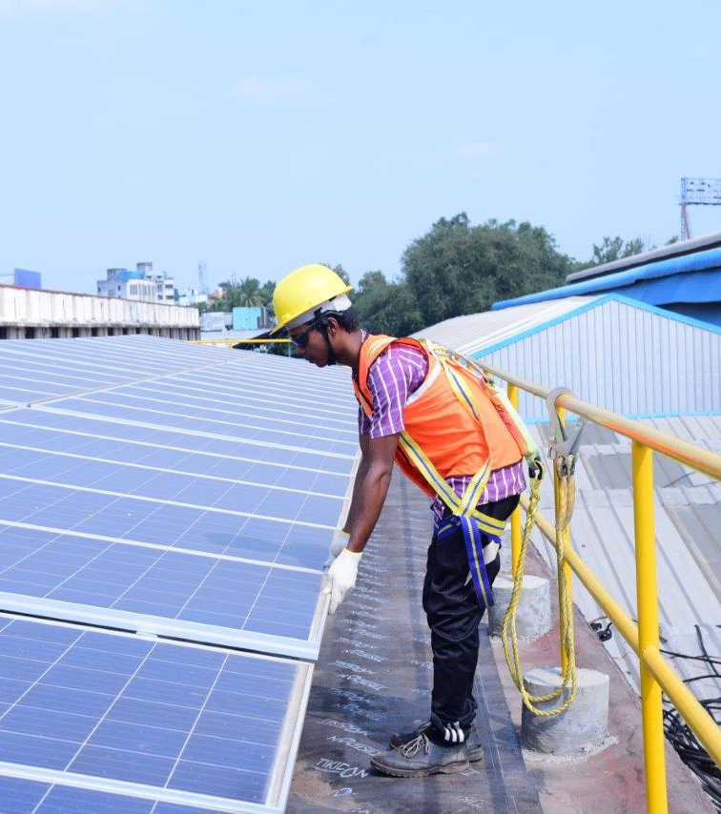
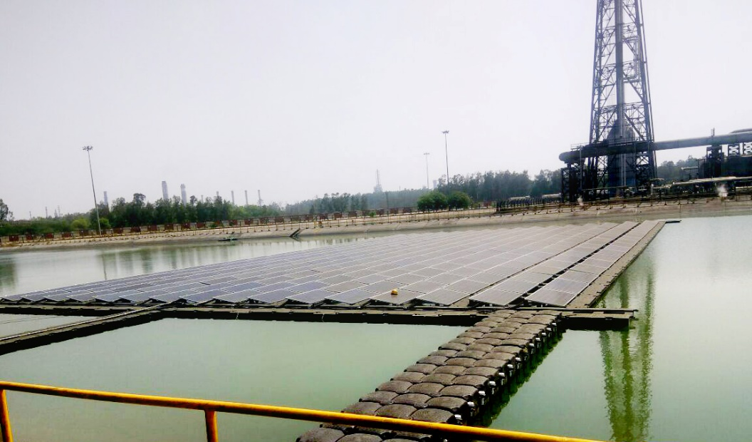
India – rooftops, solar parks, hybrids, floating solar

Slide 19
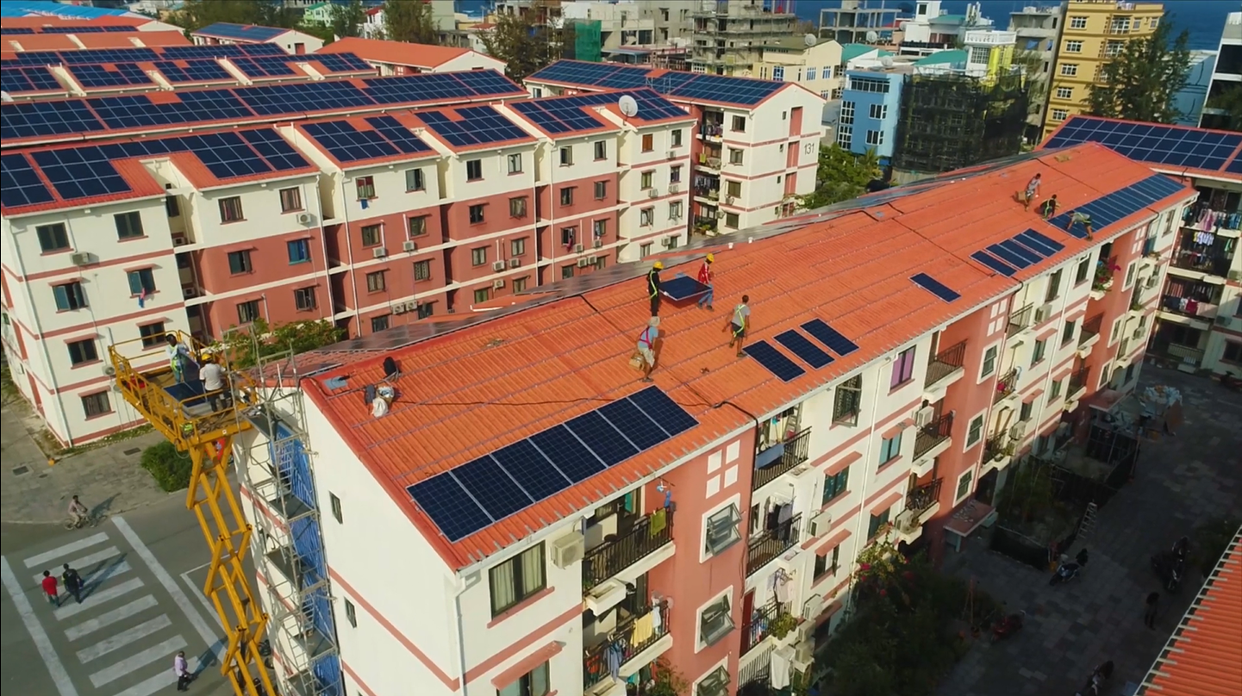
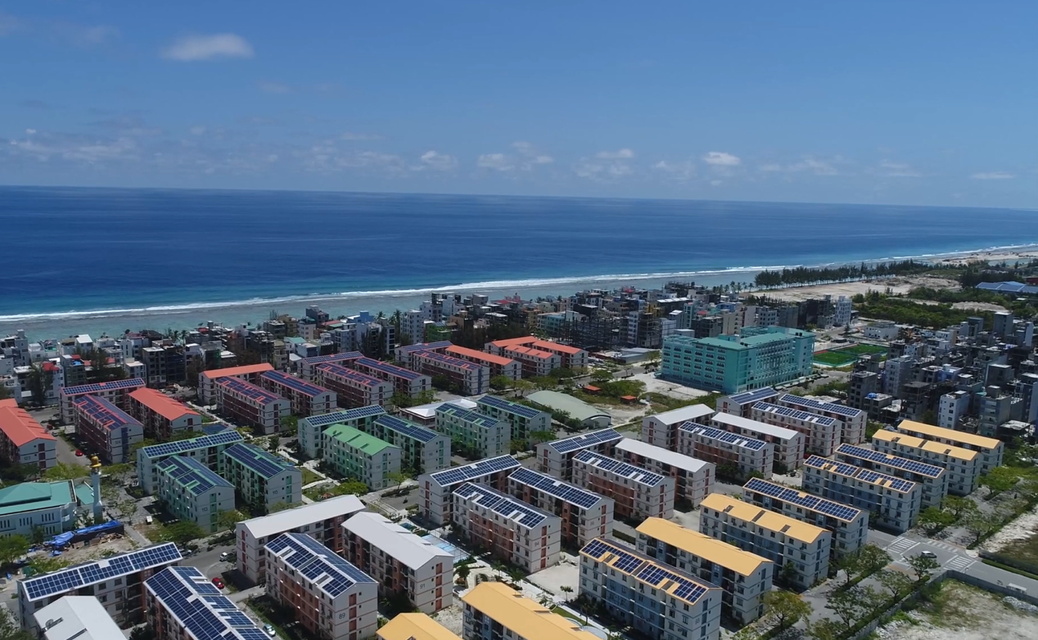
Maldives – rooftop and floating solar, batteries, EVs

