Slide 1
Are women ‘forced’ to work closer to home?
Gender, Travel and Employment Accessibility in Buenos Aires.
Tatiana Peralta Quirós
Shomik Mehndiratta, Catalina Ochoa

Slide 3
Initial Analysis

Slide 4
Modal Split
Women
Women
Men
Men
All
With Children

Slide 5
Time of Day

Slide 6
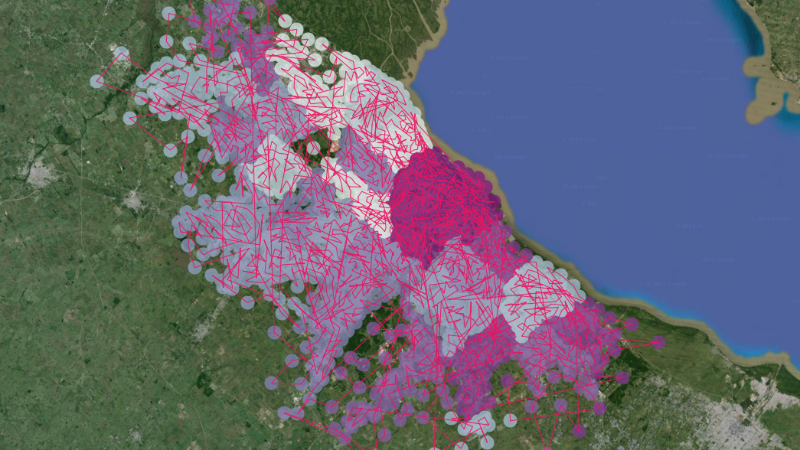
Geo-Reference OD

Slide 7
Including Spatial Component – Work Trips
 | Average Time (min) | Average Distance (km) | Average Speed (km/hr.)
Women w/o Children | 45.3 | 7.50 | 9.92
Men w/o Children | 43.3 | 8.67 | 12.01
Women w/ Children | 47.7 | 7.92 | 9.98
Men w/ Children | 48.7 | 9.96 | 12.27

Slide 8
Accessibility

Slide 9
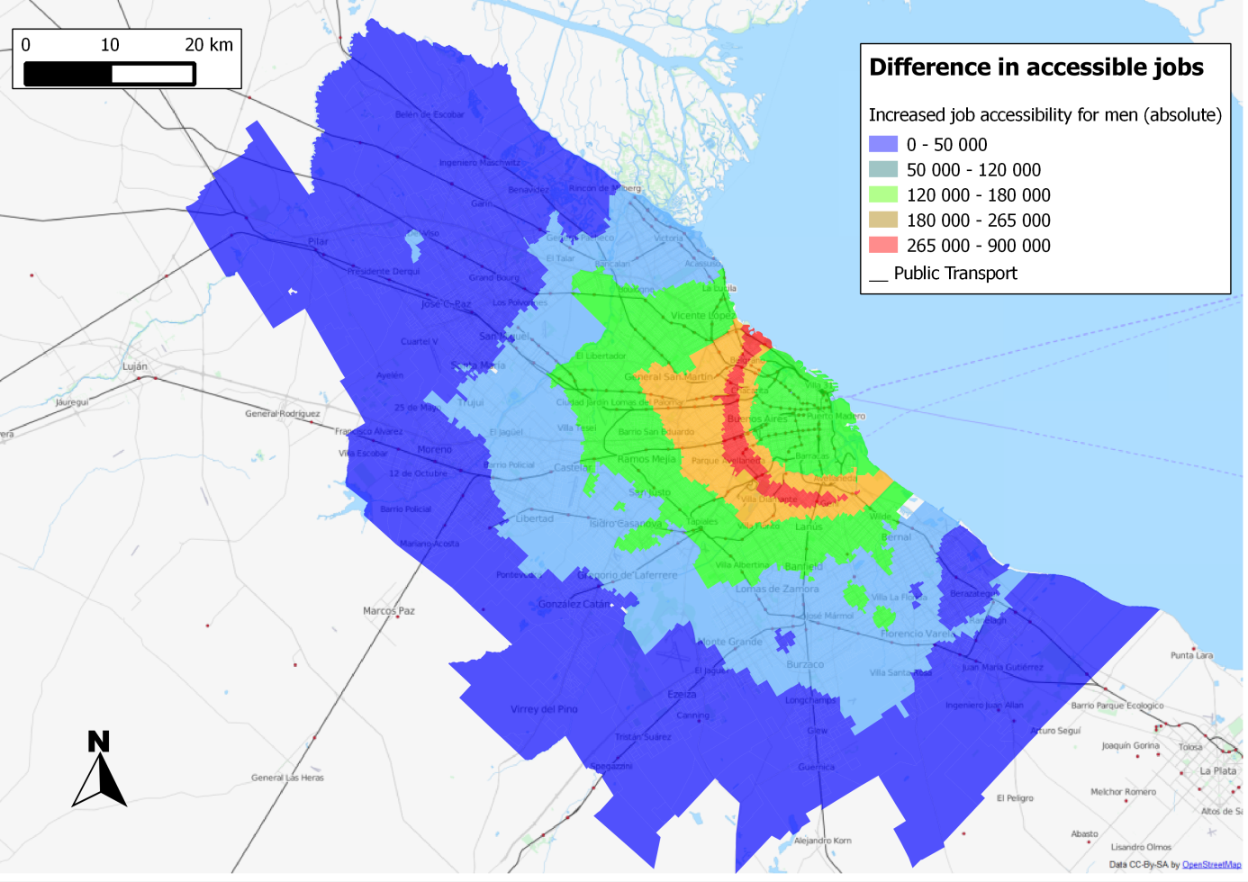
Accessibility

Slide 10
Accessibility
18%
10%

Slide 11
Sao Paulo
 |  | Time | Distance | Speed (km/hr)
Working | Woman without children | 46 | 6.44 | 8.33
 | Men without children | 43 | 7.08 | 9.90
 | Woman with children | 48 | 6.95 | 8.74
 | Men with children | 46 | 8.19 | 10.58
Not Working | Woman without children | 36 | 4.65 | 7.72
 | Men without children | 32 | 4.37 | 8.17
 | Woman with children | 28 | 3.23 | 6.95
 | Men with children | 27 | 3.25 | 7.17

Slide 12
Moving Forward
Understand the reasons underlying the different travel behavior and if it really is a disadvantage or result of choice
Characterize the manner in which and the degree to which the complexity of women’s travel needs constrain their labor market choices. A combination of qualitative, time-series and quantitative methods could help to both confirm and understand the causality underlying the findings of smaller commute-shed for women.
Gender informed surveys.

Slide 13
Policy Implications
First, the degree to which mobility systems can be adapted more to diverse travel needs and the needs of women – in terms of providing higher quality of mobility off-peak/off-trunk routes
Addressing constraints posed by non-work travel needs
The role that cars may be playing in lowering gender-related constraints.
Develop an evaluation framework that allows both for assessing the social and economic cost of gender-oriented mobility constraints

