Slide 1
SDN Week - Low Cost ICT Solutions for Transportation Planning and Management
Evaluation of Urumqi PT ITS System
Future Challenges
Lessons Learned
Bank Financed ITS Projects
ITS Lessons from China
Zong Yan, Transport Specialist,
WB Beijing Office

Slide 2
Urban Transport Projects with ITS Component
Bank Financed ITS Projects
Evaluation of Urumqi PT ITS System
Future Challenges
Lessons Learned
Completed ATC Projects | Shanghai Guangzhou Liaoning (Shenyang/Fushun) Urumqi Shijiazhuang Wuhan Tianjin
Completed Public Transport ITS | Guangzhou Urumqi Wuhan
On-going ATC Projects | Liaoning (Panjin, Jinzhou, Fushun, Benxi, Liaoyang) Fuzhou Taiyuan Changzhi Yining Xi’an Xiangyang
On-going Public Transport ITS | Taiyuan Xiangyang Yining Changzhi
Pipeline PT ITS | Harbin Mudanjiang

Slide 3
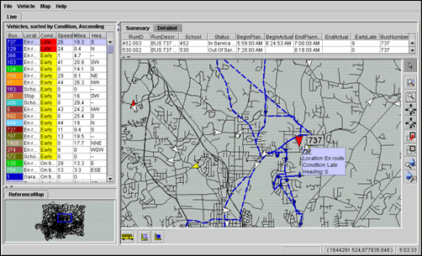
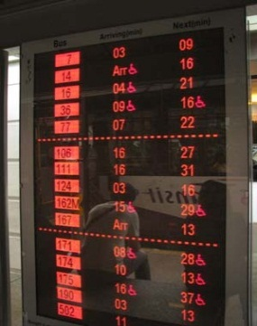
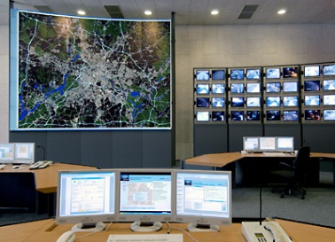
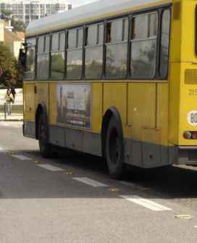
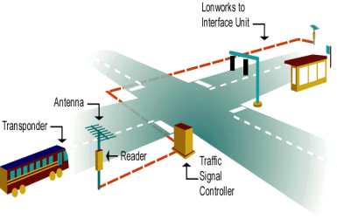
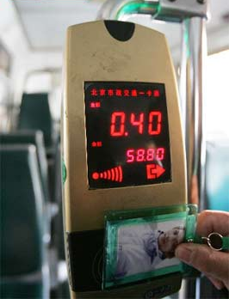
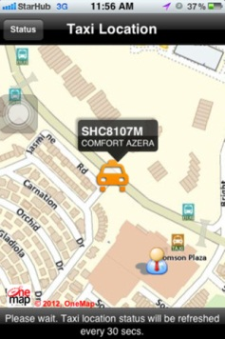
Typical ITS Applications
Bank Financed ITS Projects
Evaluation for Urumqi Transit System
Future Challenges
Lessons Learned
ITS
Automatic Vehicle Location
Traffic Signal Priority
Fare Collection Systems
Automatic Passenger Counting
Computer-aided Dispatch
Dynamic Lane Control
Real-time Travel Information
Area Traffic Control
etc…

Slide 4
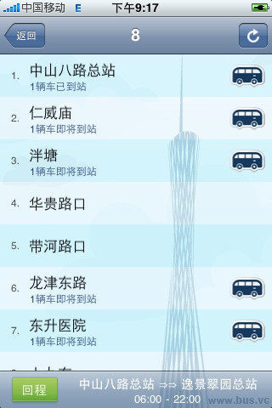
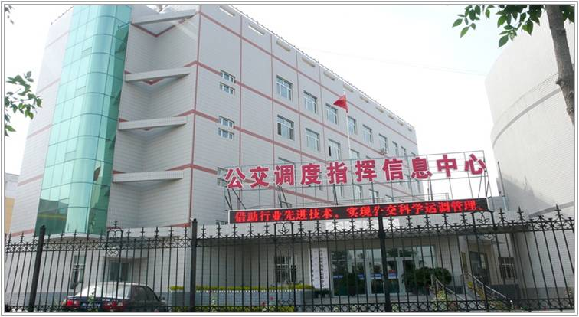
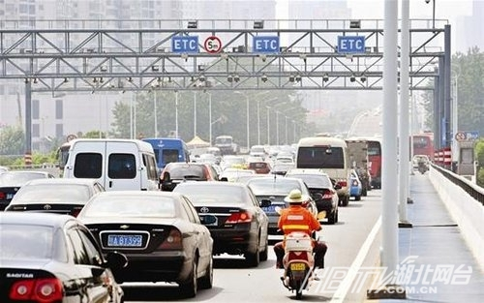
ITS in GZ, Urumqi, and Wuhan
Bank Financed ITS Projects
Evaluation of Urumqi PT ITS System
Future Challenges
Lessons Learned
Urumqi Bus Dispatching Information Center
Mobile App for Guangzhou Real-time Bus Info
Wuhan ETC

Slide 5
ITS in GZ, Urumqi, and Wuhan
Bank Financed ITS Projects
Evaluation of Urumqi PT ITS System
Future Challenges
Lessons Learned
 | Guangzhou | Urumqi | Wuhan
ATC. Intersections (financed by the bank) | 300 | 139 | 426
ATC (current total) | About 800 | 356 | 426
# Buses with GPS (financed by the bank) | 1414 | 289 | 700
# Buses with GPS (current total) | About 10,000 | 2442 | About 10,000

Slide 6
ITS in GZ, Urumqi, and Wuhan
Bank Financed ITS Projects
Evaluation of Urumqi PT ITS System
Future Challenges
Lessons Learned
 | Guangzhou | Urumqi | Wuhan
ATC. Intersections (financed by the bank) | 300 | 139 | 426
ATC (current total) | About 800 | 356 | 426
# Buses with GPS (financed by the bank) | 1414 | 289 | 700
# Buses with GPS (current total) | About 10,000 | 2442 | About 10,000

Slide 7
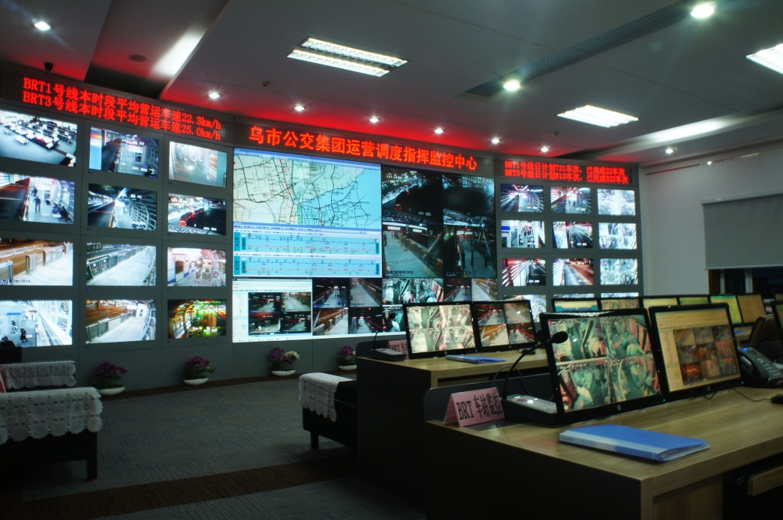
Bank Financed ITS Projects
Evaluation of Urumqi PT ITS System
Future Challenges
Lessons Learned
Major Achievements: Urumqi
Transformed concept into practical, operating system in daily use
Reduced PT fatalities (10 in 2008 1 in 2012)
Reduced PT fuel consumption, operating costs

Slide 8
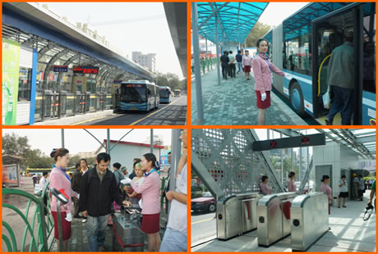
Bank Financed ITS Projects
Evaluation of Urumqi PT ITS System
Future Challenges
Lessons Learned
Increased bus passenger volume, from 200,00/day (2008) to 450,000 (2012)

Slide 9
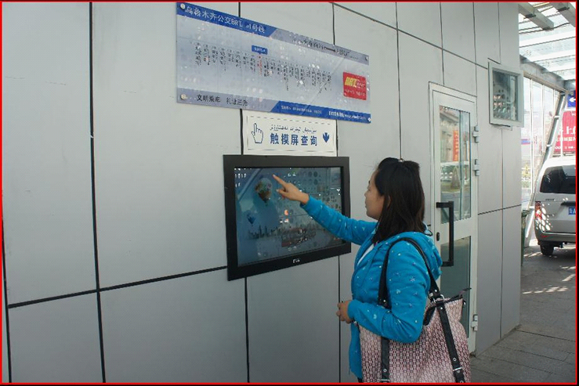
Bank Financed ITS Projects
Evaluation of Urumqi PT ITS System
Future Challenges
Lessons Learned
Significantly improved customer satisfaction

Slide 10
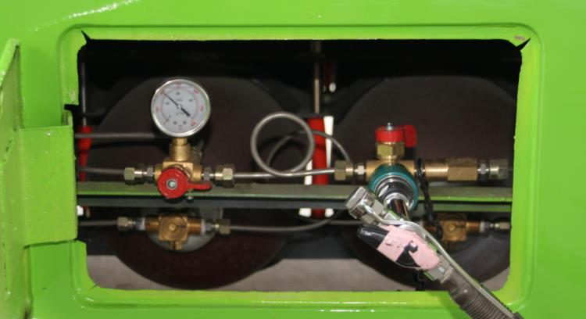
Bank Financed ITS Projects
Evaluation of Urumqi PT ITS System
Future Challenges
Lessons Learned
Energy Efficiency | Before (2008) | After (2012) | Reduction
Fuel (NG) consumption | 35m3 per bus per 100km | 31.8m3 per bus per 100km | 9 % reduction

Slide 11
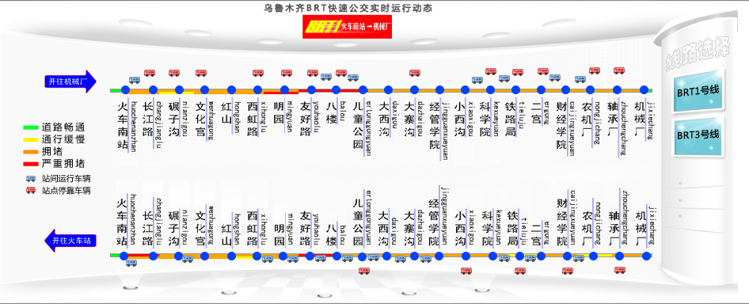
Bank Financed ITS Projects
Evaluation of Urumqi PT ITS System
Future Challenges
Lessons Learned
Operating Efficiency | Before (2008) | After (2012) | Reduction
Number of buses required for service level | 2298 buses, 71 routes | 2096 buses, 71 routes | 9 % reduction

Slide 12
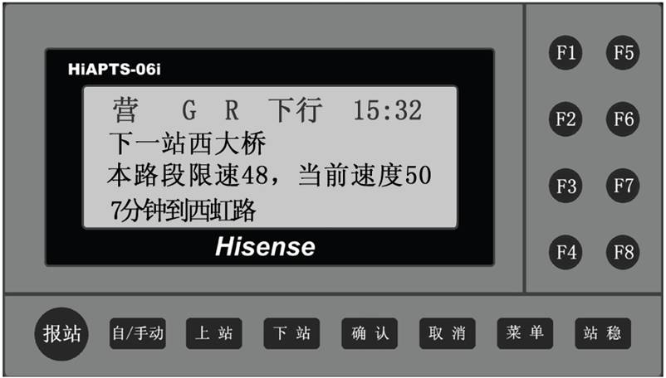
Bank Financed ITS Projects
Evaluation of Urumqi PT ITS System
Future Challenges
Lessons Learned
Operating Efficiency | Before (2008) | After (2012) | Reduction
Deadhead km | 60km per bus per day |  | 19% reduction

Slide 13
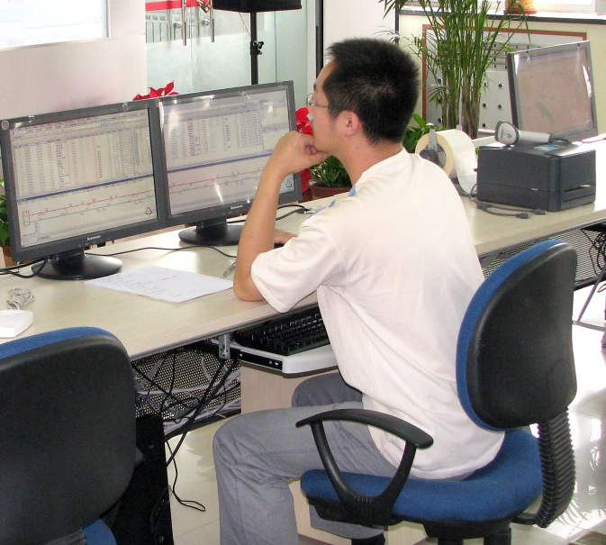
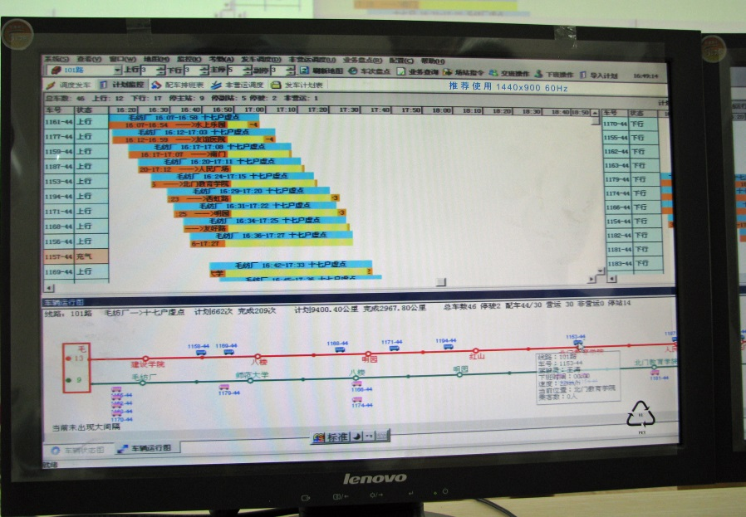
Bank Financed ITS Projects
Evaluation of Urumqi PT ITS System
Future Challenges
Lessons Learned
Operating Efficiency | Before (2008) | After (2012) | Reduction
Staff | 248 dispatching staff | 120 staff | 52% reduction

Slide 14
Bank Financed ITS Projects
Evaluation of Urumqi PT ITS System
Future Challenges
Lessons Learned
Public Transport ITS Success Requires:
Transformation of way customer services are provided and related business practices and processes

Slide 15
Bank Financed ITS Projects
Evaluation of Urumqi PT ITS System
Future Challenges
Lessons Learned
Public Transport ITS Success Requires:
Strong leadership engagement and dedicated, technically qualified staff

Slide 16
Bank Financed ITS Projects
Evaluation of Urumqi PT ITS System
Future Challenges
Lessons Learned
Public Transport ITS Success Requires:
Strong, formalized inter-agency cooperation and coordination, e.g., between traffic police and PT companies

Slide 17
Bank Financed ITS Projects
Evaluation of Urumqi PT ITS System
Future Challenges
Lessons Learned
Other Lessons:
Start with pilot

Slide 18
Bank Financed ITS Projects
Evaluation of Urumqi PT ITS System
Future Challenges
Lessons Learned
Other Lessons:
Train staff at all levels at all system development stages

Slide 19
Bank Financed ITS Projects
Evaluation of Urumqi PT ITS System
Future Challenges
Lessons Learned
Other Lessons:
Provide adequate budget for ongoing operating and maintenance costs

Slide 20
Bank Financed ITS Projects
Evaluation of Urumqi PT ITS System
Future Challenges
Lessons Learned
Other Lessons:
Put into place post-implementation monitoring and analysis process to make use of enhanced data

Slide 21
THANK YOU!

