Slide 1
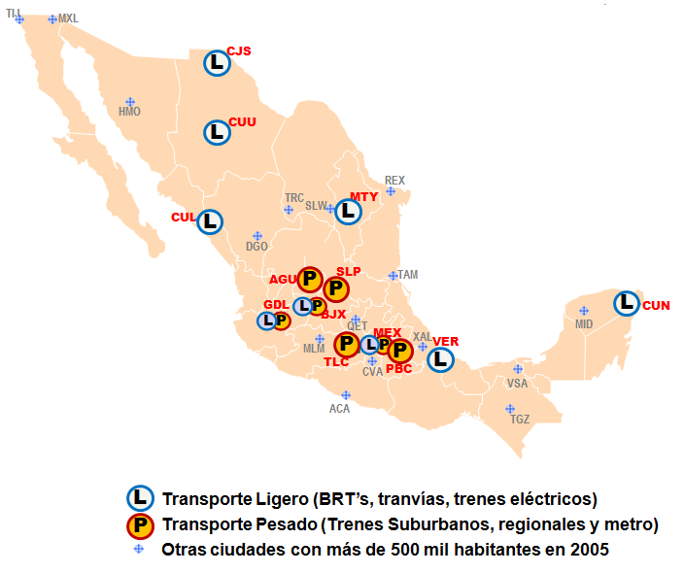
Mexico: from the PROTRAM to a Federal Urban Transport Policy
lessons learned from national urban transport programs
SDN forum 2013

Slide 2
Modal split by type of city

Slide 3
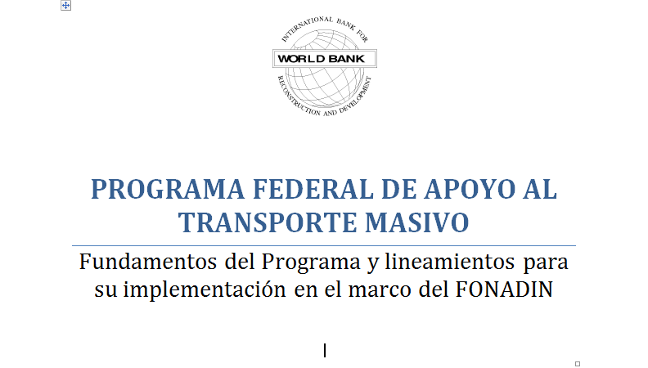
Precedents: FONADIN
Urban transport not a federal responsibility
Government of Mexico hired the World Bank to structure a Federal Mass Transit Support Program through a Fee Based Service (FBS)

Slide 4
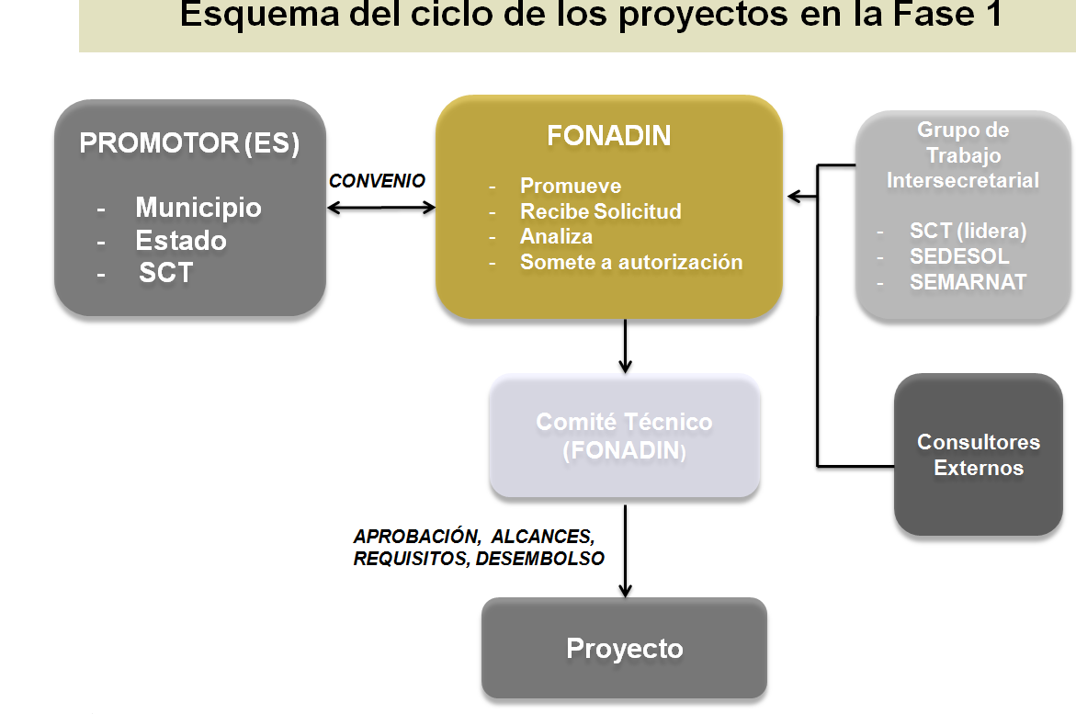
PROTRAM – Gives a Role to Federal Government
World Bank FBS designed the Federal Mass Transit Support Program, PROTRAM, within FONADIN and its rules
FONADIN provides up to 50% financing
FONADIN requires private sector to finance 35% of the project costs

Slide 5
PROTRAM – results
9 BRT projects under implementation
More than 30 in preparation
Compliance with World Bank safeguards
World Bank has Urban Transport Transformation Project to complement financing

Slide 6
Second FBS/RAS
Federal government interested in creating a Federal Urban Transport Policy
PROTRAM is a mechanism not a policy
FBS/RAS currently under development

Slide 7
Contents of study
1. Current situation of UT in Mexico
2. Challenges a FUTP must tackle
3. The pillars of a FUTP
4White Paper
5. Implementation guidelines
ANEXO I – White paper
ANEXO II – International experience and lesons
ANEXO III – legal aspects
ANEXO IV – Data base

