Slide 1
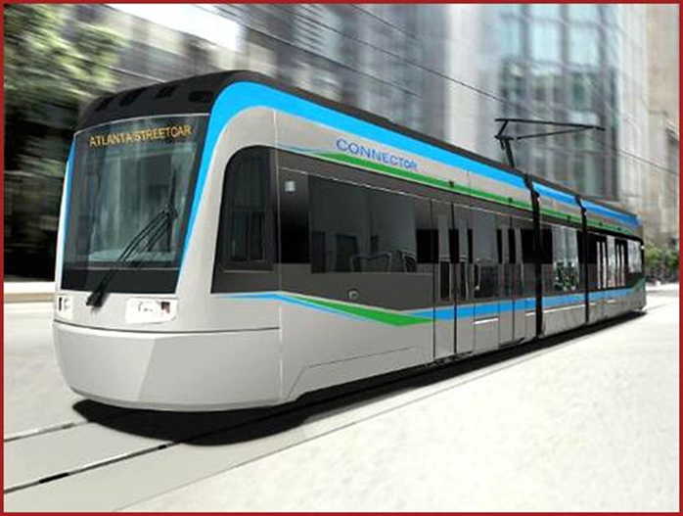
Public Transport Development in the US: The Federal Role Sean Gordon Libberton Director, FTA Office of Capital Project Initiatives World Bank March 7, 2013

Slide 2
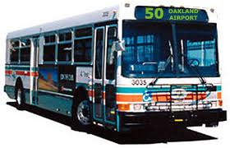
Public Transport in the US
10.4 billion annual trips, 55.2 billion passenger miles
New York City MTA 3.2 B trips, 11.9 B miles
7,200 local/regional systems
80 rail systems
Annual Capital Investment: $18.2 B
Annual Operating Costs: $38.9 B

Slide 3
Federal Transit Administration
Modal agency within USDOT
Established in 1964
Grant-making, research, technical assistance
500 employees in Washington DC and 13 Field Offices

Slide 4
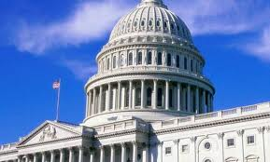
Federal Transit Administration
Authority granted by Congress (MAP-21 in effect beginning October 2012 thru September 2014)
$10.5 B annual program
Mostly capital
Limited funds for operations
Small program for regional transport planning
Formula funding from Highway Trust Fund (80%)
Discretionary programs from General Revenues (20%)
Typical 80/20 - Fed/Local Share
Except Most Major Capital Projects

Slide 5
Major Capital Project Development
“New Starts” Program
$2 B annual discretionary program
Funds “fixed guideway” transit – rail and bus
Specific project development and FTA approval process to qualify; overmatch essential
Highly Competitive
Over 30 projects in engineering and design
Total estimated cost = $27 B, New Starts demand = $13 B

Slide 6
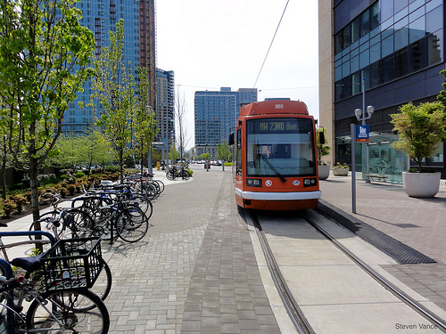
Federal Interest/Initiatives in Public Transport
Ensure stewardship of Federal tax-payer dollars
Ensure compliance with Federal law
Civil Rights/ADA
Buy America
Safety
Promote national policy objectives
Provide improved – and safe - mobility and transportation choices for all Americans
Foster economic development and job creation
Improve air quality, preserve the environment, conserve energy
Create livable and “sustainable” communities
Delivering effective and consistent oversight
“Streamlining” project development
Ensuring a “State of Good Repair”

