Slide 1
Rapidly Evolving Urban Transport in China
Roles of
National Government
local government
and the World Bank
SDN Week 2013, Washington DC

Slide 2
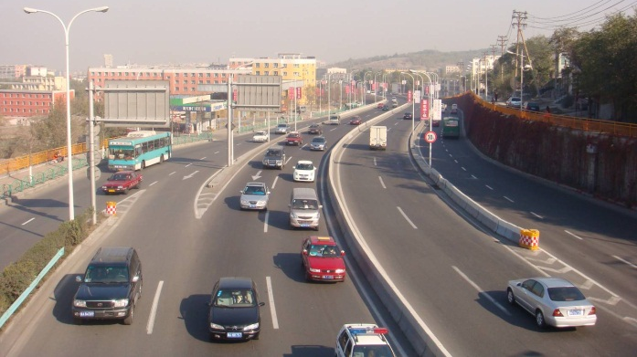
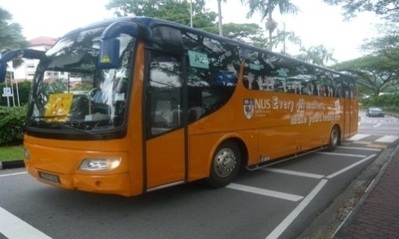
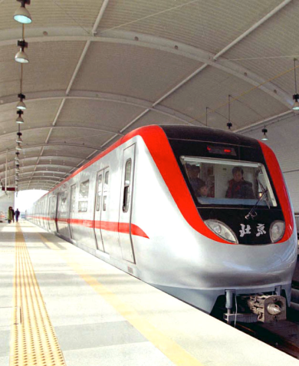
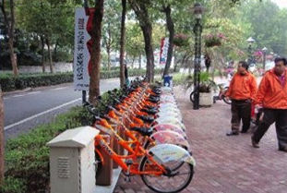
Urban Transport in China
- Evolving agenda:
1990s
- 2000s
GDP-driven:
Construction of road infrastructure for economic growth
2005
- 2011
Inclusive Development-
Public Transport Infrastructure
2011 -
Promoting Transit
Metropolis:
Comprehensive improvements
Notes:
During 1990's and early 2000s, chinese cities focused on building roads/expressways to accelerate economic growth. The second phase started in 2005 when many cities—especially large cities started to invest heavily in public transport, buying new buses, and constructing metro rail systems. The third phase came in recently, many cities started to use various measures to combat congestion, not only looking at public transport, but also promoting bicycle, TDM approaches, such as increasing parking fees, restricting car registrations and car use in city centers, and widely use of intelligent transport systems, and ICT technology in transport, so on and so forth.

Slide 3
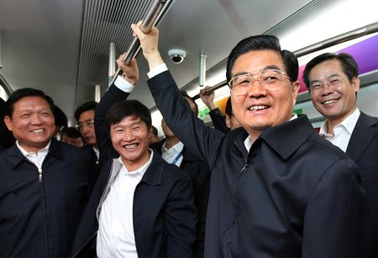
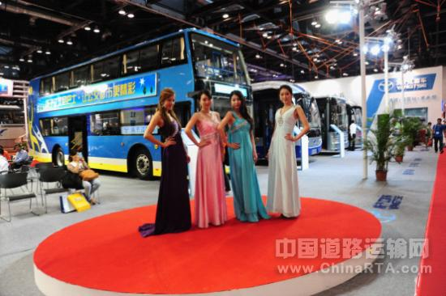
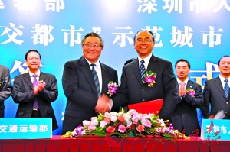
National Government
Providing Strategic Guidance
1990s
- 2000s
Economic Growth:
Construction of road infrastructure for economic growth
2005
- 2011
Inclusive Development-
State Decree 2005 [46]:
Public Transport Infrastructure
2011 -
Promoting Transit
Metropolis:
Comprehensive improvements
Notes:
During 1990's and early 2000s, chinese cities focused on building roads/expressways to accelerate economic growth. The second phase started in 2005 when many cities—especially large cities started to invest heavily in public transport, buying new buses, and constructing metro rail systems. The third phase came in recently, many cities started to use various measures to combat congestion, not only looking at public transport, but also promoting bicycle, TDM approaches, such as increasing parking fees, restricting car registrations and car use in city centers, and widely use of intelligent transport systems, and ICT technology in transport, so on and so forth.

Slide 4
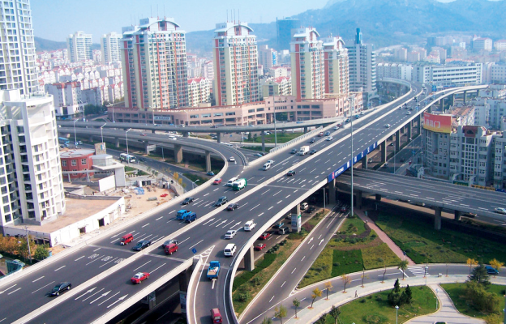
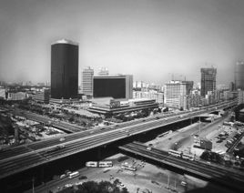
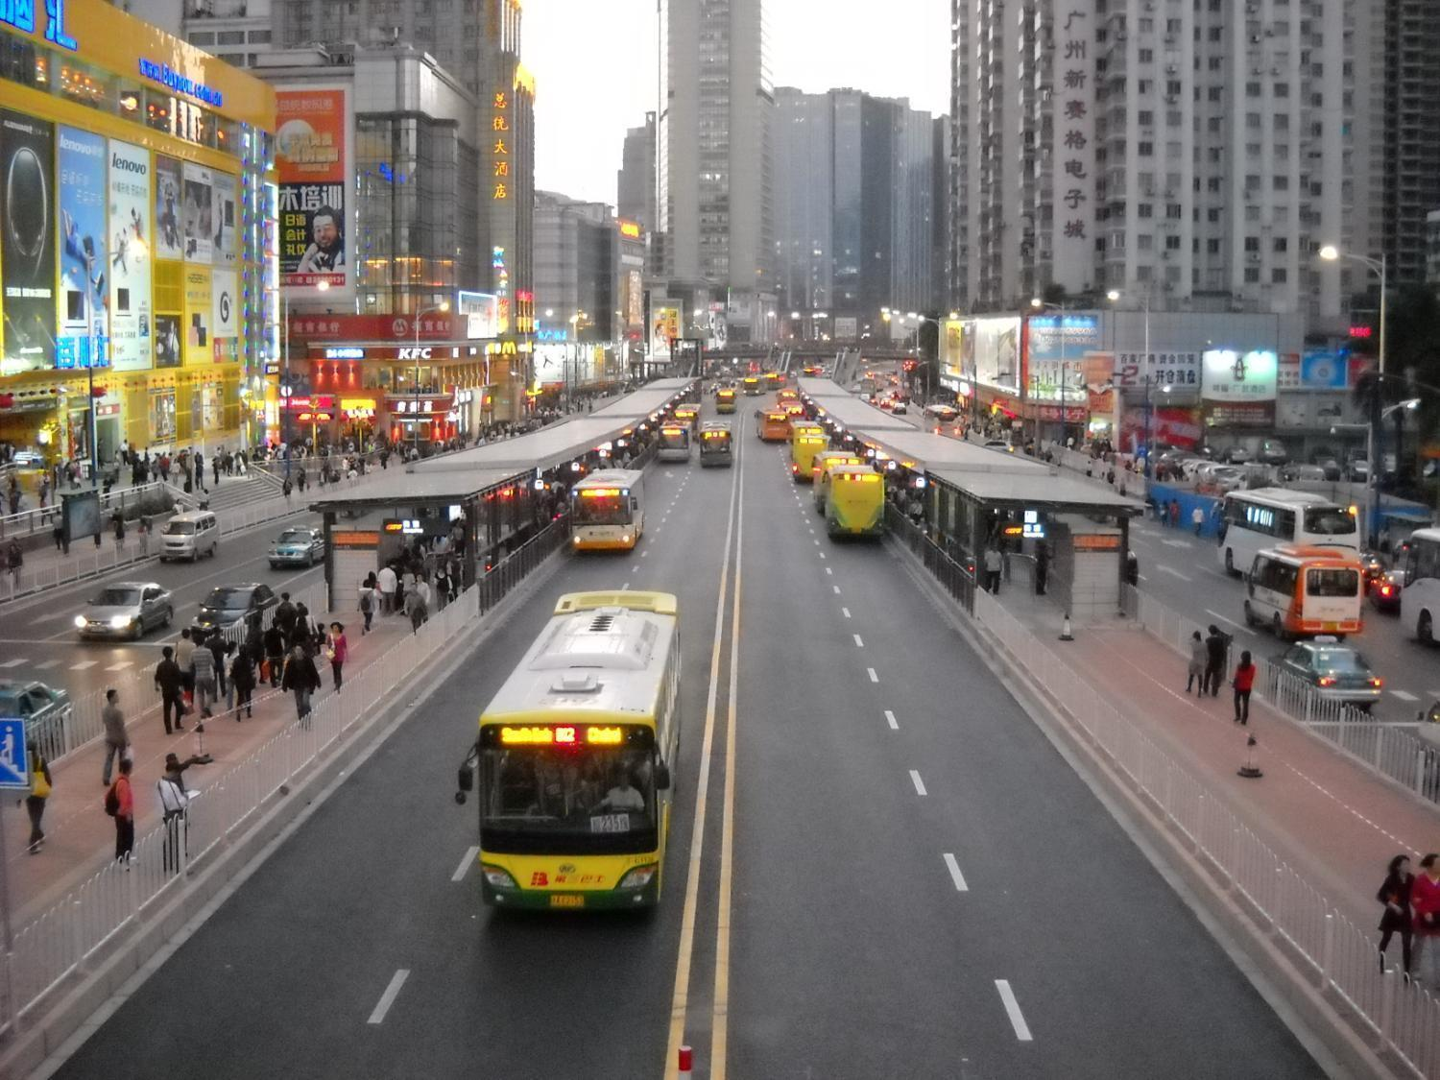
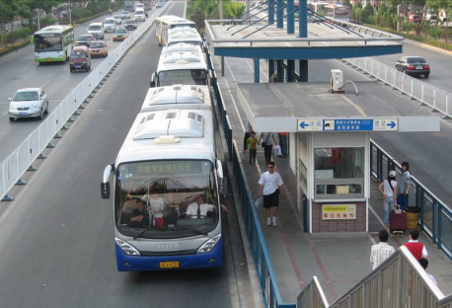
Local Government
- Manage implementation with own resources
Looking up to National Guidance / Criteria
Proactive Risk Taking and
Innovation
Peer Learning and
Emulating Large Cities
Notes:
Under Chinese decentralization system, planning and implementation of urban transport development is the responsibility of municipal governments. Three interesting phenomenon have been observed:first, cities are very sensitive to national policy guidance. This is quite obvious, mayors cannot get promotion if they don’t follow national guidance. But national policy guidances oftentimes only set up goals and objectives, they don’t tell cities what they should do and how to do it. This led to two other interesting phenomenon. On one side, cities watch each other , try to mimic/copy each other, particularly emulate those large cities. I will quickly show you some examples. and on the other side,
cities had to decide how to do things by themselves with their own money and thus have to take risks and be innovative.

Slide 5
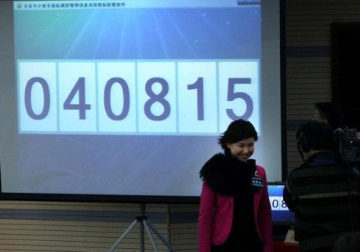
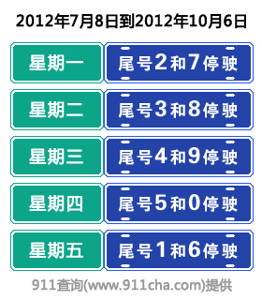
Risk-taking and Innovation by cities
Shanghai’s Car License Auction
Beijing’s License Lottery + Restriction of Car Use by Plate Numbers

Slide 6
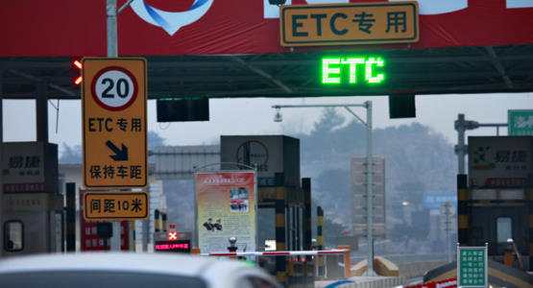
Risk-taking and Innovation by cities
Wuhan: ETC

Slide 7
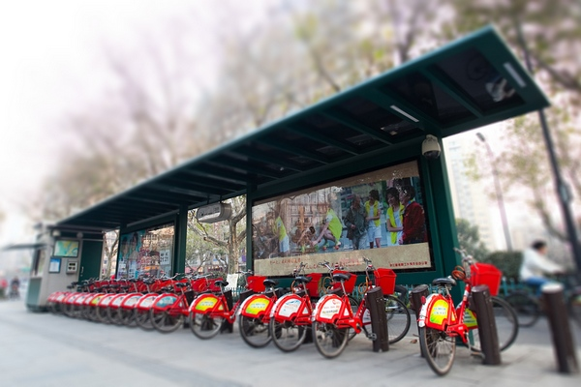
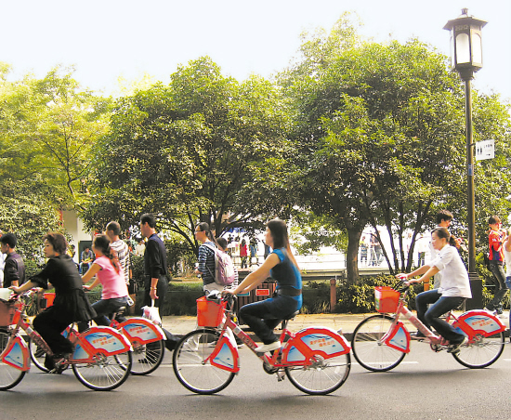
Risk-taking and Innovation by cities
Hangzhou: Public Bike Sharing

Slide 8
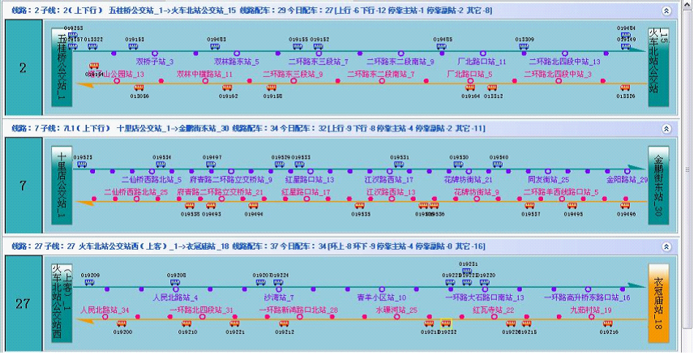
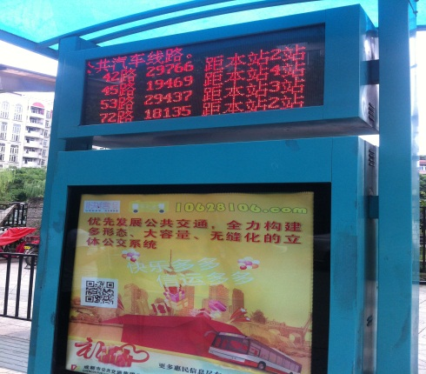
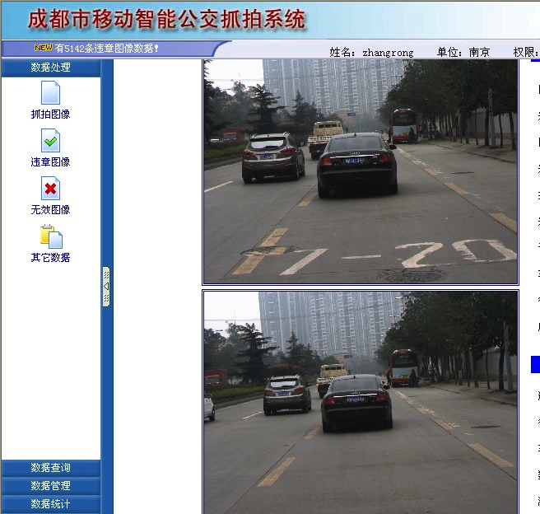
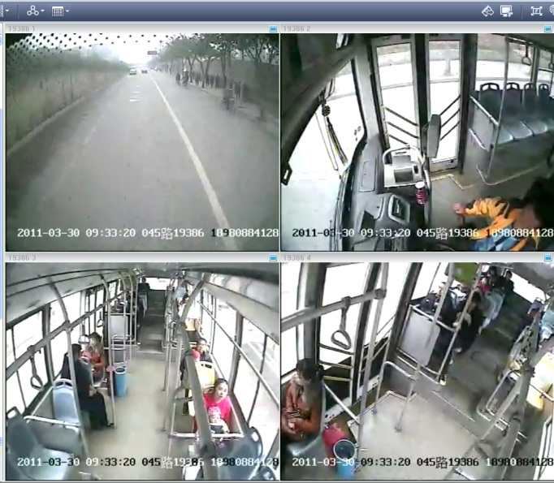
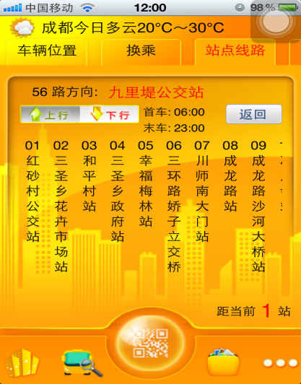
Risk-taking and Innovation by cities
Chengdu: ITS/ICT applications in bus operation
Monitoring
Dispatching
Real-time Info

Slide 9
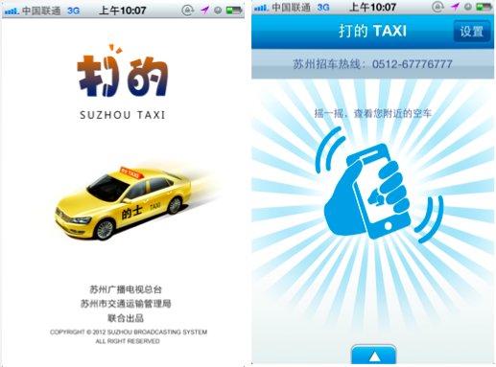
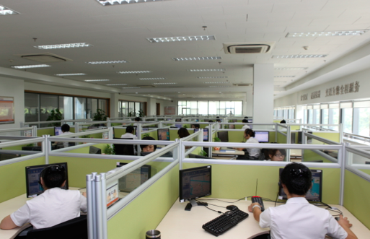
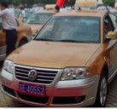
Risk-taking and Innovation by cities
Suzhou: City-wide Taxi Management System
smart phone app
Calling/Dispatching Center

Slide 10
Role of the Bank’s Assistance
Evolution of WB Urban Transport Operations in China
Integration
Green
Accessible
National level:
Policy advice
TA for MoT, NDRC, MOF through two GEF funded programs
Innovation Workshops

Slide 11
Role of the Bank’s Assistance
Evolution of WB Urban Transport Operations in China
Innovation
Demonstration
Transformation
City Level:
Lending operation
Strategic knowledge partnership
Knowledge and convening events
City-to-City peer learning and capacity building

Slide 12
Role of the Bank’s Assistance
Evolution of WB Urban Transport Operations in China
Innovation
Demonstration
Transformation
Integrated Public Transport/Safety/Traffic Management Corridors
Green Freight Demonstration in Guangdong
Low Carbon Logistics in Hubei
Pilot “green airport” for medium sized cities in Shangrao
Integrated multi-mode terminals
Transit Oriented Development (TOD) pilots
New financing mechanisms for operations and maintenance of urban rails in Zhengzhou and Nanchang
Notes:
National level:
Policy advice
Technical assistance for MoT, NDRC, MOF through two GEF funded programs
Innovation Workshops
City Level:
Lending operation
Strategic knowledge partnership
Knowledge and convening events
City-to-City peer learning and capacity building

Slide 13
Impacts and Results
Quiet but strong influence on national & local policy development
State Council Directive 64 [2012]
Media coverage/reports
Convening power
First round of
“Transit Metropolis” Demonstration Cities awarded by MoT in 2012
A solid, growing, and increasingly innovative lending program
from 1 project/year to 3-5 projects/year since 2009
Pipeline more aligned with Bank’s UT agenda
An Organic Network of “Knowledge/Solution Agents”
Partnerships with various stakeholders
Network of local institutes/practitioners , demonstration cities
13
Out of 15
Selected from 700+
Have obtained
Bank support

Slide 14
Thank You!
For more information, please visit: www.worldbank.org/china/urbantransport

