Slide 1

Cecilia Paradi-Guilford
ICT Unit
February 28, 2013
http://cairo.hackathome.com/
#TAppCairo

Slide 2





What’s an app challenge?
Notes:
An App challenge convenes app developers to come up applications to address a particular market demand or in the context of international development a development problem or challenge.
The app challenge built on previous work done through the water and sanitation hackathons.
A hackathon is an activity that brings together development / sector experts and software developers and designers to co-create the innovative solutions needed to help solve today's pressing development problems. This usually takes place through a 24-48 hour physical event whereby technologists and subject matter experts work side by side to develop a proof of concept for a technology application to address the defined problem statements

Slide 3
How this can support transport data collection and analysis?
Utilizing readily available technologies like mobile
Offering a more open, agile development process
Leveraging the homegrown talent of local technologists
Building unusual partnerships
Complimenting larger ITS systems
Notes:
These mechanisms not only convene different partners to work together but also catalyze change in the way of doing things for governments as well as the world bank.

Slide 4

Critical transport challenges in Cairo
In 2010 over 7000 people died in traffic in Egypt according to official statistics.
Private vehicles account for 70% of the traffic share in Cairo with less than 1.3 people per car.
By 2015, commuting time will increase 4x.
www.egypt-cairo.com
Notes:
Harassment is biggest barrier for women to use public transport.
New Government has put traffic as the second most important priority.

Slide 5

WaterHack Cairo as a precursor
Notes:
The Cairo Transport App Challenge was a World Bank-funded initiative that proceeded WaterHackathon Cairo, which took place in 2011 and aimed to build an open collaboration and support innovative ideas to address Egypt’s pressing problems around water resource management and sanitation by leveraging Egyptian technology talent and embracing bottom-up innovation.

Slide 6
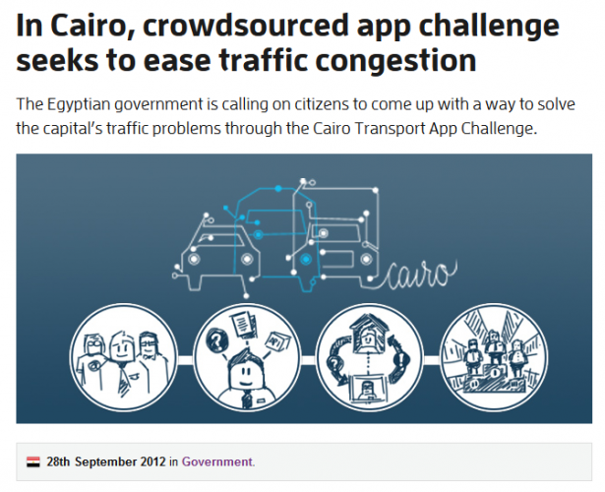
TApp Cairo structure
Notes:
App Challenges, similarly to a Hackathon, support open technology innovation. However, they provide a different structure to move beyond convening different communities for problem solving to also producing a more advanced technology application as a result.
Cairo Tapp had several stages:
Stakeholder consultation and problem statement defitinition - June
Tech briefing - Sept
Hack at home with mentor ship –October, Nov
Pre-evaluation and 10 finalsts - Dec
Award event - Feb

Slide 7
















Open collaboration across sectors
Notes:
Over 16 partners locally and internationally, 5 government affiliates, private sector, NGO, 2 academia

Slide 8
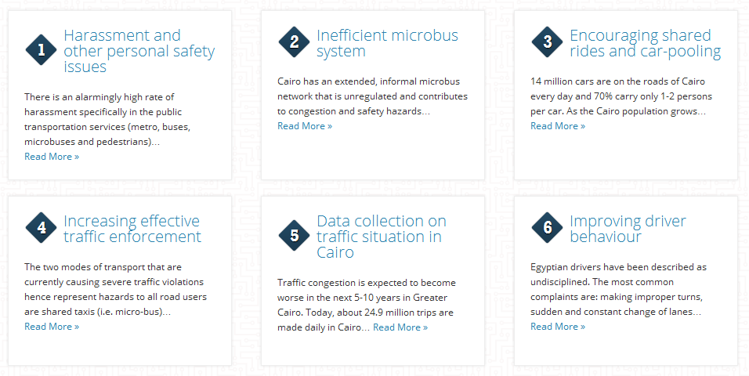
TApp Cairo problem statements

Slide 9
Cairo TApp Participants
All app creators
  developers,
  designers,
  marketers,
  users with great ideas!
Stakeholders and technical specialists in Cairo transport

Slide 10
Submission specifications
Working prototypes
Apps that serve a transport related need for the city of Cairo as described in the briefing
Apps running on any platform
Preferably open source software

Slide 11
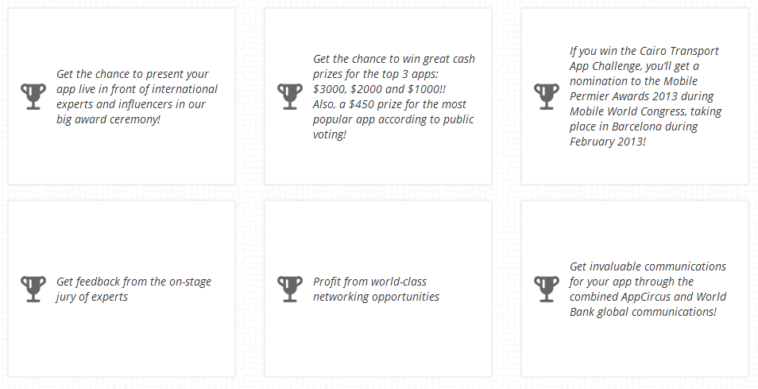
Prizes: $ + exposure

Slide 12
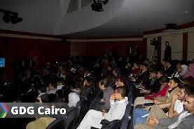


Over 250 registrants, 30 teams, 20 mentors
Notes:
Mentorship: technical, design, business, marketing

Slide 13










After mentor evaluation + public vote, 10 finalists

Slide 14
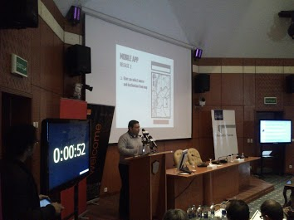
3-minute pitches @ Final Awards

Slide 15
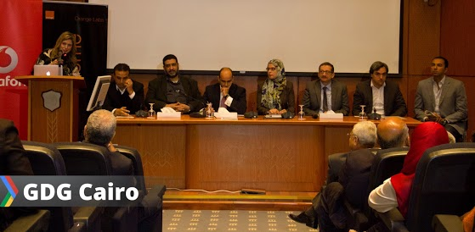
The jury: gov’t, private and NGO

Slide 16
Evaluation criteria
User experience and design
Addressing the problem statement
Sustainability
Creativity, originality and innovation
Economic and financial viability
Team effort

Slide 17
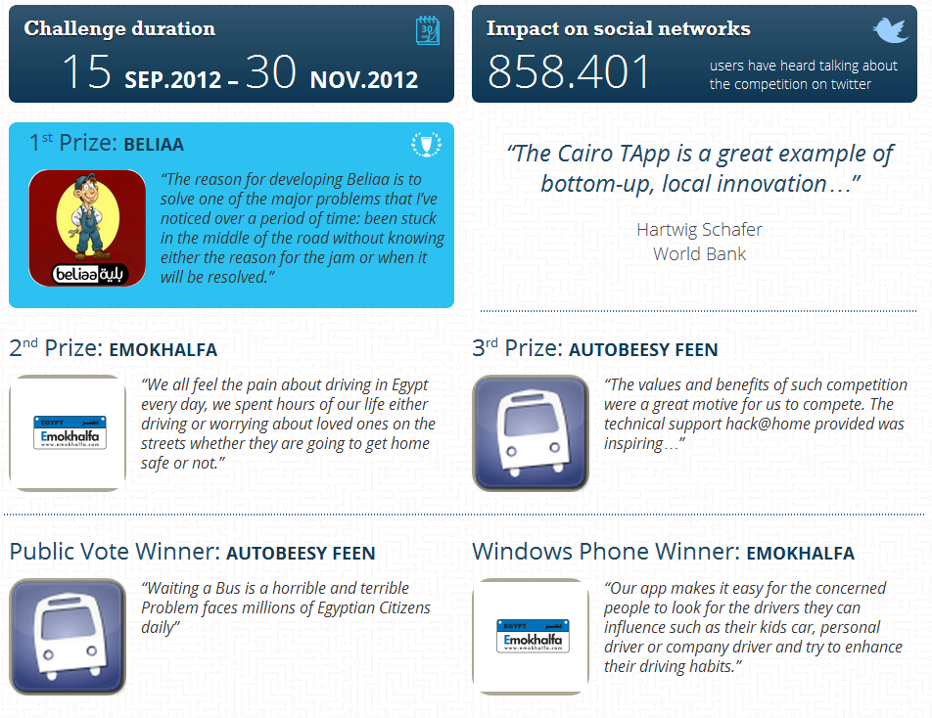
And the winners are….

Slide 18
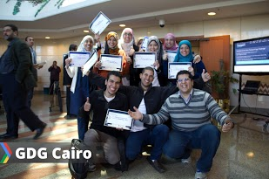
“Hope to see these apps in action!”
Hart Schafer, Country Director

Slide 19
Results: convene & catalyze
Support open innovation, co-creation in urban transport
Leveraging local talent + readily available technologies that compliment large ITS systems
Do things differently, working with new partners and quicker timelimes
Bring ICT and Transport sectors together
Connect technologists to peers & industry leaders
Offer a launch pad for app developers
Help make an impact on Cairo citizens’ daily lives

Slide 20
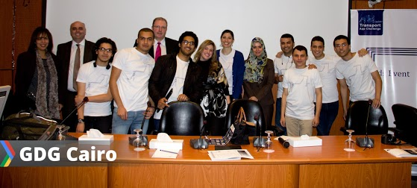
Questions?
Thank you!
http://cairo.hackathome.com/
#TAppCairo

