Slide 1
Towards sustainable mobility – challenges and ideas from Brazilian cities
Georges Darido
Sr. Transport Specialist
World Bank, LCSTR
February 2013

Slide 2
Elements of sustainable transport
Public Transport
Non-motorized transport
Land use planning and urban development
Demand management of private modes
Traffic management and freight logistics
…
Notes:
In Brazil there is consensus on most of the basic elements, but the more relevant question is often how to implement?
PT is the backbone of this agenda. But what happens when you have very congested infrastructure, and it is very slow and costly to expand?
NMT is always the cleanest, but convenience, safety, and connectivity to the rest of the system varies widely.
LU planning– perhaps the holy grail– but we don’t have many practical tools to advise how to capture value from a big investment.
TDM– when congestion pricing is not feasible– are there things that can be done to build a program and the constituency?
Freight– an emerging issue or already interfering with passenger transport in many cities.
Because of time, I’m only going to focus on examples for points 1, 3 and 4.

Slide 3
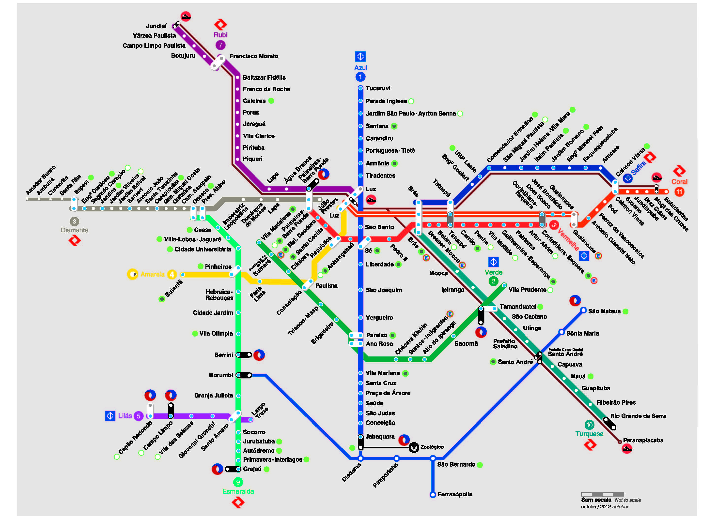
São Paulo Metropolitan Network -- today
Notes:
I’ll focus on Sao Paulo, not so much because it is a shining example, but mostly because it is where we have concentrated a good deal of our investments and efforts in the past 20 years.
SP has a network of high-capacity rail and BRT lines of about 300km, including underground, elevated and surface.
Might sound like a lot, but for a metro region of >20M with terrible congestion and air pollution etc, all agree that the network should be much larger. And there is wide public support to expand and modernize this network.

Slide 4
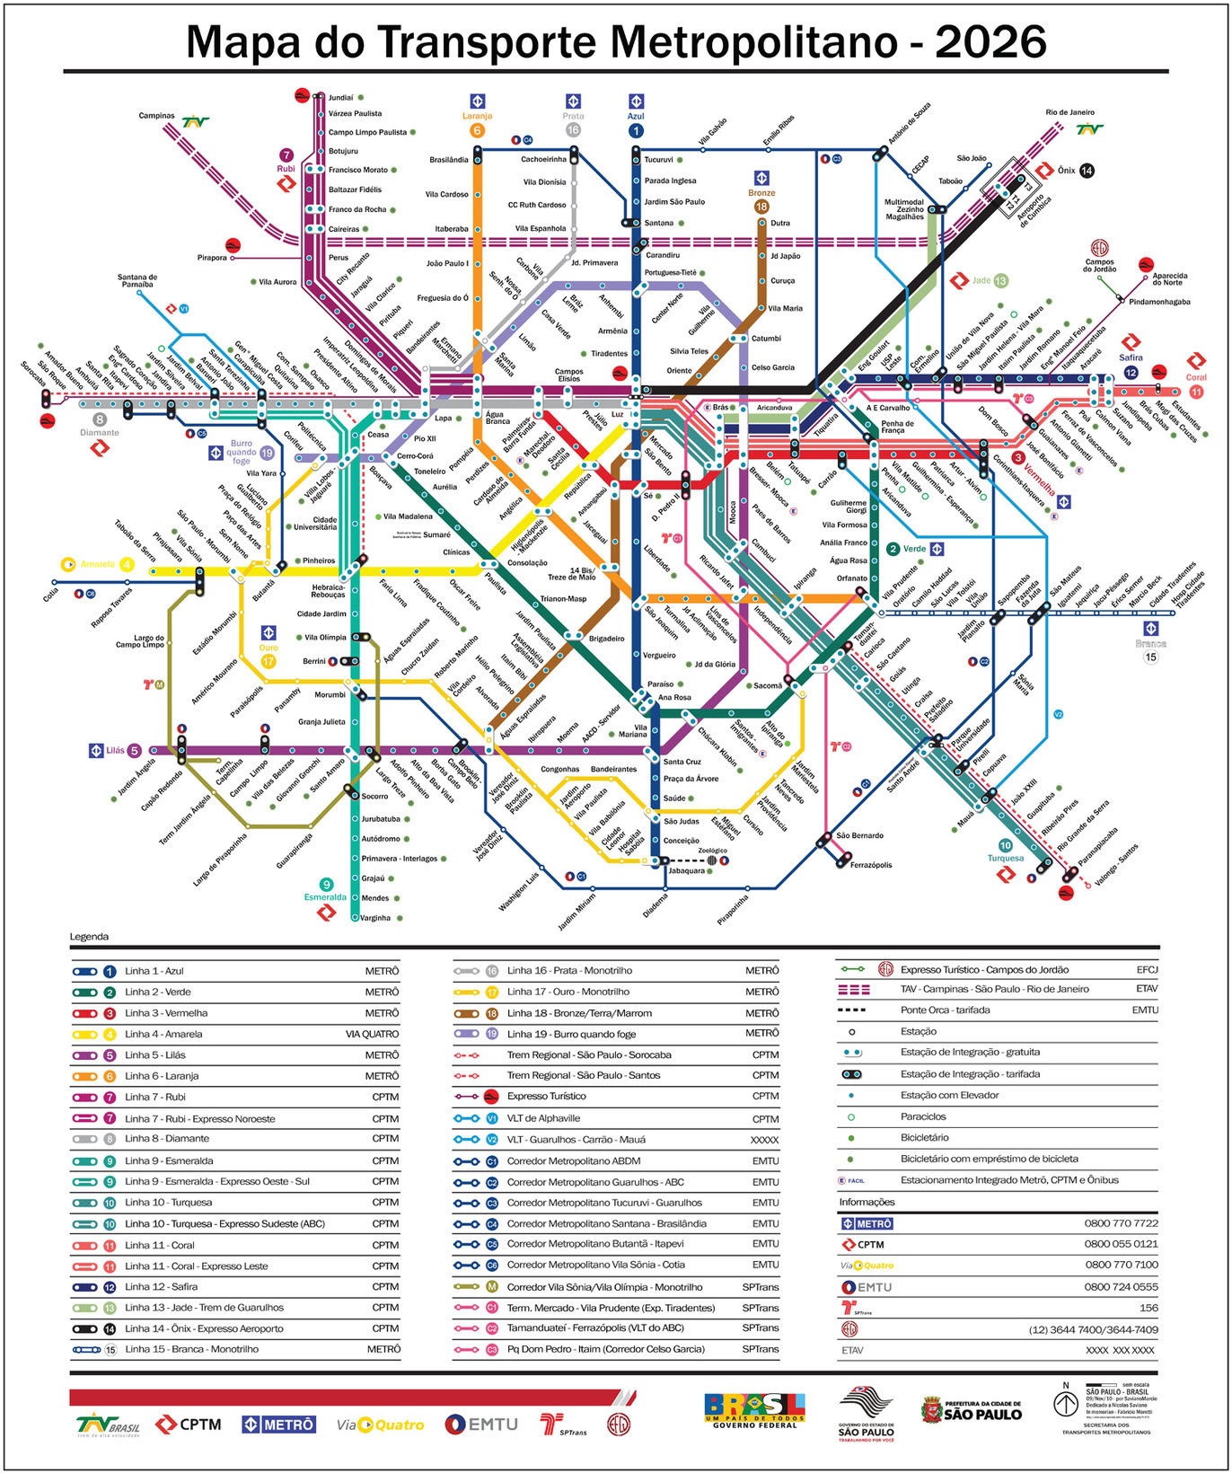
São Paulo Metropolitan Network – in 20-30 years?
Notes:
The idea is to triple it in 20 to 30 years– something like this, although the plans are periodically analyzed and updated. A massive challenge since SP has not built more a few kilometers of high-quality PT per year.
The good news is that, unlike in the past, there are government funds to finance part of this backlog of infrastructure investments– the bad news is there are few “shovel-ready” projects.
So the question we are working on with government, both as financiers and advisors, is: how to accelerate implementation while assuring quality, cost-effectiveness, and overall value for money?

Slide 5
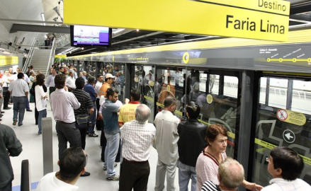
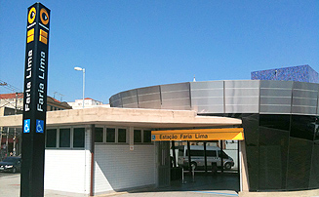
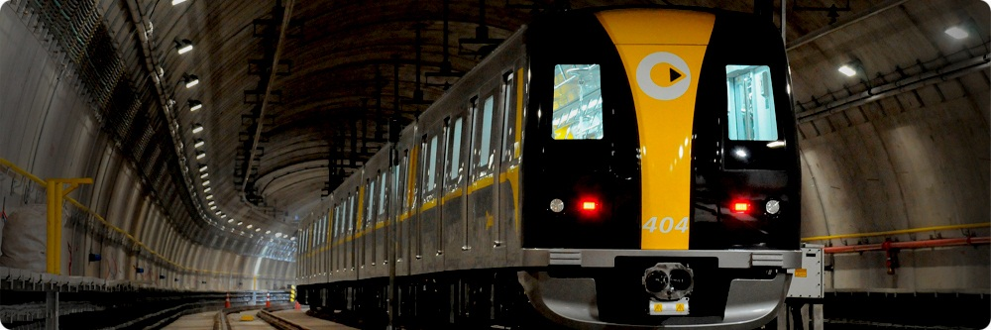
Metro Line 4
Notes:
Like many other governments, SP is turning to PPPs to address part of this issue.
They gained valuable experience with Metro Line 4, which was built using a turnkey civil works contract and started operating in 2011 under a concession that included private financing for the rail cars and some of the communications and controls systems.
PPP is not only a mechanism to share risks, but also to improve the viability of projects. To do just that, the State has implemented a process of receiving unsolicited proposals and requesting alternative technical and financially feasibility studies from the private sector.
It is their hope that they will award the first truly bundled PPP, a DBOM contract with private financing, for Metro Line 6 later this year and that it will become a model for several other projects.

Slide 6
São Paulo Metropolitan Network – in 20-30 years?
Notes:
Just to give you a sense, Line 4 in yellow and Line 6 in orange highlighted here are multi-billion dollar projects.
But even if they could implement this supply-sided approach, is it enough to ensure sustainable mobility? Probably not because by it may never serve a majority of trips.
Currently, the PT mode share is about 1/3. Metro and CPTM alone serve 6 million trips per day and this has been steadily increasing. However, with rising auto ownership and use, it will be a challenge to maintain this.
Obviously integration with local buses, bikes, and pedestrian access is key, and they have made quite a bit of progress on physical, operational and fare integration.
But also important is how to integrate with urban development plans and demand management.

Slide 7
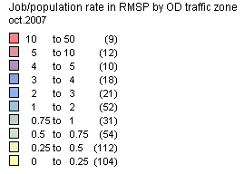
Jobs/inhabitant ratios in SP Metro Area
Notes:
One way to think about this is to model the location choices of residences and business with each proposed intervention in the transport system. It is a complex process with lots of uncertainly, but at the right level of simplification you can understand the basic trade-offs people make in terms of property costs or housing quality and transport costs (including travel times, fares and access to job opportunities).
The current jobs-housing balance in the SP Metro Area, which you see here is much higher in the center of the city, induces a lot of pendular movements in the peak hours from the outskirts of the city, which can be inefficient and costly.

Slide 8
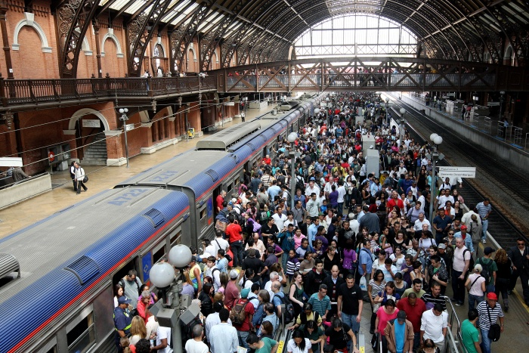
Inside Luz Rail Station – integration point for 2 Metro lines and 3 CPTM Lines
Notes:
This photo of one of the busiest integration stations in central SP shows you what I mean. Much less demand in the counterflow.
The bottom line is that although Metro has some of the most productive lines in the world in terms of passengers per kilometer and needs to be expanded, more can be done with the rest of the system.
There are opportunities to balance better flows in the long-term by influencing urban development with transport projects, and vice versa.

Slide 9
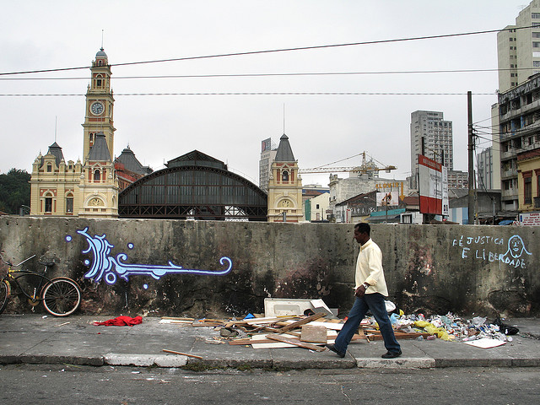
Outside Luz Rail Station and the Redevelopment Project in the City Center
Notes:
A good example of that is area surrounding the same Luz station, which has been degraded for many years.
The city has bought up and cleared large areas around it for redevelopment with a mix of housing, commercial and institutional uses, and the station is seen as the anchor of this urban renewal project.

Slide 10
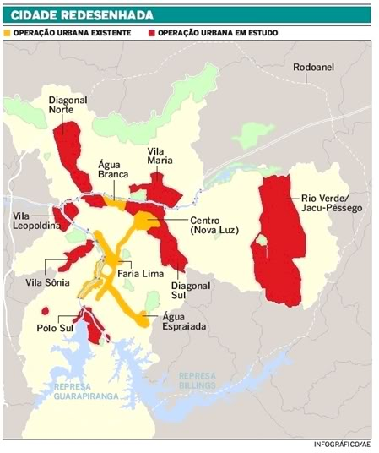
Urban Operations
(for a predefined area) =
infrastructure investment +
value capture instrument (CEPAC) +
urban and social development goals
Notes:
The mechanism that is used in Brazil is generally know as an Urban Operation.
For a predefined area, the City can pledge to improve infrastructure and public services, in turn it is able to sell development or densification credits (know as CEPACs) to pay for part of the investment. With the right development goals and infrastructure project, this can be a valuable value capture tool.

Slide 11
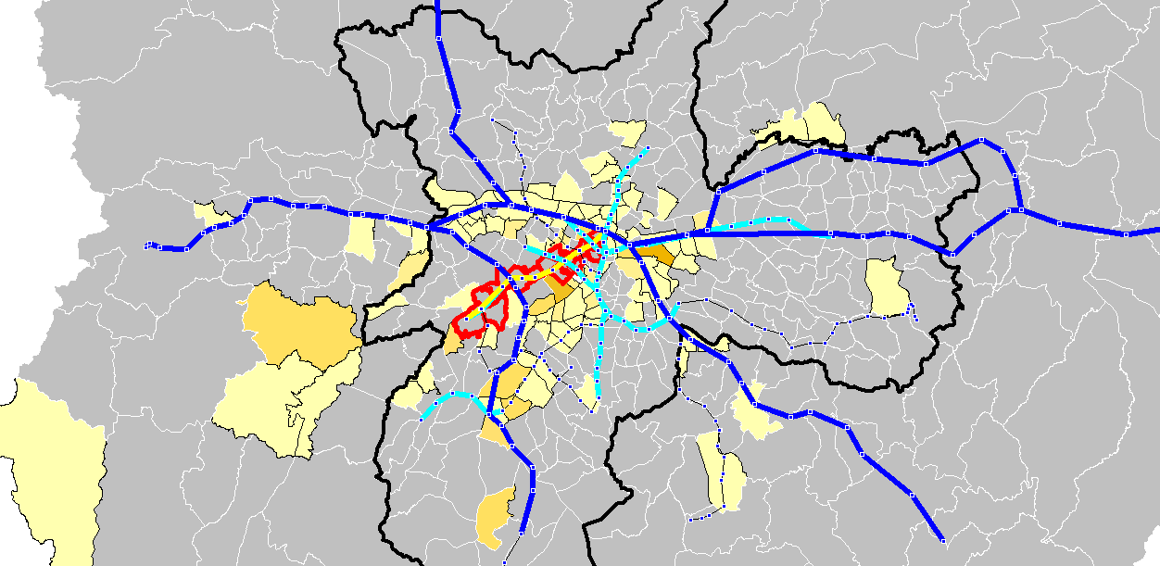
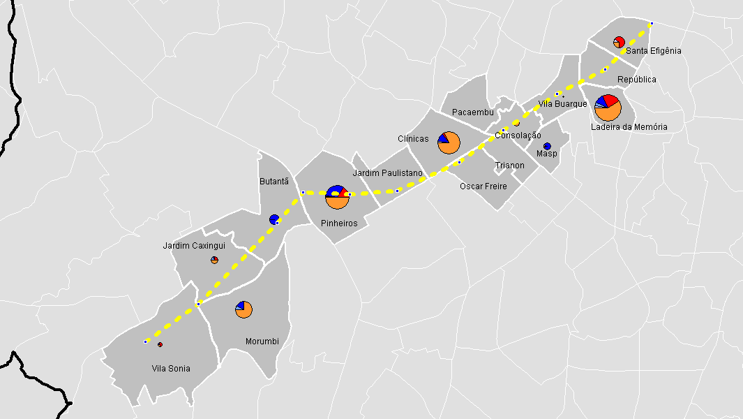
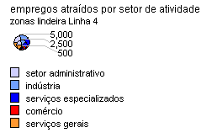
Integrated transport-land use modeling
Improve design
Capture value
Notes:
We find that the devil though is in the details and understanding the land market response to specific transport projects.
This is how integrated transport-land use modeling can be valuable– improving the design of projects and the application of value capture instruments. Used in the right way, it can make good transport projects more financially viable, and make others more socially equitable.
These are some examples from our retrospective modeling of Line 4 to validate the approach.

Slide 12
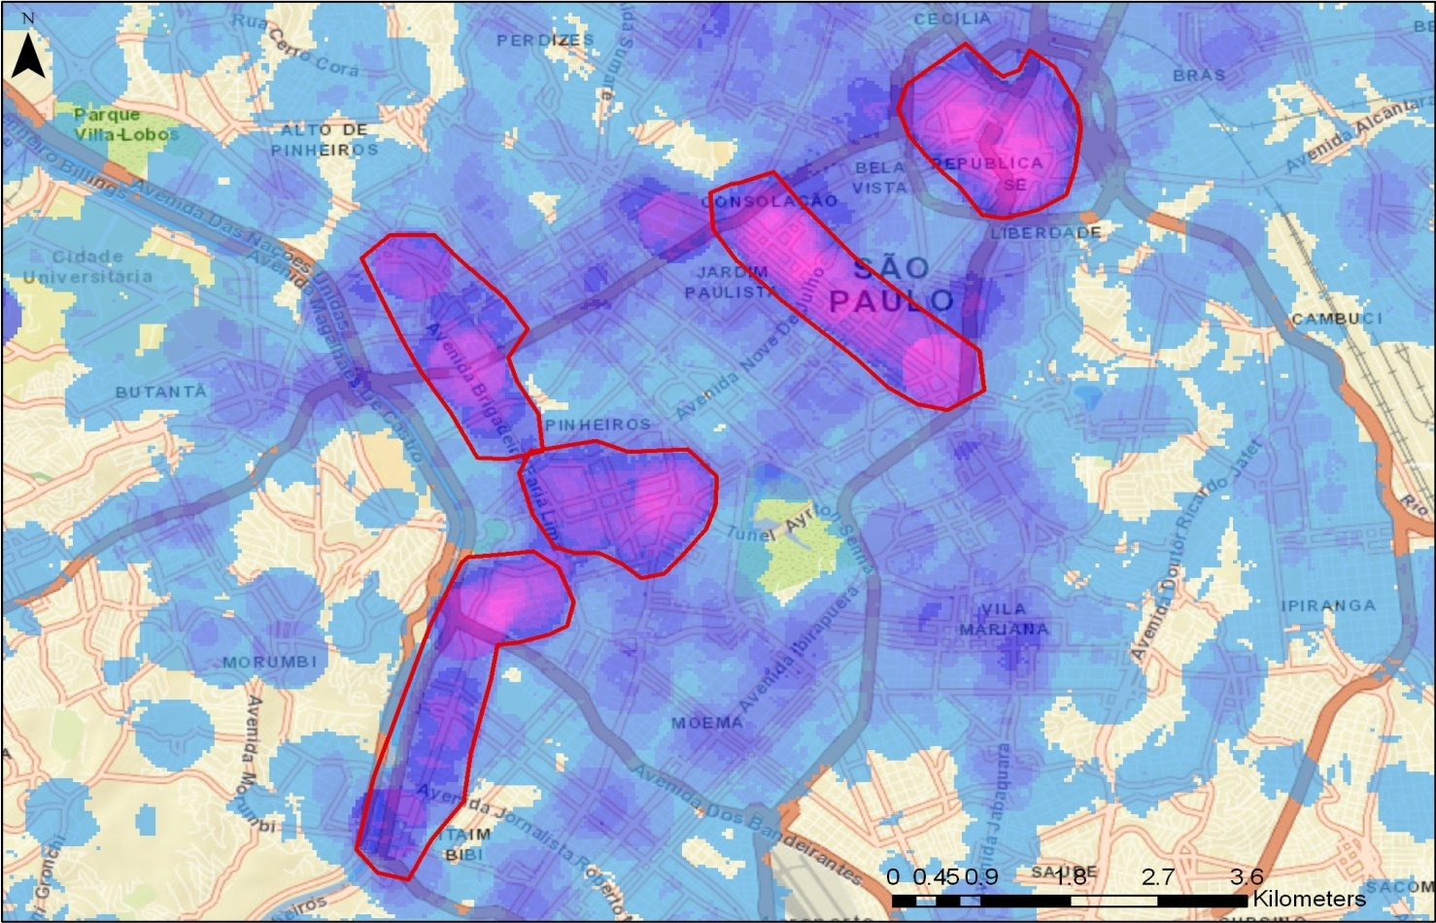
Point density plot of single-occupancy automobile trips in São Paulo (2007 OD Survey)
Faria Lima
Av. Paulista
Historic Center
Pinheiros
Morumbi/
Av. Berrini
Area around Berrini >53% of trips by SOV
Notes:
But long-term land use planning is clearly not enough. There needs to be a near-term strategy where congestion is already a problem and no supply-side solution is feasible.
This map shows the SOV hotspots in SP which is one indicator for where demand management strategies could work. The hotspots tend to be the CBDs, including the emerging ones, where modern buildings are attracting many companies and professionals.

Slide 13
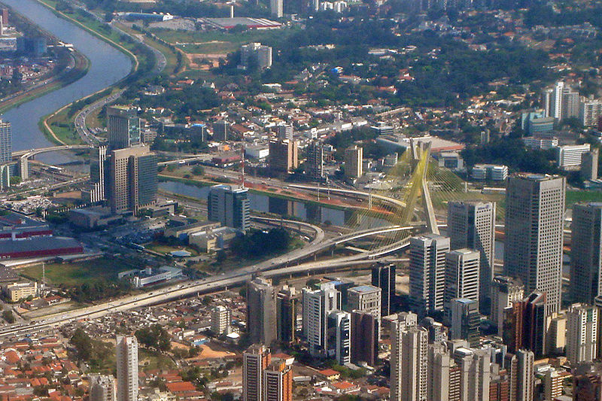

Demand Management: CENU/WTC Pilot Project
Notes:
So we selected one of these emerging areas for a pilot demand management project to understand the potential for reducing SOV trips and promoting more sustainable alternatives.
It is an area of high-end office towers where 6,000 work, along the Pinheiros river near Berrini Avenue and within walking distance of a suburban rail station. It happens to be where the IFC has an office along with many multinational companies.
The pilot included training for mobility coordinators in several participating companies. We are now monitoring the behavior of hundreds of employees before and after modest interventions like promoting or facilitating carpooling, teleworking, facilities for bike commuters, bike and car sharing stations.
We are doing this with the support of trust funds and hope to conclude in the next couple of months.

Slide 14
Pillars of Sustainable Urban Transport
Paraphrased from “Essentials for sustainable urban transport in Brazil's large metropolitan areas”, Rebelo (1996)
Integrated transport, environmental, land use plans and projects
Metropolitan governance
Financial mechanisms to cover long-run costs
Progressive involvement of private sector
Notes:
To conclude, the Bank has a fairly clear business strategy– invest in clean, safe, and affordable transport projects– and do as much as is cost-effective and practical to do. But sometimes the bigger issue is how to implement.
We often overlook or tend to forget in this message that government cannot do it alone and supply-sided solutions are not enough. In fact, neglecting private decision-making leaves out more than half of the equation. The Siemens Green City Index Study found that 75% of sustainable infrastructure investments are in the hands the private sector.
So in LAC, we like to talk about 4 pillars which were first proposed by our colleague Jorge Rebelo. They summarize very nicely the points about implementation that I’ve tried to illustrate.

