Slide 1
TRANSFORMING TRANSPORTATION 2015
Smart Cities for Shared Prosperity
Washington DC - January 15 – 16, 2015
World Bank Group - EMBARQ - World Resources Institute - PRESENT
Night Delivery Program in São Paulo Time to Increase Productivity
Maurício Losada

Slide 2
Volume Vehicles - Mini Anel Viário
Vehicle Demand Concentration
80000
saturation
70000
60000
50000
70- 80%
idleness
volume (veíc/h)
40000
30000
20000
10000
0
1
2
3
4
5
6
7
8
9
10
11
12
13
14
15
16
17
18
19
20
21
22
23
24
Source: CET
hours
Capacity
Demand

Slide 3
Pilot Area and Participating Companies
44 Companies in 22 km² Pilot Area
Shopping Bourbon
Shopping West Plaza

Slide 4
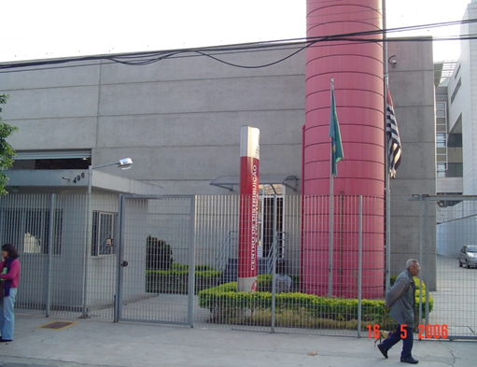
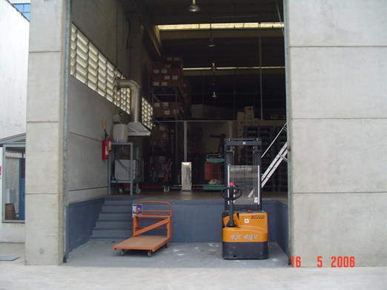
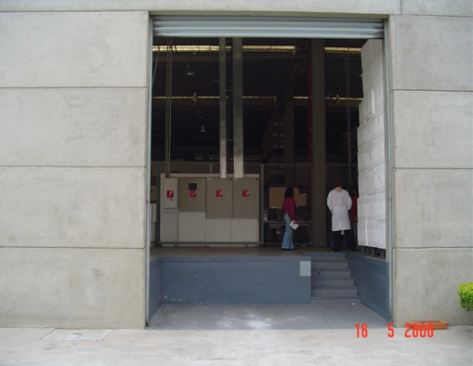
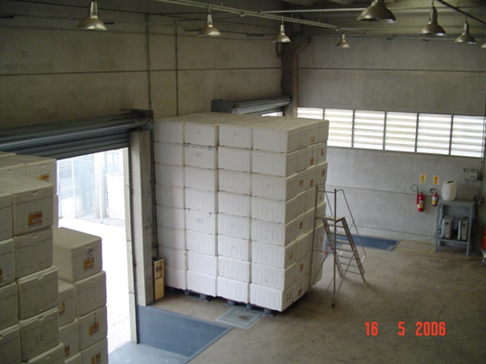
Mini Freight Terminals
Example: Logistics and Distribution Center Prof. Eduardo Juarez
TOTAL AREA -1,600 m²
Storage: 800 m² Câmaras: -18Cº 380 m² ;+2Cº a +8Cº 690m²

Slide 5
Mini Freight Terminals and Logistic Platforms
Potential Sites
TCFD
PL
PL
Large Freight Terminals – LogisticPlatforms
Mini Freight Teminals
ZMRC 100 Km² Maximum Restriction Zone
Industries, warehouses, distribution centers
Commerce and Services
TCFD
Fernão Dias Freight Terminal - Existing

Slide 6
Thank You !
Planning and Traffic Education Directorate – DP
Planning and Projects Superintendence - SPP
Planning, Logistics and Traffic Studies Management – GPL
Logistics and Traffic Studies Department - DLE
Companhia de Engenharia de Tráfego
PREFEITURA DE
SÃO PAULO
Transportes
Mauricio Losada
mauricioc@cetsp.com.br

Slide 7
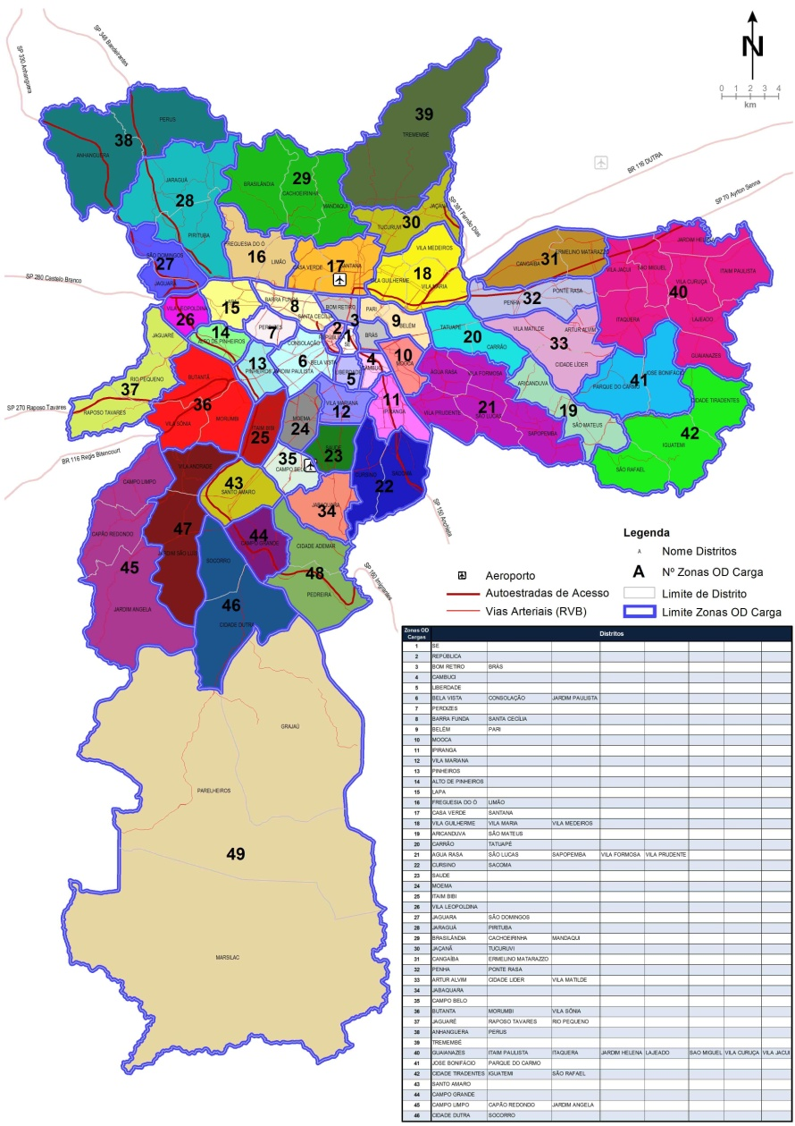
São Paulo O/D Freight Survey - 2015
Premisses
Confidentiality of data providers and identity of participating companies
Results made available to the interested public
Scope, Target audience and Collection Devices
Municipal / Metropolitan - 90 O/D Freight Zones;
Internal trips MSP - Urban Distribution;
Inbound / Outbound Trips MSP / MRSP - Supply / Production;
Will be applied in 4,000 randomly selected companies located in São Paulo;
The selection of companies is based on the business sector and its size;
Data collection will be done by web application, face to face interviews and telephone;
Questionnaire by web app, laptop or paper.

Slide 8
São Paulo O/D Freight Survey - 2015
Methodology – Who will be surveyed?
Companies of 16 economic sectors - RAIS e CNAE data dase
Lodging and Food Sector
Transportation, Warehousing and Mail
Hospitals
Public Admin., Banking , Justice, IT
Extraction Industry - Rock, Sand
Transf. Ind. Food Processing,
Transf. Ind Consumer Goods
Transf. Ind Capital Goods - machinery, raw materials, fuels
Maintenance / Repair of vehicles and machinery - heavy load
Construction Ind. Buildings/Infrastructure
Wholesale Consumer Goods
Wholesale Capital Goods
Wholesale - Other
Retail - Supermarkets
All other retailers
Waste – Hazardous and hospital , garbage, earth, debris, recyclable materials and water distribution (tanker trucks)

Slide 9
Thank You !
Planning and Traffic Education Directorate – DP
Planning and Projects Superintendence - SPP
Planning, Logistics and Traffic Studies Management – GPL
Logistics and Traffic Studies Department - DLE
Companhia de Engenharia de Tráfego
PREFEITURA DE
SÃO PAULO
Transportes
Mauricio Losada
mauricioc@cetsp.com.br

