Slide 1
Framework for Green and Smart City Logistics
Trends in Logistics, which influence City Logistics
Customer
Orientation
Volatility and
Risks
Complexity in
global networks
Sustainability
Lack of Logistics
Infrastructure
New
Technologies
Costs
Pressure
Skills
Shortage
Concepts
Logistics oriented management of transportation and infrastructure
4) Integration of Transport and Logistics planning
5) New mobility concepts for the Last Mile distribution, e.g. E-Mobility
Future technologies and new Information and Communication systems
2) Seaporthinterland Initiative
6) Research cooperations
5) Application of new technology in handling, vehicles and engines
3) Regulation regarding logistical efficiency
9) Role of private stakeholders
1) Assesment of cities
7) Intermodal and intelligent Network-Hubs
Policies influencing transportation and logistics

Slide 2
Discussion of a Sustainability Ranking in Mega-cities
Indicators and results
Indicators to measure sustainability
Ecology | SO₂ – Concentration PM_{2,5} – Concentration CO₂ – Emission per capita Part of Traffic Area Part of Green Area
Economy | Gross Domestic Product City/ Country Infrastructure Investment/ GDP City Number of cars per 1000 inhabitants ride time to work
Social | Traffic accidents per 1000 inhabitants Noise Exposure due to traffic Population Density Modal Split Passenger Traffic, Part of Cars Modal Split Passenger Traffic, Part of local public Transport
 | Points overall (out of 100) | Ranking overall | Point Ecology | Points Economy | Points Social
Osaka | 65 | 1 | 34 | 14 | 17
Tokyo | 61 | 2 | 30 | 19 | 12
Paris | 60 | 3 | 32 | 13 | 15
New York | 58 | 4 | 32 | 13 | 14
Moscow | 55 | 5 | 32 | 10 | 13
Mexiko-City | 54 | 6 | 26 | 12 | 16
Los Angeles | 54 | 6 | 30 | 14 | 10
Shanghai | 52 | 8 | 22 | 13 | 17
Istanbul | 51 | 9 | 26 | 14 | 11
Buenos Aires | 50 | 10 | 26 | 10 | 14
Sao Paulo | 49 | 11 | 24 | 16 | 9
Manila | 47 | 12 | 30 | 10 | 7
Mumbai | 46 | 13 | 24 | 11 | 11
Cairo | 46 | 13 | 24 | 11 | 11
Rio de Janeiro | 46 | 13 | 20 | 12 | 14
Calcutta | 44 | 16 | 22 | 9 | 13
Dhaka | 44 | 16 | 20 | 12 | 12
Delhi | 44 | 16 | 20 | 11 | 13
Beijing | 43 | 19 | 20 | 9 | 14
Karatschi | 34 | 20 | 14 | 13 | 7
Lagos | 30 | 21 | 10 | 11 | 9
None of the 21 surveyed megacities shows a satisfactory result regarding the sustainability indicators (max achieved points:61 out of 100)
Shanghai achieved 51 points, Beijing 43 points out of 100 possible points
Source: TU Berlin, Research: Chair of Logistics

Slide 3

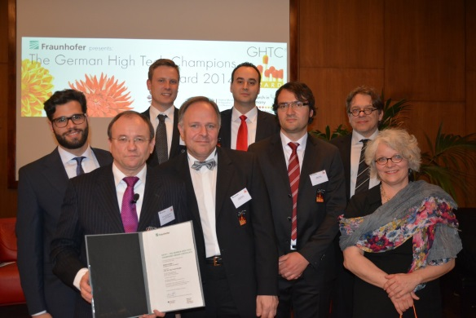










German High Tech Champions Award 2014 for the research project „eMobilty- Smart e-User“
It is the aim of the „Smart e-User“ project to evaluate and implement the utilization of battery electric vehicles (up to 3.5 t) in commercial transportation in the city logistics of Berlin (smart transportion-smart energy-smart services)
In April 2014 the „Smart e-User“ project won the GHTC® – the German High Tech Champions Award 2014 in "Urban Distribution“. The award ceremony took place in the German Embassy in Paris.
Fachgebiet Logistik

Slide 4




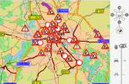



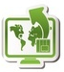

An Integrated Concept for electric mobile city logistics: Smart e-User
Vehicle Routing Planning
Development of these modules
Holistic integration of all modules
Energy Management
recent traffic data
weather (forecast) information
charging station
charge control
demand-oriented charging
Order Management
Integration of companies order management systems
Commercial freight and business passenger transport
Zero (Local) Emissions
Limited Range/ Battery Capacity
Long Charging Time
Notes:
Satzpunkte ergänzt

Slide 5
Smart Logistics Grid
Supply Chain Operations Room and Event Cloud
Adaptive multimodal logistics networks
Adaptive multimodal logistics networks through integrated supply chain planning and control
The foundation is built by models of agile networks and intermodal supply chains
Supplier
LSP
Supplier
Manufacturer
LSP
Customer
LSP
Supplier
High resolution real-time data are collected at the Event Cloud and aggregated to complex events
Process and environmental events
Traffic data
Process coordination
Weather data
Manufacturing data
Disposition data
Automated supply of alternative actions to support supply chain planners
Control through evaluated options for optimization of the distribution network

