Slide 1
Data in support of urban transport policy: problems and way forward Jerome Pourbaix

Slide 2
Focus
Collection and use of data in support of urban transport policy:
Comparing performance of urban transport between different cities and mobility patterns
Measuring societal costs and benefits of urban transport
Monitoring changes in urban transport patterns
Data used for these purposes usually are collected for other purposes, by many different players.

Slide 3
Energy Consumption for Passenger Transport
Annual energy consumption (megajoules/inhabitant)

Slide 4
Parking policy and urban transport
Public transport market share
(mechanised & motorised trips)
Number of parking spaces per 1000 jobs in the CBD

Slide 5
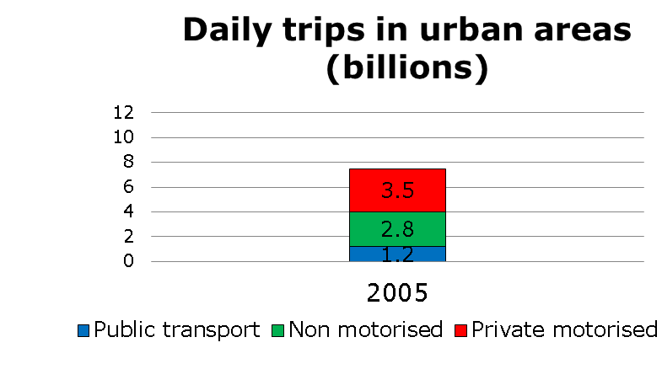
Urban mobility patterns

Slide 6
Sources of data
Transport operators (public transport, taxi, car sharing, etc.)
Local, regional and national governments (various departments and agencies)
Research centres (universities, consultancies, etc.)
Telecom operators, service providers, banks, …

Slide 7
Problems
Geographical scale
Availability and reliability of data
Comparability of data

Slide 8
Geographical scale
Problems:
Need to compare areas that have similar functions.
Frequent mismatch between functional and administrative areas.
Multiplicity of sources at metropolitan level
Way forward:
Development of methodologies for definition of comparable functional areas (cf. OECD, EU)
Development of urban transport accounts

Slide 9
Availability and reliability of data
Problems:
High costs of data collection
Commercial sensitivity of data
Methodological issues
Way forward:
Promotion of open data strategies
Inclusion of data provision in service contracts
Provision of financial incentives for data collection
Devise new indicators
Exploit the potential of new technologies

Slide 10
Household travel surveys: update frequency
London and Vienna: annual
Turin: two years
Berlin, Hamburg, Munich: six years
Rome, Milan, Budapest, Brussels: ten years

Slide 11
Comparability of data
Problems:
Definitions reflect local circumstances, and local/national standards.
Different hypotheses/bias behind different data collection methodologies.
Unwillingness to break time-series.
Way forward:
Develop methods for post-harmonisation of data (through explicitation of underlying hypotheses).
Progressive diffusion of harmonised methodologies and definitions.

Slide 12
Conclusion
Agenda for international associations and agencies
Developing guidance and building capacity for:
Translation of objectives into indicators,
Choosing relevant data collection methods,
Developing of observatories of mobility and local transport accounts
Exploitation of new technologies
Post-harmonsation of data

Slide 13
Thank you for your attention
Jerome Pourbaix
Head of Policy
International Association of Public Transport
UITP
jerome.pourbaix@uitp.org
www.uitp.org
@jp_uitp

