Slide 1
Symptoms, Root Causes,
Entry Points to Solutions
Understanding and Improving Urban Transport in the Russian Federation

Slide 2
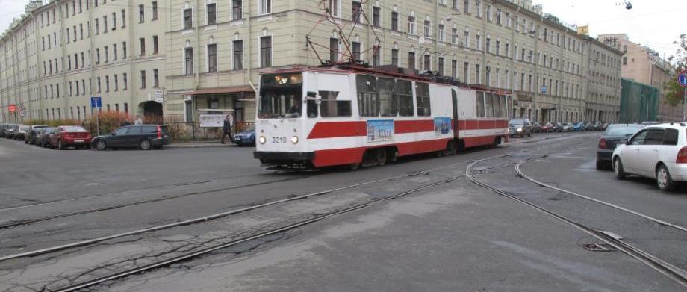
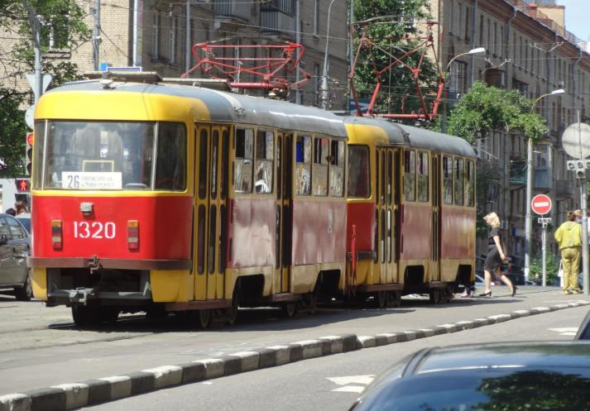
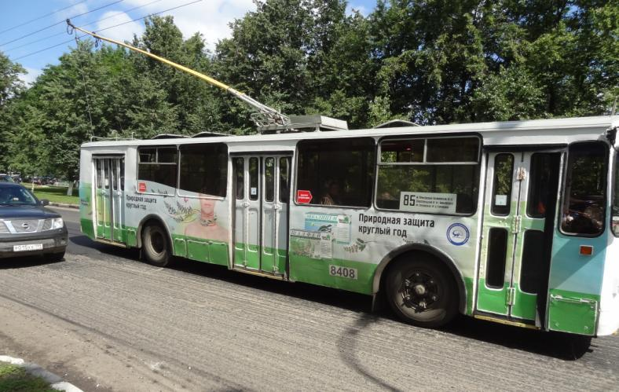

Slide 3
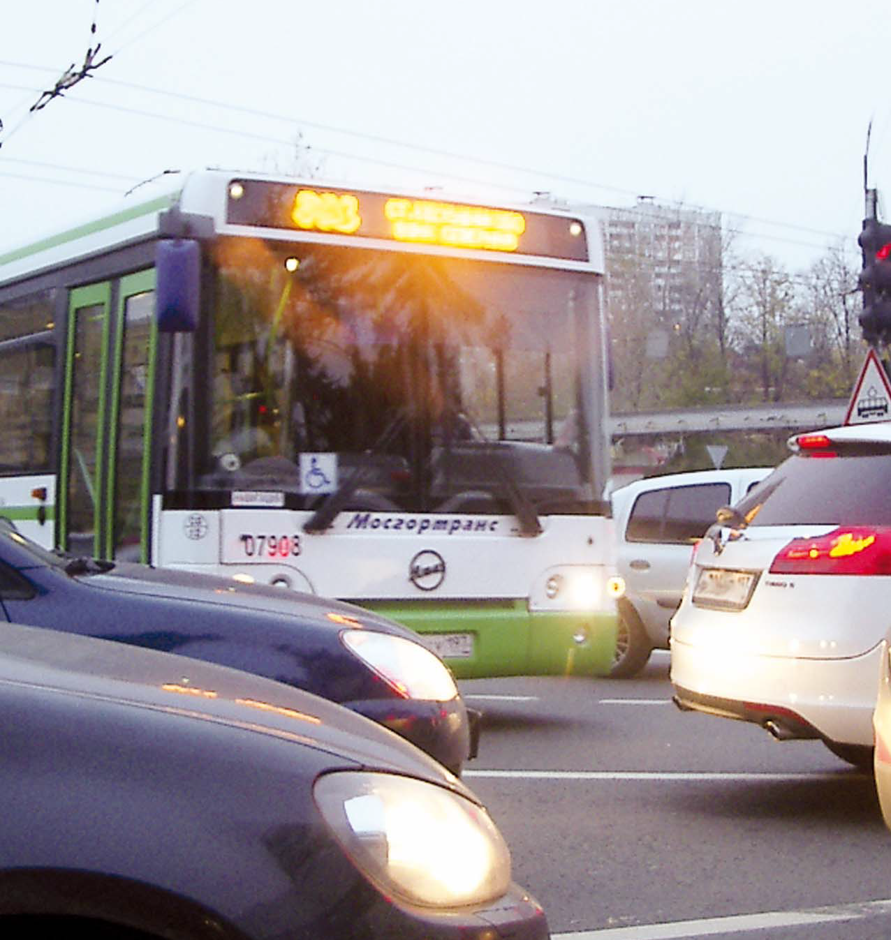

Slide 4
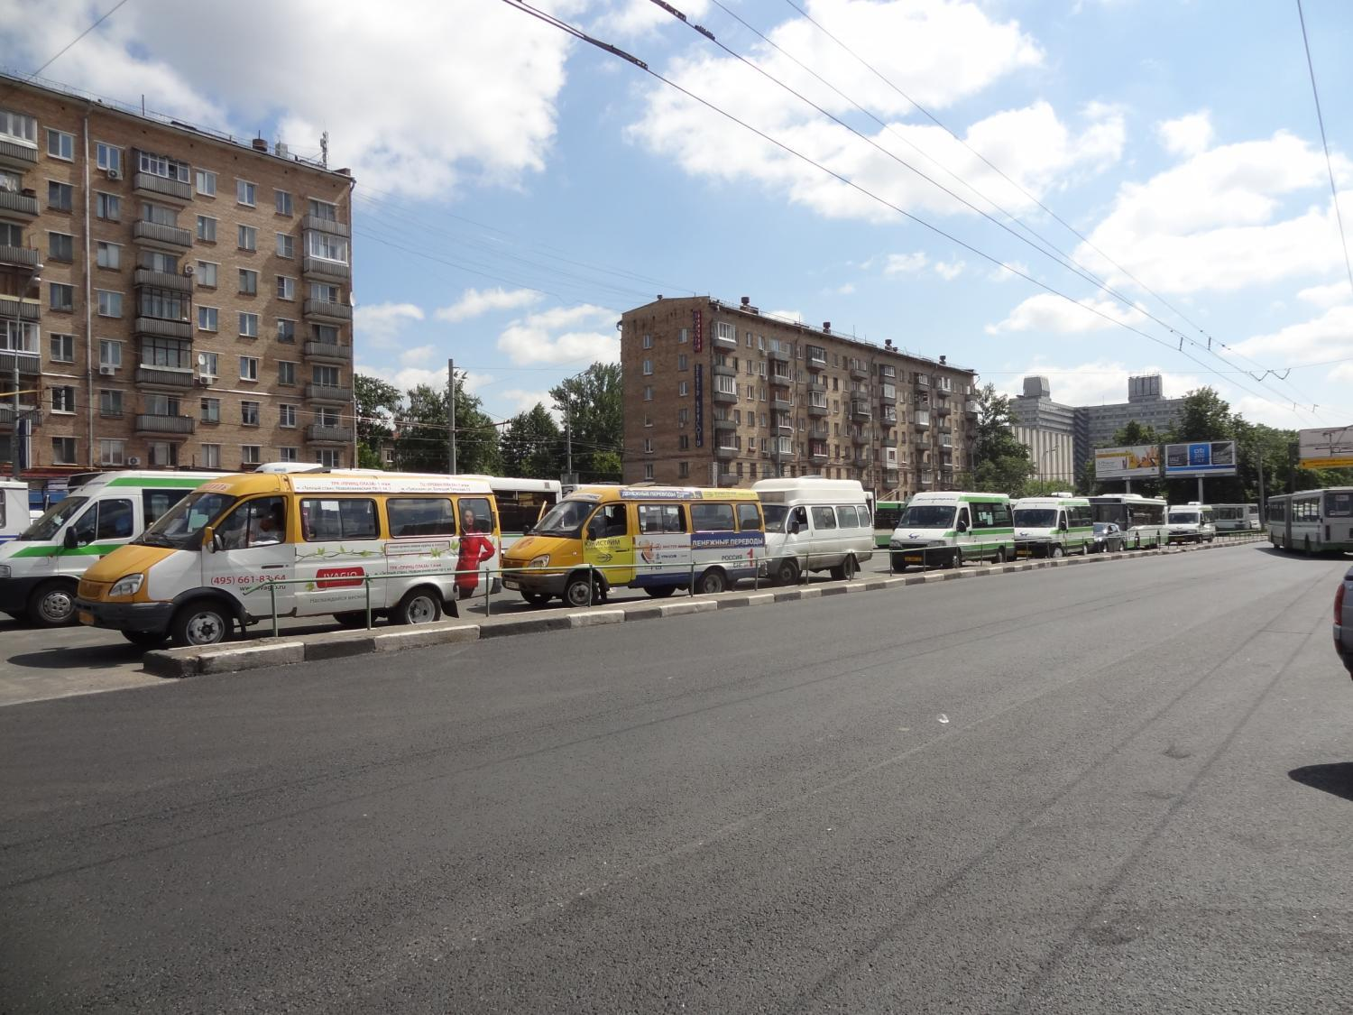

Slide 5
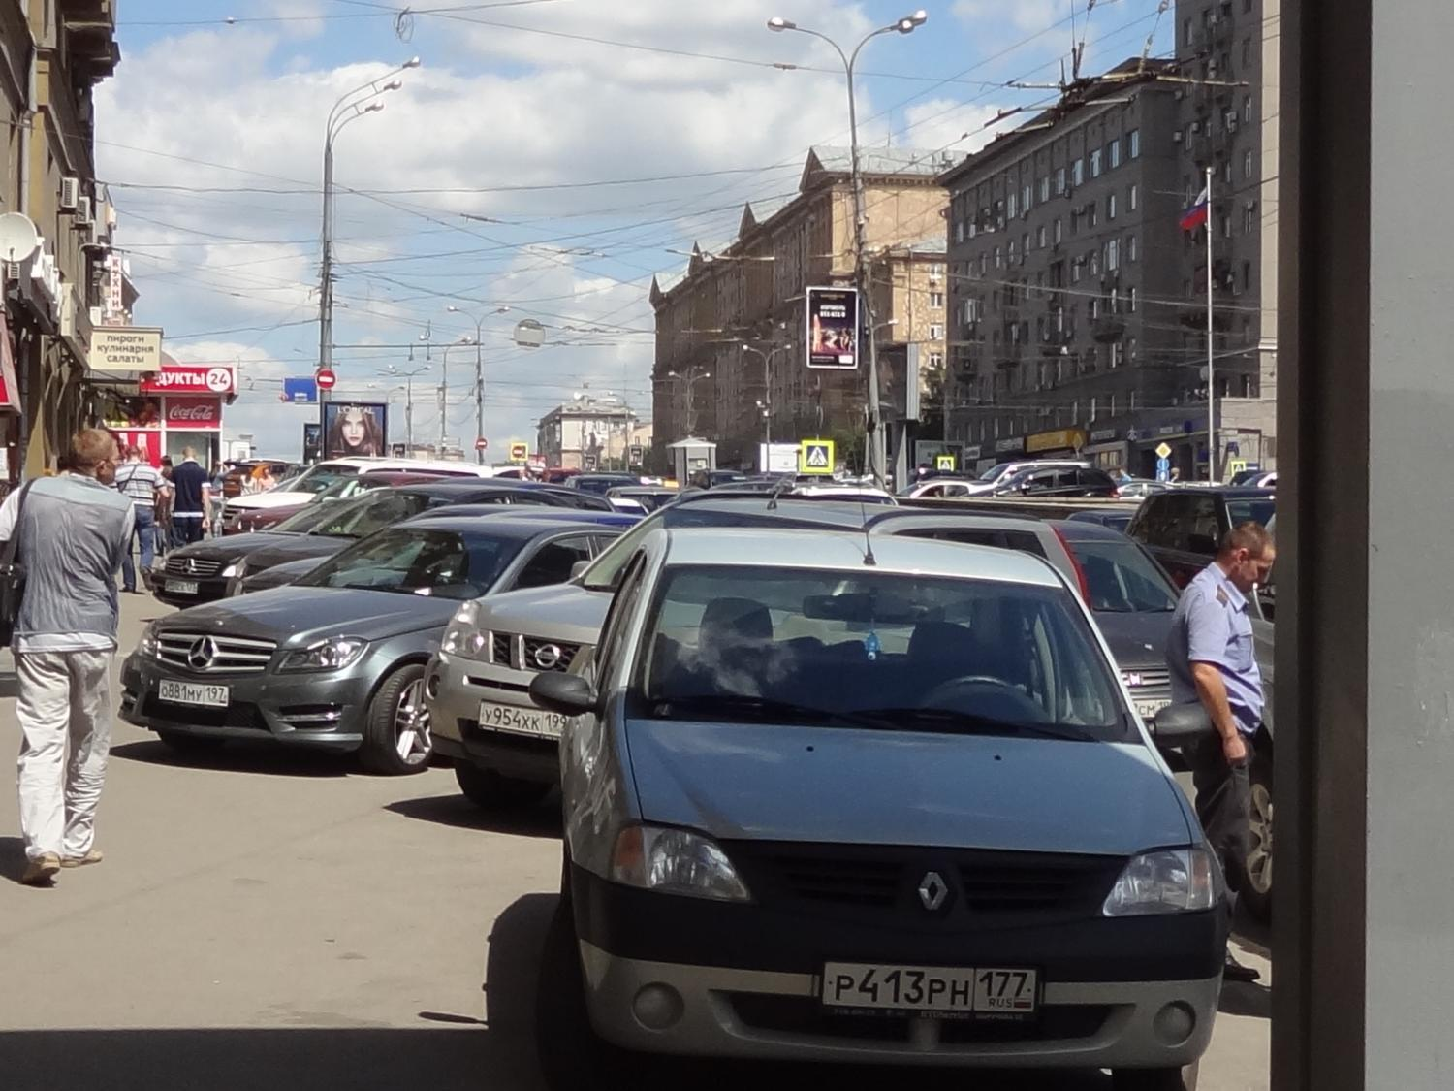

Slide 6
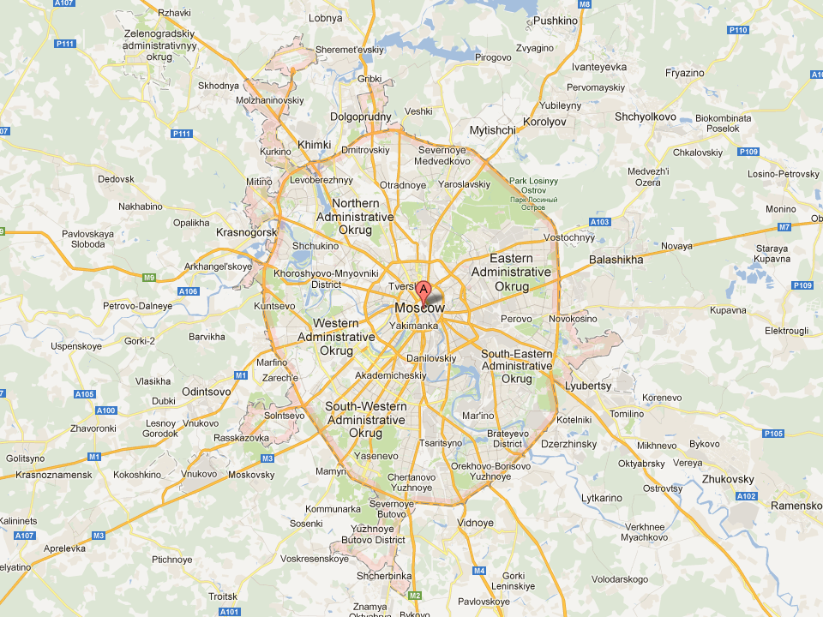

Slide 7




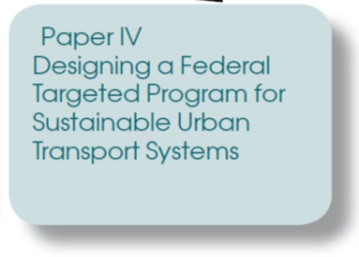

Slide 8
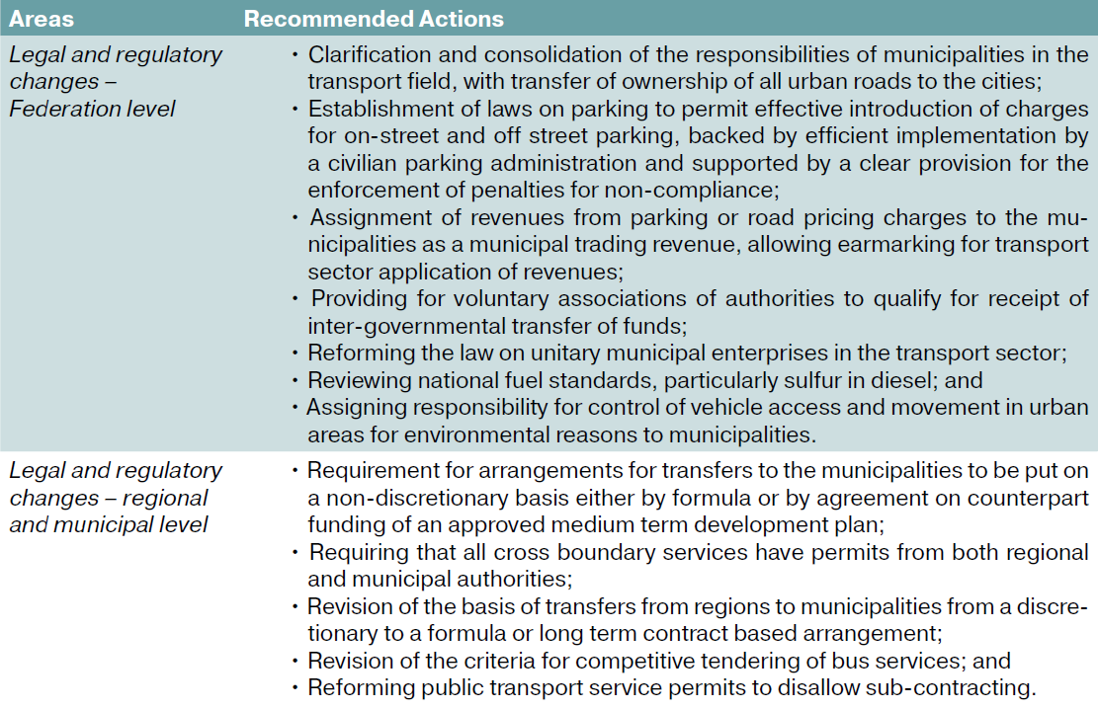
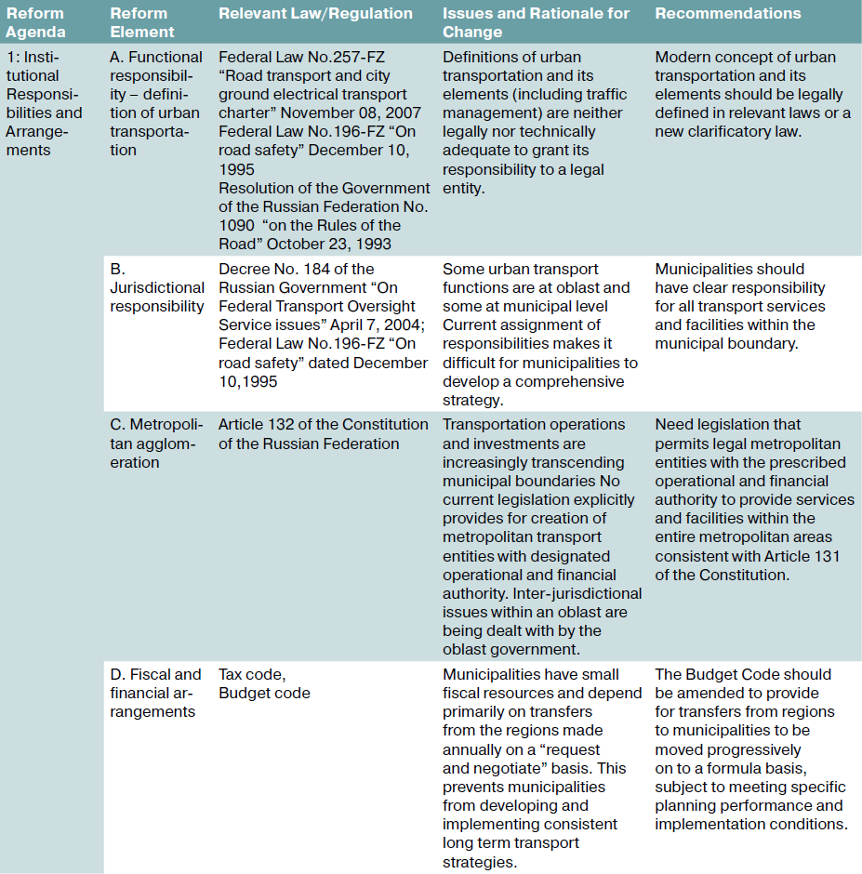
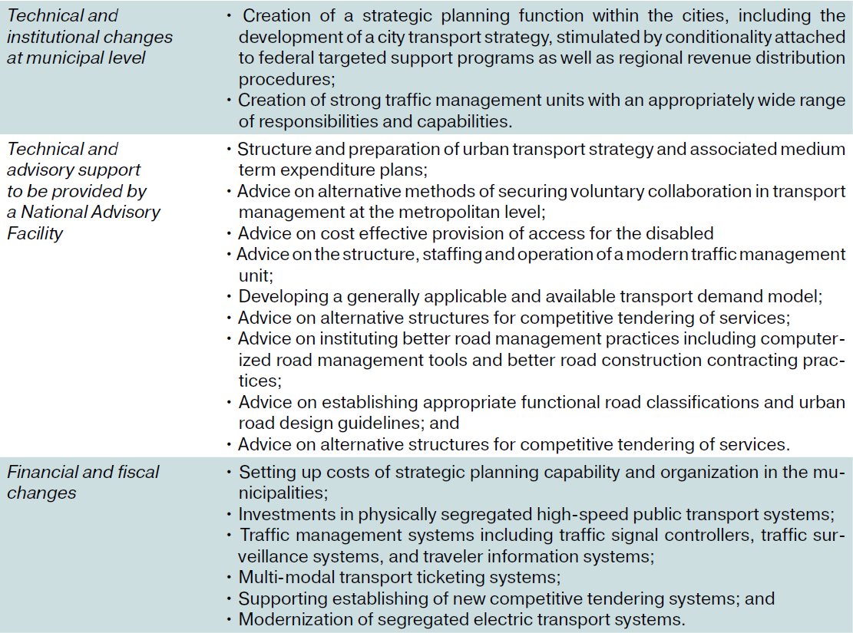
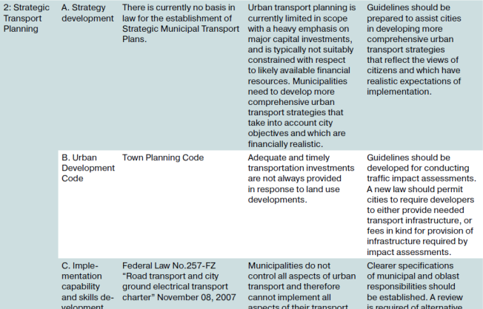
Where to start?
How we can use the instruments we have to make a difference?

Slide 9
Treating the Common Root Causes
Political Economy – Appetite for Reform
Aspiration for Innovation
City Strategies and Priorities
Thematic Approach
“Upgrading mass transit for better service and safety”
“Saving 30 minutes for 50,000 commuters each day”
“More intelligent information for public transport users”

Slide 10
Entry Point 1
National Framework, Capacity Building at Federal Level
Support for high priority legal changes
Development of national UT benchmarking framework
National UT learning program
Toolkits and guidelines
Entry Point 2
Pilot Program for Urban Transport Improvements
– for the “innovators”
Financing 3 demonstration projects
Testing new ideas with willing and prepared municipalities
Three very different cities and types of challenges
Entry Point 3
Capacity Building at Municipal Level
– for the followers
Support for less prepared cities
Pipeline development for next phase
Possible scale-up of successful demonstration projects

