Slide 1
INTERNATIONAL METROPOLITAN GOVERNANCE:
Typology, Case Studies and Recommendations
L. Nicolas Ronderos
Regional Plan Association
New York

Slide 2
Table of Contents
Study Purpose: International Metropolitan Governance Typology, Cases and Recommendations
Typology: Space, Institutions and Participation in Metropolitan Governance
Case Studies: Pragmatic, Bottom-up, Informal and Sectoral Models
Recommendations: Create and Formalize Metropolitan Coalitions

Slide 3
Study Purpose
The study set out to identify a typology for metropolitan governments, provide an evaluation of these models, develop specific case studies, select alternatives for metropolitan governance and recommend actions to improve how metropolitan coordination is undertaken.

Slide 4
The study addresses these and other interrelated issues for emerging cities in response to the following objectives:
Document an international typology and related case studies of metropolitan governance and identify best practices of metropolitan coordination;
Develop recommendations for regional cooperation setting the stage for further refinement by taking into account local legal frameworks.

Slide 5
The Need for Metropolitan Governance
The need for metropolitan management emerges out of contemporary trends around the world for all communities:
Urbanization: Transition to a predominantly urban world and growth of urban agglomerations, in which metropolitan regions have grown beyond the boundaries of established units of municipal and regional governments;
Climate Change: Environmental degradation, and increased risks to public health, environmental quality and energy security driven by global warming and related trends;
Globalization: Integration of metropolitan regions into the global economy, and related economic restructuring and competition; and
Decentralization: Governance, subsidiarity and self-government policies.

Slide 6
Study Principles
Regions
Regional Planning
Metropolitan Subsidiarity

Slide 7
Study Tasks
Metropolitan Typology & Literature review: Based on a literature review we developed a typology of metropolitan institutional arrangements and characteristics to describe them. Based on the typology and variables identified above we selected and evaluated 15 relevant case studies to document metropolitan governance structures.
Best Practice & Case Studies Analysis: With input from the study team we selected four case studies (Barcelona, New York and Sydney) and developed them based on a preliminary evaluation, existing studies, and secondary sources.
Recommendations & Decision Analysis: Based on the analysis of the case studies and evaluation of the typology of metropolitan governments we developed a set of draft recommendations with input from the study team.

Slide 8
Governance Definition
“The exercise of political, economic and administrative authority in the management of a country’s affairs at all levels. It comprises the mechanisms, processes and institutions through which citizens and groups articulate their interests, exercise their legal rights, meet their obligations and mediate their differences”
UNDP. Governance for Sustainable Human Development, New York, 1997, pp. 2-3.

Slide 9
The most important aspect of this definition for developing a typology of metropolitan governance is that it is focused on management, including the mechanisms, processes and institutional arrangements for decision making.

Slide 10
TOP
DOWN
FORMAL
GOVERNANCE
INFORMAL
BOTTOM UP

Slide 11
Metropolitan Governance Theories & Models
Theory | Period | Emphasis | Models
Regionalism | Early 20th Century Industrialization | Institutionalism Metropolitan governments | Metropolitan Government Metropolitan Council
Public Choice | Mid 20th Century Post-industrialization | Competition Localism | Territorial Polycentrism
New Regionalism | Late 20th Century Globalization | Cooperation Inter-local pragmatism | Single Purpose Districts Inter-local Cooperation

Slide 12
Metropolitan Governance Typology
To face the need for metropolitan management different solutions have been implemented giving a spectrum of alternatives:
Metropolitan government: Unitary institution with complete regional authority;
Metropolitan council: Umbrella organization of local units that promotes shared objectives;
Territorial polycentrism: Political fragmentation and local self-government;
Single purpose district: Seeks service consolidation through inter-jurisdictional coverage;
Inter-local cooperation: Regional pragmatism and multi-actor inclusion

Slide 13
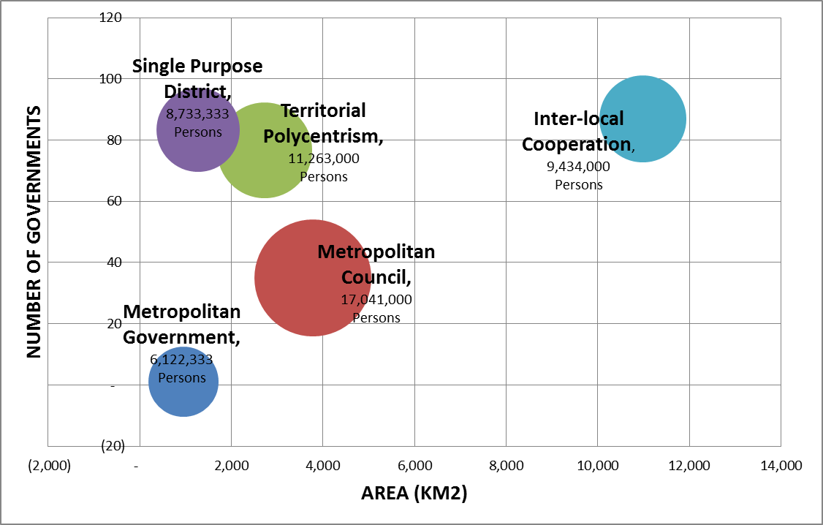
Average Number of Governments, Area and Population for Metropolitan Governance Models

Slide 14
Metropolitan Governments or unitary governance models tend to emerge in regions with a relatively low number of local governments, a small area and a small population compared to the other models. This shows that more formal and institutionalized ways of governance work best in small areas with small populations;
Metropolitan Councils, on the other hand, have medium number of governments, large land areas and high populations, showing that this tends to be an appropriate model for regions with large urban areas in which there are a small number of local governments within the region.

Slide 15
Territorial Polycentrism types of metropolitan areas one typically finds a large number of governments compared to other models, a medium range of areas and population size. To some extent the presence of this model at the center of the chart above suggests that this is the typical situation for most metropolitan areas reflecting a large population over a large area and within the existence of a large number of local and other governments.

Slide 16
Single Purpose Districts are characterized in average by a large number of governments, a small area and a small population. This shows that this model is ideal for small geographic areas in which the large number of governments creates challenges for the provision of services.
Inter-Local Cooperation metropolitan governance models are ideal for areas with high number of governments, large areas and small range populations.

Slide 17
 | Metropolis | Framework | Area (Km2) | Governments | Population
Metropolitan Government | Shanghai | Metropolitan | 746 | 1 | 10,000,000
 | Singapore | State | 479 | 1 | 4,000,000
 | Toronto | Local/Sector | 1,655 | 1 | 4,367,000
Metropolitan Council | London | Regional/Sector | 1,623 | 33 | 8,278,000
 | Paris | Council/Private | 2,723 | 9 | 9,645,000
 | Tokyo | Regional/Sector | 6,993 | 63 | 33,200,000
Territorial Polycentrism | Buenos Aires | Sector/Local | 2,266 | 25 | 11,200,000
 | Los Angeles | Sector/Local | 4,320 | 185 | 11,789,000
 | Rio de Janeiro | Local/State | 1,580 | 20 | 10,800,000
Single Purpose District | Barcelona | Local/Sector | 803 | 36 | 3,900,000
 | Madrid | Local/Sector | 945 | 178 | 4,900,000
 | Mexico City | State/Local | 2,072 | 36 | 17,400,000
Inter-local Cooperation | New York | Sector/Civic | 30,671 | 31 | 17,800,000
 | Sydney | State/State | 1,687 | 43 | 3,502,000
 | Lima | Local/Regional | 596 | 186 | 7,000,000

Slide 18
Metropolitan Governments such as Shanghai, Singapore and Toronto are single unitary government frameworks with only one government in charge of metropolitan issues;
Metropolitan Councils are hybrid metropolitan governance arrangements in which a regional government such as in London or Tokyo or a Council such as in Paris, which manages a large area with a medium size number of governments;

Slide 19
Territorial Polycentrism: metropolitan governance is usually sector based but local or state in implementation over large physical areas;
Single Purpose Districts generally vary in that sector implementation encompasses different local areas that are small in size and population;
Inter-Local Cooperation tend to emphasize pragmatic solutions in which stakeholders – different governments or civil society – come together to solve specific problems.

Slide 20
Metropolitan Governance Characteristics
Region: Functional and administrative coordination and city-region alignment;
Management: Vertical and horizontal mechanisms for efficiency, transparency and accountability;
Participation: Multi-actor inclusion through democratic decision making and engagement
Factors | Description | Characteristics | Options
Region | Spatial | Functional Administrative | Metropolitan Local
Management | Institutional | Vertical Horizontal | Organization Implementation
Participation | Political | Decision Making Engagement | Metropolitan Local

Slide 21
Case Studies Evaluation
Model | EXAMPLES | Region | Management | Participation
Metropolitan Government | Shanghai Singapore Toronto | Metropolitan Functionalism and Administration | Vertical Organization and Implementation | Metropolitan Decision-making and Engagement
Metropolitan Council | London Paris Tokyo | Metropolitan / Local Functionalism and Administration | Vertical / Horizontal Organization and Implementation | Metropolitan / Local Decision-making and Engagement
Territorial Polycentrism | Buenos Aires Los Angeles Rio de Janeiro | Local Functionalism and Administration | Fragmented Organization and Implementation | Localized Decision-making and Engagement
Single Purpose District | Barcelona Madrid Mexico City | Service-based Functionalism and Administration | Horizontal Organization and Implementation | District Decision-making and Local Engagement
Inter-local Cooperation | New York Sydney Lima | Regional Functionalism and Administration | Horizontal Organization and Implementation | Multiple-actor Decision-making and Engagement

Slide 22
Metropolitan Governments encompass a metropolitan wide functional and administrative region and are usually vertically managed organizationally and for implementation. Participation in the political process is undertaken by metropolitan institutions that regulate decision-making and engagement;
Metropolitan Councils have a combined metropolitan and local functional and administration with an emphasis on metropolitan functions and local administration. The organization and implementation functions combine hierarchical metro-local institutionalized systems but frequently rely on the coordination of localities within the umbrella of the metropolitan council. Participation is also hybrid with metropolitan and local opportunities for democratic engagement

Slide 23
In a Territorial Polycentrism model local functions and administration prevail and this tends to rely upon a fragmented organization and implementation structure for policies and plans and localized decision-making and engagement;

Slide 24
Single Purpose Districts are service based and have a functional metropolitan scale and can have hybrid administrative boundaries. Institutionally the intergovernmental relations tend to be horizontal in that all localities participate as equals. Decisions are made at the district level while engagement tends to be localized.
Inter-Local Cooperation arrangements have a regional functional and administrative spatial boundary and localities participate horizontally in inter-governmental relations while multiple actors participate in decision making through a robust civil society engagement. A variant of this model are state run metropolitan areas, for example, in Sydney, in which governance is jurisdiction of the state.

Slide 25
Metropolitan Governance Best Practices
Metropolitan areas are places where settlements and economic activity expands across institutionalized boundaries and beyond the reach of stable, pre-existing governance arrangements. This causes absence of territorial controls or guidance for these urban agglomerations, shortcomings in management capabilities and experience, and lack of sufficient consultation in attempts to solve common problems.
For the purposes of this presentation, our analysis of best practices in metropolitan governance allows us to recommend that Single Purpose Districts and Inter-local Cooperation are the optimal models to analyze further for their relevance to metropolitan regions, based on the following considerations:

Slide 26
A metropolitan area needs to define the region’s scope in terms of its functional space coverage, for example how it:
Provides metropolitan growth boundaries;
Focuses on sectoral delivery of services;
Promotes sustainability goals and objectives
A metropolitan also area needs to build on historic regulatory frameworks and clarify municipal, state and national relations to:
Move from government to governance;
Build upon business & civic leadership;
Foster active public participation

Slide 27
Selected Case Studies
Based on this analysis we have selected Case Studies for four world city regions --Barcelona, New York and Sydney-- to document the in-depth characteristics of a set of metropolitan areas. Each of the four cases will describe in turn the following aspects:
What is its institutional arrangement?
How did metropolitan arrangement get established?
How does the Metropolitan area work?
Implications for metropolitan areas

Slide 28
Barcelona: Voluntary and Sector Based Cooperation
Barcelona, Spain is 803 KM2 in area, making it a small metropolitan area from a spatial perspective. It is defined in its metropolitan administrative boundary by the existence of 36 governments making it a middle range metropolis in terms of number of jurisdictions. In terms of population it is a small metropolitan area with 3.9 Million people, representing 10% of Spain’s population. The institutional arrangement for the Barcelona metropolis is a result of the cooperation of the different local governments within the region on specific sector based issues.
Implications for metropolitan areas:
Local voluntary cooperation, by which municipal and other local governments agree to cooperate to address regional issues;
Sector based provision of services, that address specific and targeted issues that require metropolitan cooperation

Slide 29
New York: A Sectoral and Civic Governance System
New York, USA has one of the largest areas for its metropolitan boundary with 30,671 KM2. The administrative definition of its boundary for Census purposes includes portions of three US States, 31 counties and more than 900 incorporated municipalities. It also has a very large population with 17.8 Million people, representing 6% of the national population. New York is a Sector based metropolis that services transportation through the Port Authority of New York and New Jersey, and the Metropolitan Transportation Authority and through a strong civic network reflected in the Regional Plan Association.
Implications for metropolitan areas:
Sector based governance, that shows how competing states can cooperate to promote bi-state services;
Civic led governance, which represents a pragmatic and cooperative strategy to include businesses and other actors.

Slide 30
Sydney: A State and Inter-local Cooperation Metropolis
Sydney, Australia has a middle range area with 1,687 KM2 while 43 governments define this boundary making it also a metropolitan area in the middle range based on its number of jurisdictions. In terms of population it has 3.5 million people making it small region with 16% of Australia’s total country population. Given the highly fragmented system of local governments in the region, the Sydney metropolitan area is governed by the State of New South Wales which controls the Local Government Areas within its borders. Sydney is thus a case in intra-local cooperation in which the state coordinates local area planning and management.
Implications for metropolitan areas:
State led governance, which manages regional issues through coordination with local governments;
Local government implementation, especially of local services while metropolitan issues are regulated by the state.

Slide 31
Recommendations for the Metropolitan Framework
In the short term, voluntary cooperation structures where incentives are provided to foster planning and inter-local collaboration should be implemented in metropolitan regions. In the long term, and as these structures get consolidated, their potential formalization should be explored.

Slide 32
This implementation should follow the following approach, in coordination with identification of regulatory bottlenecks:
Short term: Form metropolitan coalitions or councils that would create and adopt regional plans to address current issues in need of regional cooperation;
Long Term: Formulate the needed regulatory and political reforms for incorporation of the coalitions as non-profits and/or single purpose districts.

Slide 33
Metropolitan Governance Process
Coalition Building
Governance Institutionalization

Slide 34
Short Term Recommendation
Through an incentive-based planning and investment program, new collaborative institutions involving government, business and civic sectors, metropolitan governance coalitions should be formed. Through this pragmatic approach, based on the Inter-Local Cooperation Civic model, the country and its metropolitan regions can start an informal process that builds on existing relations and establishes a network of jurisdictions and other actors willing to collaborate. This process can be promoted through financial incentives for planning and coordination from the national government.

Slide 35
Steps in this recommendation could include:
Identify in each region the jurisdictions, business and civic actors that would be included in the coalition;
Define the role of the coalition and identify planning and coordination tasks to be accomplished by the coalition;
Provide the financial incentives by the national government to create a regional coordination plan addressing a range of metropolitan planning and management issues, possibly including urban growth management, transport, economic development, environmental protection, water management and other concerns.

Slide 36
Long Term Recommendation
Based on the success of these voluntary coalitions, these institutions could be formalized in non-profit organizations and/or sector based structures following the Civic and Single-Purpose District models documented above. It is possible that different regions across the country could utilize either the civic based or sector based structure or a combination of both.

Slide 37
Steps in this recommendation include:
Identify each successful metropolitan coalition civic and single purpose district needs;
Study the legal and administrative requirements to satisfy the metropolitan area needs;
Develop and establish entities for metropolitan coordination and assign responsibilities and resources to them.

Slide 38
Examples of National Financial Incentives for Metropolitan Coordination
Based on the potential role for national governments (federal or unitary) in promoting metropolitan coordination, the following section describes specific examples of financial incentives from four different nations and showcases the metropolitan planning and coordination process related to these incentives.

Slide 39
Governance capacity is strongly determined by given spatial, economic, social and political conditions and depends on cooperative actor behavior, adequate incentive structures and territorial political leadership under specific local conditions.
Of specific interest are the financial incentive structures. Other incentives, especially regulatory or legal, promote creation of metropolitan areas as seen in the cases of Greece and Finland, for example.

Slide 40
Incentives set by upper government are important factors in building metropolitan governance since local and regional areas can be influenced by fiscal frameworks established by national government.
Incentives to strengthen metropolitan area-wide governance include grants, taxes or designation of more competencies as the general types of incentives.

Slide 41
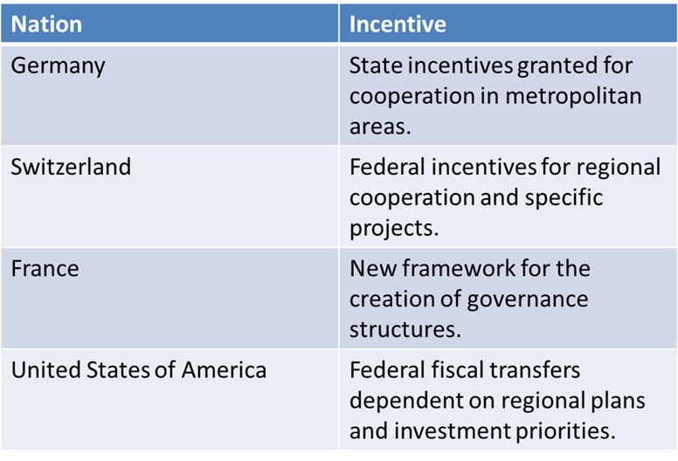
Examples of National Financial Incentives for Metropolitan Coordination

