Slide 1
Integrated Planning
Metropolitan strategic planning uses spatial tools and approaches to integrate social, environmental, and economic concerns into single combined plans.
As such, they challenge the governance arrangements in most places where they are undertaken.
These plans require collaborative governance, shared financing, and common advocacy to succeed.

Slide 2
Integrated planning
Addressing population growth
Tackling climate change
Improving productivity and business efficiency
Modernising infrastructure and housing
Preventing sprawl
Civic and citizen renewal

Slide 3
Metropolitan Strategic Planning
Definition:
“Regional/spatial planning gives geographical expression to the economic, social, cultural and ecological policies of society.”
(European Regional / Spatial Planning Charter)
“It is at the same time a scientific discipline, an administrative technique and a policy developed as an interdisciplinary and comprehensive approach directed towards a balanced regional development and the physical organisation of space according to an overall strategy."
(European Regional / Spatial Planning Charter)

Slide 4
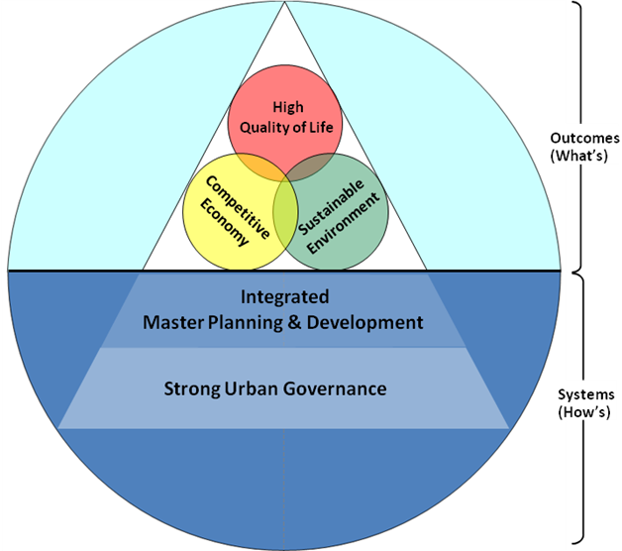

Slide 5
Metropolitan Development is an integrated process…
Global economy and Macro-economic framework
Markets
Feedback effects
Development and growth
Productivity
Use of resources
Population
Drivers
Innovation & creativity
Industrial structure
Business ownership & mgt
Human capital
Environ mgt
Connectivity
Business environment & investment
Educational and research base
Land and physical infrastructure
Social/ cultural infrastructure & quality of life
Ecological base
Governance structure
Pre-conditions

Slide 6
Whole of government approach
Inter-governmental coordination
Partnership with non-governmental sectors

Slide 7
Metropolitan Identity: why?
Identity
Vision
Brand
Reputation
Belonging

Slide 8
Key ingredients for Governance of Strategic Plan.
Municipal coalition. Cross Party. Barcelona
State participation and co-ordination. Mumbai
Federal Government as active ‘sponsor’.
Paris
Mechanism for Civic, Business, and Citizen engagement. Gauteng

Slide 9
Transportation
Relates to: Spatial forms of metro area, centres and sub-centres, land uses, productivity, housing, density, urban design, environmental performance, air quality.
Metro Issues: Identify the transport systems for the future. Common agenda?
Value creation and capture. Who pays, who benefits? How value is captured?
Choices Large projects versus system integration.
How to influence citizen choices and behaviour.

Slide 10
Urban Resilience and Climate Change Adaptation
Relates to: Energy, transportation, spatial form, housing, governance, built environment, waste and water systems, food, and technology.
Metro Issues: A common agenda? Systems integration and inter-operability. Institutional reach and flexibility. Pubic and private providers, owners, users, occupiers.
Choices: Resilience or adaptability? Flexibility? Where should leadership come from?
How to use technology?
Where to start?

Slide 11
Urban Regeneration
Relates to Land Use, Housing, Transportation, Economic Strategy, Municipal Finance, Energy and Environmental Performance, City Identity and Brand.
Metro Issues Competition v collaboration for investment.
Density v sprawl.
Cross border movement of jobs and people.
Choices Urban Regeneration at different scales.
Mega-projects v neighborhood renewal
Land Uses and changes.
Density and urban form.
Financing and implementation choices.

