Slide 1
GLOBAL LAB
on Metropolitan Strategic Planning
1st Metropolitan Exchange
NEW YORK CITY
April 19-25, 2013

Slide 2
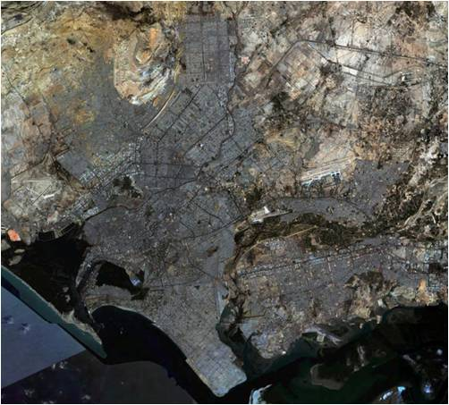
KARACHI (Pakistan)
BASIC DATA
Name of authorities: KMC Administrator: Syed Hashim Raza Zaidi
Metro population: 22 million % of national population: 11%
Annual population growth: 3.5%
# of states in metro area: 5 Districts # of municipalities: 18 Towns
Land mass: Total area = 3,600 sq km (Urban area = 1,300 sq km) Density: 5,000 per sq km of total area (13,800 per sq km of urban area)
Primary industries: Textiles, financial services, wholesale and retail, trade (import-export)
FIVE KEY FACTS ABOUT YOUR METRO AREA
Largest city – in population and economic terms
Contributes 20% of national GDP – backbone of country’s growth potential; Generates 60% of government revenues, federal and provincial; Commercial hub of Pakistan
Two major sea ports handle bulk of cargo and provide access points for neighbors - Aghanistan
Municipal control/ devt fragmented, 29 agencies - 30% of municipal land controlled by KMC
60% residents rely on private transport (mini buses) for mobility, yet no mass transit system. Transport system run by informal private contractors. 40 persons compete for one seat.
Housing backlog: about 100,000 new units to be added per year. About 700 informal settlements exist. 60% of city’s housing stock is in informal settlements.
Water demand is 1080 million gallons per day but capacity of the supply system is only 680 MGD, out of which 30% is lost in transmission due to leakage, theft, diversion etc.

Slide 3
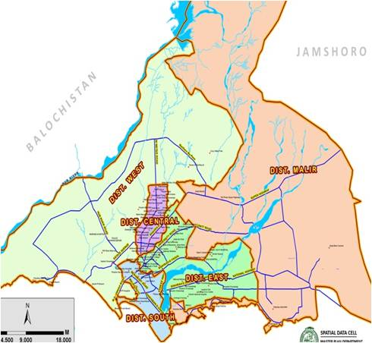
KARACHI
Planning and Institutional Framework
INSTITUTIONS
Managed by Karachi Metropolitan Corporation (KMC)
Jurisdiction: Service jurisdiction 100% metropolitan area (including areas not under KMC)
Master Plan made in 2007:
Karachi Strategic Development Plan 2020 (KSDP-2020)
Land, planning, development and municipal control fragmented into 29 federal, provincial and local agencies with overlapping powers / functions and lack of coordination
These agencies were involved in Master Plan development, but are not bound to follow it
SUCCESSES & LESSONS
ROADBLOCKS
PROGRESS
Involving various agencies in drafting a Master Plan, which is considered a solid document providing vision for future development
But without binding authority, cannot guarantee other agencies will follow Plan
Without political will and ownership, plan will remain shelved
Only 30% of land is in KMC jurisdiction and control
Lack of financial resources to create business plan to operationalize Master Plan
Due to limited political support, implementation is weak and patchy
New challenges emerged after masterplan was conceived – migration from northern areas due to internal conflict
Few prioritized investment projects have been conceived – solid waste, circular rail, bulk water, biogas plant
Introduction of new local government system

