Slide 1
Urban Regeneration
Relates to Land Use, Housing, Transportation, Economic Strategy, Municipal Finance, Energy and Environmental Performance, City Identity and Brand.
Metro Issues Competition v collaboration for investment.
Density v sprawl.
Cross border movement of jobs and people.
Choices Urban Regeneration at different scales.
Mega-projects v neighborhood renewal
Land Uses and changes.
Density and urban form.
Financing and implementation choices.

Slide 2
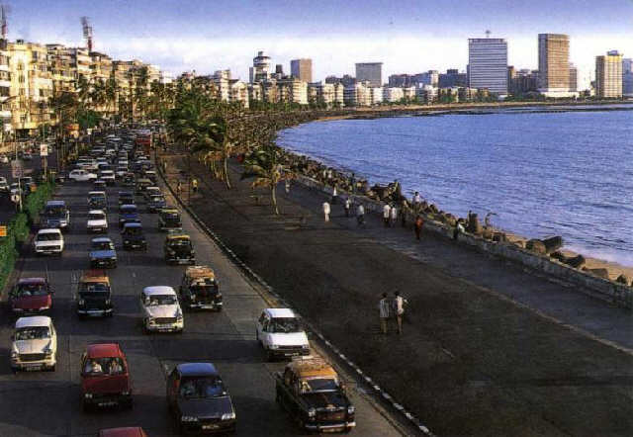
MMR
Urban Growth and Economic Development
WHAT ARE YOU TRYING TO ACCOMPLISH?
Retain MMR’s lead in contribution to the GDP of India
Spread growth into the region
Micro-plan all areas identified for urbanisation
Population and employment distribution through co-ordinated planning of land-use & transportation
Industrialisation with environmental concerns
Map or Image related to urban development
SUCCESSES & LESSONS
ROADBLOCKS
KNOWLEDGE GAPS
Wholesale markets shifted to planned environment
New growth centres developed (BKC)
Land & regulations to maximize value
Land laws Rationalization
High land and real estate values
Declining manufacturing industry
SEZs not delivering anticipated results
3. Infrastructure Inadequate
4. 50% informal economy
Data Gaps
Capacity Building
Institutions

Slide 3
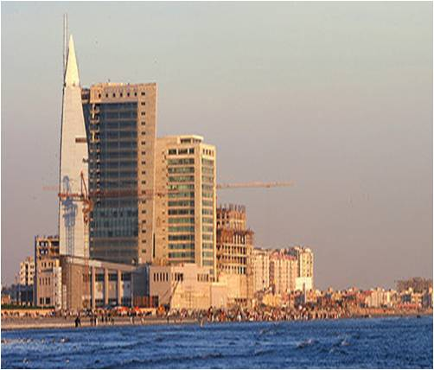
KARACHI
Urban Growth and Economic Development
WHAT ARE YOU TRYING TO ACCOMPLISH?
Development of a Karachi business plan to help guide the city towards core growth drivers by improving the city’s competitiveness and livability
Development of new town schemes to cope with population
Development of 11 high-rise, high-density mixed use zones
Revitalize and activate traditional City Center and Historic District
Develop 80 km of coastal area
Improve infrastructure in 7 industrial areas
Focus on providing additional drinking water
SUCCESSES & LESSONS
ROADBLOCKS
KNOWLEDGE GAPS
Government-funded infrastructure investments can drive growth –
trunk infrastructure and services for industrial areas
improved transport infrastructure
Sustainability is important – developed parks, planted trees
Training centers for youth to improve skills
Improved public health
Lack of availability of land and fragmented management
Shortage of housing and services (mobility and urban transport, energy, water, sewage, and solid waste management, electricity and gas)
Persistent crime and violence
Inter-organizational conflicts in provision of basic infrastructure, Municipal services and revenue collection in view of multiple agencies
How to facilitate private investment
How to reduce urban crime
How to control unplanned and haphazard growth, and enforce Town Planning & Building Regulations
How to encourage inter-agency planning, coordination and implementation
How to influence govt to generate electricity and gas

Slide 4
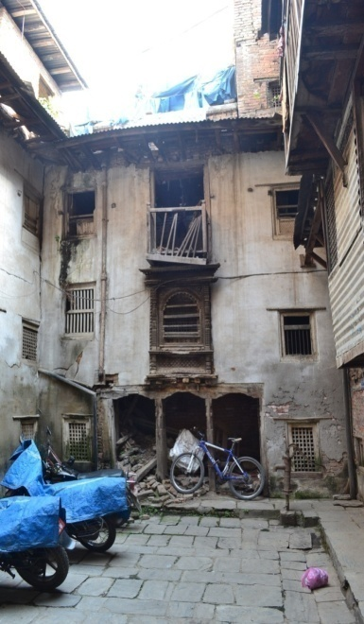
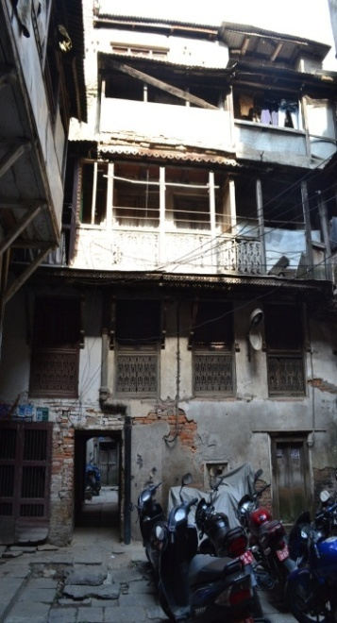
Kathmandu Valley
Urban Growth and Economic Development
URBAN REGENERATION PROGRAM
Historic city cores in the Kathmandu Valley are under physical, social and economic distress. The Government is taking initiatives to reverse the decline of the historic city cores of Kathmandu and also prevent the environmental deterioration of traditional settlements located in the periphery. Efforts are also underway to seek the World Bank support for (a) piloting the demonstrative project (b) developing a strategic framework for urban regeneration and (c) scaling up
STRENGTHS
ROADBLOCKS
KNOWLEDGE GAPS
Unique cultural assets and traditions
Growing number of tourists
Significant private sector interest
Vibrant artisan communities
1. Dedicated Urban Regeneration Policy lacking
National Shelter Policy of 2012 is yet to be implemented in a full fledged manner
Integrated view is lagging to suffice urban regeneration effort
4. Limited local capacity
5. Inadequate enforcement of building byelaws
How to incentivize homeowners to maintain traditional buildings and encourage their participation in urban regeneration efforts?
What should be the institutional arrangements including the role of MoUD, KVDA and local bodies in urban regeneration?
How to leverage cultural industries for urban regeneration in a sustainable manner?

Slide 5
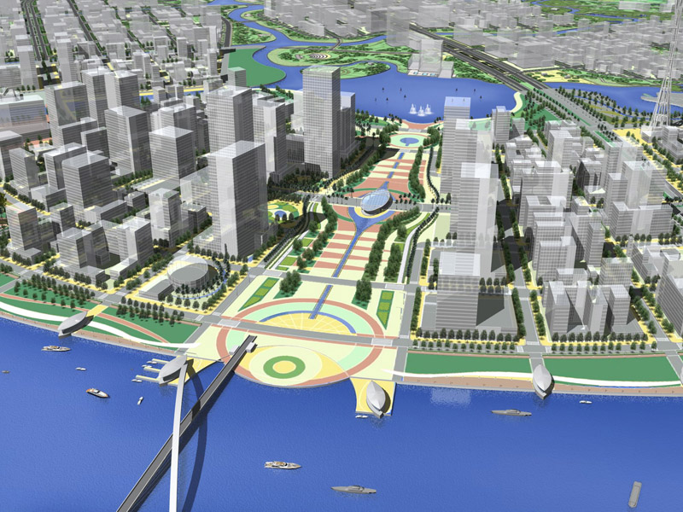
HO CHI MINH CITY
Urban Growth and Economic Development
WHAT ARE YOU TRYING TO ACCOMPLISH?
Making HCM become the economical – social development core for the region and the whole country
Focus in improving and making breakthrough in building city infrastructure system.
Increasing production with advance technology, focusing in
Practicing sustainable development, combining economic development with preserving resources, protecting natural environment.
Map or Image related to urban development
SUCCESSES & LESSONS
ROADBLOCKS
KNOWLEDGE GAPS
<Success / Lesson 1>
<Success / Lesson 2>
<Success / Lesson 3>
…
<Roadblock 1>
<Roadblock 2>
<Roadblock 3>
…
<Question/Advice sought 1>
<Question/Advice sought 2>
<Question/Advice sought 3>
…

Slide 6
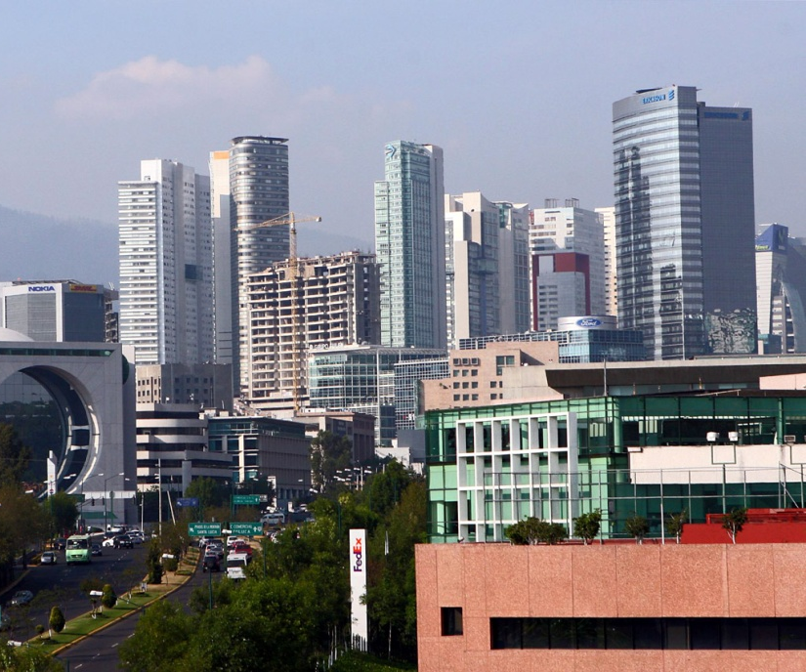
CIUDAD DE MÉXICO
Urban Growth and Development
What are we trying to do
Design, coordinate and apply public policy
Orient growth, public space recuperation, infill development, protection and conservation of urban landscape and incentivize social housing.
Improve mobility, sustainable growth, urban land efficiency, productivity, equity and universal access.
SUCCESSES & LESSONS
ROADBLOCKS
KNOWLEDGE GAPS
Mexico City Center
Santa Fe
Ciclyst corridors Roma-Condesa-Centro.
Paseo de la Reforma, tourism corridor.
Mobility Conditions: congestion, deterioration of sidewalks, pavement, lighting, open space, signage, urban furniture
Successful cases on sustainable mobility
Decision-making tools to decide on new urban centers

Slide 7
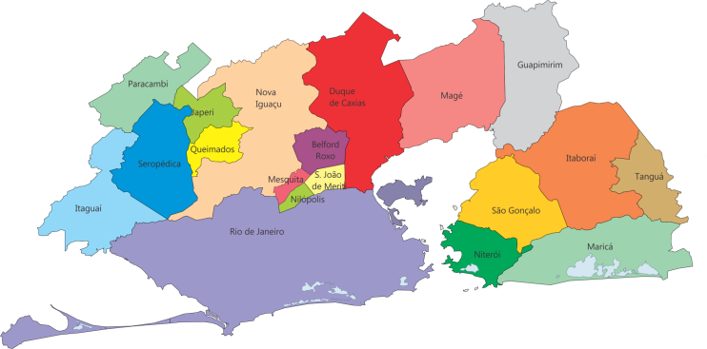
Rio de Janeiro
Urban Growth and Economic Development
WHAT ARE YOU TRYING TO ACCOMPLISH?
A metropolis with equitable distribution of opportunities.
A metropolis with polynuclear service offering.
Resumption of structuring, multisectorial and integrated actions.
SUCCESSES & LESSONS
ROADBLOCKS
KNOWLEDGE GAPS
Insert intentional scenarios in the revision of our Master Plan for Urban Transport - PDTU.
Have agreed on a Future Vision for the Metropolis at the State Government level.
Lack of a metropolitan management agency.
Loss of the territorial dimension in the planning by the state in recent years.
Lack of objectivity in the Sectorial Plans.
Lack of sustainable information about territorial dimension of the region.
Difficulty of involving local actors.
Constitutional vagueness about the nature of the management of the metropolis.

Slide 8
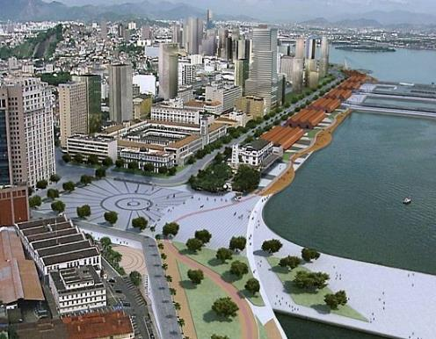
Accra Metropolitan Assembly
Urban Growth and Economic Development
WHAT ARE YOU TRYING TO ACCOMPLISH?
Improve on the quality of life of the people /
Private Sector Development
Provision of socio-economic Infrastructure
Create an enabling environment for economic transportation
To generate sufficient funds
To have a cashless system of revenue collection
Map or Image related to urban development
SUCCESSES & LESSONS
ROADBLOCKS
KNOWLEDGE GAPS
Use of technology to collect revenue
Use of financial institutions in the collection of IGF
Streamlining operations (issuing of permits)
Prosecution of defaulters
Weekly revenue review meeting
Low application of Technology in collecting IGF
Untimely release of District Assembly Common Fund
High Wage Bill
High expenditure on allowances
Inadequate logistics
increase the use of automation and technology
Collaborate with Private Sector to increase the use of technology

Slide 9
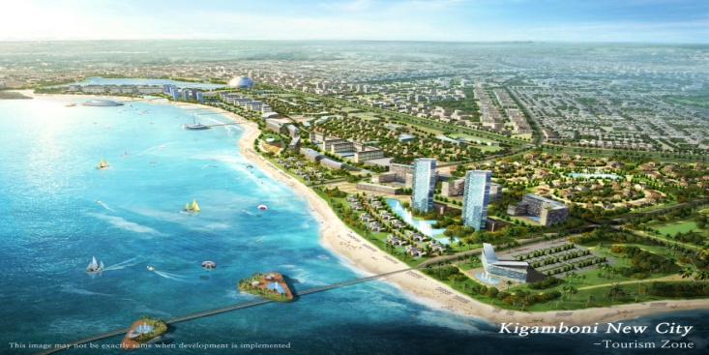
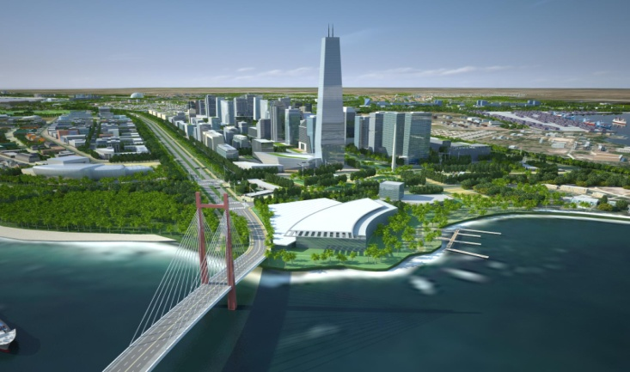
DAR ES SALAAM
Urban Growth and Economic Development
WHAT WE ARE TRYING TO ACCOMPLISH
employment /vocational training , entrepreneurship skills at different academic levels, support informal and home based Industries, formal employment land allocation
Promote Tourism / designation of land for tourism, maintain historical sites.
Attract Investments / Designation of land for Industries
Housing/ provide more land for residential areas
Improve quality of life for the poor/Upgrade unplanned areas
Attract Investments/Kigamboni New City Project
Map or Image related to urban development
SUCCESSES & LESSONS
PPP arrangement is on the rise / Private sector key player in development
Informal Home based economic activities increasing / need to locate land
40% of vegetables consumed are grown within the City / Land and tech. for Urban Agriculture needed
…
ROADBLOCKS
KNOWLEDGE GAPS
Inadequate finances
Appropriate technologies lacking
Community Based Organisations need more training to perform and compete
How LGAs can access direct funding from International Financial Institutions
How can higher learning Institutions work with LGAs to address the challenges
Need to build capacity at local level especially women and youths towards economic empowerment

Slide 10
Nairobi Metro
Urban Growth and Economic Development
WHAT ARE YOU TRYING TO ACCOMPLISH?
Make Nairobi metropolitan Region grow into a robust economic hub
Improve economic & investment climate
Infrastructure Investment to support the region& Utilities support manufacturing, industrial and technology parks
Expand Jomo Kenyatta International Airport
Establishment of a technology city within the region
Map or Image related to urban development
SUCCESSES & LESSONS
ROADBLOCKS
KNOWLEDGE GAPS
Big Infrastructure investments
a number of studies going on to inform on the best mode of public trasport for the region
use of technology to improve investment climate
Nairobi Metropolitan Spatial plan & related investment plans
Inadequate infrastructure & utilities
Inadequate Transportation services
Decreased average per capita & household incomes – high unemployment levels
Inadequate housing
Financial resources to support the activities
Capacity building
Strong PPP frameworks to support involvement of Private Sector to tap on their resources & talents

Slide 11
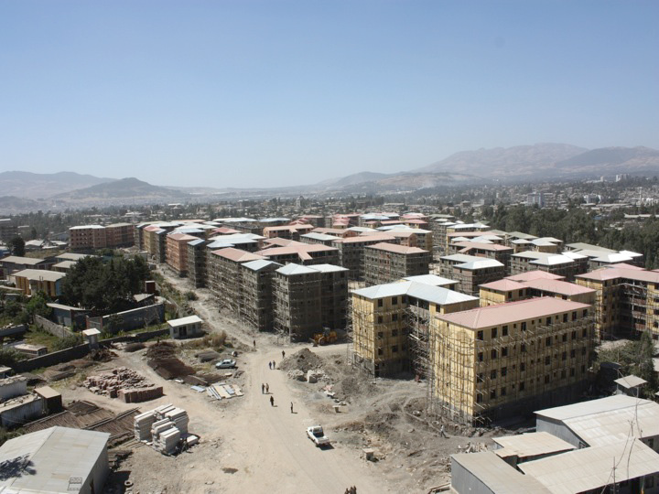
ADDIS ABABA
Urban Growth and Economic Development
WHAT ARE YOU TRYING TO ACCOMPLISH?
Centre of competitive and innovative businesses for the transformation of the national economy; and
A thriving African Capital and major international destination by 2020.
Map or Image related to urban development
SUCCESSES & LESSONS
ROADBLOCKS
KNOWLEDGE GAPS
Widespread poverty and unemployment.
Multiple governance related and management challenges.
Lack of a clear, focused and strategic economic growth direction for the city.
Low industrial base
Innovative projects linking employment creation with housing, renewal and infrastructure development
Enhancing A.A competitiveness as the Diplomatic African Capital.
Investing in and/or facilitating the implementation of strategic
projects/ activities with multiplier effects.
• Identify and allocate serviced land for strategic projects
• Policy and institutional reforms for business environment favorable for private sector investment
Capacity to promote investment opportunities in the city
Low saving experiences
Entrepreneurship skill

